Slide 1
SentinelFlow
A Safe, Observable AI Agent Architecture
Ian Madhara
Tinashe Kachepa
Simbaremuteuro Chin’ombe

Slide 2
Abstract
Large Language Models (LLMs) enable natural language interfaces but pose safety risks when executing actions.
SentinelFlow presents a system architecture that separates reasoning from execution.
We demonstrate deterministic, auditable agent behavior with full observability.

Slide 3
Motivation
Direct LLM tool execution risks hallucinations and silent failures.
Production systems require safety, traceability, and reproducibility.
Most agent demos lack evaluation and observability.

Slide 4
Research Objectives
Design a safe agent execution architecture.
Enforce policy and confirmation for risky actions.
Provide trace-level observability and auditability.
Evaluate reliability using automated tests.

Slide 5
System Overview
LLM generates structured action plans.
Orchestrator validates and executes plans deterministically.
All actions are logged and auditable.

Slide 6
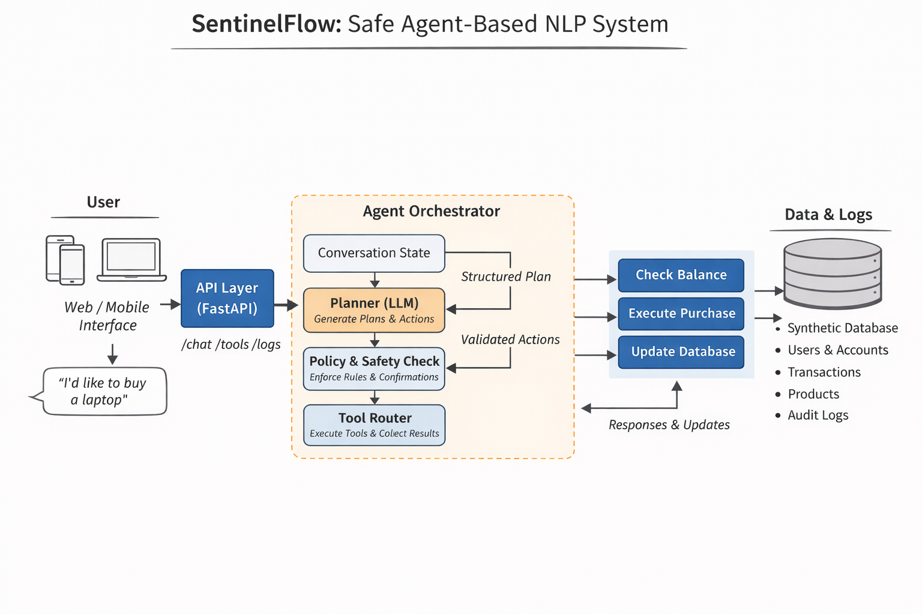

Slide 7
Planner Design
Two modes: heuristic planner and LLM planner.
Outputs structured JSON plans.
Planner never executes side effects.

Slide 8
Orchestrator Responsibilities
Schema validation (Pydantic).
Argument repair and enforcement.
Confirmation gating for high-risk actions.
Tool execution and error handling.

Slide 9
Safety Mechanisms
Explicit confirmation tokens for purchases.
No implicit or silent execution.
Policy-enforced tool access.

Slide 10
Observability Model
Trace: one record per user interaction.
AuditLog: one record per tool invocation.
Complete input/output capture.

Slide 11
Evaluation Framework
Automated eval suite covering core user flows.
Balance checks, product search, and purchase confirmation.
LLM and heuristic planners evaluated separately.

Slide 12
Experimental Results
100% pass rate across critical evaluation cases.
Consistent latency across planner modes.
No unsafe executions observed.

Slide 13
Frontend Demonstration
SaaS-style landing page.
Agent chat interface with session memory.
Observability dashboard for traces and audits.

Slide 14
Discussion
Agent systems must be engineered, not prompted.
Observability improves trust and debuggability.
Clear separation of concerns improves safety.

Slide 15
Limitations
Single-agent scope.
Synthetic data only.
Authentication and authorization omitted.

Slide 16
Future Work
Multi-agent coordination.
Role-based access control.
Asynchronous workflows.
Production deployment and monitoring.

Slide 17
Conclusion
SentinelFlow demonstrates a production-oriented agent architecture.
Combines safety, observability, and evaluation.
Provides a foundation for real-world AI agents.

