Slide 1
Parallel Python (2 hour tutorial)
EuroSciPy 2012

Slide 2
Goal
Evaluate some parallel options for CPU-bound problems using Python
Your task is probably in pure Python, is CPU bound and can be parallelised (right?)
We're not looking at network-bound problems
Focusing on serial->parallel in easy steps

Slide 3
About me (Ian Ozsvald)
A.I. researcher in industry for 13 years
C, C++ before, Python for 9 years
pyCUDA and Headroid at EuroPythons
Lecturer on A.I. at Sussex Uni (a bit)
StrongSteam.com co-founder
ShowMeDo.com co-founder
IanOzsvald.com - MorConsulting.com

Slide 4
Something to consider
“Proebsting's Law”
http://research.microsoft.com/en-us/um/people/toddpro/papers/law.htm“improvements to compiler technology double the performance of typical programs every 18 years”
Compiler advances (generally) unhelpful (sort-of – consider auto vectorisation!)
Multi-core/cluster increasingly common

Slide 5
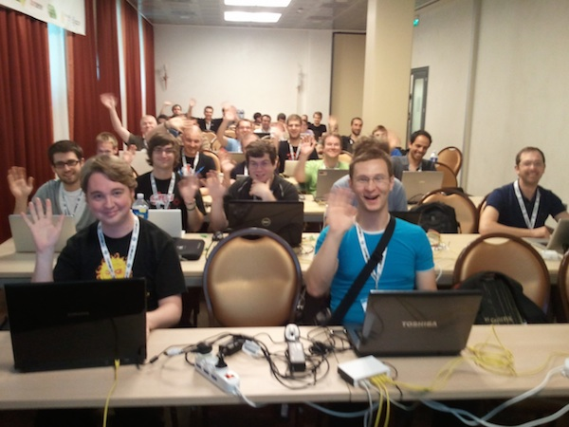
Group photo
I'd like to take a photo - please smile :-)

Slide 6
Overview (pre-requisites)
multiprocessing
ParallelPython
Gearman
PiCloud
IPython Cluster
Python Imaging Library

Slide 7
We won't be looking at...
Algorithmic or cache choices
Gnumpy (numpy->GPU)
Theano (numpy(ish)->CPU/GPU)
BottleNeck (Cython'd numpy)
CopperHead (numpy(ish)->GPU)
BottleNeck
Map/Reduce
pyOpenCL, EC2 etc

Slide 8
What can we expect?
Close to C speeds (shootout):
  http://shootout.alioth.debian.org/u32/which-programming-languages-are-fastest.php
  http://attractivechaos.github.com/plb/
Depends on how much work you put in
nbody JavaScript much faster than Python but we can catch it/beat it (and get close to C speed)

Slide 9
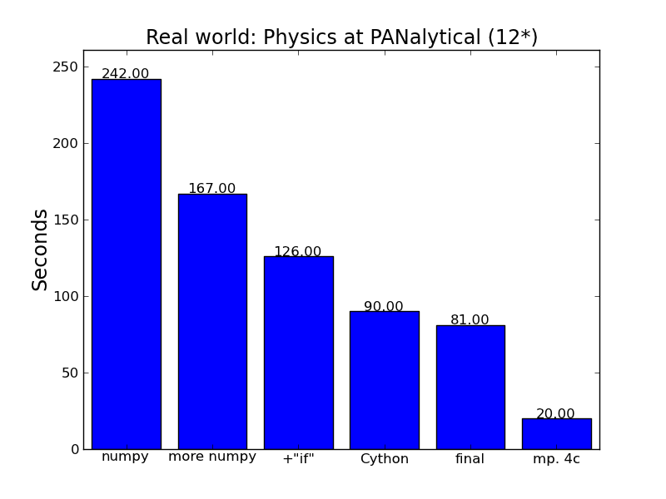
Practical result - PANalytical

Slide 10
Our building blocks
serial_python.py
multiproc.py
$ python serial_python.py
XXX Google “github ianozsvald” -> HighPerformancePython_PyCon2012
https://github.com/ianozsvald/HighPerformancePython_PyCon2012

Slide 11
Mandelbrot problem
Embarrassingly parallel
Varying times to calculate each pixel
We choose to send array of setup data
CPU bound with large data payload

Slide 12
multiprocessing
Using all our CPUs is cool, 4 are common, 32 will be common
Global Interpreter Lock (isn't our enemy)
Silo'd processes are easiest to parallelise
http://docs.python.org/library/multiprocessing.html

Slide 13
multiprocessing Pool
# multiproc.py
p = multiprocessing.Pool()
po = p.map_async(fn, args)
result = po.get() # for all po objects
join the result items to make full result

Slide 14
Making chunks of work
Split the work into chunks (follow my code)
Splitting by number of CPUs is a good start
Submit the jobs with map_async
Get the results back, join the lists

Slide 15
Time various chunks
Let's try chunks: 1,2,4,8
Look at Process Monitor - why not 100% utilisation?
What about trying 16 or 32 chunks?

Slide 16
How much memory moves?
sys.getsizeof(0+0j) # bytes
250,000 complex numbers by default
How much RAM used in q?
With 8 chunks - how much memory per chunk?
multiprocessing uses pickle, max 32MB pickles
Process forked, data pickled

Slide 17
ParallelPython
Same principle as multiprocessing but allows >1 machine with >1 CPU
http://www.parallelpython.com/
Seems to work poorly with lots of data (e.g. 8MB split into 4 lists...!)
We can run it locally, run it locally via ppserver.py and run it remotely too
Can we demo it to another machine?

Slide 18
ParallelPython
ifconfig gives us IP address
NBR_LOCAL_CPUS=0
ppserver('your ip')
nbr_chunks=1
term2$ ppserver.py -d
parallel_python_and_ppserver.py
Arguments: 1000 50000

Slide 19
ParallelPython + binaries
We can ask it to use modules, other functions and our own compiled modules
Works for Cython and ShedSkin
Modules have to be in PYTHONPATH (or current directory for ppserver.py)

Slide 20
“timeout: timed out”
Beware the timeout problem, the default timeout isn't helpful:
  pptransport.py
  TRANSPORT_SOCKET_TIMEOUT = 60*60*24 # from 30s
Remember to edit this on all copies of pptransport.py

Slide 21
Gearman
C based (was Perl) job engine
Many machine, redundant
Optional persistent job listing (using e.g. MySQL, Redis)
Bindings for Python, Perl, C, Java, PHP, Ruby, RESTful interface, cmd line
String-based job payload (so we can pickle)

Slide 22
Gearman worker
First we need a worker.py with calculate_z
Will need to unpickle the in-bound data and pickle the result
We register our task
Now we work forever
Run with Python for 1 core

Slide 23
Gearman blocking client
Register a GearmanClient
pickle each chunk of work
submit jobs to the client, add to our job list
#wait_until_completion=True
Run the client
Try with 2 workers

Slide 24
Gearman nonblocking client
wait_until_completion=False
Submit all the jobs
wait_until_jobs_completed(jobs)
Try with 2 workers
Try with 4 or 8 (just like multiprocessing)
Annoying to instantiate workers by hand

Slide 25
Gearman remote workers
We should try this (might not work)
Someone register a worker to my IP address
If I kill mine and I run the client...
Do we get cross-network workers?
I might need to change 'localhost'

Slide 26
PiCloud
AWS EC2 based Python engines
Super easy to upload long running (>1hr) jobs, <1hr semi-parallel
Can buy lots of cores if you want
Has file management using AWS S3
More expensive than EC2
Billed by millisecond

Slide 27
PiCloud
Realtime cores more expensive but as parallel as you need
Trivial conversion from multiprocessing
20 free hours per month
Execution time must far exceed data transfer time!

Slide 28
IPython Cluster
Parallel support inside IPython
Supports MPI
$ ipcluster start --n=8

Slide 29
Recommendations
Multiprocessing is easy
ParallelPython is trivial step on
PiCloud just a step more
IPCluster good for interactive research
Gearman good for multi-language & redundancy
AWS good for big ad-hoc jobs

Slide 30
Bits to consider
Cython being wired into Python (GSoC)
PyPy advancing nicely
GPUs being interwoven with CPUs (APU)
Learning how to massively parallelise is the key

Slide 31
Future trends
Multi-core is obvious
Cloud based systems getting easier
CUDA-like systems are inevitable
disco looks interesting, also blaze
numpush for local & remote numpy
Auto parallelise numpy code?

Slide 32
Job/Contract hunting
Start-up didn't go so well
Returning to London, open to travel
Looking for HPC/Parallel work

Slide 33
Feedback
Write-up: http://ianozsvald.com
I want feedback (and a testimonial please)
ian@ianozsvald.com
Thank you :-)

