Slide 1
High Performance Python
EuroSciPy May 2014
License: CC ByAttribution NonCommercial
Ian Ozsvald @IanOzsvald MorConsulting.com

Slide 2
We'll cover
Why we need to think about high performance
Cython (pure Python and numpy)
Numba
Pythran
PyPy

Slide 3
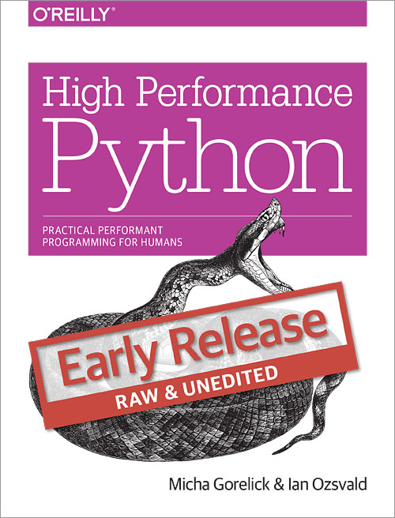
“High Performance Python”
Published August
Python 2.7 focused
Lots of practical stuff
Today's source:
bit.ly/euroscipy2014hpc

Slide 4
About Ian Ozsvald
“Exploiter of Data” in ModelInsight.io
I teach privately (modelinsight.io)!
Teacher: PyCon, EuroSciPy, EuroPython
Various ML/Parallel/Data projects
ShowMeDo.com
IanOzsvald.com

Slide 5
Gordon Moore's Law
Number of transistors on an IC doubles every 18-24 months
Self fulfilling
Clearly doesn't mean linear speed increases...

Slide 6
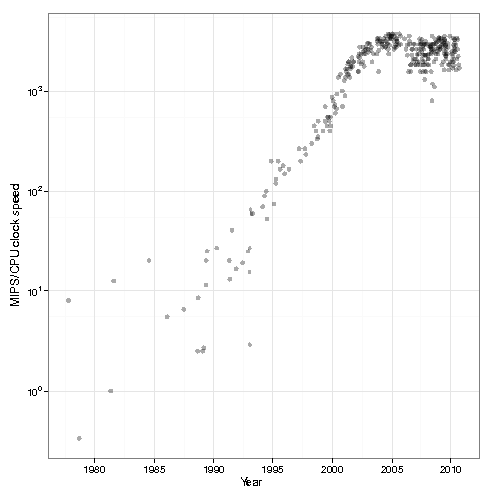
Moore's Law - limitation
3.4GHz – why?
http://csgillespie.wordpress.com/2011/01/25/cpu-and-gpu-trends-over-time/

Slide 7
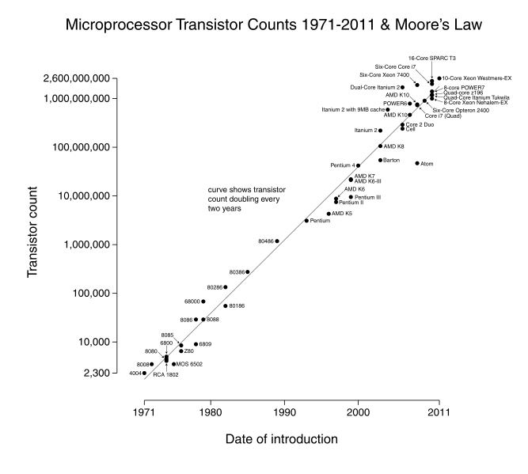
Moore's Law
http://en.wikipedia.org/wiki/Moores_law

Slide 8
Proebsting's Law
“Proebsting’s Law asserts that improvements to compiler technology double the performance of typical programs every 18 years”
“Pro. has suggested that … communities should focus less on optimization and more on programmer productivity”
http://www.cs.virginia.edu/~techrep/CS-2001-12.pdf

Slide 9
Why use Python?
Easy to use tooling
Designed as beginner language
Easy to keep in your head
Large community (sci+eng)
People are tackling all the problems
Science, storage, visualisation, machine clustering, html, robustness, parsimonious coding

Slide 10
General go-fast rules
Do as little work as possible
You won't beat grep: http://lists.freebsd.org/pipermail/freebsd-current/2010-August/019310.html
Cache to avoid re-work
Keep everything debuggable
Keep everything documented

Slide 11
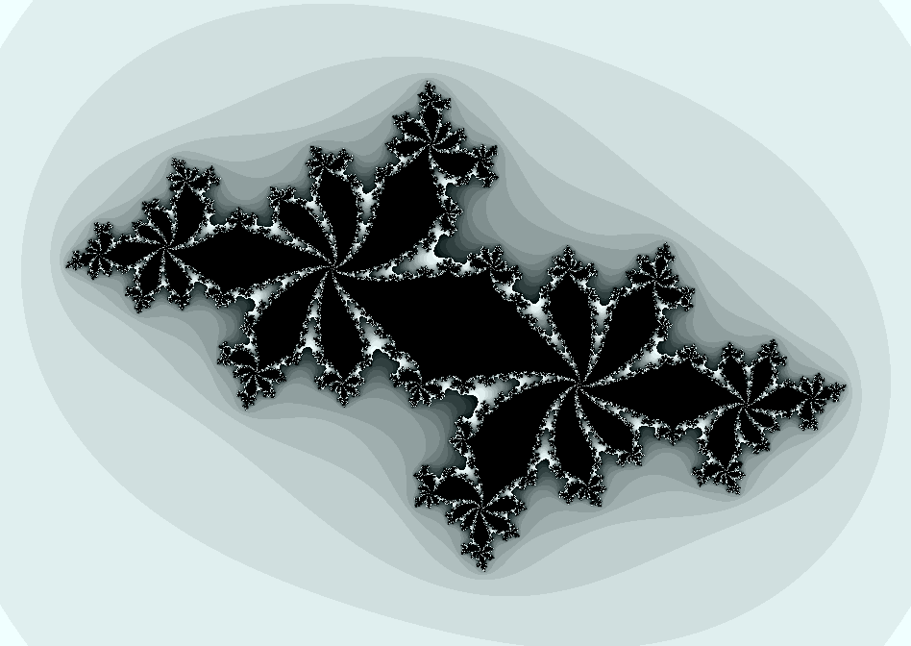
The Julia Set Fractal

Slide 12

The Julia set
Complex plane (just a co-ord set)
Complex behaviour (what does this mean?)
Embarrassingly parallel function
  what does this mean?
We're testing for bounded behaviour

Slide 13
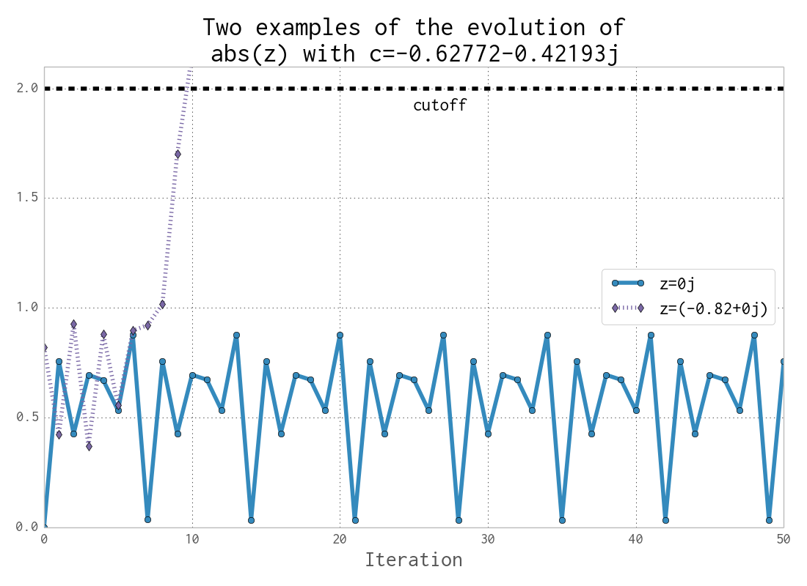
The Julia set - evolution

Slide 14

The Julia set
Simple loop in code
Let's review the code in julia.py (it is deliberately written suboptimally)
We have a 1000 x 1000 array

Slide 15
Profiling the CPU
“We should forget about small efficiencies, say about 97% of the time: premature optimization is the root of all evil” - Donald Knuth
Figure out what's slow, only optimize if it is worth it
Optimizing takes time, costs mental cycles, introduces more complex code

Slide 16
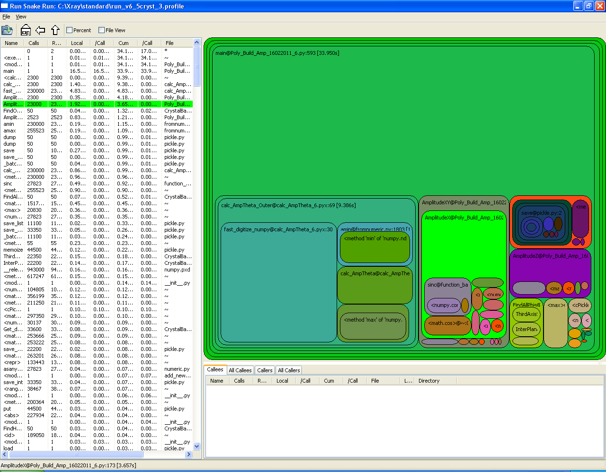
cProfile & runsnakerun

Slide 17
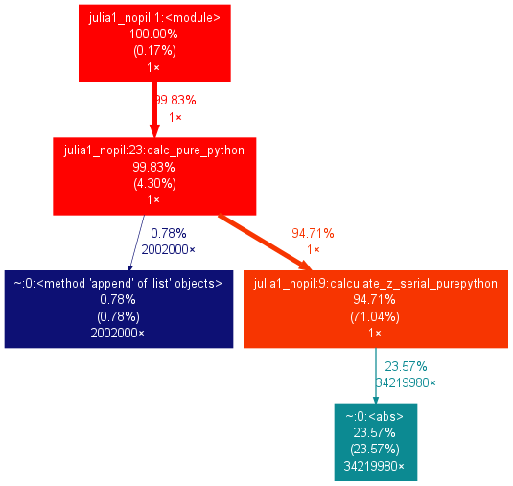
cProfile and gprof2dot
gprof2dot -f pstats profile.stats | dot -Tpng -o output.png

Slide 18
line_profiler
More informative, takes longer
Line by line profiling
Uses a C backend
@profile – what is this?
Make “julia_lineprofiler.py”, add @profile before calculate_z_serial_purepython
!change max_iterations to 100 (from 300)
!remove the assert

Slide 19
line_profiler
kernprof.py -l -v julia_lineprofiler.py
Run this first! It takes a while...
Can you explain the output to me?
What is most costly?
We're using 100 max_iterations (not 300)
More informative, takes longer
Line by line profiling
Uses a C backend

Slide 20
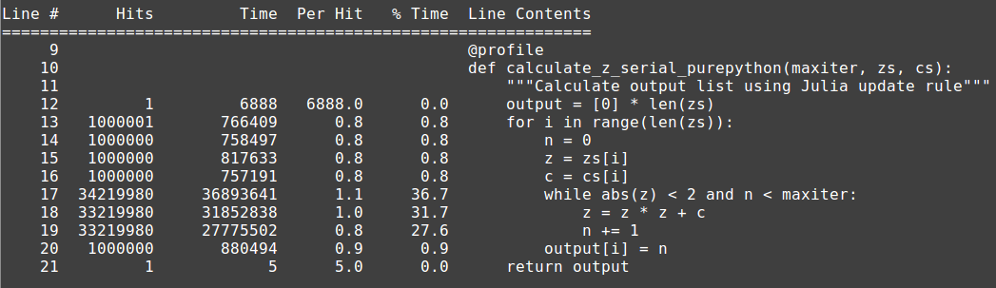
line_profiler (max 300 its.)

Slide 21
Profiling memory
Samples system's memory report via psutil
Can do line-by-line or graph
What is using RAM in our Julia set? What do we expect to see? What is a surprise?

Slide 22
Profiling memory
Make “julia_memoryprofiler.py”,
add @profile before calculate_z...and calc_pure_python
!Set desired_width=100 (not 1000)
!max_iterations can stay at 100
python -m memory_profiler julia_memoryprofiler.py # from line_pr...

Slide 23
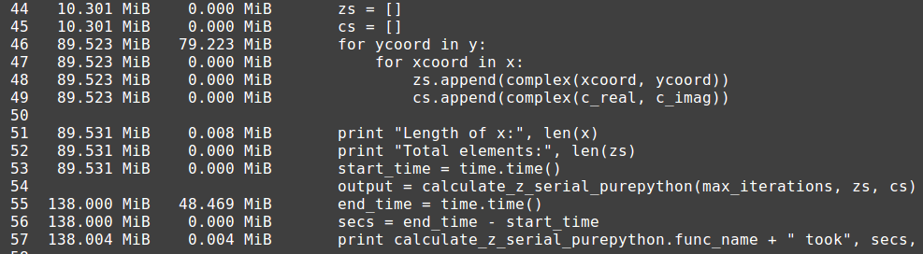
memory_profiler output

Slide 24
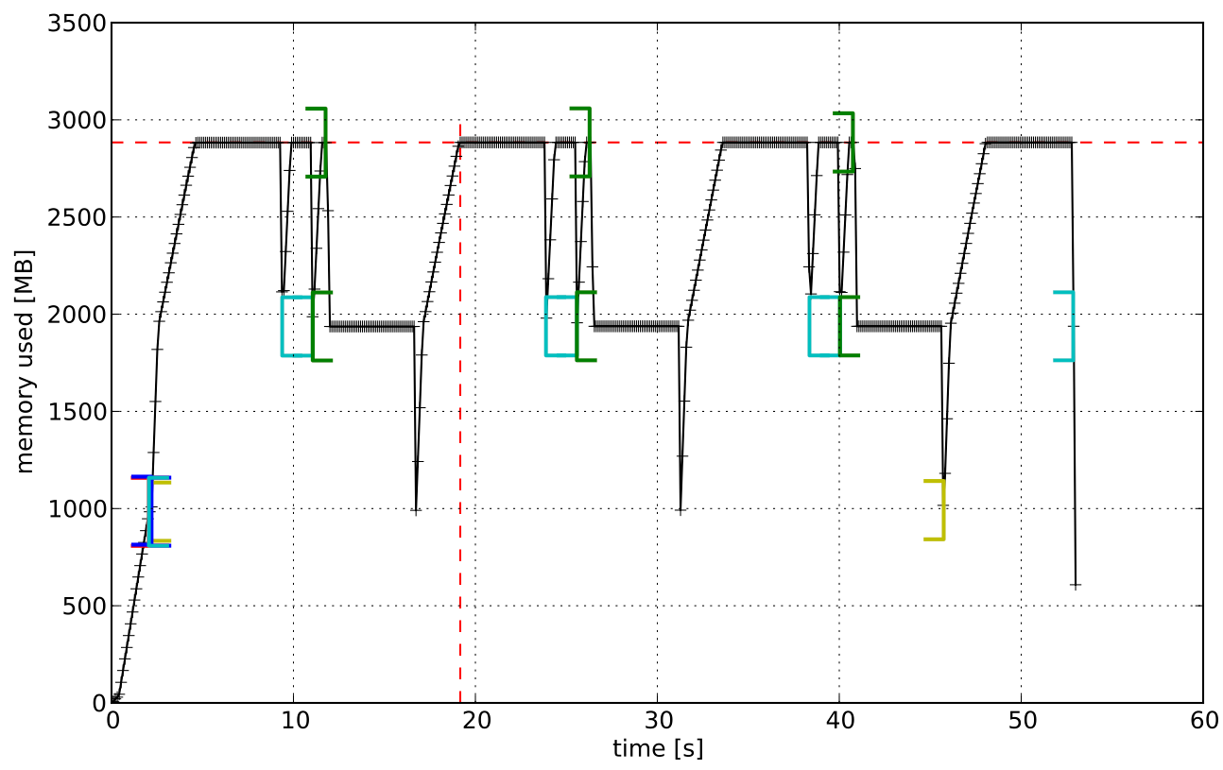
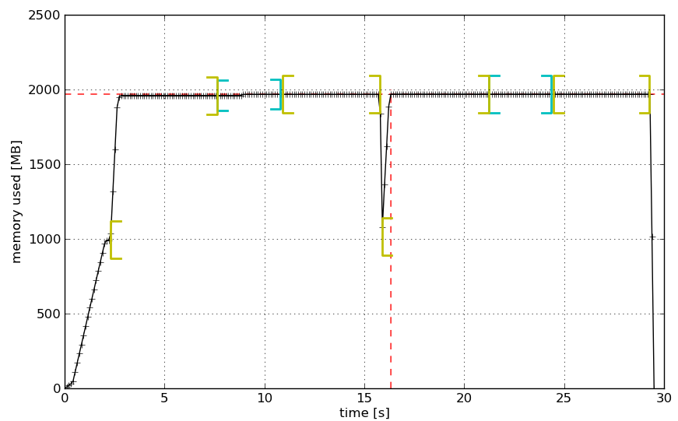
mprof (memory_profiler)
https://github.com/scikit-learn/scikit-learn/pull/2248
Before & After an improvement

Slide 25
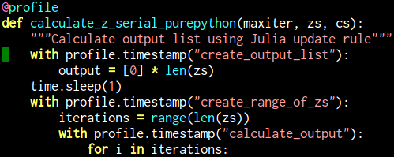
mprof – draw the mem. usage
!desired_width=1000
mprof run julia_memoryprofiler.py
mprof plot # should show a graph

Slide 26
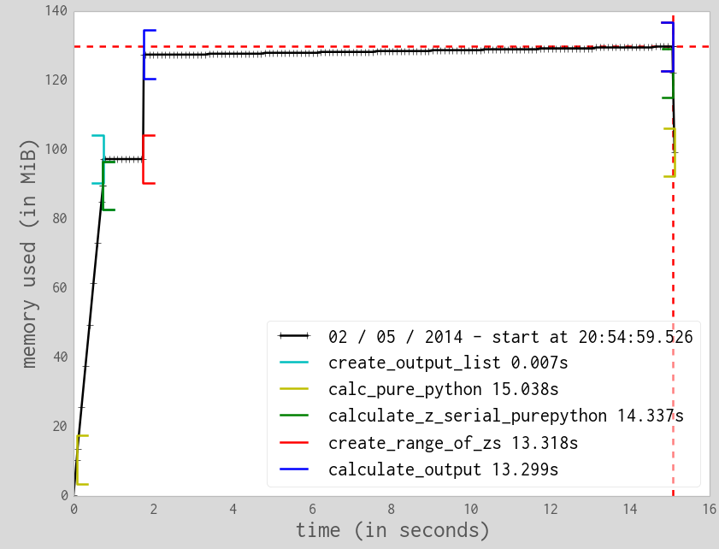
mprof

Slide 27
mprof – final tweak
What could we change the range call to?
Make the change – how does mprof plot change?
We could also add annotations beyond function names

Slide 28
Compiling with Cython
2007 project (forked from Pyrex .pyx)
Converts annotated Python into C
You have to do the conversion
We'll convert the plain Python version into C (we'll do numpy version later)
We'll import a compiled version of the function

Slide 29
Cython
Make “cython” directory, copy julia_nopil.py in there
Make cythonfn.py (it'll become cythonfn.pyx soon)
Move calculate_z function
“from cythonfn import calculate_z”

Slide 30
Cython
Once we know it works, rename to cythonfn.pyx (after pyrex project)
cython -a cythonfn.pyx
open “firefox cythonfn.html”

Slide 31
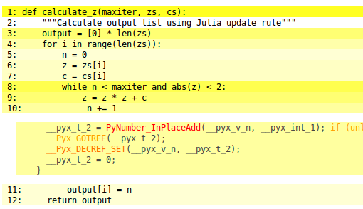
Cython – annotated
Note InPlaceAdd and Reference Counting

Slide 32
Cython – make setup.py
from distutils.core import setup
from Cython.Build import cythonize
setup(
ext_modules = cythonize("cythonfn.pyx")
)

Slide 33
Cython
MOVE cythonfn.py → cythonfn.pyx
To compile:
python setup.py build_ext –inplace
note build<under>ext dashdashinplace
We should have a .c and a .so
python julia_nopil.py
This won't be much faster (and why is that?)

Slide 34
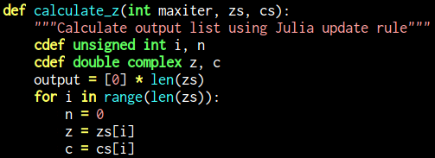
Cython – add annotations

Slide 35
Cython
How could we remove the abs operation?

Slide 36
Cython
How could we remove the abs operation?
abs(z) just sqrt(real^2 + imag^2)

Slide 37
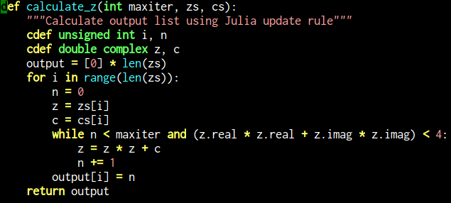
Cython – expand the math

Slide 38
Cython
Why do we expand the math?
Avoid doing work we don't have to do!
What else is abs(z) doing? We're forcing more specialisation
We can disable bounds checking (but it doesn't change much)

Slide 39
Cython – tradeoffs
Probably the fastest and most reliable solution for compiling
You have to know some C
You have to be happy working with C
Removes generic behaviour, specialises your code (so less flexible)
Use unit tests!
Can compile with debug libs, easy enough just to use print statements

Slide 40
numpy serial version (slow!)
Let's replace the Python lists with numpy arrays
Look in src/numpy_version
Walk through the new zs code first
np.array is fast, right?
Try the new demo <ouch> (>2 mins!)
What's going on?

Slide 41
Cython and numpy
We let C see the block of memory inside numpy arrays
arr.data[0] → first byte
__array_interface__.items() for the internal guts
No need to manage access to Python objects any more
What else might a C compiler do without the GIL restriction?
Let's convert the numpy version with Cython

Slide 42
Cython and numpy
Start with cythonfn.py and julia_nopil.py as before
Check they run
Copy setup.py from before
“python setup.py build_ext --inplace”
It'll take >2mins to run due to dereferencing cost

Slide 43
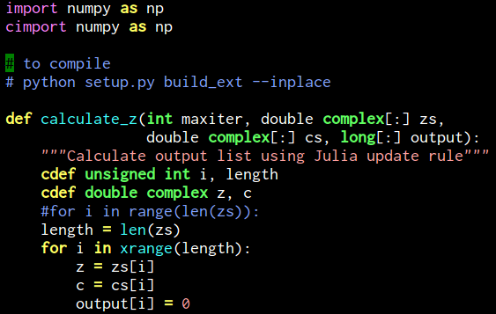
Cython and numpy
x

Slide 44
Cython and numpy
Now we're back to 4 seconds
Can you expand the math like we did before?
Does it run faster again? (it should be slightly faster to what we had for the lists version)
Adding early binding, type specialisation and going to the raw low level objects means C can compile it very efficiently
Could a non-Cython colleague understand this code?

Slide 45
OpenMP
What does OMP give us?
shared memory multiprocessing
Multi-platform, multi-OS, C/C++/Fortran
We need to make the decisions
parallel for, parallel reduce

Slide 46
Cython and OpenMP
How we do annotate the loop?
We have to tell the compiler to use OMP
What is static and dynamic scheduling?

Slide 47
Cython and OpenMP
Add “from cython.parallel import prange”
Change the for loop:
with nogil:
for i in prange(length,
schedule="guided"):

Slide 48
Cython and OpenMP
from distutils.core import setup
from distutils.extension import Extension
from Cython.Build import cythonize
from Cython.Distutils import build_ext
ext_module = Extension("cythonfn",
["cythonfn.pyx"],
extra_compile_args=['-fopenmp'],
extra_link_args=['-fopenmp'])
setup(name = 'Cython fn',
cmdclass = {'build_ext': build_ext},
ext_modules = [ext_module])

Slide 49
Cython and OpenMP
This is as fast as we can easily go!
Fully exploits multiple cores
Reductions are possible too

Slide 50
Pythran
Somewhere between ShedSkin and Cython
Has an annotation extension engine
You supply the function annotation
Works on Python and numpy variants
Has interesting AST rebuilding and lightweight reimplemented modules
Uses lightweight RefCounting (like CPython)
CPython data must be copied into Pythran's memory space

Slide 51
Pythran
Annotate: #pythran export calculate_z(int, complex[], complex[], int[])
pythran fn.py → fn.so
If you delete the .so then your original .py file will run unchanged – great for testing!

Slide 52
Pythran and OpenMP
We can easily add OMP
Add “#omp parallel for” before the for loop
pythran -fopenmp -march=corei7-avx cython_np.py

Slide 53
Pythran specialisations
Core library has been lightly reimplemented
What if we take away a lot of the numpy machinery?
It tries to auto-parallelise e.g. on a map

Slide 54
Pythran - tradeoffs
Young project, very few users
They're quick to respond
Only some numpy modules supported
Uses comments therefore does not disrupt code (unlike Cython)

Slide 55
Numba
numpy-aware optimizing compiler
Not a tracing JIT (unlike PyPy) but method-based (tracing is likely to be loop-based)
Uses LLVM
Requires a tiny bit of decoration
GC handled by LLVM

Slide 56

Numba
Add “from numba import jit”
Add “@jit”, optionally add types
With the current version we have to pass in “output” from outside of the compiled function (but this hasn't always been the case)

Slide 57
Numba - tradeoffs
Be aware that the API changes with each release
Really needs Anaconda
Note run 1 has compile cost, run 2 no additional cost
Does nothing useful for non-numpy code (but does work)
Somewhat mixed real-world reports
Probably has best long-term future as 'drop in replacement' for numpy speed-ups

Slide 58
PyPy
“Like CPython but 6.3* faster (ish)”
http://speed.pypy.org/
Different implementation of Python including different GC
Tracing JIT – considers loops and frequent code paths rather than whole functions, then compiles the hot loops
No annotation is required
Does have a GIL
Python 2.7 and Python 3 (beta)
Written in RPython (restricted Python enabling easy inference of variable's type), not written in C
Built out of Armin's psyco (32 bit JIT)

Slide 59
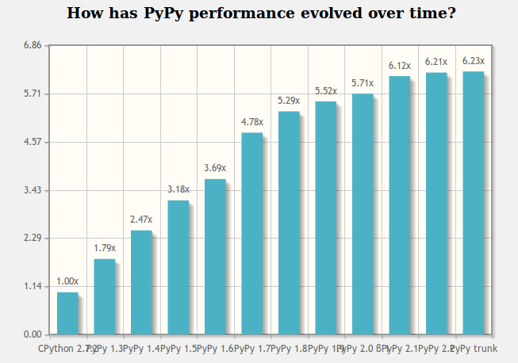
PyPy
Run it, run with julia1_nopil.py
How much faster?

Slide 60
PyPy
Run it, run with julia_nopil.py
How much faster?
Not bad for no work at all

Slide 61
Sidenote – ref counting GC in Python
RefCounting to keep track of live objects
When 0 references left – delete object
This is a CPython implementation choice
This is not the only GC strategy
PyPy doesn't use RefCounting, it has a modifed mark-and-sweep with nursery

Slide 62
PyPy
Software Transactional Memory
Replaceable Garbage Collectors
Has had Java backend
PyPy.js – RPython->C->Emscripten (C to JS via LLVM))->JS – faster than CPy but slower than PyPy
JS & LLVM receiving lots of attention in the compiler community
If you want to write your own efficient interpreter:
http://www.wilfred.me.uk/blog/2014/05/24/r-python-for-fun-and-profit/

Slide 63
PyPy tradeoffs
There is numpypy support (sort of)
CPyExt sort-of provides access to C compiled extensions (and do we really need them?) e.g. cPickle in PyPy is not written in C any more
CFFI is the right solution for C modules with Python + PyPy compatibility

Slide 64
“High Performance Python”
I think I'm signing...
Training courses
in October in London
pyvideo.org
PyDataLondon meetup

