Slide 1

playgroup – deep dive LLM day
Mor Consulting 2026-04
@IanOzsvald – ianozsvald.com

Slide 2




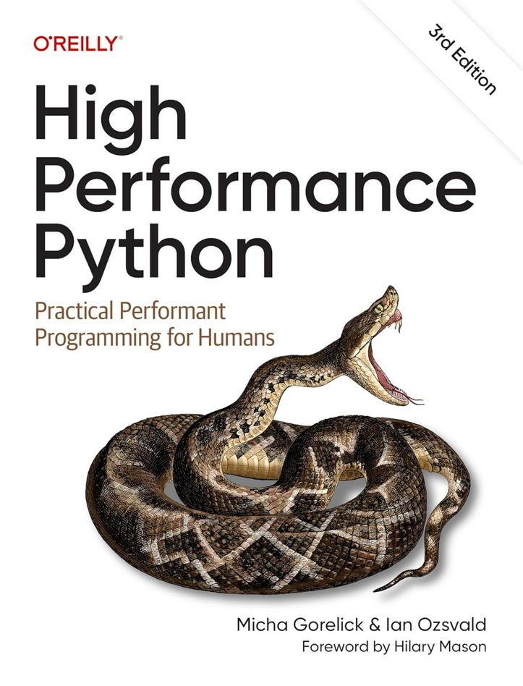
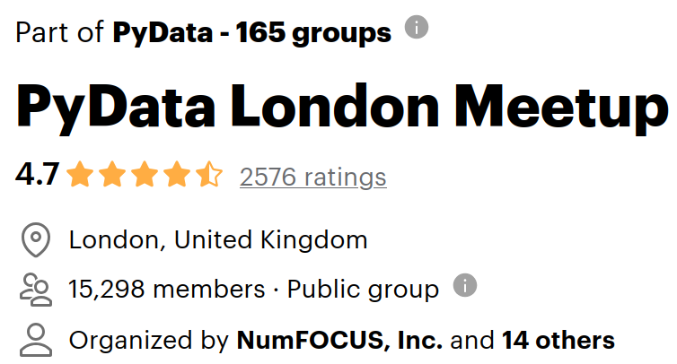




Interim Chief Data Scientist
Strategist/Trainer/Speaker/Author 25+ years
Figuring where LLMs fit into DS
By [ian]@ianozsvald[.com]

Slide 3

Goal
Will agents take over the world or are we living in a world of approximate retrieval? Is AGI nearly here?
Can an LLM solve novel problems?
You – think on a novel problem, meet interesting folk, get your qs answered
By [ian]@ianozsvald[.com]

Slide 4
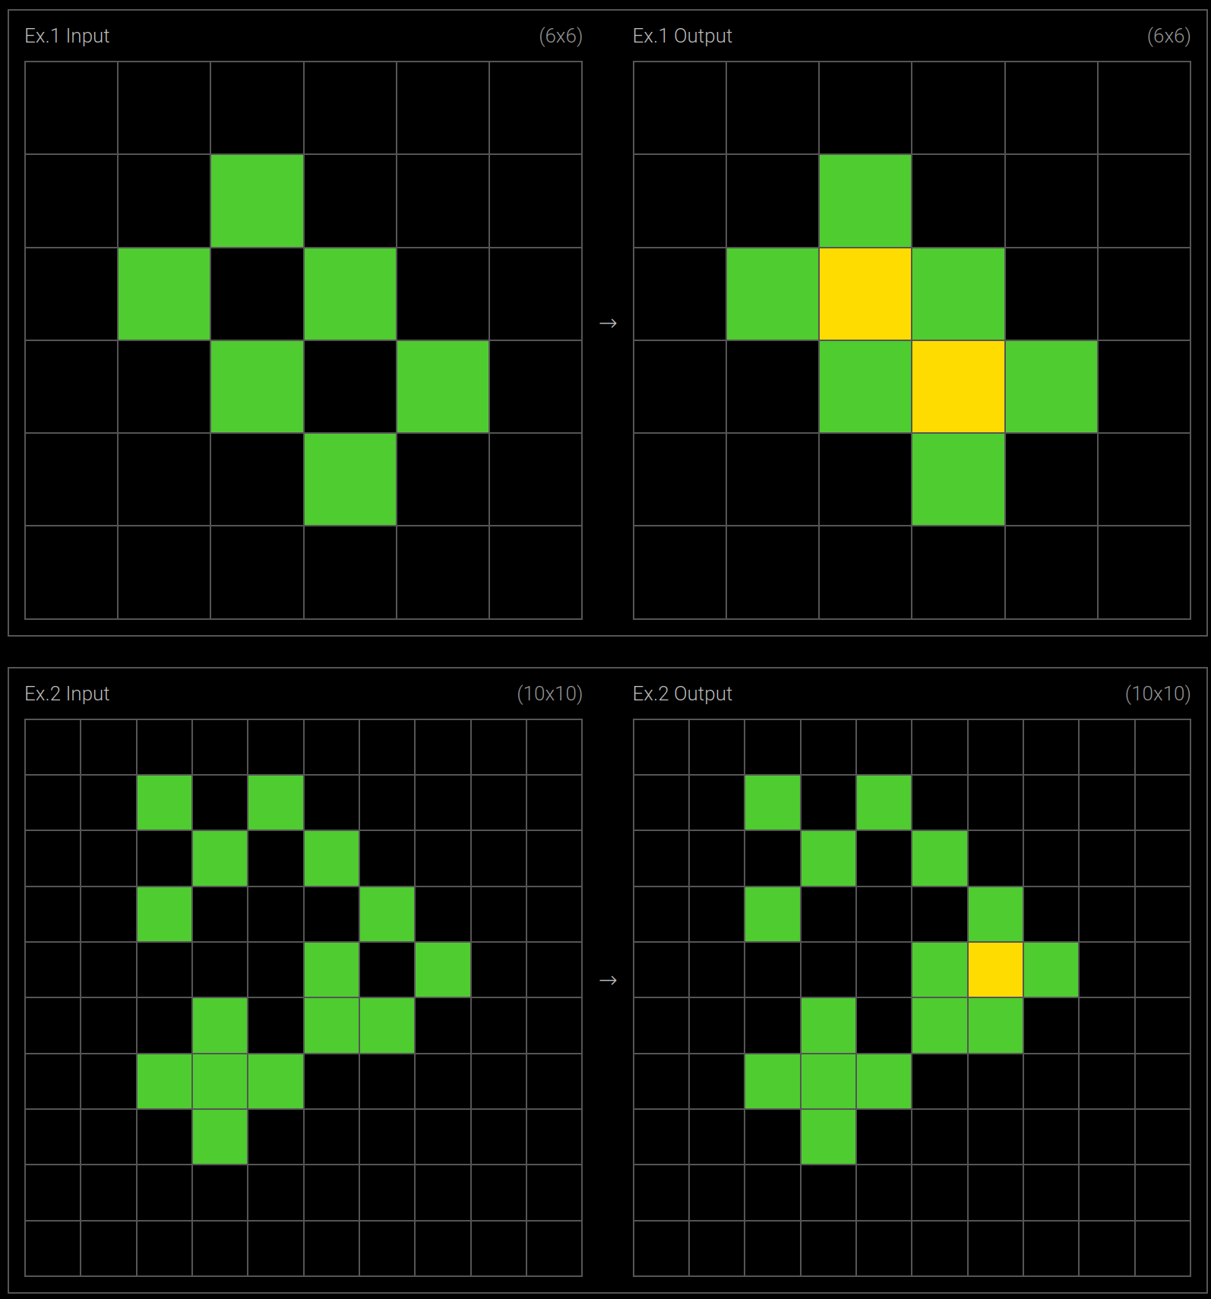
Agenda
ARC AGI solved (so far) via brute force https://arcprize.org/tasks?v=1
Quick look at older examples
Try an online puzzle together
Now->64x64 grid, frame/turn based, goal never revealed (we figure it out!)
By [ian]@ianozsvald[.com]

Slide 5
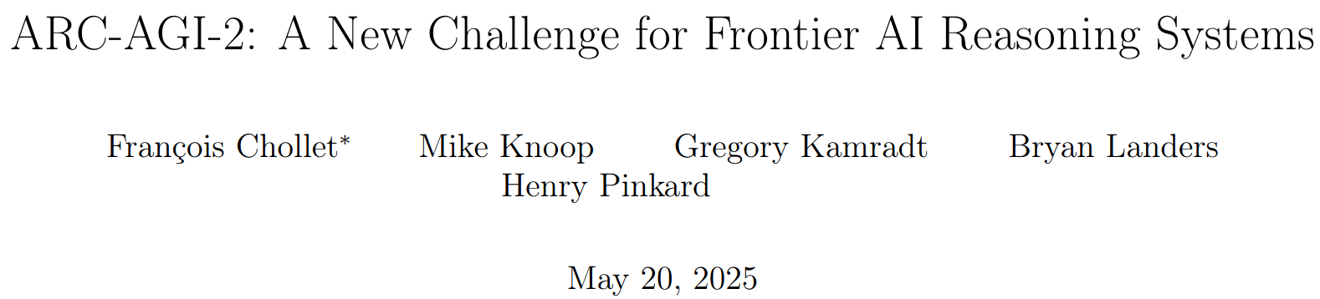
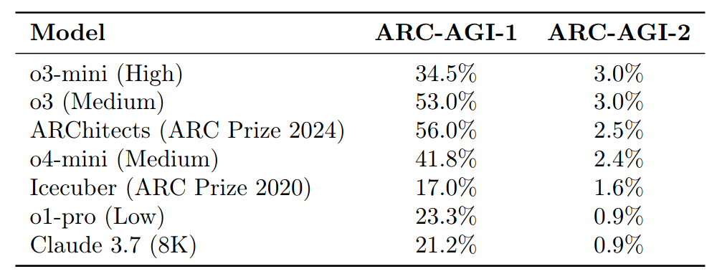
ARC AGI
ARC AGI 1 (few years), now ARC AGI 2025
400+ problems, public and private (offline) set
ARC AGI 1 “solved” by GPT o3 88% public $70k (xmas)
By [ian]@ianozsvald[.com]

Slide 6
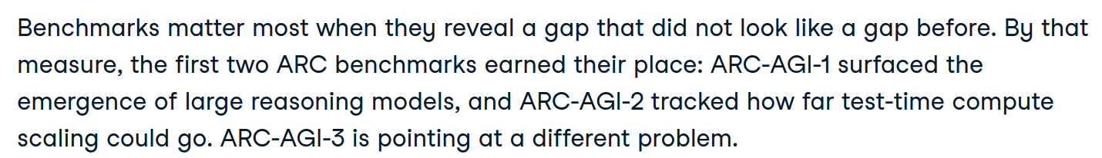
Why do we care?
https://www.datacamp.com/blog/arc-agi-3
Can we help the machines understand "our world" in a way that approximates how children learn?
https://arcprize.org/tasks?v=3
By [ian]@ianozsvald[.com]

Slide 7
Stages for the day
How do you solve these tasks?
Can you get the provided agent running?
How might you develop an agent?
Can you beat the (very stupid!) benchmark code?
By [ian]@ianozsvald[.com]

Slide 8
Outcome for the day
Have fun on a hard benchmark
Ponder how we solve problems
Push the edge of what we can do with agents
Learn from each other
By [ian]@ianozsvald[.com]

Slide 9
Day guide
Intros - now
Show and tells scattered throughout (LIST THEM)
We buy our own lunch
Please collaborate (don’t isolate!)
Pub at 4.30, so winding up for 3.30pm
By [ian]@ianozsvald[.com]

