Slide 1
Some Title
Ian Ozsvald @IanOzsvald ModelInsight.io

Slide 2
Introductions
Stuff...
Can't the machine do this for us?

Slide 3
We’ll cover...
Two class classification
Pandas and scikit-learn
A process to build an ML model
Cross validation
Debugging the model
Deployment

Slide 4
We won’t cover
Regression
Multi-class classification
Deep learning
Highly imbalanced data
Data preparation (see Katharine Jarmul’s talk)

Slide 5
Process
Exploratory Data Analysis (EDA)
Build a DummyClassifier model
Build a RandomForest with several features
Use cross-validation
Find worst errors and display results

Slide 6
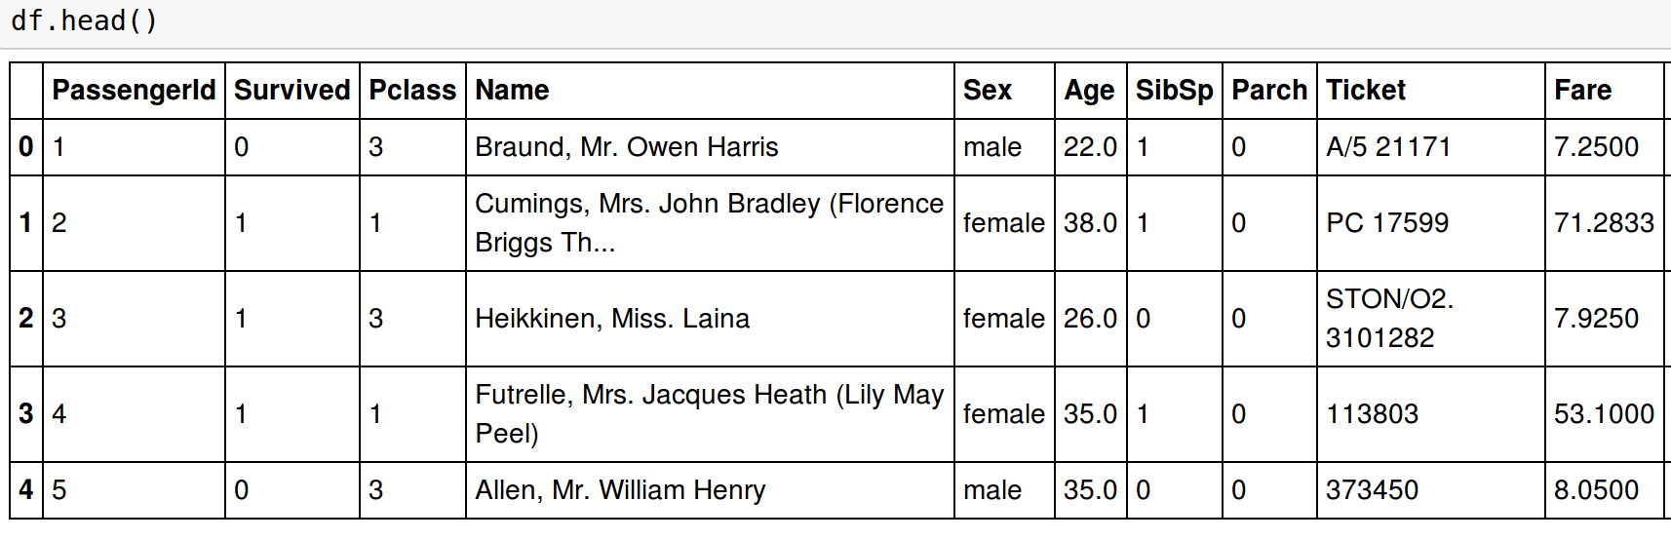
Data overview

Slide 7
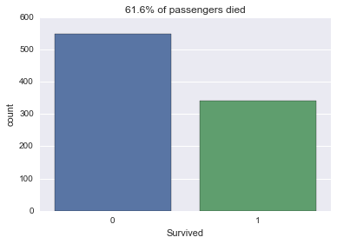
Seaborn plots

Slide 8
Title!
Stuff...
Can't the machine do this for us?

Slide 9
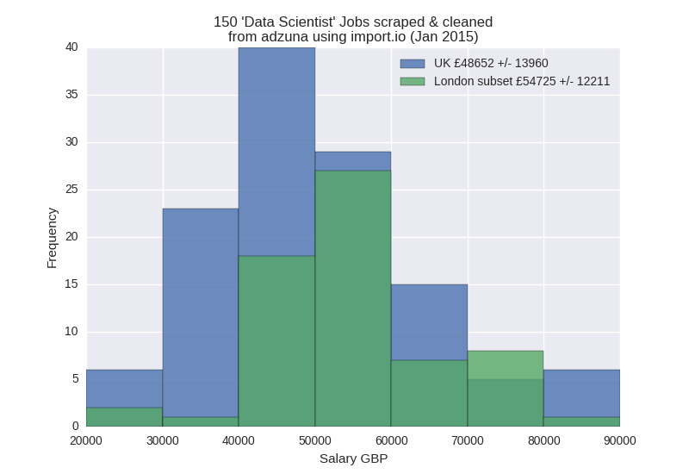
Salary extraction
No regular expressions!
No fiddling!

Slide 10
Deployment
Ad-hoc scripts → reports or db
Microservices (flask, my featherweight API on github, Jupyter microservices)
Pickle your models
Do please have unit tests and a reproducible environment (e.g. Docker+conda)

Slide 11
Closing...
Write-ups: http://ianozsvald.com/
Use github repo to try this yourself XXXX
Take an engineering mindset and go slow
Book signing with Katharine!

