Slide 1
Using Containers for Agile Scalable Releases
Ian Philpot
Sr. Technical Evangelist
@tripdubroot

Slide 2
The cloud is changing expectations
Notes:
Changing industries and customer and how they approach development

Slide 3
Every company is becoming a software company
Notes:
As we look at different industries, existing companies are chaining
Or new companies are pushing out the brick and mortar

Slide 4


Slide 5


Slide 6


Slide 7


Slide 8


Slide 9


Slide 10
Developer Productivity
Hyper-scale

Slide 11
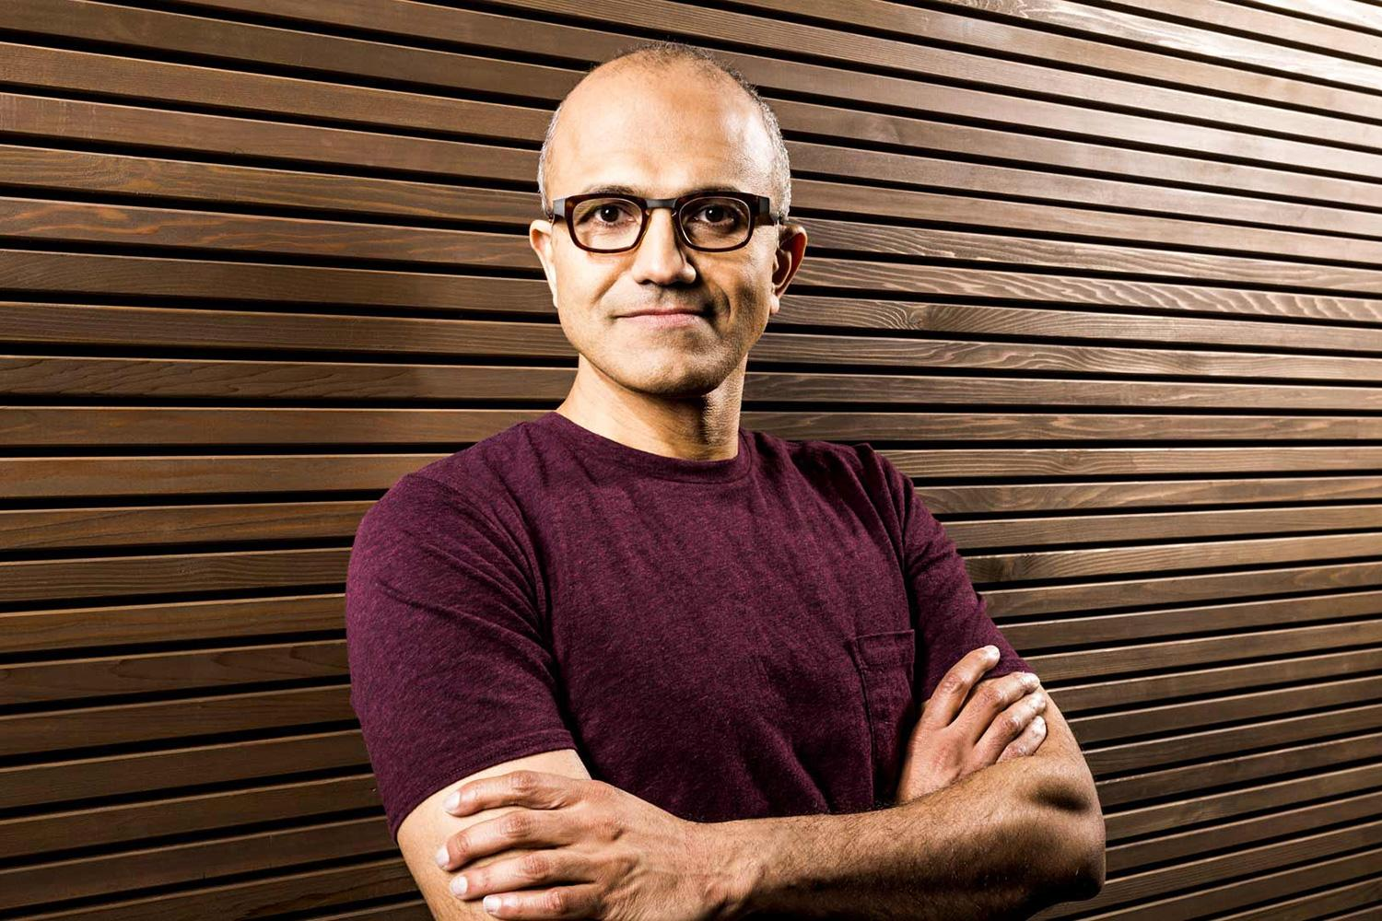


Slide 12
Hyper-scale
Availability
Agility

Slide 13
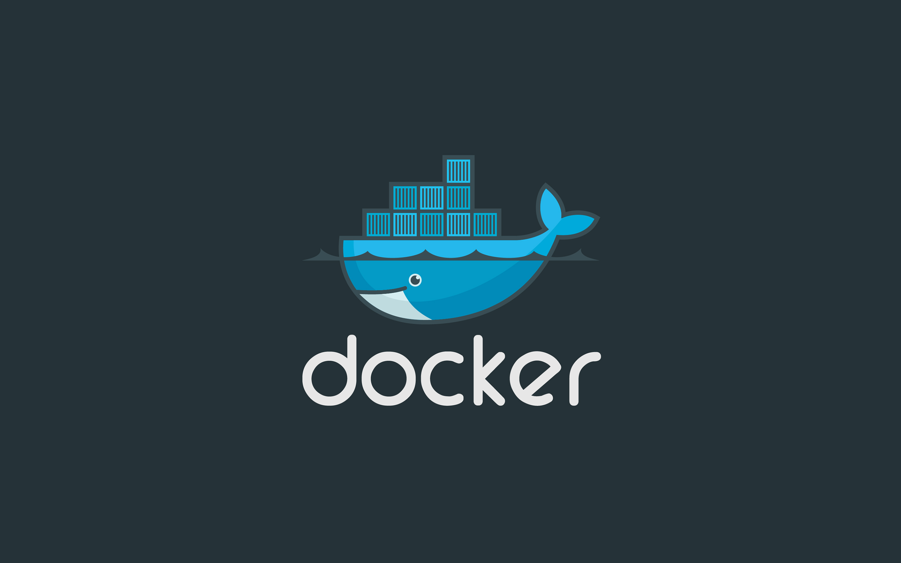

Slide 14
Contoso Rider Engineering
Rapidly Growing Company/Department
iOS/Android App – Ride sharing
Was a monolithic application
Now using Microservices
Requesting/Dispatching
ETC Calculations
Price Calculation
Billing
Etc…

Slide 15
One image per service @ ContosoRider

Slide 16
Docker Compose Up

Slide 17
Developer Workflow
Monolith 50+ services
Four to Five Days Dev Setup
2-3 weeks before first commit
Docker Based Microservice
5 minute Dev Setup
Commit code by EOD
Push to production by EOD

Slide 18
Change the way devs do feature work

Slide 19
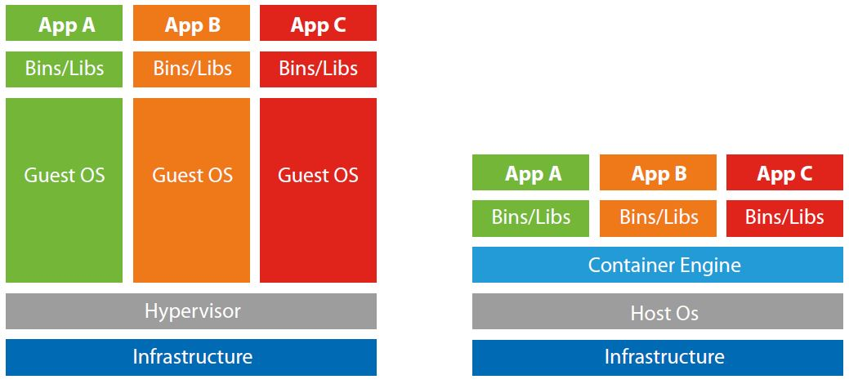
VMs vs. Containers

Slide 20
Virtual Machines in Azure
Scale Sets
IaaS

Slide 21
Azure Container Service
Azure Container Service
Scale Sets
Scale Sets
Scale Sets
IaaS
IaaS
IaaS

Slide 22
Demo: Containers in Azure

