Slide 1
Cobra: Content-based Filtering and Aggregation of Blogs and RSS Feeds
Ian Rose¹, Rohan Murty¹, Peter Pietzuch², Jonathan Ledlie¹, Mema Roussopoulos¹, Matt Welsh¹
hourglass@eecs.harvard.edu
¹ Harvard School of Engineering and Applied Sciences
² Imperial College London

Slide 2
Motivation
Explosive growth of the “blogosphere” and other forms of RSS-based web content. Currently over 72 million weblogs tracked (www.technorati.com).
How can we provide an efficient, convenient way for people to access content of interest in near-real time?

Slide 3
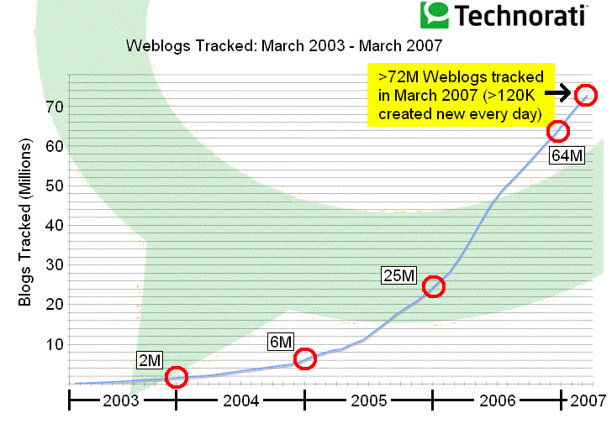
Source: http://www.sifry.com/alerts/archives/000493.html
Notes:
Blogosphere doubling about every ~230 days.
55% of all blogs are “active” (updated in the past 3 months)

Slide 4
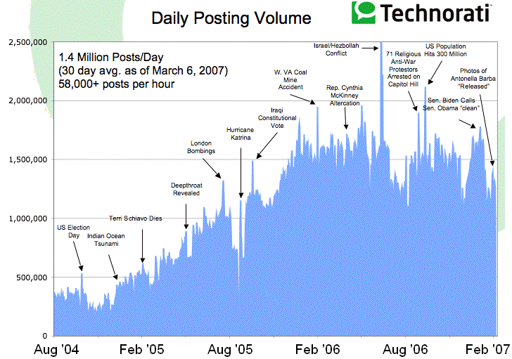
Source: http://www.sifry.com/alerts/archives/000493.html

Slide 5
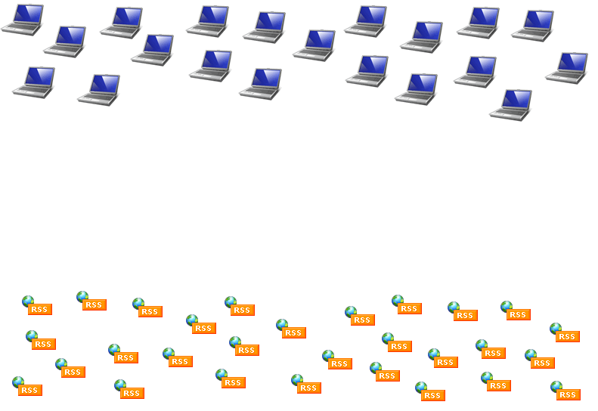
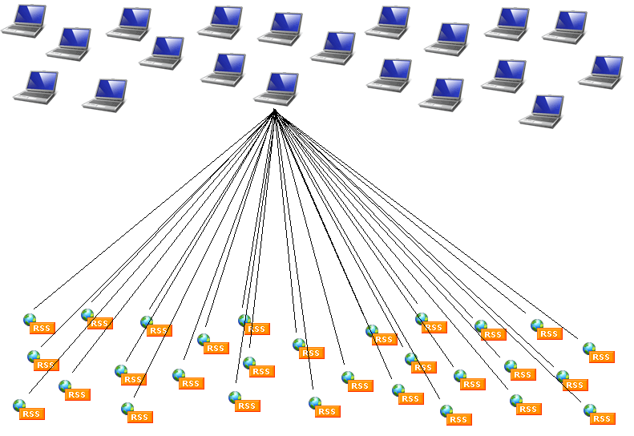
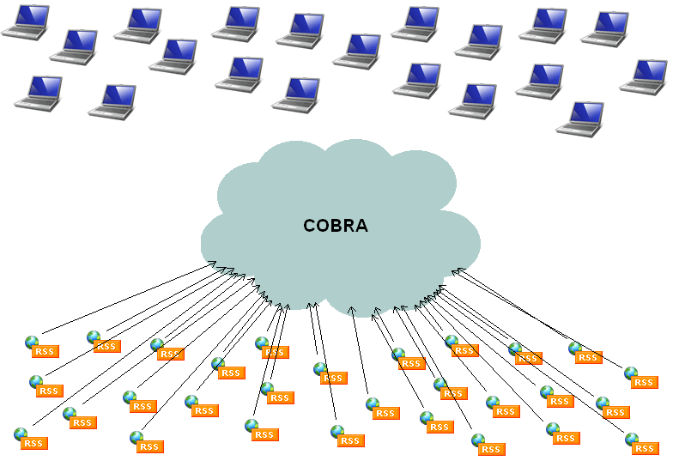
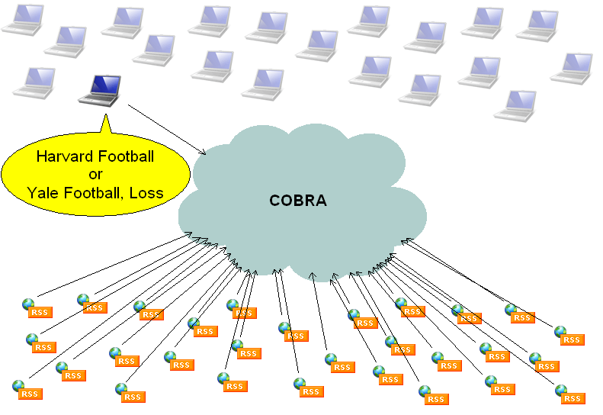


Slide 6
Challenges
Scalability
  How can we efficiently support large numbers of RSS feeds and users?
Latency
  How do we ensure rapid update detection?
Provisioning
  Can we automatically provision our resources?
Network Locality
  Can we exploit network locality to improve performance?

Slide 7
Current Approaches
RSS Readers (Thunderbird)
  topic-based (URL), inefficient polling model
Topic Aggregators (Technorati)
  topic-based (pre-defined categories)
Blog Search Sites (Google Blog Search)
  closed architectures, unknown scalability and efficiency of resource usage
Notes:
RSS Readers
many parallel requests to popular servers

Slide 8
Outline
Architecture Overview
  Services: Crawler, Filter, Reflector
Provisioning Approach
Locality-Aware Feed Assignment
Evaluation
Related & Future Work

Slide 9
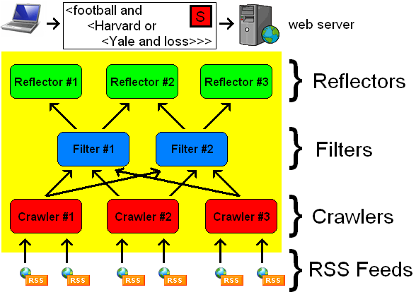
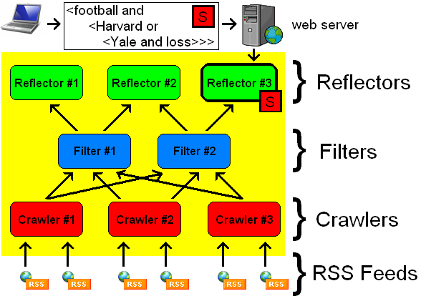
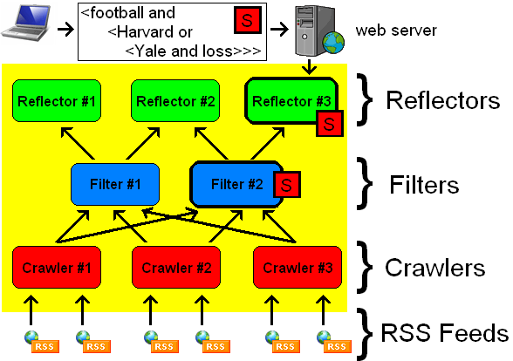
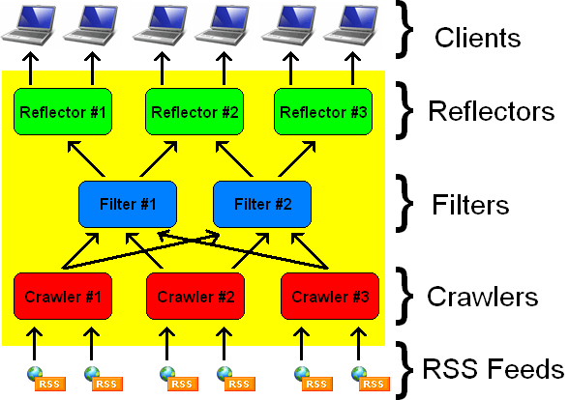
General Architecture
Notes:
* We assume pre-existing list of web feeds to crawl (e.g. syndic8.com)
* Reflectors expose user’s matching articles as a normal RSS feeds (interoperable with normal client readers)

Slide 10
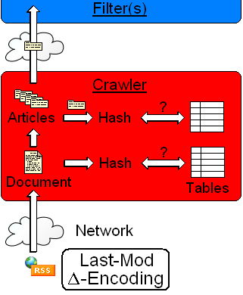
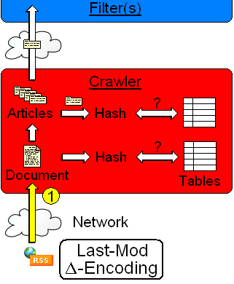
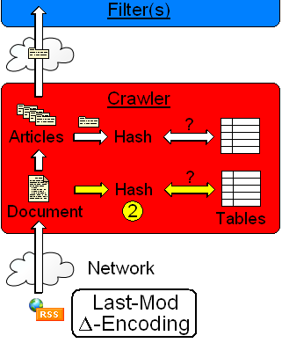
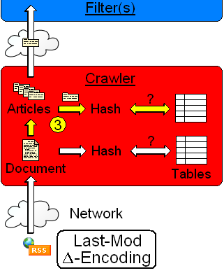
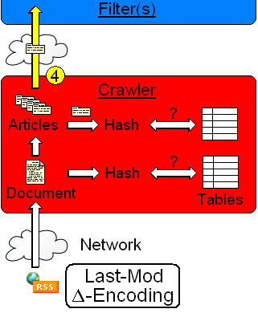
Crawler Service
Retrieve RSS feeds via HTTP.
Hash full document & compare to last value.
Split document into individual articles. Hash each article & compare to last value.
Send each new article to downstream filters.
Notes:
Responsible for crawling subset of feeds every N minutes.
Supports “Last-Modified” and “ETag” HTTP headers
Important not to relay on any server services (delta, last-mod, etc.)

Slide 11
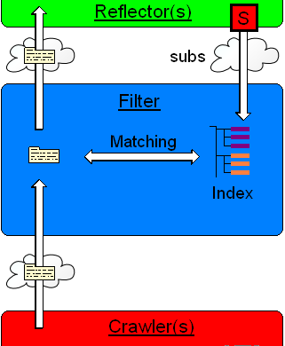
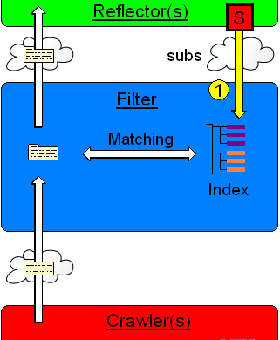
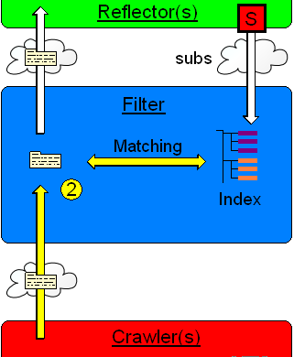
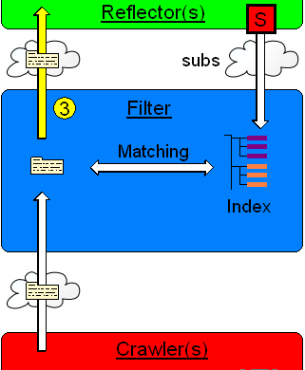
Filter Service
Receive subscriptions from reflectors and index for fast text matching (Fabret ’01).
Receive articles from crawlers and match each against all subscriptions.
Send articles that match 1 subscription to host reflectors.

Slide 12
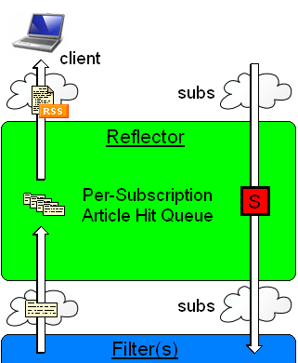
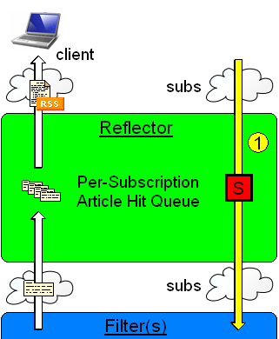
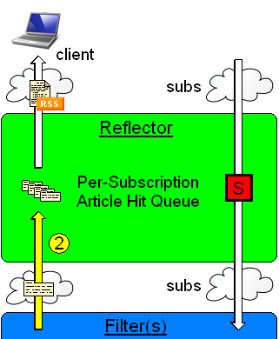
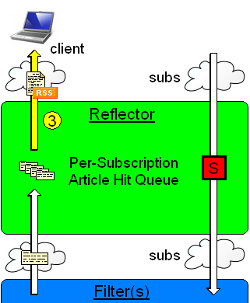
Reflector Service
Receive subscriptions from web front-end; create article “hit queue” for each.
Receive articles from filters and add to the hit queues of matching subscriptions.
When polled by a client, return articles in hit queue as an RSS feed.

Slide 13
Hosting Model
Currently, we envision hosting Cobra services in networked data centers.
  Allows basic assumptions regarding node resources.
  Node “churn” typically very infrequent.
Adapting Cobra to a peer-to-peer setting may also be possible, but this is unexplored.

Slide 14
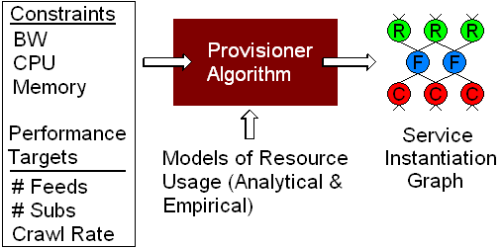
Provisioning
We employ an iterative, greedy, heuristic to automatically determine the services required for specific performance targets.

Slide 15
Provisioning
Algorithm:
  Begin with minimal topology (3 services).
  Identify a service violation (in-BW, out-BW, CPU, memory).
  Eliminate the violation by “decomposing” service into multiple replicas, distributing load across them.
  Continue until no violations remain.

Slide 16
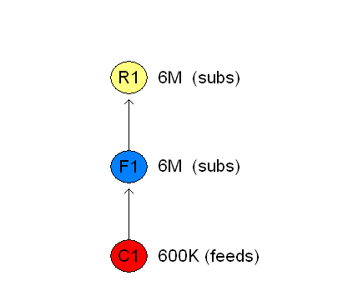
Provisioning: Example
BW: 25 Mbps
Memory: 1 GB
CPU: 4x
subscriptions: 6M
feeds: 600K

Slide 17
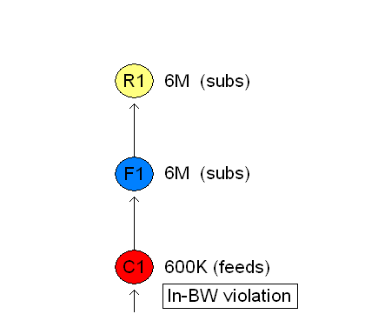
Provisioning: Example

Slide 18
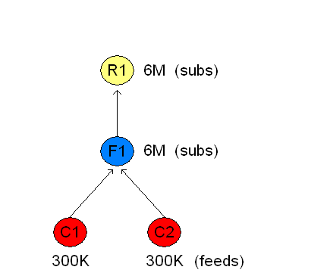
Provisioning: Example

Slide 19
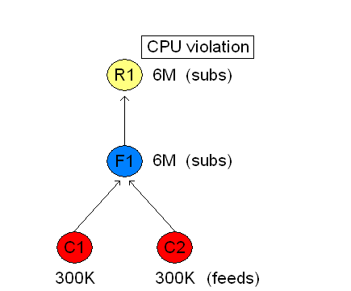
Provisioning: Example

Slide 20
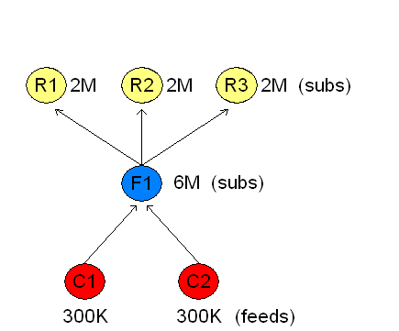
Provisioning: Example

Slide 21
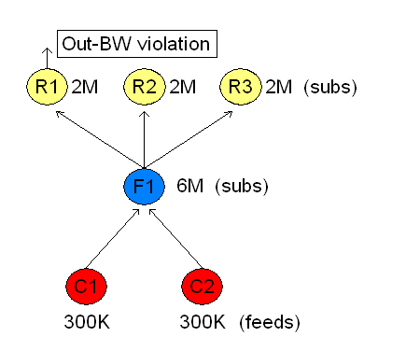
Provisioning: Example

Slide 22
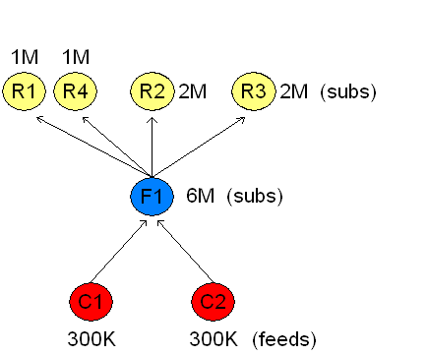
Provisioning: Example

Slide 23
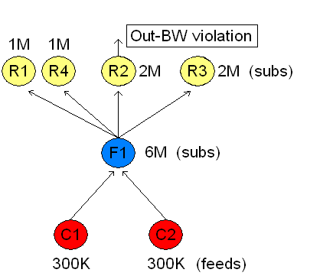
Provisioning: Example

Slide 24
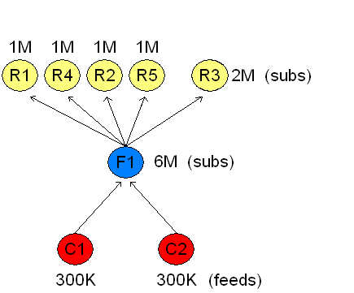
Provisioning: Example

Slide 25
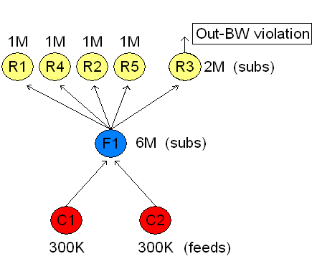
Provisioning: Example

Slide 26
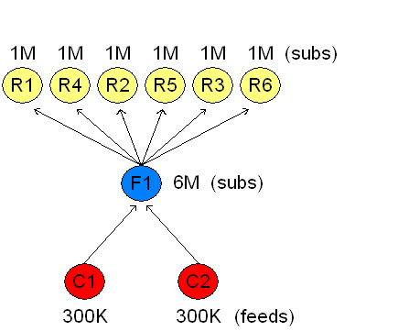
Provisioning: Example

Slide 27
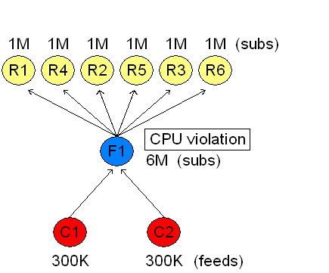
Provisioning: Example

Slide 28
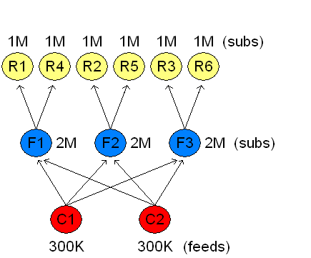
Provisioning: Example

Slide 29
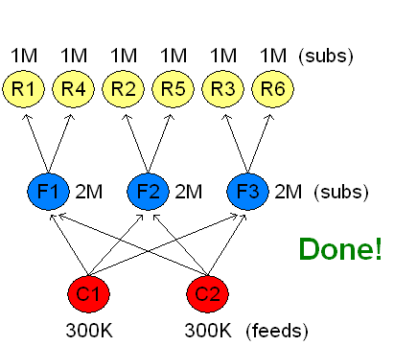
Provisioning: Example

Slide 30
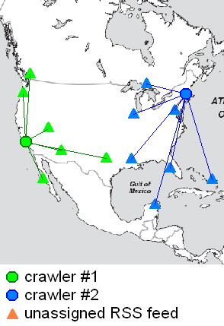
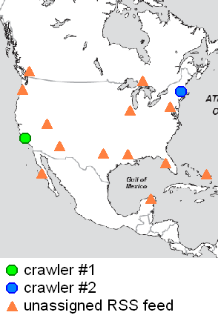
Locality-Aware Feed Assignment
We focus on crawler-feed locality.
Offline latency estimates between crawlers and web sources via King02¹.
Cluster feeds to “nearby” crawlers.
¹Gummadi et al., King: Estimating Latency between Arbitrary Internet End Hosts
Notes:
King measures DNS-to-DNS latency (this doesn’t require end-hosts to run special software, like Vivaldi). King has been reported to have a 75th percentile error of 20% of the true value.

Slide 31
Evaluation Methodology
Synthetic user queries: number of words per query based on Yahoo! search query data, actual words drawn from Brown corpus.
List of 102,446 real feeds from syndic8.com
Scale up using synthetic feeds, with empirically determined distributions for update rates and content sizes (based in part on Liu et al., IMC ’05).

Slide 32
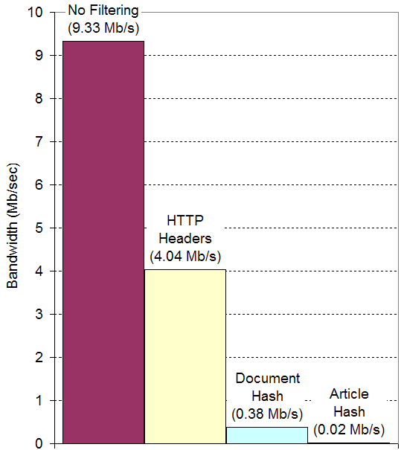
Benefit of Intelligent Crawling
One crawl of all 102,446 feeds over 15 minutes, using 4 crawlers. BW usage recorded for varying filtering levels.
Overall, crawlers are able to reduce bw usage by 99.8% through intelligent crawling.
Notes:
last-mod check: bw reduction by 57% (to 43%)
delta-encoding: not supported by any servers!
document hash: bw reduction by 91% (to 9%)
article hash: bw reduction by 95% (to 5%)

Slide 33
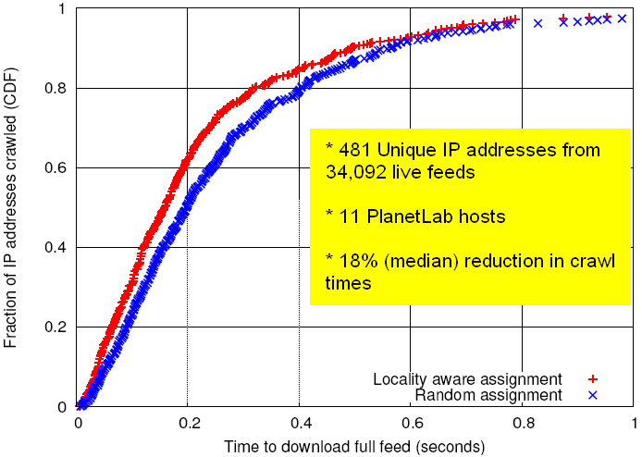
Locality-Aware Feed Assignment
Notes:
King measures DNS-to-DNS latency (this doesn’t require end-hosts to run special software, like Vivaldi). King has been reported to have a 75th percentile error of 20% of the true value.

Slide 34
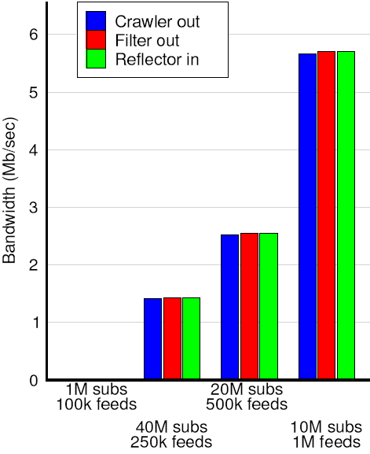
Scalability Evaluation: BW
Four topologies evaluated on Emulab w/ synthetic feeds:
Subs | 1M | 10M | 20M | 40M
Feeds | 100K | 1M | 500K | 250K
Total Nodes | 3 | 57 | 51 | 57
Crawlers | 1 | 1 | 1 | 1
Filters | 1 | 28 | 25 | 28
Reflectors | 1 | 28 | 25 | 28
Bandwidth usage scales well with feeds and users.

Slide 35
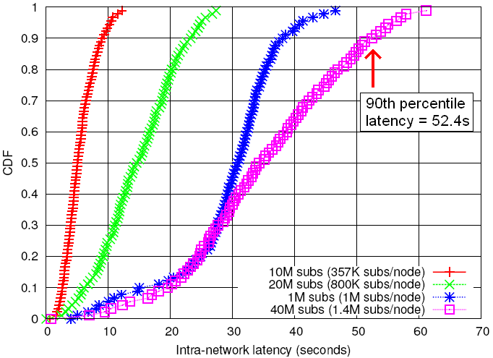
Intra-Network Latency
Total user latency = crawl latency + polling latency + intra-network latency
Overall, intra-network latencies are largely dominated by crawling and polling latencies.

Slide 36
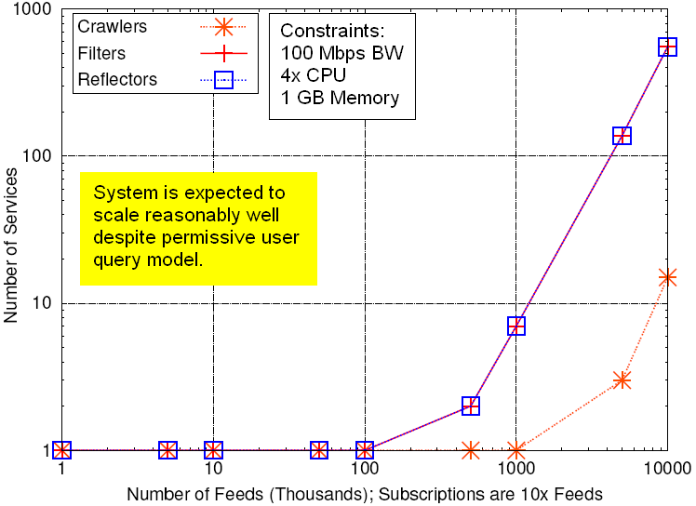
Provisioner-Predicted Scaling

Slide 37
Related Work
Traditional distributed pub/sub systems, e.g. Siena (Univ. of Colorado):
  Address decentralized event matching and distribution.
  Typically do not (directly) address overlay provisioning.
  Often do not interoperate well with existing web infrastructure.
Notes:
Corona - requires known update times

Slide 38
Related Work
Corona (Cornell) is an RSS-specific pub/sub system
  topic-based (subscribe to URLs)
  Attempts to minimize both polling load on content servers (feeds) and update detection delay.
  Does not specifically address scalability, in terms of feeds or subscriptions.
Notes:
Corona - requires known update times

Slide 39
Future Work
Many open directions:
  evaluating real user subscriptions & behavior
  more sophisticated filtering techniques (e.g. rank by relevance, proximity of query words in article)
  subscription clustering on reflectors
  how to discover new feeds & blogs

Slide 40
Thank you!
Questions?
hourglass@eecs.harvard.edu

Slide 41
extra slides

Slide 42
The Naïve method…
“Back of the envelope” approximations:
  1 user polling 50M feeds every 60 minutes would use ~560 Mbps of bw
  1 server serving 500M users Feeds every 60 minutes would use ~5.5 Gbps of bw

Slide 43
Comparison to Other Search Engines
Created blogs on 2 popular blogging sites (LiveJournal and Blogger.com)
Polled for our posts on Feedster, Blogdigger, Google Blog Search
After 4 months:
  Feedster & Blogdigger had no results (perhaps posts were spam filtered?)
  Google latency varied from 83s to 6.6 hours (perhaps use of ping service?)

Slide 44
FeedTree
Requires special client software.
Relies on “good will” (donating BW) of participants.

Slide 45
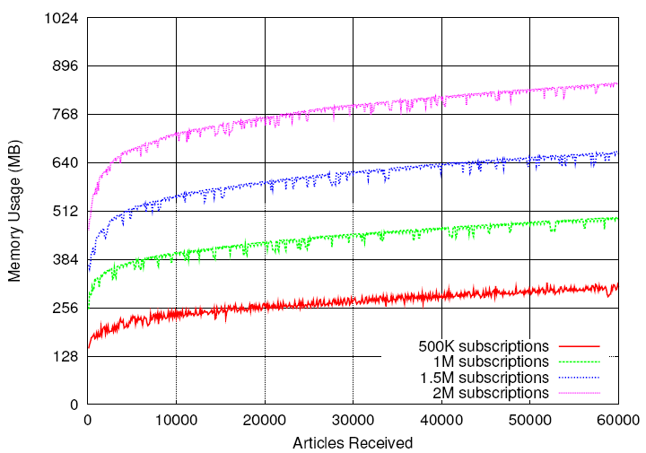
Reflector Memory Usage

Slide 46
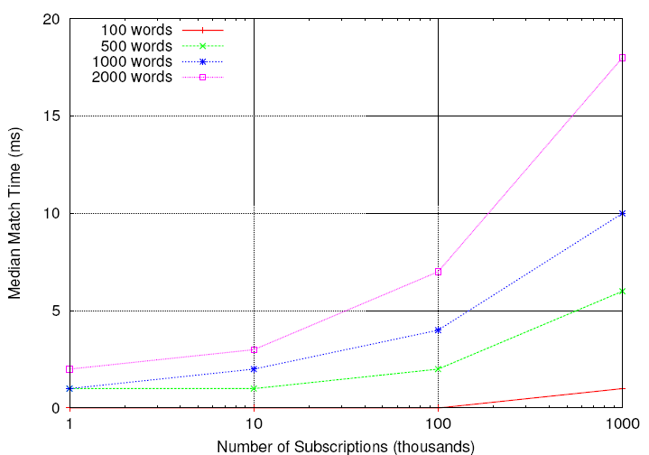
Match-Time Performance

Slide 47
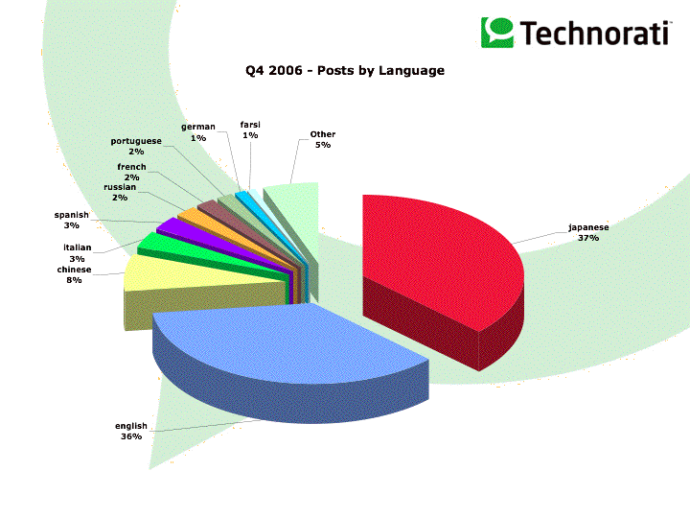
Source: http://www.sifry.com/alerts/archives/000443.html

