Slide 1
Covid-Crash?
Ernest Subah, Francisco Lopez, Matt Olentine, & Ian Walter

Slide 2
Motivation & Summary

Slide 3

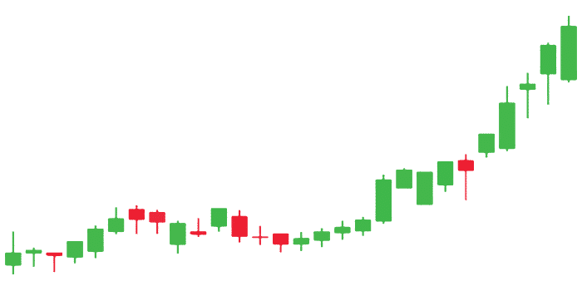

Are we in Armageddon?
Notes:
Francisco
We started off wondering what was going on in the country? The stock market’s turbulence got us thinking and wondering what is actually going on. We saw data reflecting markets shifting and changing and many things that were changing, but not following predictive analysis

Slide 4
Questions & Data
Notes:
MATT

Slide 5

We Asked Ourselves
Is COVID-19 the catalyst of the next recession?
Where will the market end up?
What were the most resilient and least resilient sector specific large cap stocks? How would we build an optimal portfolio?
Among the top three performing indices what would be the optimal portfolio?
What else are we seeing in the country?
Notes:
Matt
Optimal *highest return, lowest volatility

Slide 6
Data Exploration & Cleanup
Notes:
Ian

Slide 7
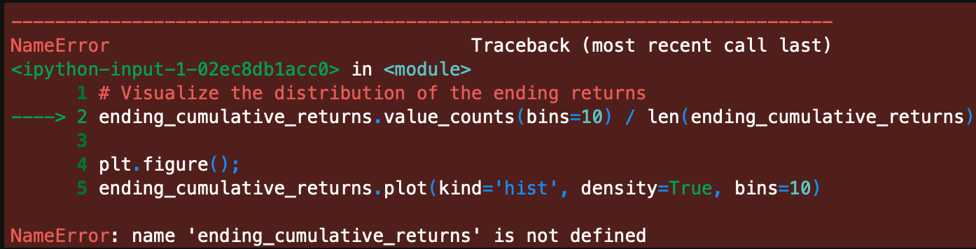
Data Scavenging
Issues
Used our backgrounds to pull from FRED, Alpaca, Google Finance, Google Trends, etc.
Read the CSVs and manipulated to be usable
Data availability from APIs
Data longevity both historical & up-to-date
Data sequence (Daily, Weekly, Quarterly)

Slide 8
Data Analysis & Discussion

Slide 9

And now for Jupyter Lab . . .
Notes:
Ian - first question
Passing to Francisco
Passing to Matt
Passing to Ernest
Passing to Ian

Slide 10
Postmortem

Slide 11
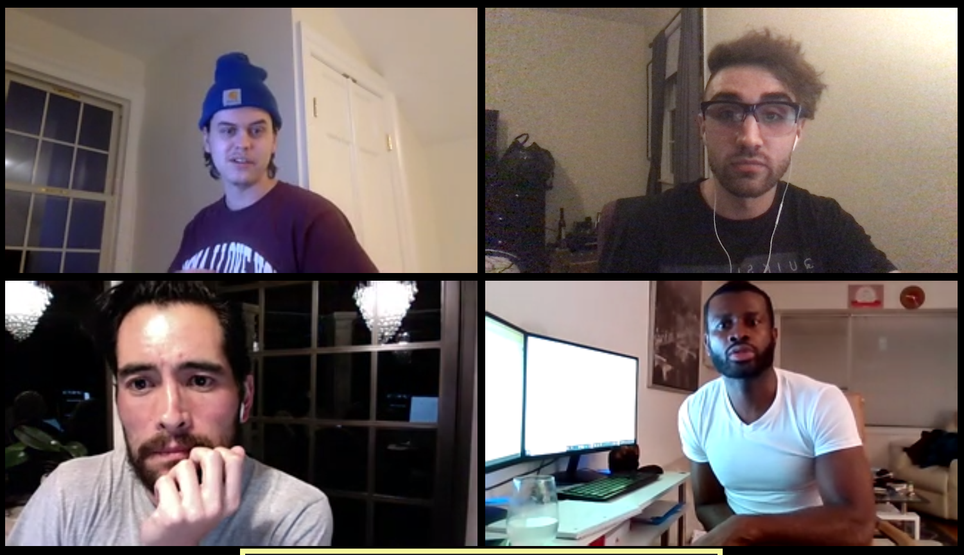
Difficulties
Opportunities
Data availability
Determining the best approach for each of our questions
Distance
Time
Revised some code for better automation
Hone in on one sector as opposed to multiple tickers
Dive into data that signals market changes for predictive modeling

Slide 12
Any Questions

Slide 13
Thank You

