Slide 1
Covid-Crash?
Ernest Subah, Francisco Lopez, Matt Olentine, & Ian Walter

Slide 2
Motivation & Summary

Slide 3

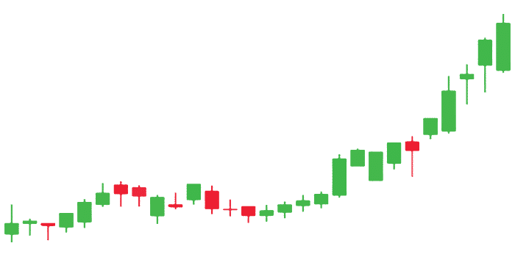

Are we in Armageddon?
Notes:
We started off wondering what was going on in the country? The stock market’s turbulence got us thinking and wondering what is actually going on. We saw data reflecting markets shifting and changing and many things that were changing, but not following predictive analysis

Slide 4
Questions & Data

Slide 5

We Asked Ourselves
Is COVID-19 the catalyst of the next recession?
Where will the market end up?
Which markets are most resilient and least resilient?
What do we anticipate based on resiliency?
What else are we seeing in the country?

Slide 6
Data Exploration & Cleanup

Slide 7
Data Scavenging
Used our backgrounds to pull from FRED, BEA, Google Finance, Google Trends, etc.
Read the CSVs and manipulated to be usable

Slide 8
Data Analysis & Discussion --Resiliant Stocks

Slide 9
S&P 500 Target (TGT) – Consumer Discretionary Activision Blizzard (ATVI) – Interactive Home Entertainment Microsoft (MSFT) – Information Technology Dow Jones Industrial Walmart (WMT) - Retail Procter & Gamble (PG) – Fast-moving Consumer Goods Johnson & Johnson (JNJ) – Pharmaceutical Industry NASDAQ (Technology) American State Water Company (AWR) - Utility Algonquin Power & Utilities Corp. (AQN) - Utility InMode Ltd. (INMD) - BioTech

Slide 10
Approach
Selected the top three most defensive stocks within each index described earlier and…
Determined/plotted the optimal portfolio/Efficient Frontier
Reallocation of asset weights
Highest return per unit of risk (Sharpe Ratio)
Identified the best performing stock
Developed a correlation matrix to identify stocks that move in tandem
Created a new portfolio comprising of the best performing stocks each index…
Determined/plotted the optimal portfolio/Efficient Frontier
Reallocation of asset weights
Highest return per unit of risk (Sharpe Ratio)
Identified the best performing stock
Developed a correlation matrix to identify stocks that move in tandem

Slide 13
Postmortem

Slide 14
Questions

Slide 15
Thank You

