Slide 1


F# in Production
Ian Russell
@ijrussell

Slide 2
About me:
I've discovered the secret to my happiness: F# & functional-first programming.
Too dumb for modern C#.
Author of https://leanpub.com/essential-fsharp

Slide 3
Agenda:
What are we working on?
What is working in F# like?
Why did we choose F#?

Slide 4


GPSA - How we started:
Credentials
Processing Pipeline
Signal Recipients
Providers
Validation
ETA

Slide 5

GPSA – Where we are now:
Signal Sources
Signal Recipients
Pull Providers
Mobile App
ETA
API
Processing Pipeline
Deduplication
Validation
Ownership
Push Providers
API
Data Lake
Fleet

Slide 6
GPSA in numbers:
Nearly 9,500,000 signals per day
250 providers
5,500 Signal Sources
Over 65,000 devices per day
24/7/365

Slide 7
Why F#: Requirements
High signal to noise ratio
Strongly typed
Easy to learn and understand
Functional-first
.NET or JVM

Slide 8


Why F#: Options

Slide 9
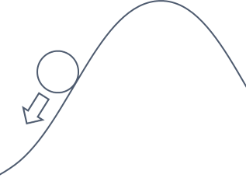
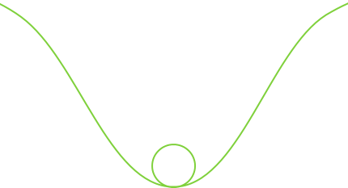
The Pit of Success
https://blog.ploeh.dk/2016/03/18/functional-architecture-is-ports-and-adapters/

Slide 10
The Type System
The best way to handle bugs is to prevent them in the first place.
Make illegal states unrepresentable
Immutable data
Say ‘NO’ to nulls
Statically typed
Model the core domain in one file

Slide 11
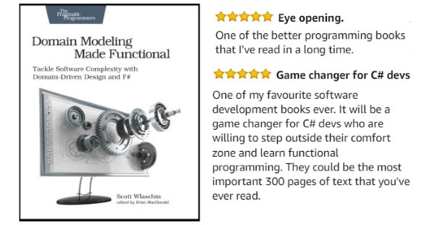
A Roadmap
https://pragprog.com/titles/swdddf/domain-modeling-made-functional/

Slide 12
Working in F#
Data processing
Code structure
Updating F#, .NET and NuGet packages
Adding new features/extending
Tooling
Recruitment/Onboarding

Slide 13
Tools We Use
Npgsql.FSharp + postgresql
JetBrains Rider/VSCode+ionide/VS2022
Giraffe + ASP.NET Core
F# Interactive

Slide 14
Data Processing:
JSON (de)serialization + Protobuf
Type Providers
CSV, JSON, and XML/SOAP
Interop (null <-> Option)

Slide 15
Handling updates
Upgrading F#/.NET has been painless so far
Looking forward to native Task support in F# 6
Use Paket

Slide 16
Code structure:
Make use of modules
Put code that changes together in the same file
Clean separation between types and functions
Pipelines - Composition of functions/CEs
Domain-centric structure
Refactoring is generally trivial (copy and paste)
Code that fits in your head

Slide 17
Adding features:
“Don't write code that guesses the future, arrange code so that you can adapt to the future when it arrives.”
Sandi Metz

Slide 18
Collective code ownership:
“… a fundamental criterion for evaluating a pull request is: Will I be okay maintaining this?”
Mark Seemann
https://blog.ploeh.dk/2021/10/18/readability-verification/

Slide 19
Recruitment/Onboarding:
Learning F# is easier today -> Anyone can do it!
Join the F# community
Publicise your use of F#
Have an experienced F# dev on the team
Use functional-first style
Allow learning/getting-up-to-speed time

Slide 20

What about …?
It’s .NET*
* There may be exceptions to this statement.

Slide 21
Are we happy with our decision?
“Domain code in F# reads like documentation. Type system also helps when domain must be evolved or the code refactored.”
“I feel that I'm writing very readable code very fast. I feel very productive.”
“In F# projects, files tend to be longer than in C# projects. Files contain many modules and types. I was surprised by how easy it is to work with these files. Arguably even more straightforward than with C# projects where each class has its own file.”
“F# is phenomenal in integration scenarios. Whenever you have to process various formats of data, F# will be a clear winner.”

Slide 22
Summary
What we’re working on
What working in F# is like for us
Why we chose F#

Slide 23
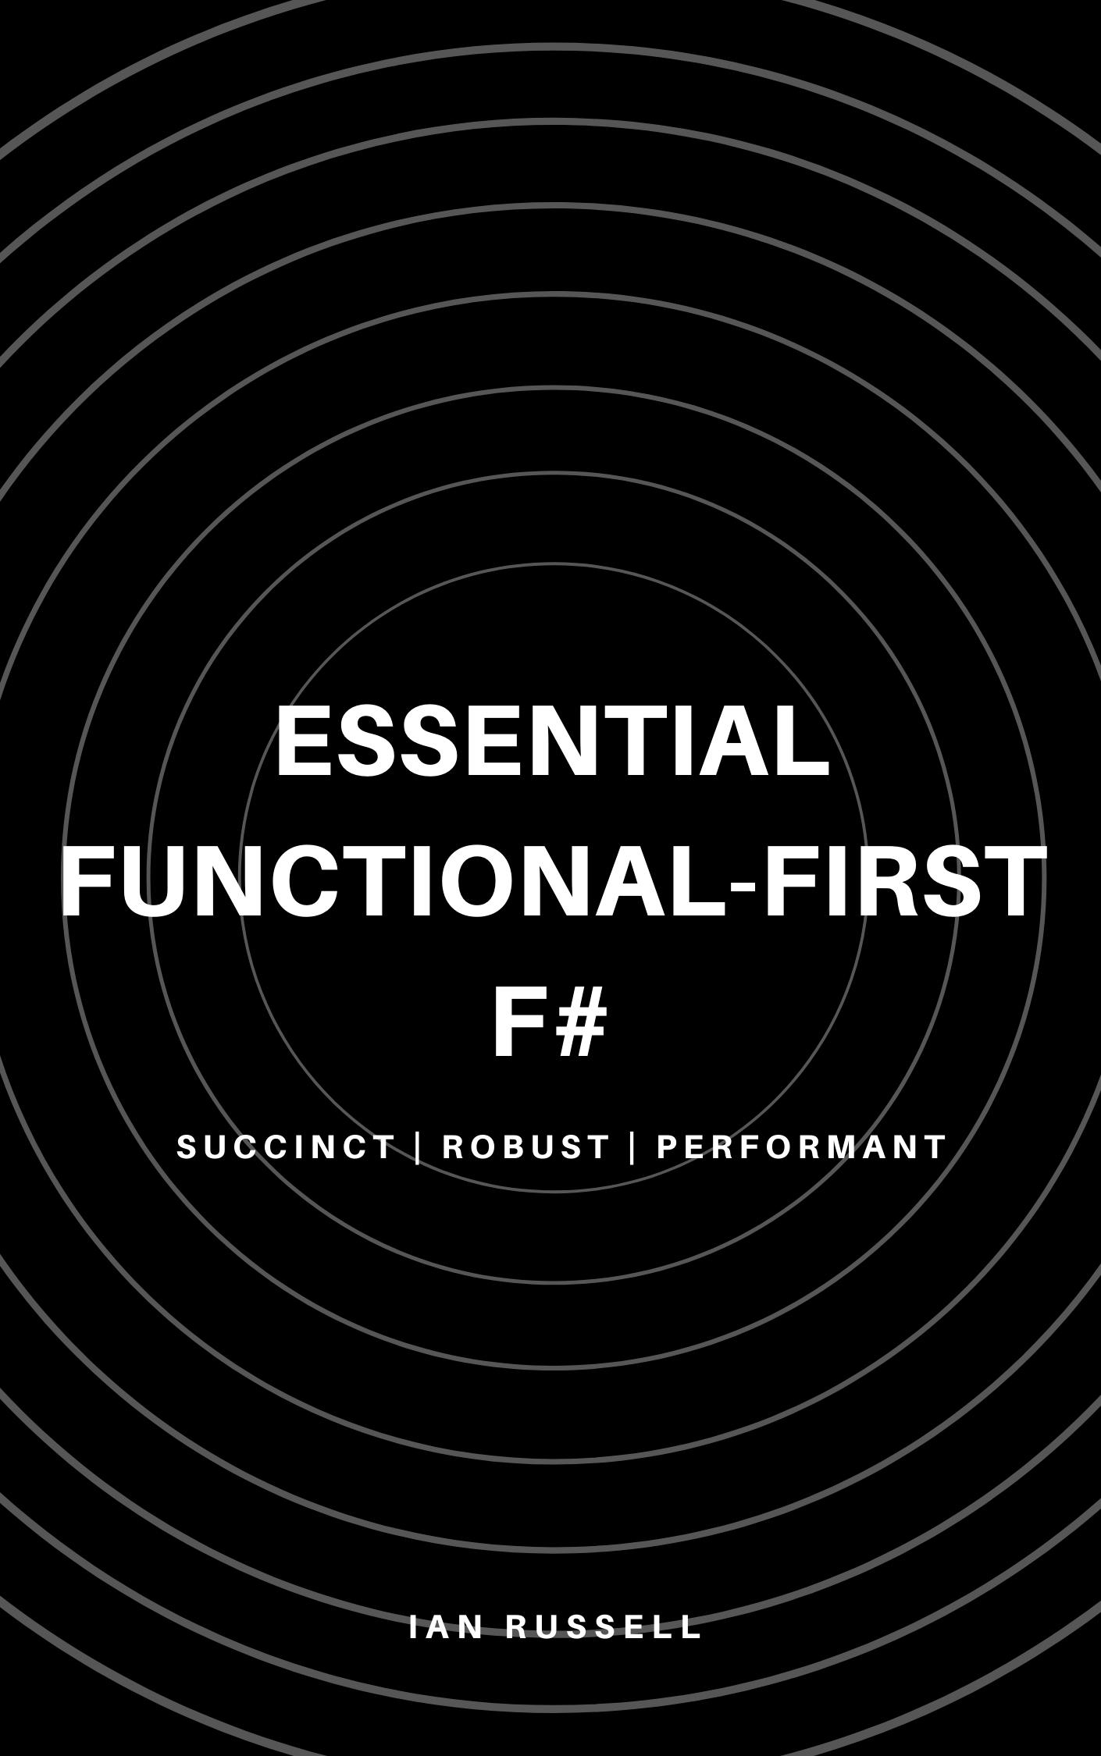
Thank you
https://leanpub.com/essential-fsharp
https://fsharp.org
https://trustbit.tech/blog
@ijrussell

