Slide 1
Extra Ensembl

Slide 2
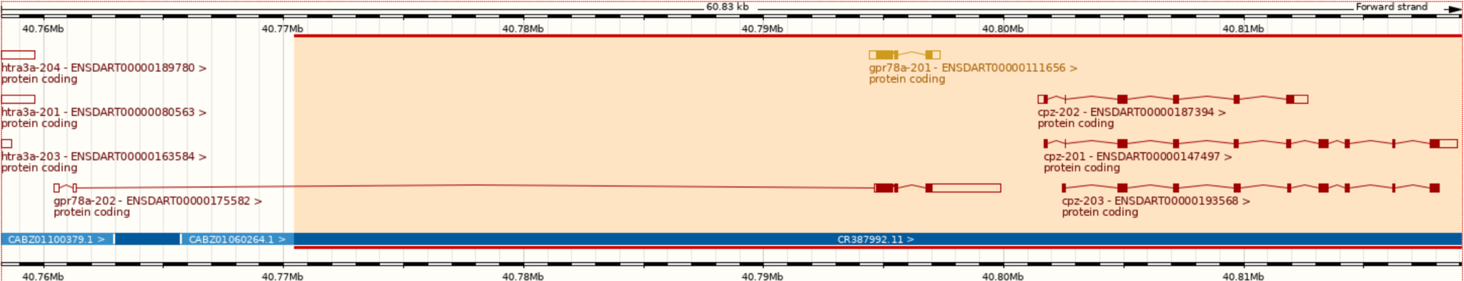
Zebrafish Genome
GRCz11 (danRer11) - latest assembly, released in 2017
Sequencing strategy:
90% clone by clone sequencing
High quality
10% whole genome shotgun sequencing
Lower quality
Fills gaps between clones
Identified by accessions beginning with CABZ
Notes:
Note good transcript on clone sequence, but spindly transcript with intron in 5’ UTR on WGS sequence

Slide 3
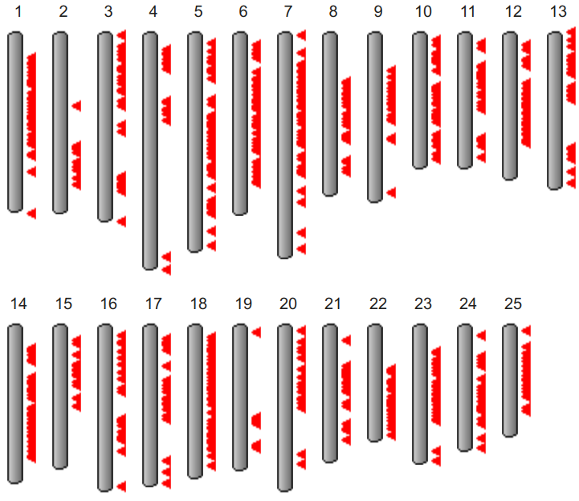
Zebrafish Genome History
Genome project started in 2001 at Sanger Institute
Initially sequenced pool of Tübingen zebrafish
But zebrafish very polymorphic compared to humans
Too much variation to join clones, so lots of gaps
+ same region represented by 2+ clones, leading to artificial duplication
Later used double haploid Tübingen fish for some clones and most WGS
Only 925 gaps between scaffolds and N50 > 7 Mbp
GRCz11 contains alternative scaffolds
From https://www.ncbi.nlm.nih.gov/grc/zebrafish
When downloading sequence from Ensembl FTP site, "toplevel" includes alternative sequence, but "primary_assembly" doesn't and is probably what you want
Notes:
N50 = measure of how contiguous genome is (50% of sequence is in contigs longer than 7 Mbp)
Ideogram shows locations of alternative scaffolds

Slide 4
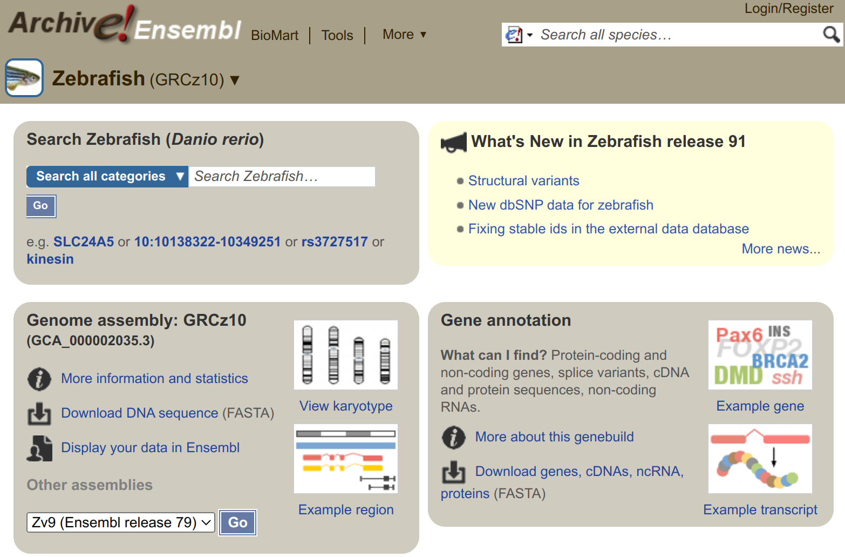
Older Assemblies
Previous assemblies available in Ensembl archives: www.ensembl.org/info/website/archives/assembly.html
GRCz10 / danRer10: http://e91.ensembl.org/
Zv9 / danRer7: http://e77.ensembl.org/
Zv8 / danRer6: http://e54.ensembl.org/
Even older assemblies available in UCSC
Numbering coordinated when GRC (Genome Reference Consortium) took over managing zebrafish assembly from Sanger Institute
Notes:
Note Ensembl archives always brown colour

Slide 5
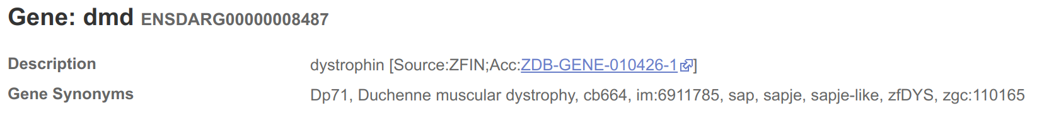
Gene Names
Names assigned to Ensembl genes automatically based on sequence similarity
Mistakes are possible
Names can change
ZFIN gene symbols (i.e. the name assigned by ZFIN) are preferred (>23,000 genes), but other databases are also used, e.g. HGNC for ~150 genes, miRBase for ~300 genes
Description indicates source of name
Genes without a match are given a name based on the sequence used to identify them, e.g AL645792.1 (clone) or CABZ01052570.1 (WGS)

Slide 6
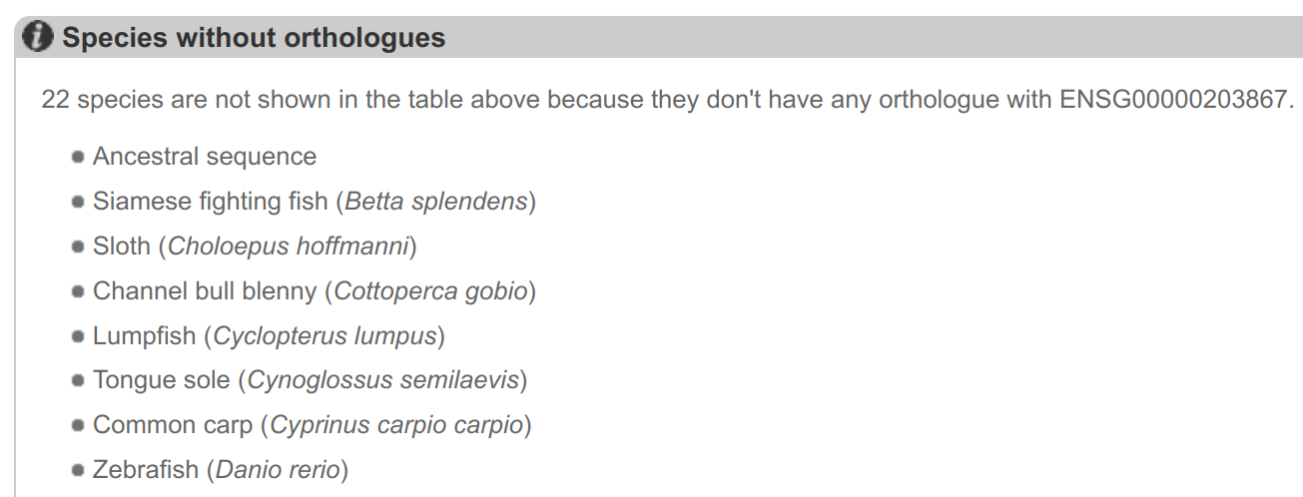
Synteny Example
No zebrafish orthologue listed for human RBM20 gene (ENSG00000203867)

Slide 7
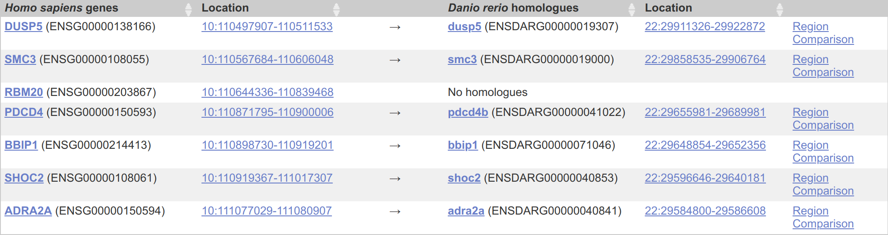
Synteny Example
If we look at the region around RBM20 in human and then click on Synteny we see conservation of synteny with zebrafish chr22

Slide 8
Synteny Example
If we look at the chr22 region in zebrafish then all the surrounding genes are the same and RBM20 is likely to be BX649294.1

Slide 9
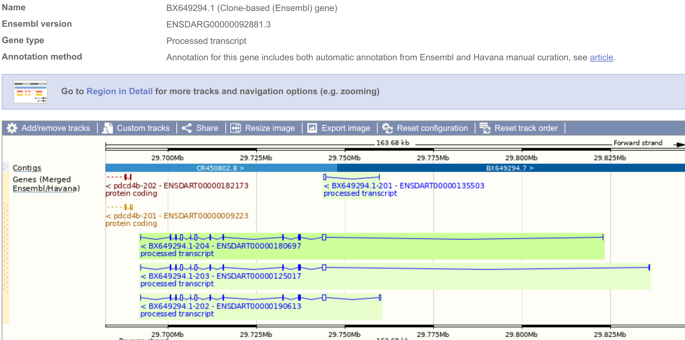
Synteny Example
Erroneously labelled as processed transcript and so not in protein gene tree, so not labelled as orthologue or named by orthology

Slide 10
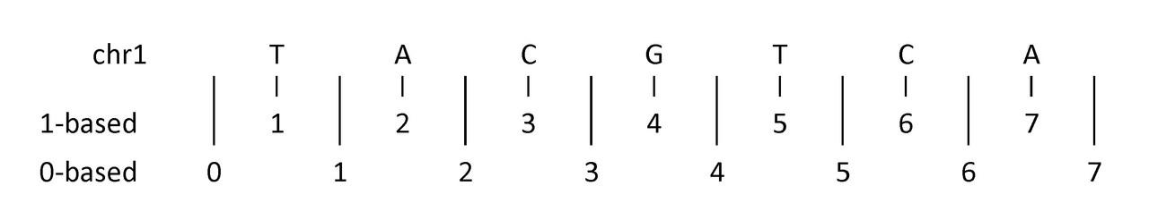
UCSC & Ensembl Differences
Ensembl: 1 UCSC: chr1
Ensembl: 1-based coordinates (bases numbered) UCSC: 0-based coordinates (numbers between bases)
The G is 1:4-4 in Ensembl coordinates but 1:3-4 in UCSC

Slide 11
Thank You!
Any questions?

