Slide 1
Guidelines for Experimental Design
General Considerations & Best Practices

Slide 2
Importance of experimental design
Design
Sequencing
QC
Analysis
Experiment hard to analyse
Experiment impossible to analyse

Slide 3
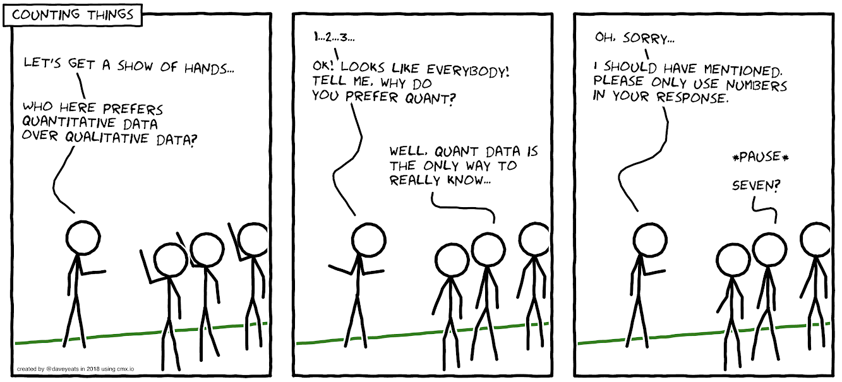
RNA-seq
Many types of RNA-seq experiment
Experimental design depends on type
Quantitative: e.g. differential gene expression, alternative splicing
Qualitative: e.g. transcript discovery, identification of poly(A) sites
Mostly focus on differential gene expression (DGE)
By Dave Yeats using cmx.io

Slide 4
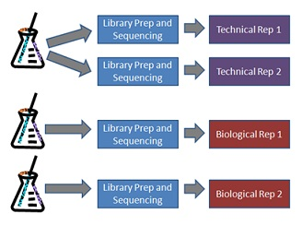
Replication
Technical replicates:
Rarely needed (except during method development, where want to differentiate technical and biological variability)
Main source of technical variability is RNA prep and library prep, not sequencing
Biological replicates:
Minimise or control for biological variability (so focus on conditions)
For example:
choose embryos from same clutch
or control for clutch in analysis
From http://scotty.genetics.utah.edu/help.html

Slide 5
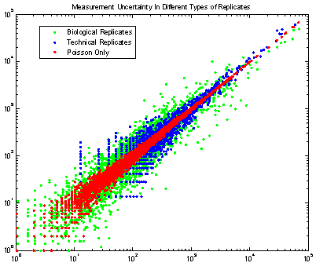
Sources of variance
Biological variance - natural variance
Zebrafish – lots of replicates, but if pool then variance reduced and can lose signal
Technical variance - from RNA & library prep
Poisson variance - counting noise; high variance at low counts
From Michele Busby

Slide 6
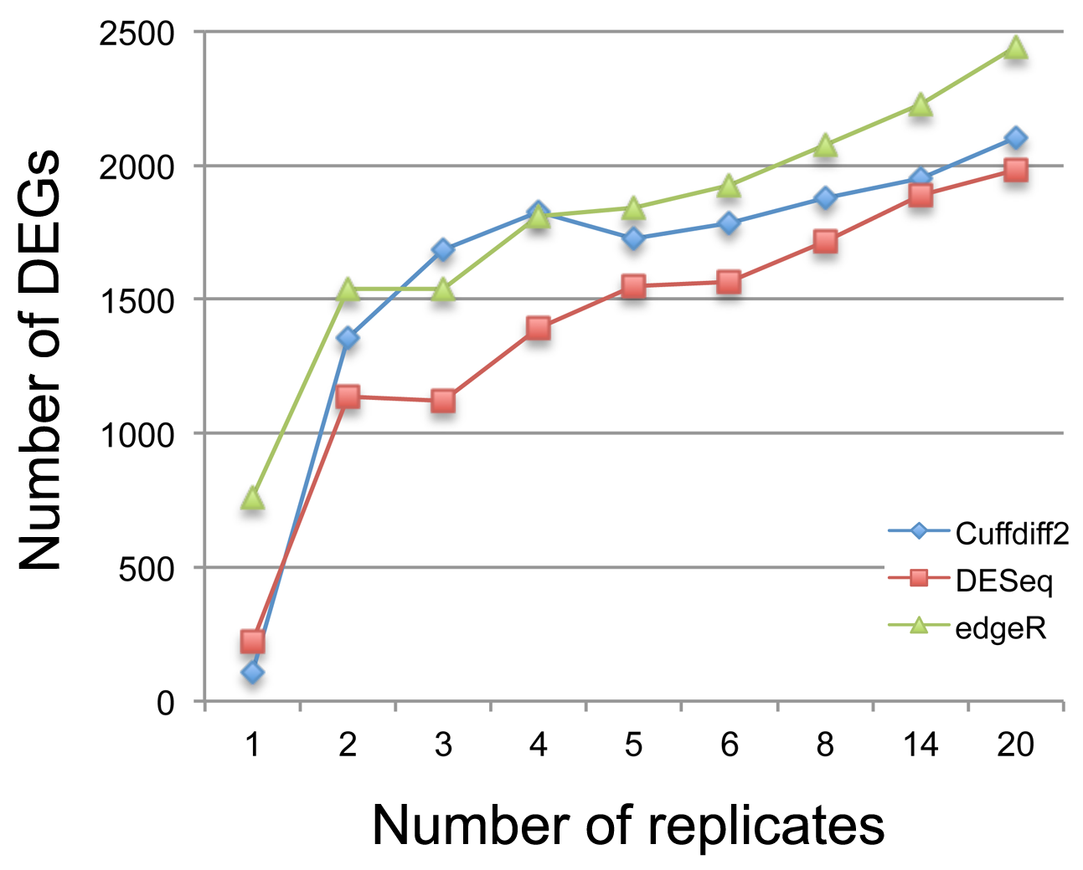
How many replicates? (1/2)
Often trade off between number of samples and sequencing depth
DGE:
More samples best (if cost allows), because reduces effect of biological variability
Can always sequence more deeply, but hard to add samples (batch effect)
Generally never < 4 samples per condition, but more better
We never do < 6 samples and often 12+
10 million reads usually enough
From Zhang et al., 2014 – “A Comparative Study of Techniques for Differential Expression Analysis on RNA-Seq Data”

Slide 7
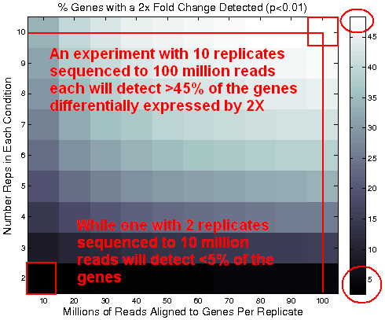
How many replicates? (2/2)
Transcript discovery:
Sequencing depth important (want overlapping reads over whole transcript)
Enrichment for desired transcripts, e.g. by size selection
Range of tissues, developmental stages or treatments
http://scotty.genetics.utah.edu/ - helps design experiment (requires similar or pilot data, plus costs)

Slide 8
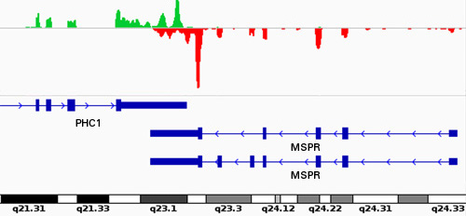
What type of reads?
For qualitative experiments, want:
Stranded library
Long reads (100 bp +)
Paired end reads
Not important for quantitative experiments
75 bp probably optimal for DGE (Chhangawala et al., 2015 – “The impact of read length on quantification of differentially expressed genes and splice junction detection”)
From Clontech

Slide 9
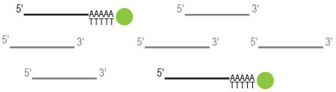
Ribosomal RNA
Usually want to sequence mRNA, but total RNA is mostly rRNA
Either enrich for mRNA or deplete rRNA
mRNA enrichment by oligo (dT):
Cheaper and less noisy, but leads to 3’ bias and ignores some ncRNAs
rRNA depletion by Ribo-Zero:
Expensive and doesn’t work as well with zebrafish as for other model organisms (designed for human, mouse and rat)
From Lexogen

Slide 10
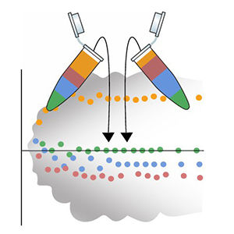
RNA spike-ins
ERCC spike-ins – set of transcripts of various lengths and concentrations
Suggested to aid normalisation
But are expensive and don’t actually improve normalisation
From https://www.nist.gov/programs-projects/external-rna-controls-consortium

Slide 11
Batch effects
Batch effects are technical variation between groups of samples
RNA prep and library prep are very sensitive to batch effects
Make sure all samples are prepared in the same way as far as possible
e.g. all samples prepared by same person at same time using same reagents
Otherwise control for batch in analysis
But requires more samples to maintain power

Slide 12
Controlling for batch
Sample | Genotype
sample_1 | wild_type
sample_2 | wild_type
sample_3 | wild_type
sample_4 | wild_type
sample_5 | knockout
sample_6 | knockout
sample_7 | knockout
sample_8 | knockout
Sample | Genotype | Batch
sample_1 | wild_type | Friday
sample_2 | wild_type | Friday
sample_3 | wild_type | Monday
sample_4 | wild_type | Monday
sample_5 | knockout | Friday
sample_6 | knockout | Friday
sample_7 | knockout | Monday
sample_8 | knockout | Monday
Sample | Genotype | Batch
sample_1 | wild_type | Friday
sample_2 | wild_type | Friday
sample_3 | wild_type | Friday
sample_4 | wild_type | Monday
sample_5 | wild_type | Monday
sample_6 | wild_type | Monday
sample_7 | knockout | Friday
sample_8 | knockout | Friday
sample_9 | knockout | Friday
sample_10 | knockout | Monday
sample_11 | knockout | Monday
sample_12 | knockout | Monday

Slide 13
Confounding
Don’t confound batch with conditions – otherwise analysis impossible
Best to randomise samples, so batches evenly distributed across conditions
Sample | Genotype | Clutch
sample_1 | wild_type | clutch_1
sample_2 | wild_type | clutch_1
sample_3 | wild_type | clutch_1
sample_4 | wild_type | clutch_1
sample_5 | knockout | clutch_2
sample_6 | knockout | clutch_2
sample_7 | knockout | clutch_2
sample_8 | knockout | clutch_2
Sample | Genotype | Clutch
sample_1 | wild_type | clutch_1
sample_2 | wild_type | clutch_2
sample_3 | wild_type | clutch_2
sample_4 | wild_type | clutch_1
sample_5 | knockout | clutch_1
sample_6 | knockout | clutch_1
sample_7 | knockout | clutch_2
sample_8 | knockout | clutch_2
Confounded
Not confounded

Slide 14
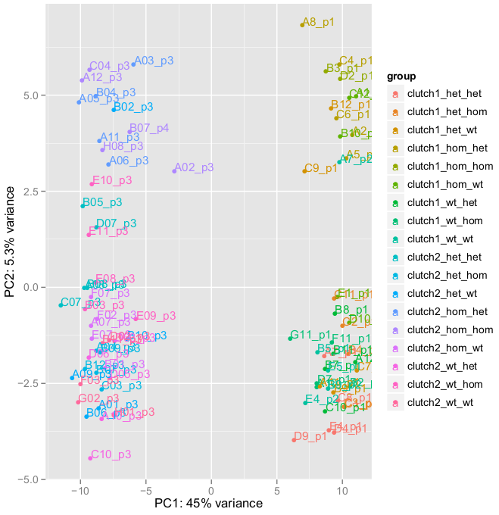
Clutch batch effect

Slide 15
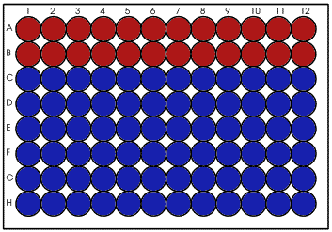
Plate effect
Rows | DE regions
A vs B | 8
C vs D | 15
D vs E | 268
E vs F | 692
G vs H | 374
A vs H | 3372
Random 12 vs 12 | 0
Col 1 vs Col 12 | 0
Phenotypic
Non-phenotypic

Slide 16
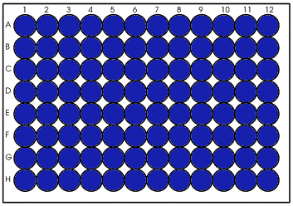
Plate effect confirmation
96 wild-type embryos
RNA extracted in rows, but libraries made in columns
Columns | DE regions
1 vs 2 | 78
1 vs 3 | 749
2 vs 3 | 225

Slide 17
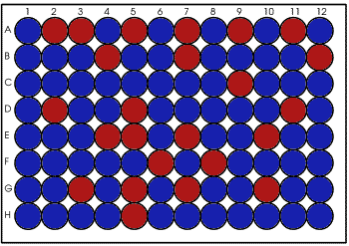
Better plate design

Slide 18
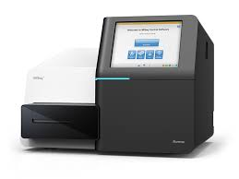
Multiplexing
Sequencing is quite consistent, but still best to pool samples and sequence across multiple lanes
Reason why difficult to add more samples to an experiment
Multiplexed libraries need to be balanced to ensure even read depth
Can check with MiSeq run
We prefer to exclude outliers (low read depth)
Another reason to have lots of samples
From Illumina

Slide 19
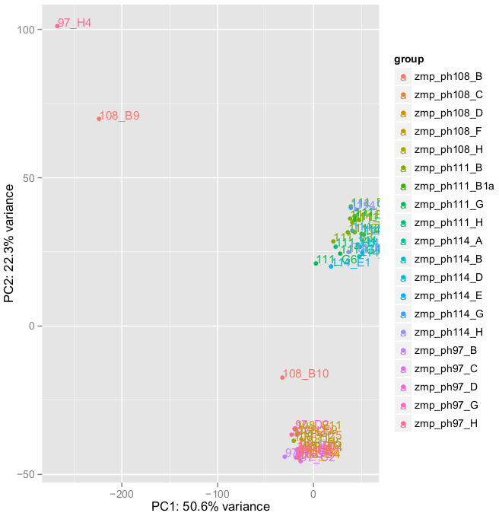
Visualisation
Important to visualise your data at each stage of analysis
e.g. PCA to identify outliers

Slide 20
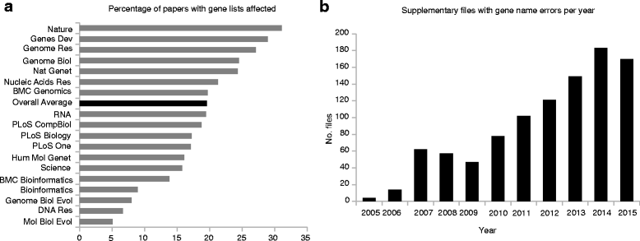
Best practices (1/2)
Avoid Excel for analysis
Fine for exploring data, but don’t export data from Excel
Ziemann et al., 2016 – “Gene name errors are widespread in the scientific literature”
e.g. sept2 converted to 2-Sep (human gene now renamed to SEPTIN2)

Slide 21
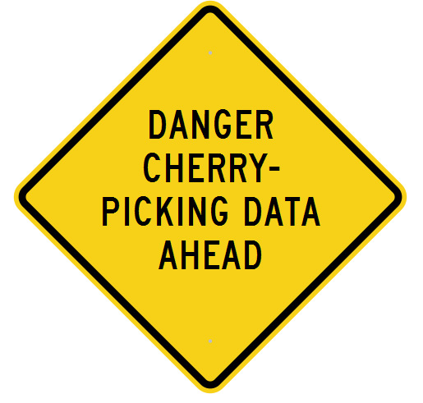
Best practices (2/2)
Don’t (subconsciously) cherrypick data
Conclusions should be robust and not rely on filtering data in an arbitrary way
e.g. can’t take a list of lipid genes and just assess those for differential expression
Write down everything you do
Future you will thank you when you analyse your data and try to discover the reason for an unexpected batch effect
Sequence deposition requires good metadata

Slide 22
Data sharing
Benefits
“Altruistic”
“Selfish”
Scientific community
Your own work

Slide 23
Altruistic reasons for data sharing
Contribute to databases we use on a daily basis (e.g. Ensembl, ZFIN, GO, etc…)
Reduce duplication of effort (Reviewer 2: “Comparison to ChIP-seq data is necessary to...”)
Enable more discovery (other people have completely different questions; data reuse statement)
Gives non-bioinformaticians access to NGS data

Slide 24
Selfish reasons for data sharing
Encourages comprehensive metadata documentation
Easy data access for you and for others (=> citations)
Data access mandatory for most funders and journals
Appreciated by reviewers (“there is tremendous utility for researchers for fully processed, discrete, clear and unambiguous annotated DE gene lists”)
Raises awareness of your work outside your own field
Good for your reputation – “they know what they are doing”

Slide 25
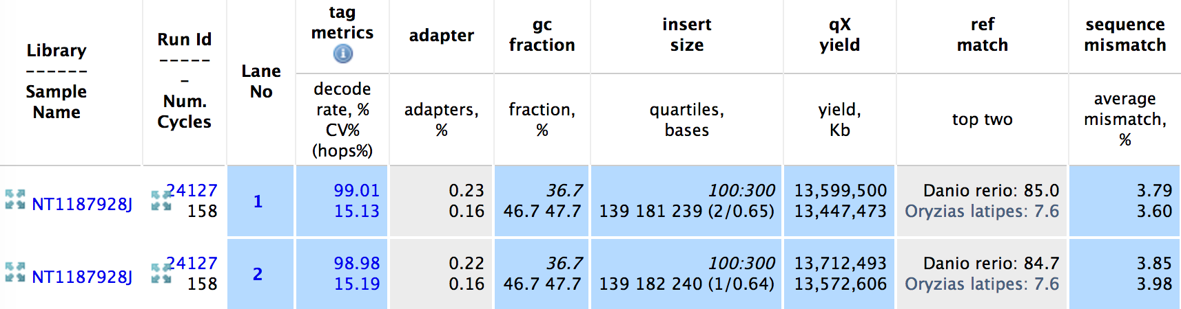
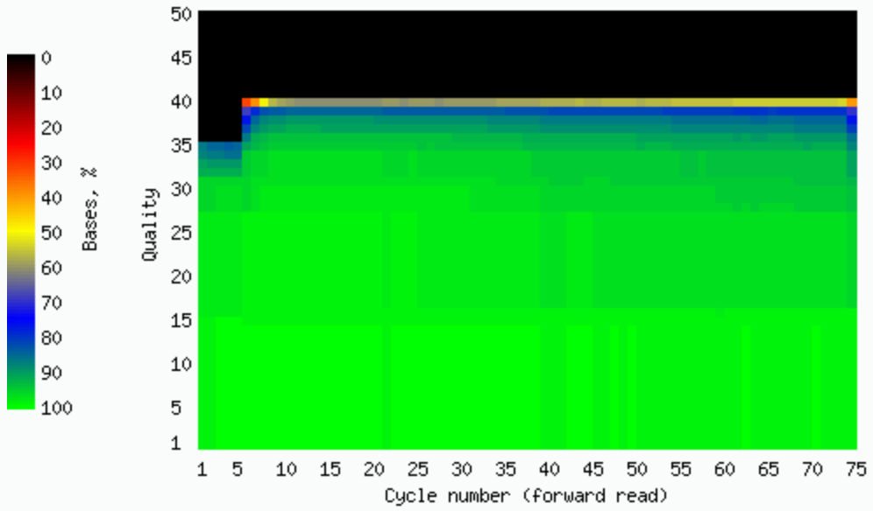
Analysis – In-house sequencing QC

Slide 26
Analysis – FastQC (+ multiqc)
Sequence quality
Sequence content
GC content
N content
Duplication
Overrepresentation
Adapter content

Slide 27
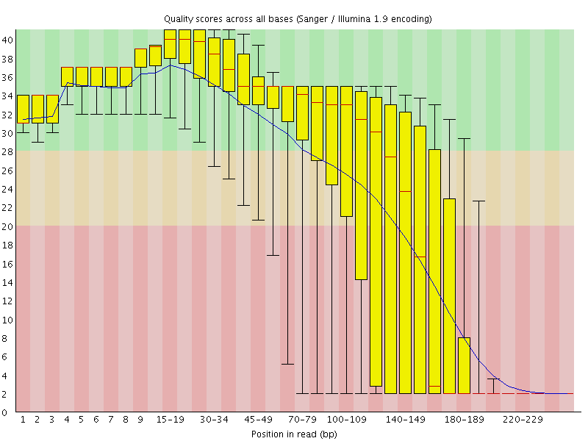
Analysis – Improving read quality
Trim low quality bases
Remove adapters
Error correction
e.g. Trim Galore! (cutadapt wrapper)

Slide 28
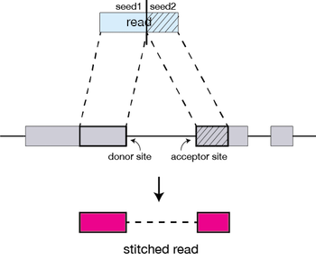
Analysis – Alignment
Good zebrafish reference genome
Splice-aware aligner
Annotation optional
e.g. TopHat2, HISAT2, STAR
Good zebrafish transcriptome
Pseudoalignment
Rapid
e.g. Salmon, kallisto
From https://hbctraining.github.io/Intro-to-rnaseq-hpc-O2/lessons/03_alignment.html

Slide 29
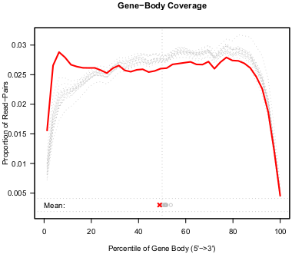
Analysis – Alignment QC
QoRTs (Quality of RNA-seq Tool-Set)

Slide 30
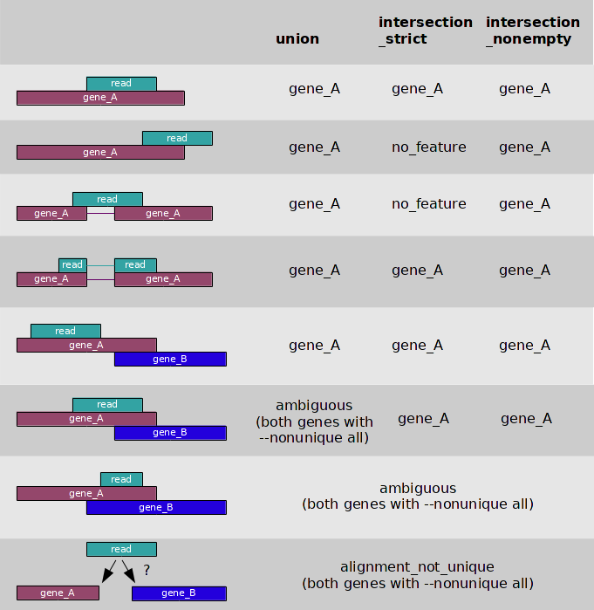
Analysis – Quantification
e.g. htseq-count, STAR

Slide 31
Analysis – Differential Expression
e.g. DESeq2, edgeR
Gene | p-value | Adjusted p-value | Log₂ fold change
ENSDARG00000068969 | 5.13E-16 | 9.95E-13 | 4.296634713
ENSDARG00000071662 | 2.31E-25 | 8.20E-22 | 5.367426329
ENSDARG00000031885 | 2.60E-23 | 7.93E-20 | 5.248888274
ENSDARG00000043196 | 7.32E-08 | 7.80E-05 | -3.715117121
ENSDARG00000075524 | 3.91E-15 | 6.94E-12 | 4.639355983
ENSDARG00000036787 | 1.22E-26 | 6.51E-23 | 4.384183256
ENSDARG00000079347 | 5.05E-08 | 5.67E-05 | -2.564399561
ENSDARG00000041381 | 4.07E-09 | 5.11E-06 | 3.220579557
ENSDARG00000070062 | 3.49E-14 | 4.97E-11 | 4.454100519

Slide 32
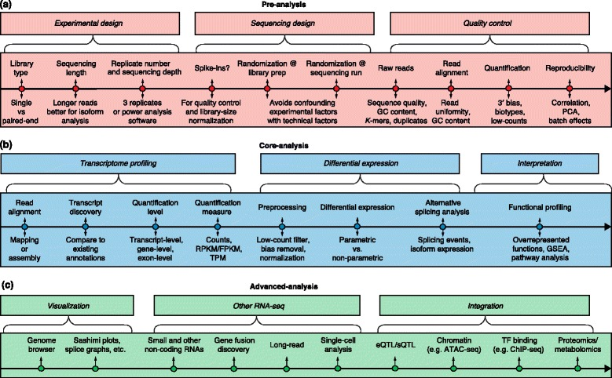
Conclusion
From Conesa et al., 2016 – “A survey of best practices for RNA-seq data analysis”

Slide 33
Thank You
Any Questions?

