Slide 1
Zebrafish Anatomical Term Enrichment

Slide 2
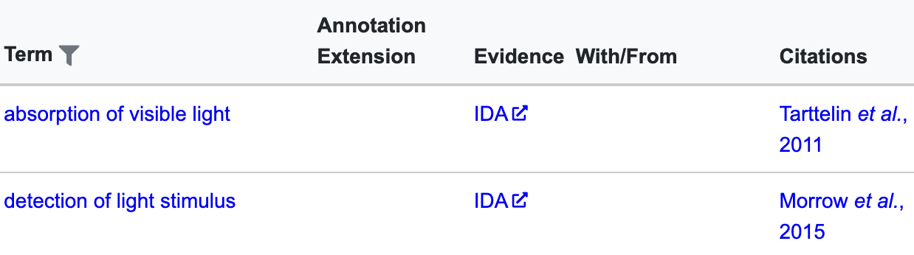
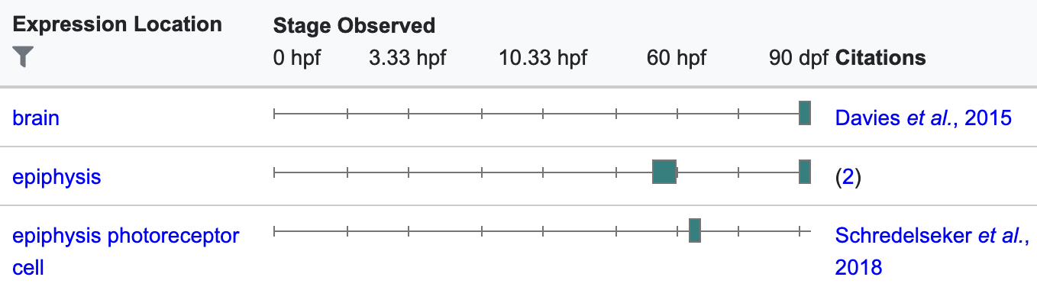
ZFIN annotation
As well as annotating genes with GO terms, ZFIN associate genes with anatomical terms (based on literature review and in situ images submitted directly)
For example, rhodopsin (https://zfin.org/ZDB-GENE-990415-271)

Slide 3
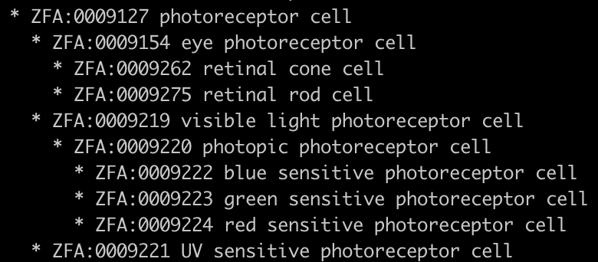
Anatomical Hierarchy
The zebrafish anatomy (ZFA) terms form a tree-like hierarchy, where each term can have children and parents

Slide 4
Anatomical Enrichment
To check for enrichment of terms, can’t just check each term as if they are independent of each other
They aren’t, so you’ll get spurious enrichments for some child terms of terms that are significantly enriched
Instead check for enrichment of a term in the context of the genes annotated to the term’s parents

Slide 5
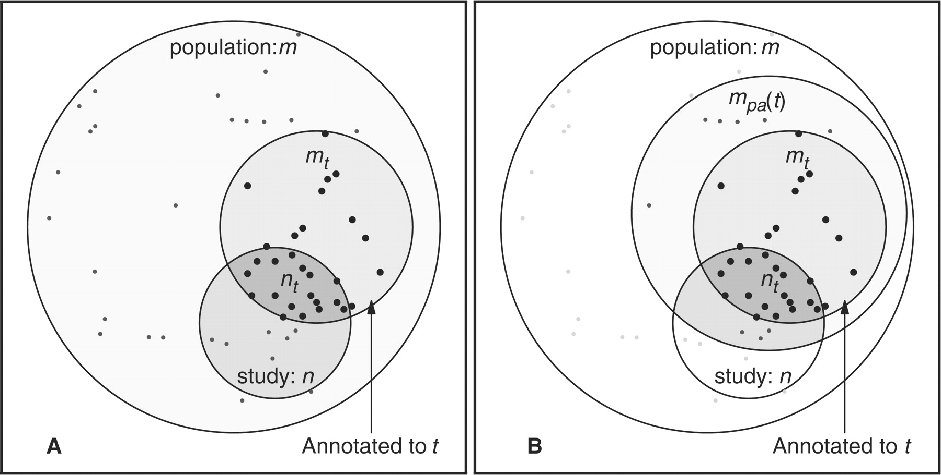
Anatomical Enrichment
From Grossman et al, 2007

Slide 6
Files
Need zfin.txt file linking ZFIN gene IDs to ZFA terms: https://funcgen2022.buschlab.org/downloads/zfin.txt
And zfa.obo file describing all ZFA terms: https://funcgen2022.buschlab.org/downloads/zfa.obo
http://ontologizer.de/ is software for testing enrichment of ontology terms
Need Ontologizer.jar file: https://funcgen2022.buschlab.org/downloads/Ontologizer.jar
All files are also available on ”penelopeprime”

Slide 7
How Files Made
wget https://raw.githubusercontent.com/cerivs/zebrafish-anatomical-ontology/master/zfa.obo
wget http://zfin.org/downloads/phenoGeneCleanData_fish.txt
wget http://zfin.org/downloads/wildtype-expression_fish.txt
wget http://ontologizer.de/cmdline/Ontologizer.jar
cut -f3,4,8,13,17 phenoGeneCleanData_fish.txt | grep ZDB-GENE- | awk '{ print $1 "\t" $2 "\n" $1 "\t" $3 "\n" $1 "\t" $4 "\n" $1 "\t" $5 }' | grep ZFA: > zfin1.tmp
cut -f1,4,6 wildtype-expression_fish.txt | grep ZDB-GENE- | awk '{ print $1 "\t" $2 "\n" $1 "\t" $3 }' | grep ZFA: > zfin2.tmp
sort -u zfin1.tmp zfin2.tmp | awk '{ print "ZFIN\t" $1 "\t" $1 "\t\t" $2 "\tRef\tND\t\tC\t" $1 "\t\tgene_product\ttaxon:7955\t20220929\tZFIN" }' > zfin.txt
rm phenoGeneCleanData_fish.txt wildtype-expression_fish.txt zfin1.tmp zfin2.tmp

Slide 8
More Files
Also need a file listing all the detectable Ensembl IDs (the population set): awk -F"\t" '$3 != "NA"' Amp.counts.tsv | cut -f1 | grep ENS > population.tsv
And a file listing all the significant Ensembl IDs (the study set): awk -F"\t" '$3 < 0.05' Amp.counts.tsv | cut -f1 | grep ENS > study.tsv
Then use BioMart to convert Ensembl IDs to ZFIN IDs to make population.zfin.tsv and study.zfin.tsv

Slide 9
Best population set?
Population set should be all the genes that are detectable
Do NOT just use all the genes in the genome (which some online tools default to)
Instead either:
Use all the genes that are above some threshold number of counts (with 1 count not being unreasonable)
If you’re using DESeq2, use all the genes that haven’t been subjected to independent filtering (i.e. those that don’t have “NA” for their adjusted p-value)
See http://bioconductor.org/packages/devel/bioc/vignettes/DESeq2/inst/doc/DESeq2.html#independent-filtering-of-results for more info on independent filtering

Slide 10
Run Ontologizer
java -jar Ontologizer.jar -a zfin.txt -g zfa.obo -c Parent-Child-Union -m Bonferroni -p population.zfin.tsv -s study.zfin.tsv
Will produce a file called table-study.zfin-Parent-Child-Union-Bonferroni.txt containing all the ZFA terms, including significantly enriched ones

Slide 11
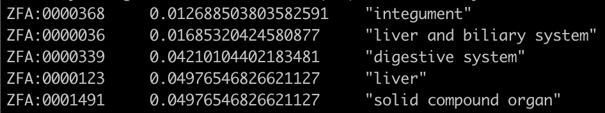
Ontologizer Output
cut -f1,11,13 table-study.zfin-Parent-Child-Union-Bonferroni.txt | awk '$2 < 0.05'

Slide 12
Thank You
Any Questions?

