Slide 1
Extra Ensembl

Slide 2
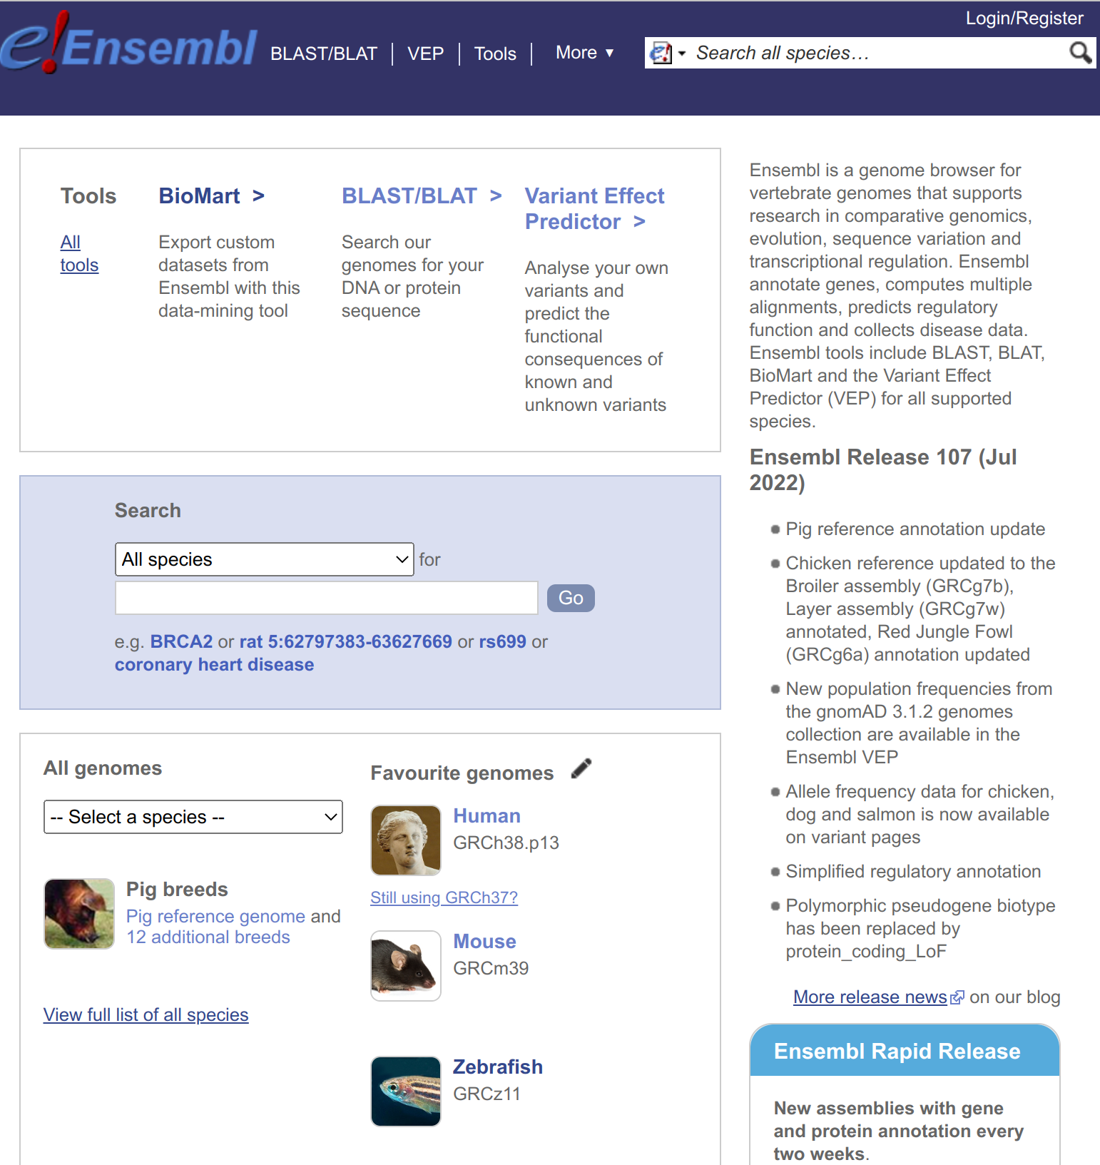
Why Ensembl?
We are biased!
But is most widely used genome browser amongst zebrafish researchers
Primary source of zebrafish annotation (UCSC imports Ensembl annotation)
Zebrafish annotation largely static between releases
But naming and homology updated (+ new functionality)
Notes:
Note zebrafish the third most commonly used organism

Slide 3
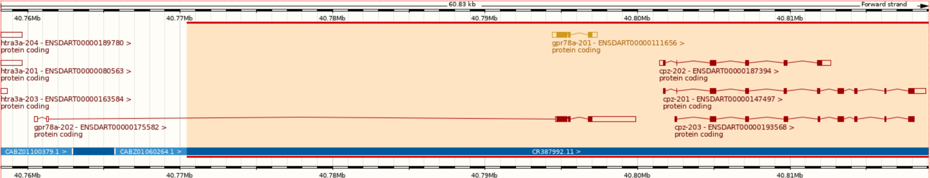
Zebrafish Genome
GRCz11 (danRer11) - latest assembly, released in 2017
Sequencing strategy:
90% clone by clone sequencing
High quality
10% whole genome shotgun sequencing
Lower quality
Fills gaps between clones
Identified by accessions beginning with CABZ
Notes:
Note good transcript on clone sequence, but spindly transcript with intron in 5’ UTR on WGS sequence

Slide 4
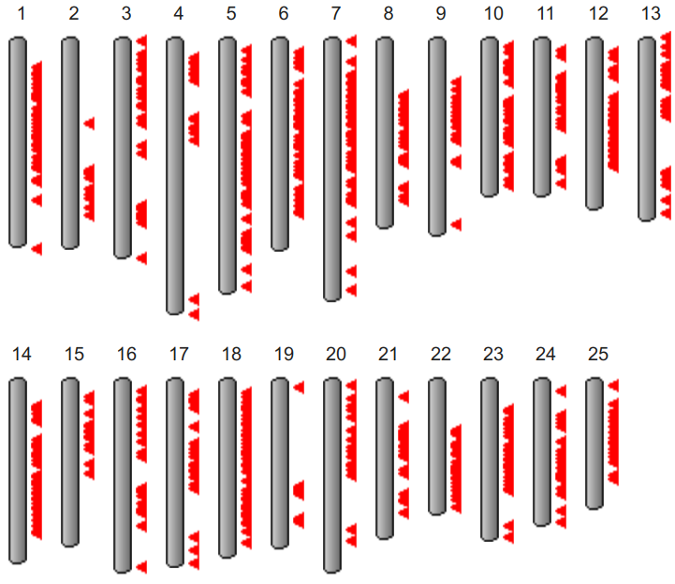
Zebrafish Genome History
Genome project started in 2001 at Sanger Institute
Initially sequenced pool of Tübingen zebrafish
But zebrafish very polymorphic compared to humans
Too much variation to join clones, so lots of gaps
+ same region represented by 2+ clones, leading to artificial duplication
Later used double haploid Tübingen fish for some clones and most WGS
Only 925 gaps between scaffolds and N50 > 7 Mbp
GRCz11 contains alternative scaffolds
From https://www.ncbi.nlm.nih.gov/grc/zebrafish
When downloading sequence from Ensembl FTP site, "toplevel" includes alternative sequence, but "primary_assembly" doesn't and is probably what you want
Notes:
N50 = measure of how contiguous genome is (50% of sequence is in contigs longer than 7 Mbp)
Ideogram shows locations of alternative scaffolds

Slide 5
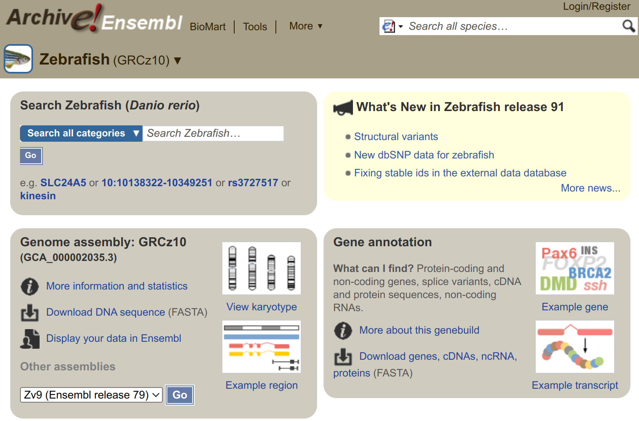
Older Assemblies
Previous assemblies available in Ensembl archives: www.ensembl.org/info/website/archives/assembly.html
GRCz10 / danRer10: http://e91.ensembl.org/
Zv9 / danRer7: http://e77.ensembl.org/
Zv8 / danRer6: http://e54.ensembl.org/
Even older assemblies available in UCSC
Numbering coordinated when GRC (Genome Reference Consortium) took over managing zebrafish assembly from Sanger Institute
Notes:
Note Ensembl archives always brown colour

Slide 6
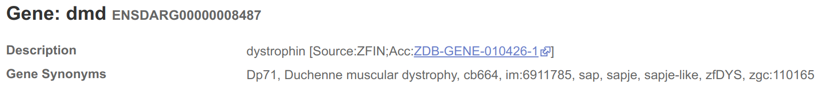
Gene Names
Names assigned to Ensembl genes automatically based on sequence similarity
Mistakes are possible
Names can change
ZFIN gene symbols (i.e. the name assigned by ZFIN) are preferred (>23,000 genes), but other databases are also used, e.g. HGNC for ~150 genes, miRBase for ~300 genes
Description indicates source of name
Genes without a match are given a name based on the sequence used to identify them, e.g AL645792.1 (clone) or CABZ01052570.1 (WGS)

Slide 7
Compara
Compara - produce Ensembl’s comparative genomics resources
Two types of analysis:
Gene level comparisons to produce gene trees, e.g. infer homologues (orthologues & paralogues)
Whole genome alignments - pairwise and multiple alignments, e.g. constrained elements and synteny
Notes:
Compara help info: https://www.ensembl.org/info/genome/compara/index.html

Slide 8
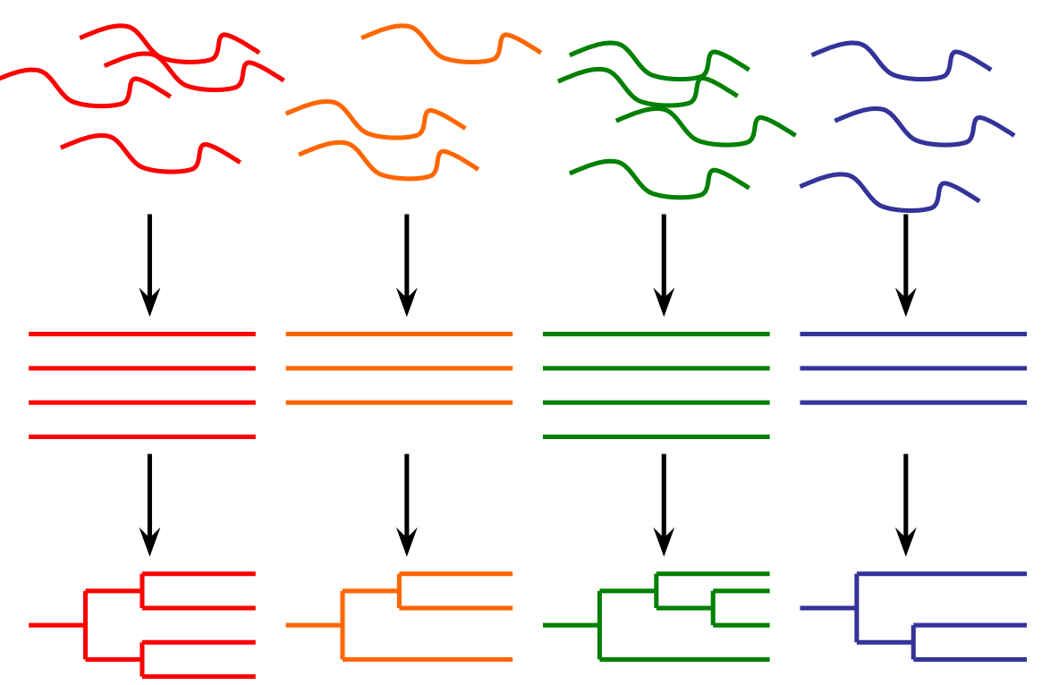
Compara - Gene Trees
Separate trees for proteins and ncRNAs (take secondary structure into account)
Process:
Take representative transcripts (e.g. longest CDS) from all genes from all species
Classify genes into clusters by TreeFam family
Build multiple alignment
Build gene tree reconciled with NCBI’s taxonomy tree
Infer orthologues and paralogues
Notes:
Note TreeFam defines gene families

Slide 9
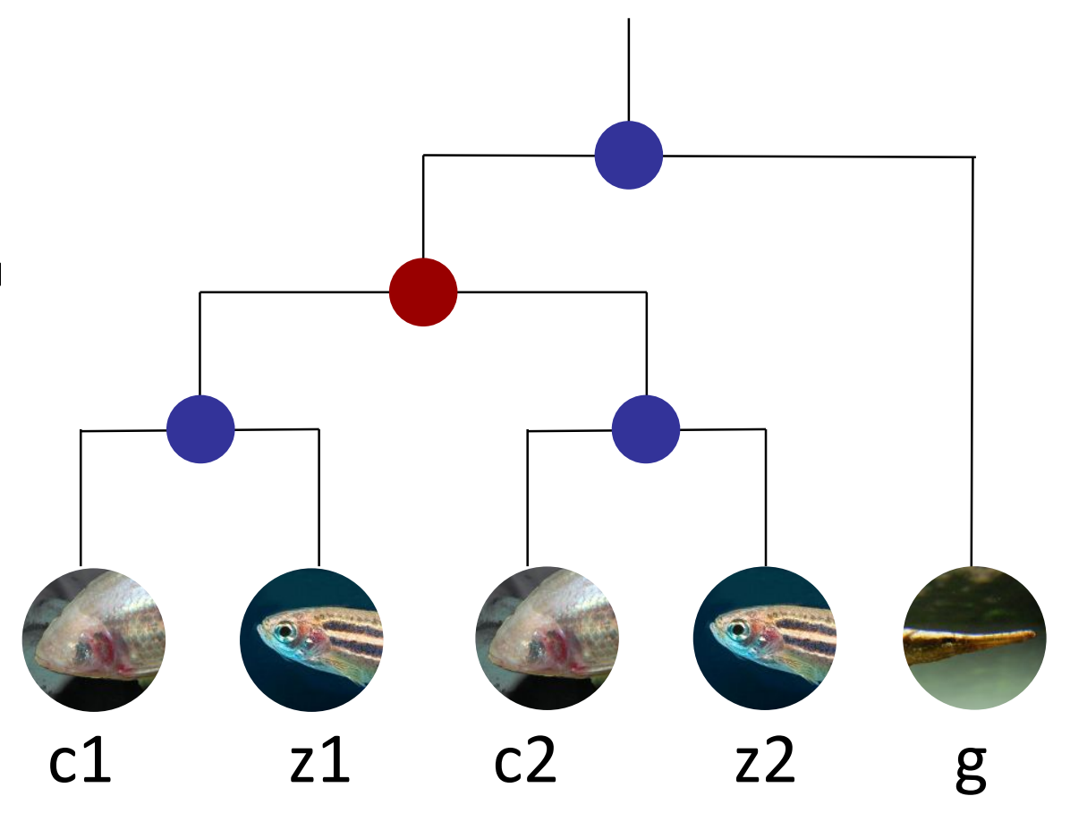
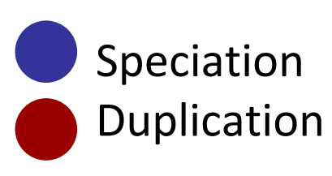
Compara - Infer Homologues (Orthologues & Paralogues)
z1 & z2 are paralogues (arose from duplication), as are c1 & c2
z1 & c1 are orthologues (arose from speciation), as are z2 & c2 + z2 & g, etc…
z1 & c1 have a one-to-one relationship
g has a one-to-many relationship to e.g. z1 and z2
Homologues labelled “high confidence” are supported by conservation of synteny or whole genome alignment blocks

Slide 10
Compara - Whole Genome Alignments
Pairwise whole genome alignments with LASTZ
Zebrafish has alignments to 64 species (plus itself)
Only human (181) and medaka (65) have more
Full list at: www.ensembl.org/info/genome/compara/analyses.html
Multiple genome alignments with EPO (Enredo, Pecan, Ortheus)
Zebrafish is in 2 alignments (out of 11 in Ensembl) - one of 39 fish and one of 65 fish
For lists of species, see: www.ensembl.org/info/genome/compara/multiple_genome_alignments.html

Slide 11
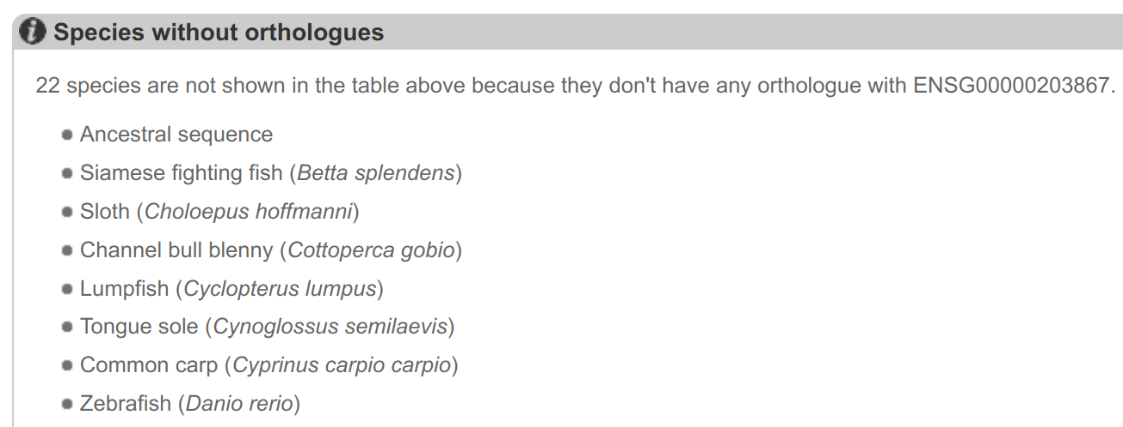
Synteny Example
No zebrafish orthologue listed for human RBM20 gene (ENSG00000203867)

Slide 12
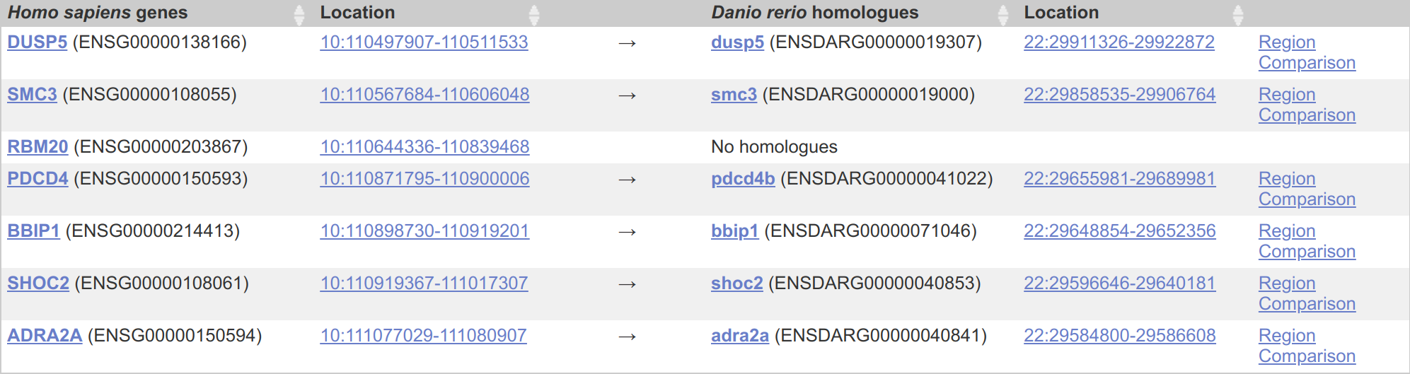
Synteny Example
If we look at the region around RBM20 in human and then click on Synteny we see conservation of synteny with zebrafish chr22

Slide 13
Synteny Example
If we look at the chr22 region in zebrafish then all the surrounding genes are the same and RBM20 is likely to be BX649294.1

Slide 14
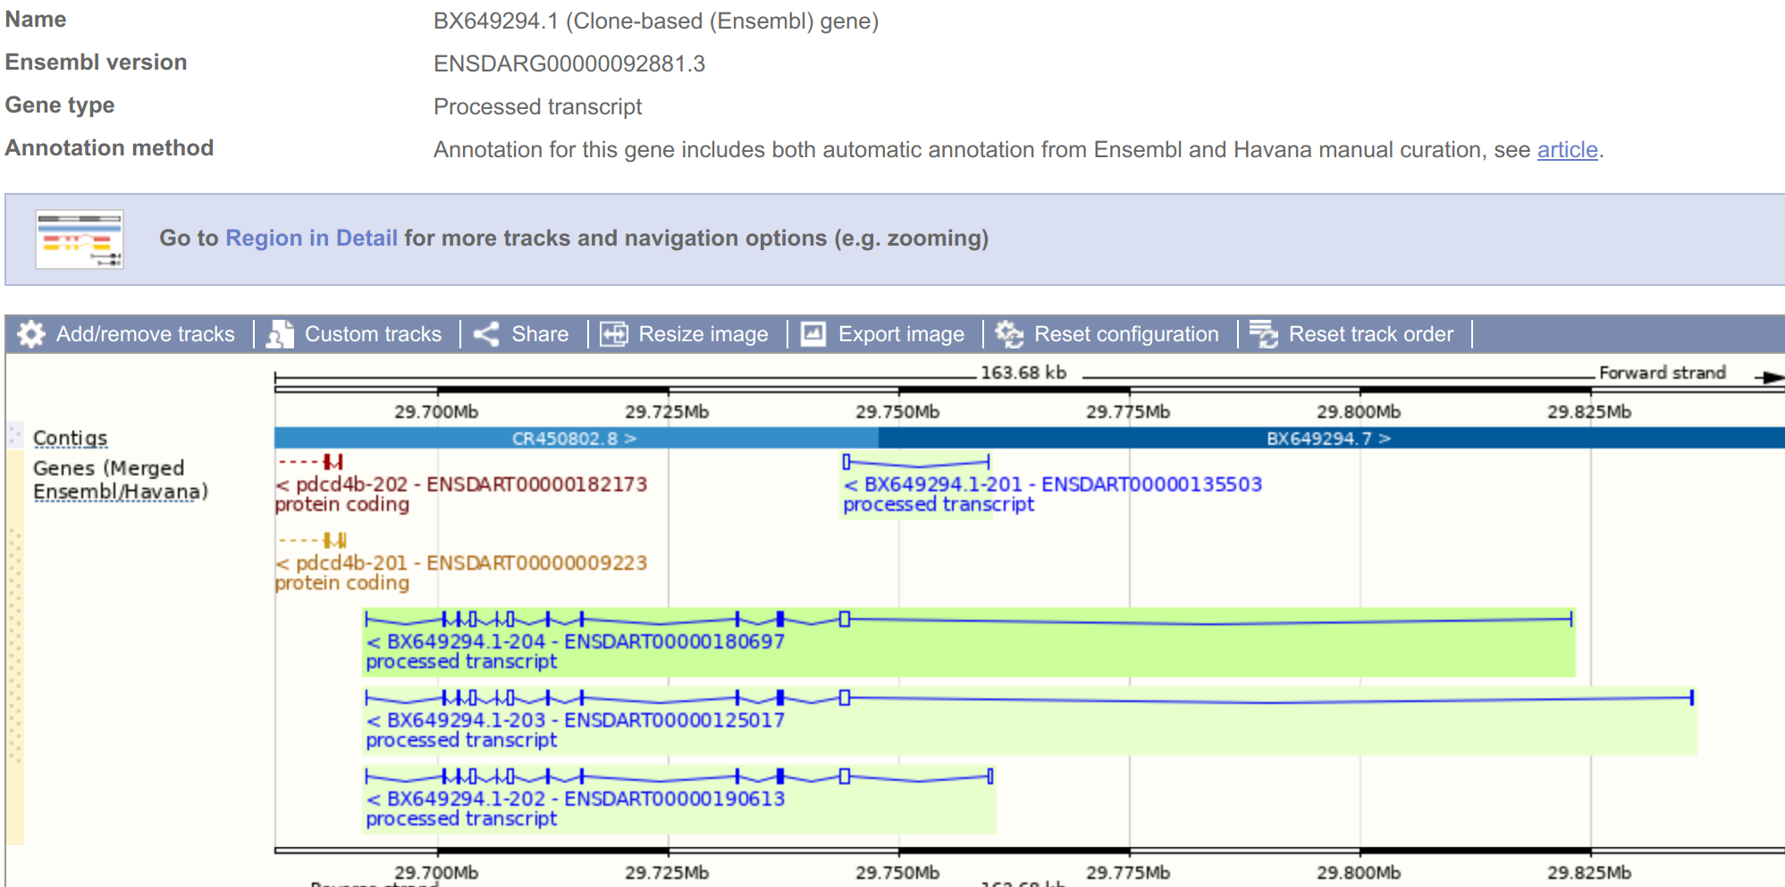
Synteny Example
Erroneously labelled as processed transcript and so not in protein gene tree, so not labelled as orthologue or named by orthology

Slide 15
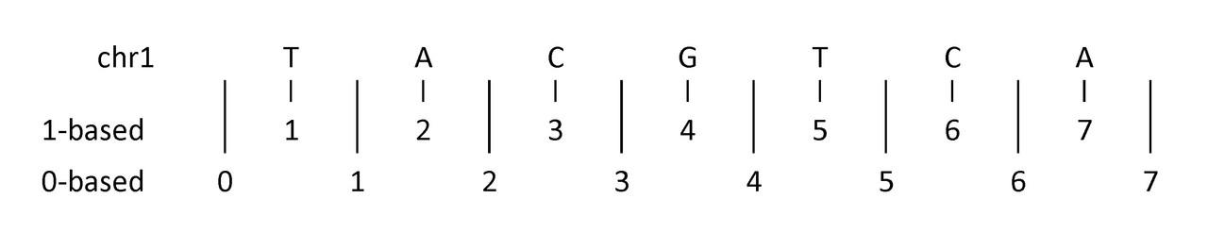
UCSC & Ensembl Differences
Ensembl: 1 UCSC: chr1
Ensembl: 1-based coordinates (bases numbered) UCSC: 0-based coordinates (numbers between bases)
The G is 1:4-4 in Ensembl coordinates but 1:3-4 in UCSC

Slide 16
Thank You!
Any questions?

