Slide 1
Command Line for Data Filtering

Slide 2
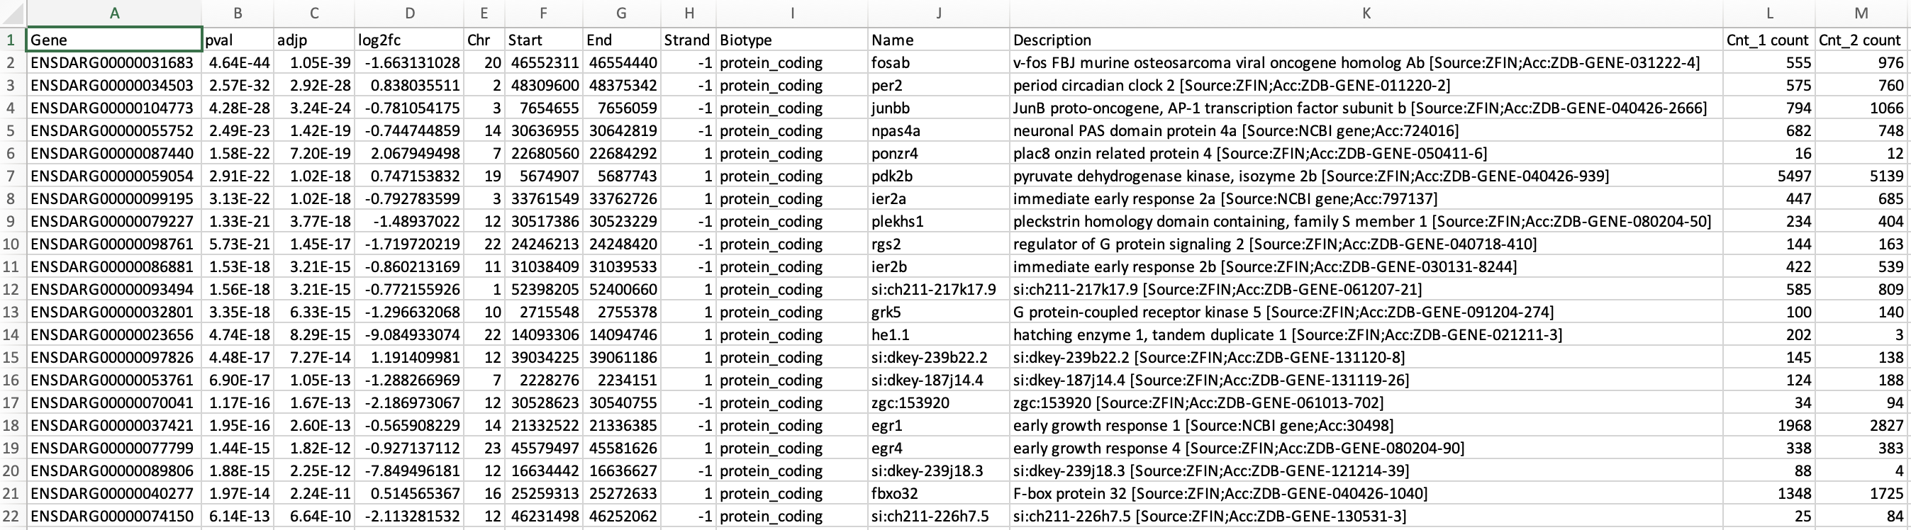
Why not just use Excel?
You can, but command line is quicker, more flexible and reproducible

Slide 3

Why not just use R?
You can, and maybe should, if you’re going to do analysis in R
But command line can be quicker if you’re filtering or reformatting data to use in another tool
R loads all data into memory first, so can be easier to filter and trim big data on command line before loading into R
Hadley Wickham and others at RStudio [CC BY-SA 4.0]

Slide 4
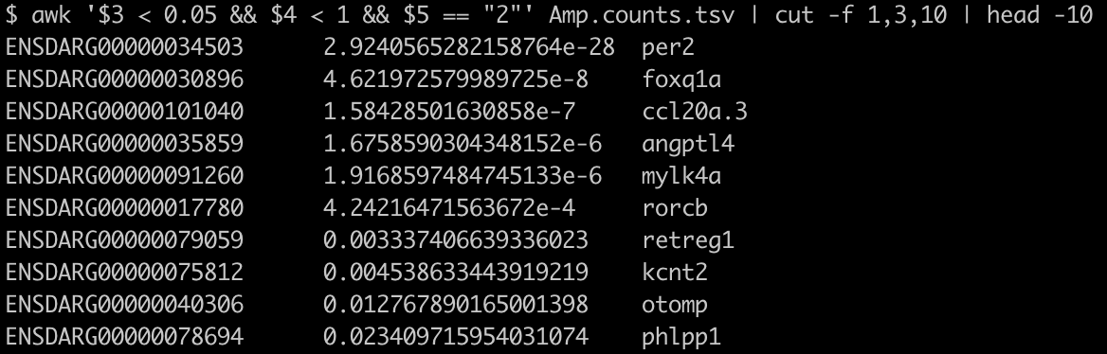
Example
Get the Ensembl ID, adjusted p-value and name of the top 10 most significantly DE genes on chromosome 2 that are down at least two-fold
awk '$3 < 0.05 && $4 < 1 && $5 == "2"' Amp.counts.tsv | cut -f 1,3,10 | head -10

Slide 5
Example data
The example files (Amp.counts.tsv and brain-development.txt) are both available on penelopeCloud
Embryos exposed to amphetamine compared to unexposed controls
Columns for Amp.counts.tsv are: Ensembl gene ID (ENSDARG), p-value, adjusted p-value, log₂ fold change, chromosome, gene start (in bp), gene end (in bp), strand (1 or -1), biotype (e.g. protein coding), name, description, counts and normalised counts

Slide 6
Other commands
Not covering commands to:
View directory contents (ls)
Change directories (cd)
Copy files or directories (cp)
Move or rename files and directories (mv)
Delete files (rm) or directories (rmdir)
To learn about these, see: https://github.com/KorfLab/unix_and_perl/blob/main/bootcamp.md
Or use the man command to find out about these or other commands, for example: man cut

Slide 7
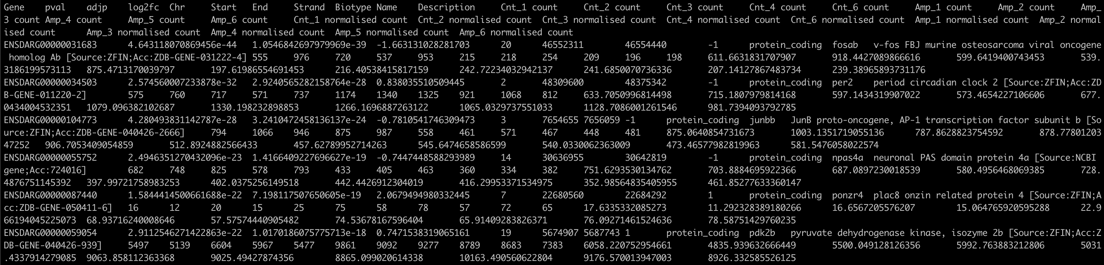
more
Look at a file a page at a time using more (or less)
e.g. more Amp.counts.tsv
Press Enter to get another line
Press Space or PgDn to see the next page
Press b or PgUp to go back a page
Press q to quit

Slide 8
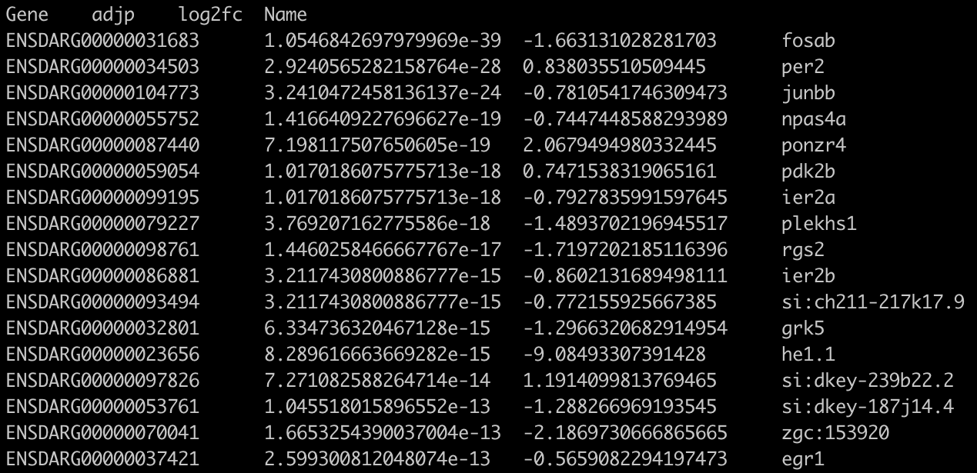
cut
View specific columns of your file using cut
e.g. cut -f1,3-4,10 Amp.counts.tsv
Will only show columns 1 (ID), 3 (adjusted p-value), 4 (log₂ fold change) and 10 (name)
-f is short for “fields”

Slide 9
Pipe
Can join two commands with a pipe |
e.g. cut -f1,3-4,10 Amp.counts.tsv | more
The output of the cut command becomes the input of the more command

Slide 10
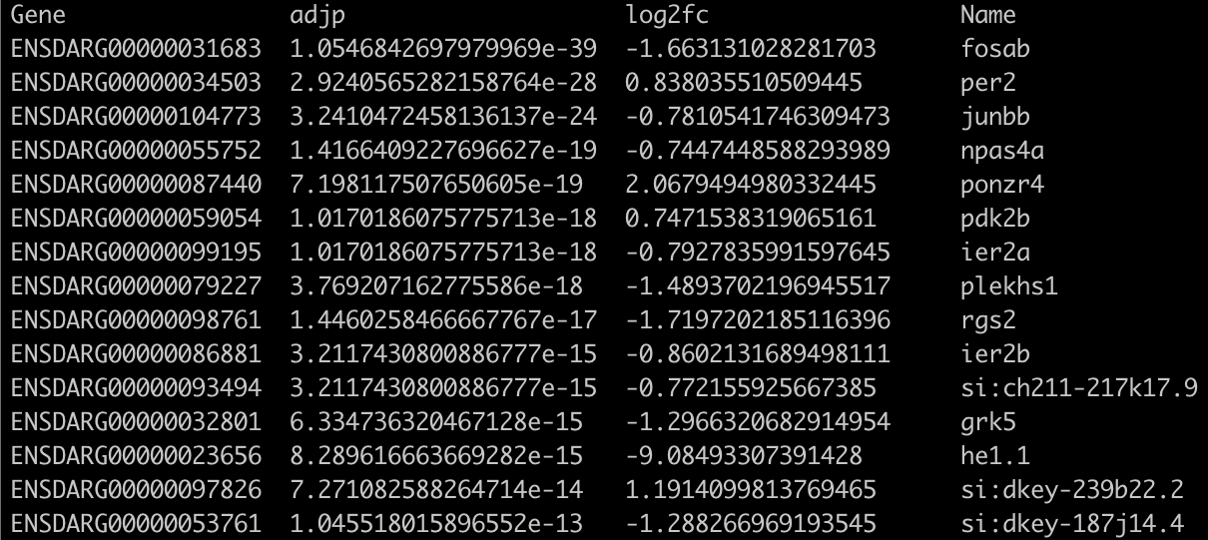
column
Can format column data tidily using column
e.g. cut -f1,3-4,10 Amp.counts.tsv | column -t | more
-t is short for “table”

Slide 11
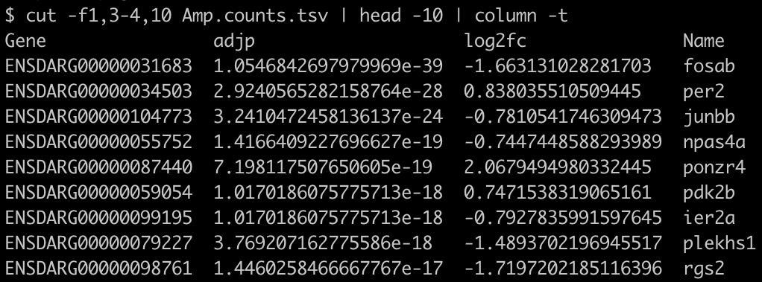
head
Can truncate data using head
e.g. cut -f1,3-4,10 Amp.counts.tsv | head -10 | column -t
Gives top 10 lines of output
Change the number to get a different number of lines

Slide 12
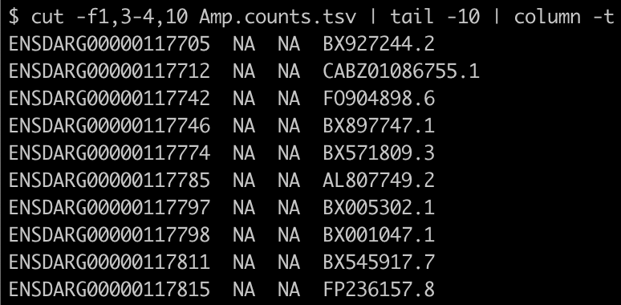
tail
Can also truncate data using tail
e.g. cut -f1,3-4,10 Amp.counts.tsv | tail -10 | column -t
Gives last 10 lines of output
Change the number to get a different number of lines

Slide 13
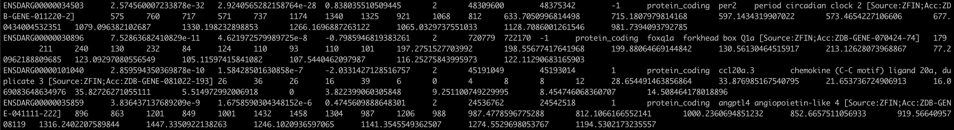
AWK
AWK is a powerful command line tool used for text processing
Can filter based on a specific column
awk -F"\t" '$4 > 0' Amp.counts.tsv | more (get “up” genes)
awk -F"\t" '$5 == "2"' Amp.counts.tsv | more (get genes on chromosome 2)
-F"\t" tells AWK that the file is delimited with tabs
$4 is the 4th column; == checks for equality (whereas = indicates assignment)

Slide 14
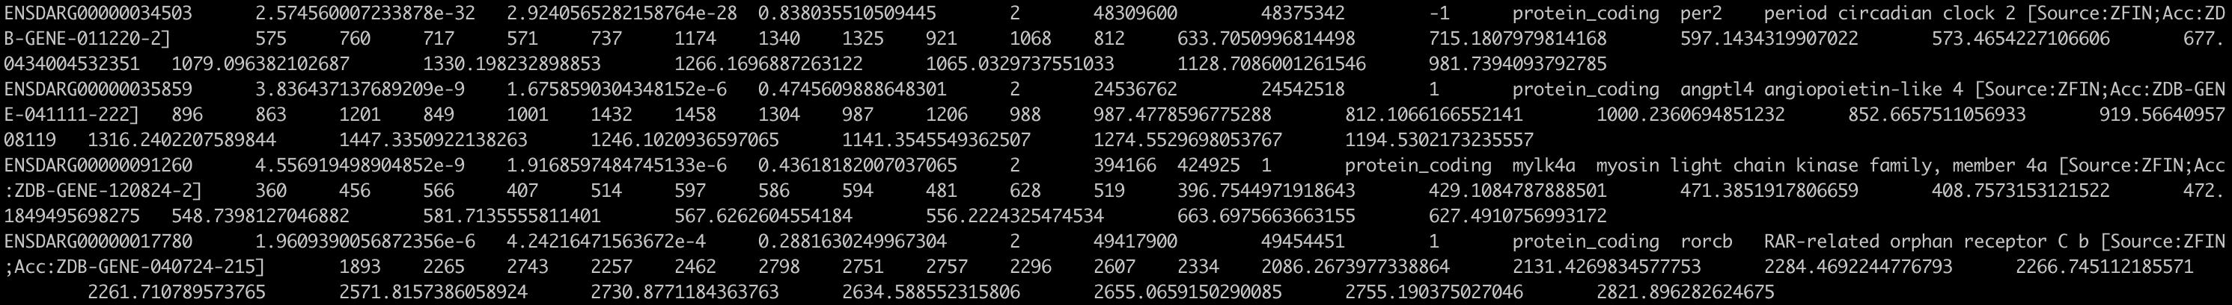
Filtering on multiple columns with AWK
Could just pipe two AWK commands together: awk -F"\t" '$4 > 0' Amp.counts.tsv | awk -F"\t" '$5 == "2"' | more
But can combine terms with &&: awk -F"\t" '$4 > 0 && $5 == "2"' Amp.counts.tsv | more

Slide 15
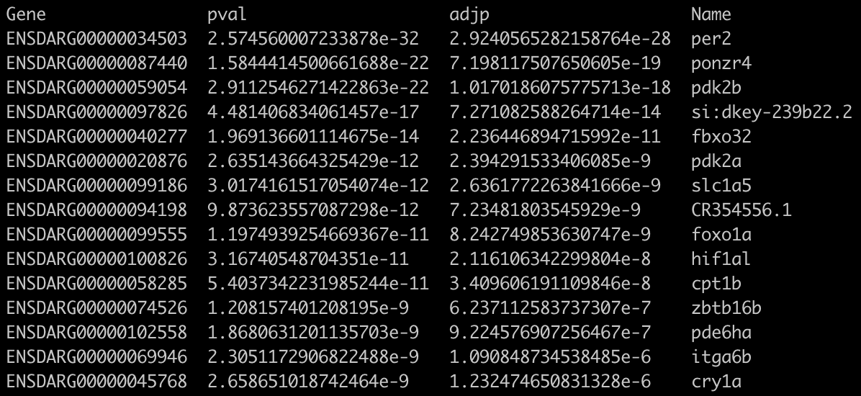
Combining AWK and cut
awk -F"\t" '$4 > 0' Amp.counts.tsv | cut -f1-3,10 | column -t | more

Slide 16
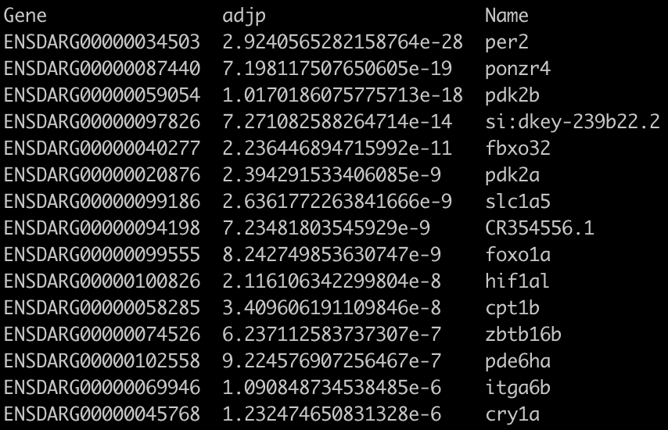
Reordering columns
awk -F"\t" '$4 > 0' Amp.counts.tsv | cut -f1,10,3 | column -t | more
Note that name column is 3rd, not 2nd, as requested - can’t reorder columns with cut

Slide 17
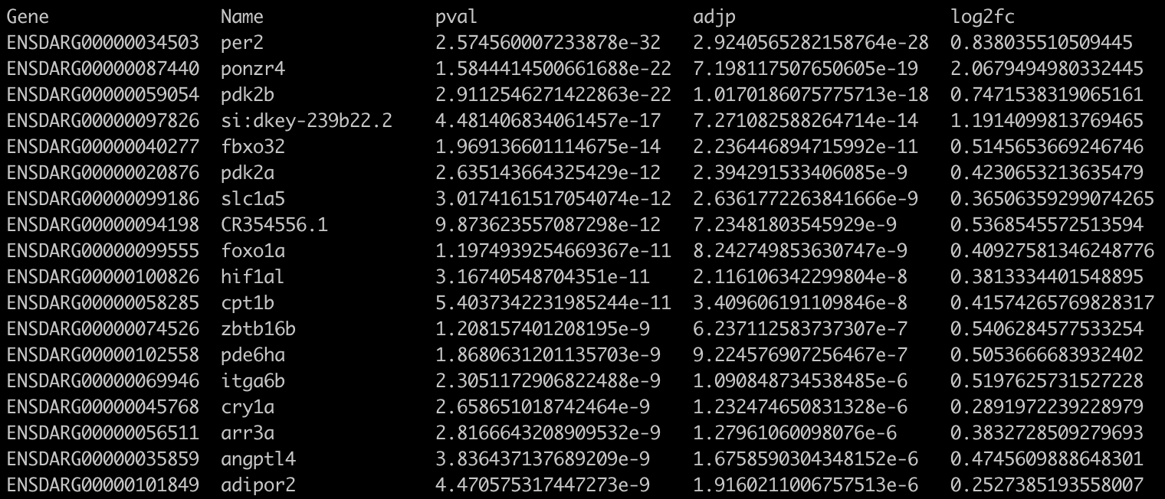
Replacing cut with AWK
awk -F"\t" '$4 > 0 { print $1 "\t" $10 "\t" $2 "\t" $3 "\t" $4 }' Amp.counts.tsv | column -t | more (can change order of columns, but can’t do ranges)
"\t" indicates a tab should be printed

Slide 18
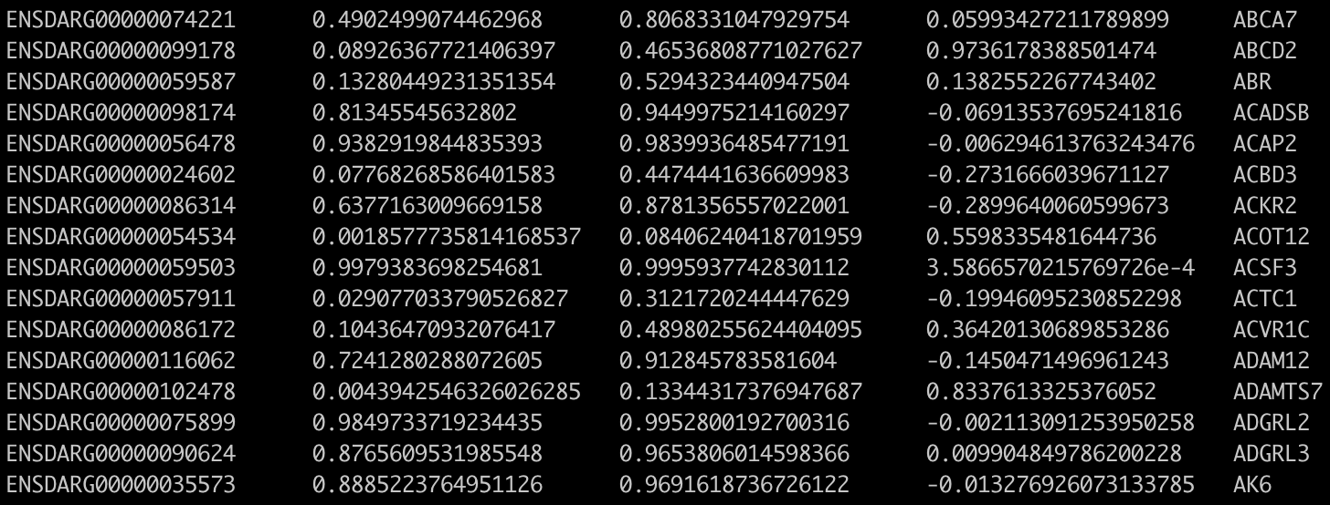
sort
Reorder data using sort
cut -f1-4,10 Amp.counts.tsv | sort -k5 | more
-k5 means sort by the 5th column (name)

Slide 19
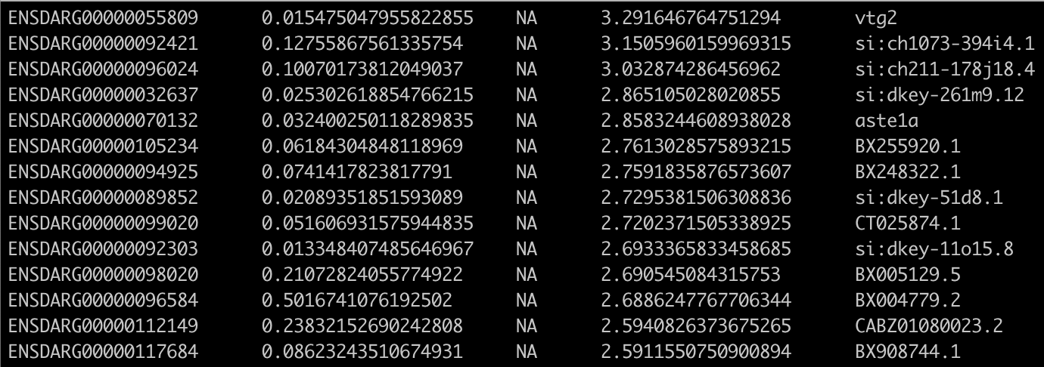
More sort
cut -f1-4,10 Amp.counts.tsv | sort -r -g -k4 | more
-g means sort numerically
-r means reverse the order

Slide 20
grep
Extract data by search term using grep
grep ENSDARG00000068567 Amp.counts.tsv
grep shh Amp.counts.tsv

Slide 21
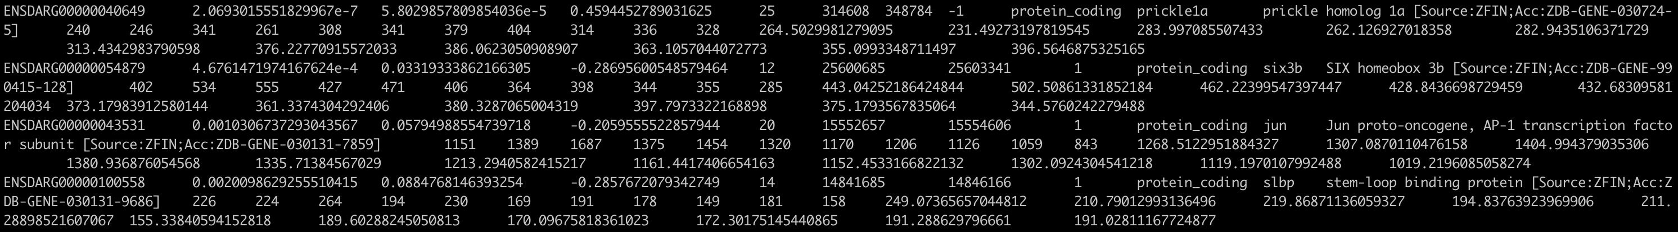
More grep
Extract using list of search terms
grep -f brain-development.txt Amp.counts.tsv | more
-f is short for “file”

Slide 22
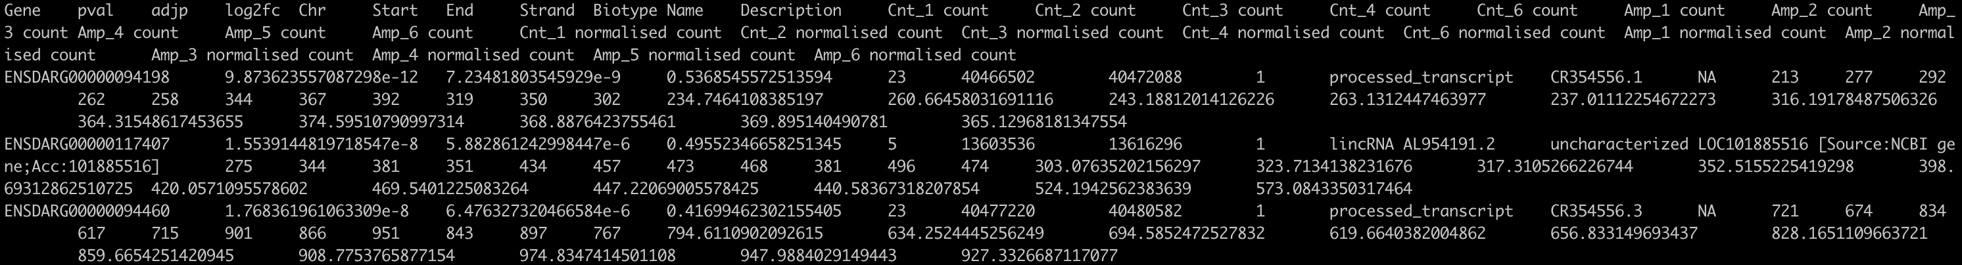
Even more grep
Exclude lines that match a search term
grep -v protein_coding Amp.counts.tsv
grep -v log2fc Amp.counts.tsv
-v is short for “inVert”

Slide 23
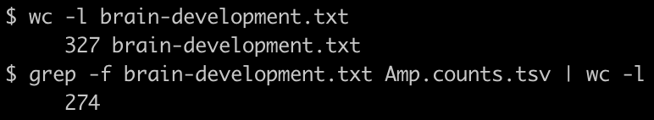
wc
wc stands for ”word count”
Count number of lines returned
wc -l brain-development.txt
grep -f brain-development.txt Amp.counts.tsv | wc -l
-l is short for “lines”

Slide 24
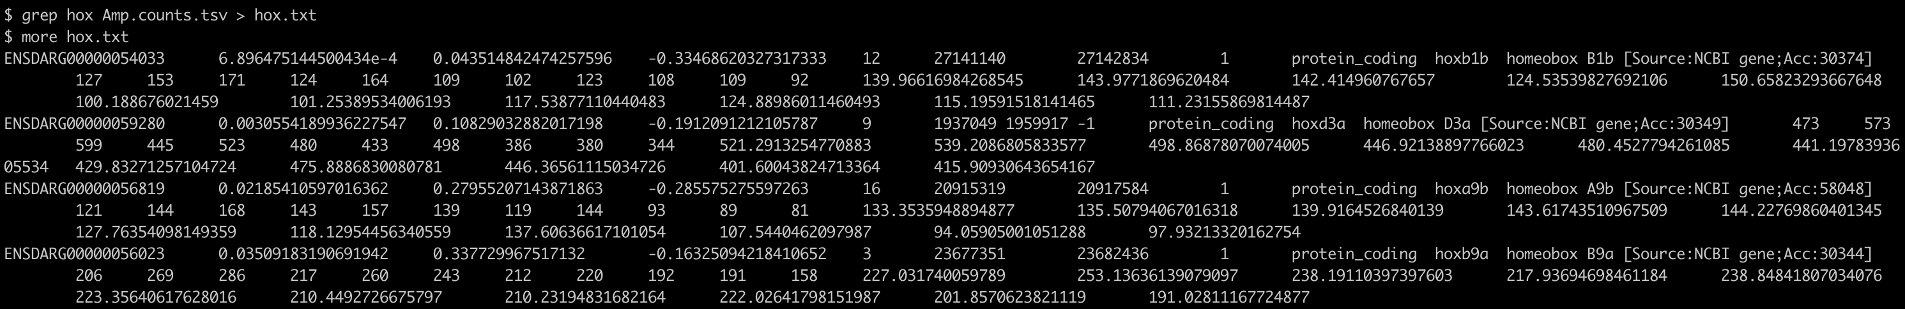
Redirecting to a file
grep hox Amp.counts.tsv > hox.txt
more hox.txt
Take care - file will be overwritten without any warning if it already exists

Slide 25
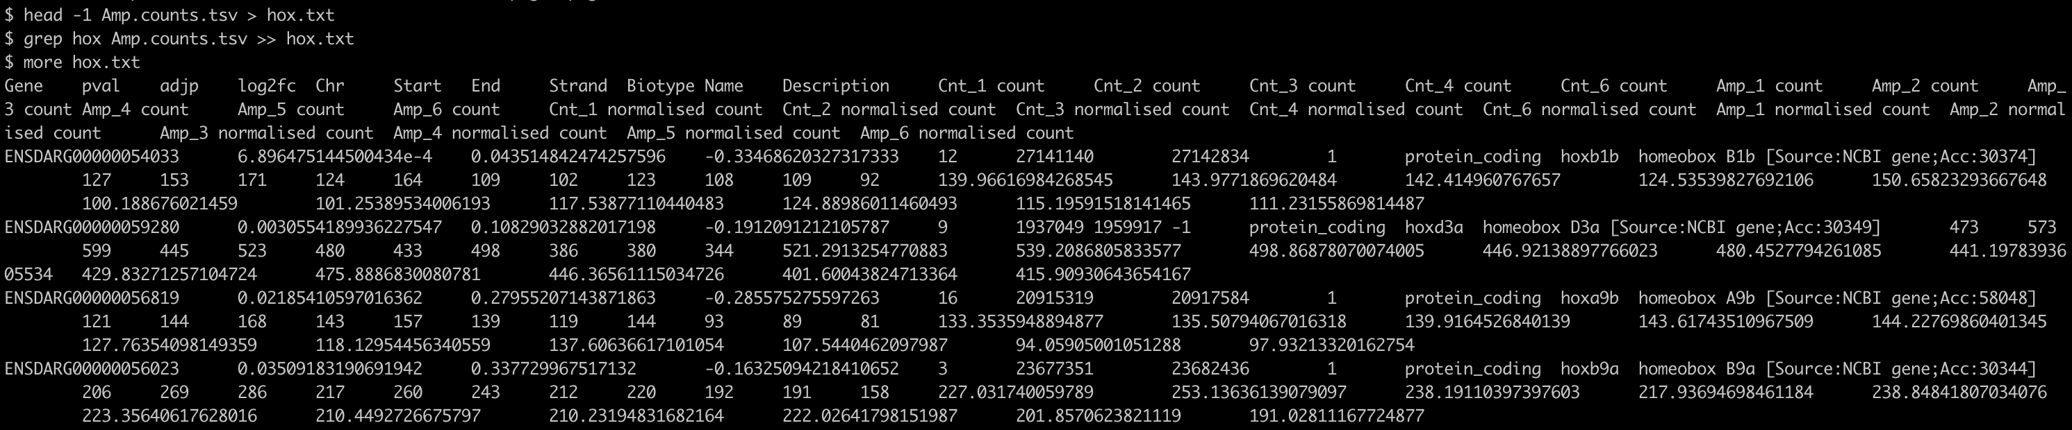
Appending to a file
head -1 Amp.counts.tsv > hox.txt
grep hox Amp.counts.tsv >> hox.txt
more hox.txt

Slide 26
Thank You
Any Questions?

