Slide 1
Web Design and Development
Principles of Project Management
Tim Priestman

Slide 2
What is a project?
What’s the difference?
Operational Work
Project Work

Slide 3
What is a project?
Operational Work – repetitive tasks – often not subject to change
Project Work – unique and one-off – about change – made up of activities (some parallel) and dependencies and

Slide 4
Definition
“ An undertaking which, via a series of planned activities is designed to achieve a particular objective by a particular time.”

Slide 5
Project Lifecycle
Concept
Definition
Implementation
Handover
Closeout

Slide 6
Concept Stage
Is it possible?
Technically
Commercially
Risk
http://www.hfl.co.uk/content/what-we-stand

Slide 7
Definition Phase
Feasibility Study
Cost benefit appraisal and risks
Authorisation and appointment of the project team
http://www.risk-doctor.com

Slide 8
Tools for Identifying Risk
Look at project concerns - subjective
SWOT analysis
PEST - political, economic, social and technical

Slide 9
Implementation Phase
There is a cycle of:
Plan
Monitor
Control
This is a continuous process.

Slide 10
Handover & Closeout
Deliverables moved to operational management structure
Final reports such as post project review

Slide 11
The Project Environment
The context of your project

Slide 12
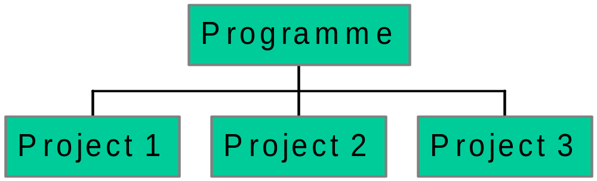
Projects, programmes & portfolios

Slide 13
Projects, programmes & portfolios
Projects are finite
Programmes focus on broader benefits being delivered
Programmes focus on external environment, cultural and social impacts
Programmes are increasingly being user to manage large scale change

Slide 14
PESTLE
Political
Economic
Social
Technical
Legal
Environmental

Slide 15
Stakeholders
High
Project Sponsor
Impact
Importance
Low
High

Slide 16
Business Case
Why is it needed
Options
Benefits
Risks
Cost and Timescale

Slide 17
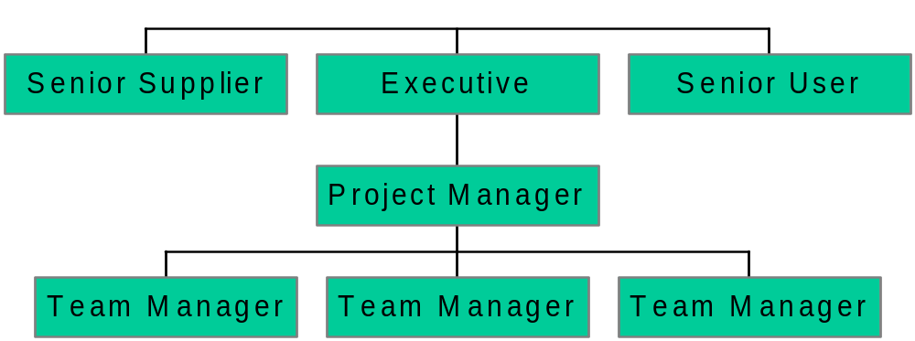
The Project Board

Slide 18
Planning a Project

Slide 19
Planning a Project
The Project Management Plan
Product Breakdown (like WBS) what are the products (deliverables) required to produce the larger product?
Assign resource (person) – person is responsible for product description – what is it (quality) why do we need it?

Slide 20
Product Flow Diagram
The sequence that shows how the product is developed
Leads on to Activity based WBS

Slide 21
Activity List
ID | Activity | Dur. | Dep.

Slide 22
Project Management Plan
Introduction and Summary
Statement of Acceptance.
Work breakdown structures
Schedule

Slide 23
Tools available
Meetings
Reports
Sign-offs
Project management tools

Slide 24
Milestones & deliverables
Points between phases - take stock and adjust
items are developed, reviewed and released (may be paper or elect.)
keep the project on track
allow for minor changes

Slide 25
Exercise
Look at the project cycle.
Identify the key deliverables and milestones.
What will they be for your project?
How does this relate to risk containment?

Slide 26
Risk Management
should take place throughout the project
management processes reduce or eliminate risk
risks can be categorised

Slide 27
Risk Management – What are the risks?

Slide 28
Tools for Identifying Risk
Look at project concerns - subjective
SWOT analysis
PEST - political, economic, social and technical

Slide 29
Exercise
Where would you expect the main risks to arise in the life-cycle?
How would you categorise them?
What are the barriers to success?
Apply those categories to your own project

Slide 30
Breakdown Structures
Work (WBS)
Organisation (OBS)
Cost (CBS)
Location (LBS)
Resources (RBS)

Slide 31
Work breakdown structure
project phases
divided into work disciplines (marketing, design)
divided into products – to fulfil discipline
Products divided into work required to complete – work packages

Slide 32
Why breakdown structures?
Identifies work required for each output (work package)
helps in planning
helps in costing

Slide 33
A Work Package
comprises one action
performance is measurable
is a manageable chunk
is unlikely to be interrupted

Slide 34
A Work package
cost and time is predictable
is owned by one person
requires the same resource throughout
May be critical or non-critical

Slide 35
Exercise
Take one part of your project and follow the diagram to create a work package
Exchange with a colleague to review.

Slide 36
Microsoft Project
Enables rapid adjustment
Clear project representation
good presentation tool - at different levels of detail

Slide 37
Exercise
Take one work package from your project. Put it into Microsoft project - use either Module 2 or 3
Review with a colleague

