Slide 1
PG Certificate in Web Design and Development
Tim Priestman
December 7th, 2013

Slide 2
Strategy
Strategy is the direction and scope of an organisation over the long term, which achieves advantage for the organisation through its configuration of resources within a changing environment and to fulfil stakeholder expectations
    Johnson & Scholes 2002 :10

Slide 3
Strategy
A plan, method, or series of actions designed to achieve a specific goal or effect. - Wordsmyth dictionary

Slide 4
Strategy
Where to compete and how to compete

Slide 5
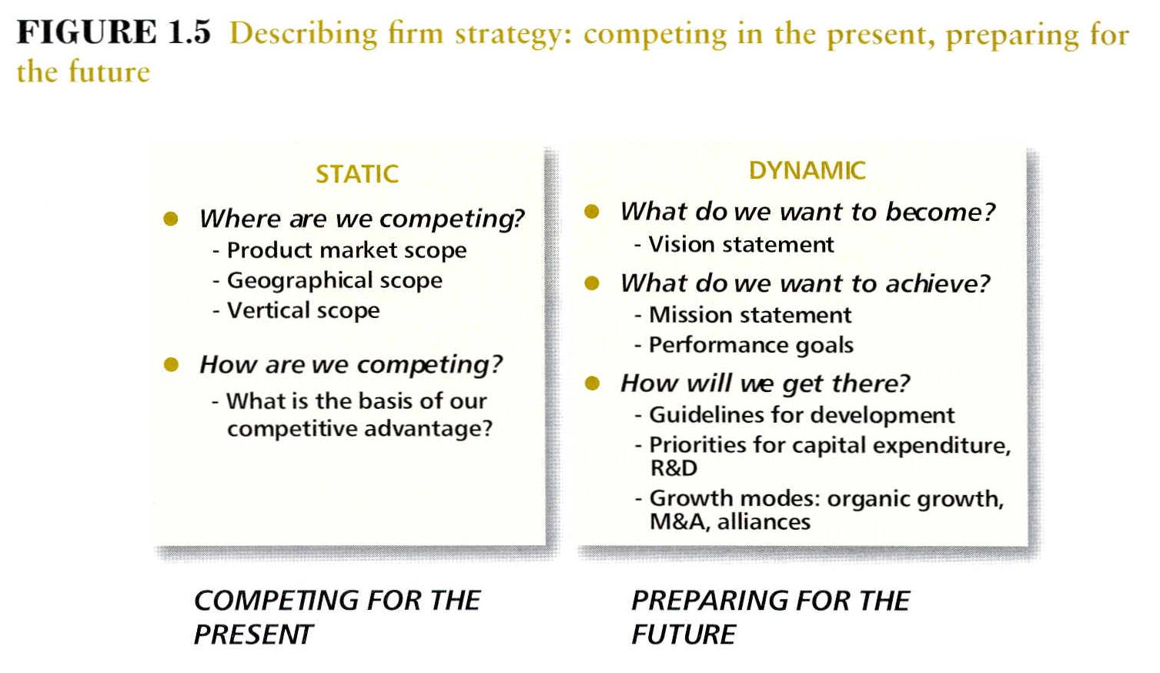

Slide 6
Strategy is the link between the firm and its environment
‘WHAT’?
Global environment
Industry dynamics
EXTERNAL
Competitive arenas
Leadership & General Management
INTERNAL
Competences
Culture
Values & Ethics
‘HOW’?
‘WHY’?

Slide 7
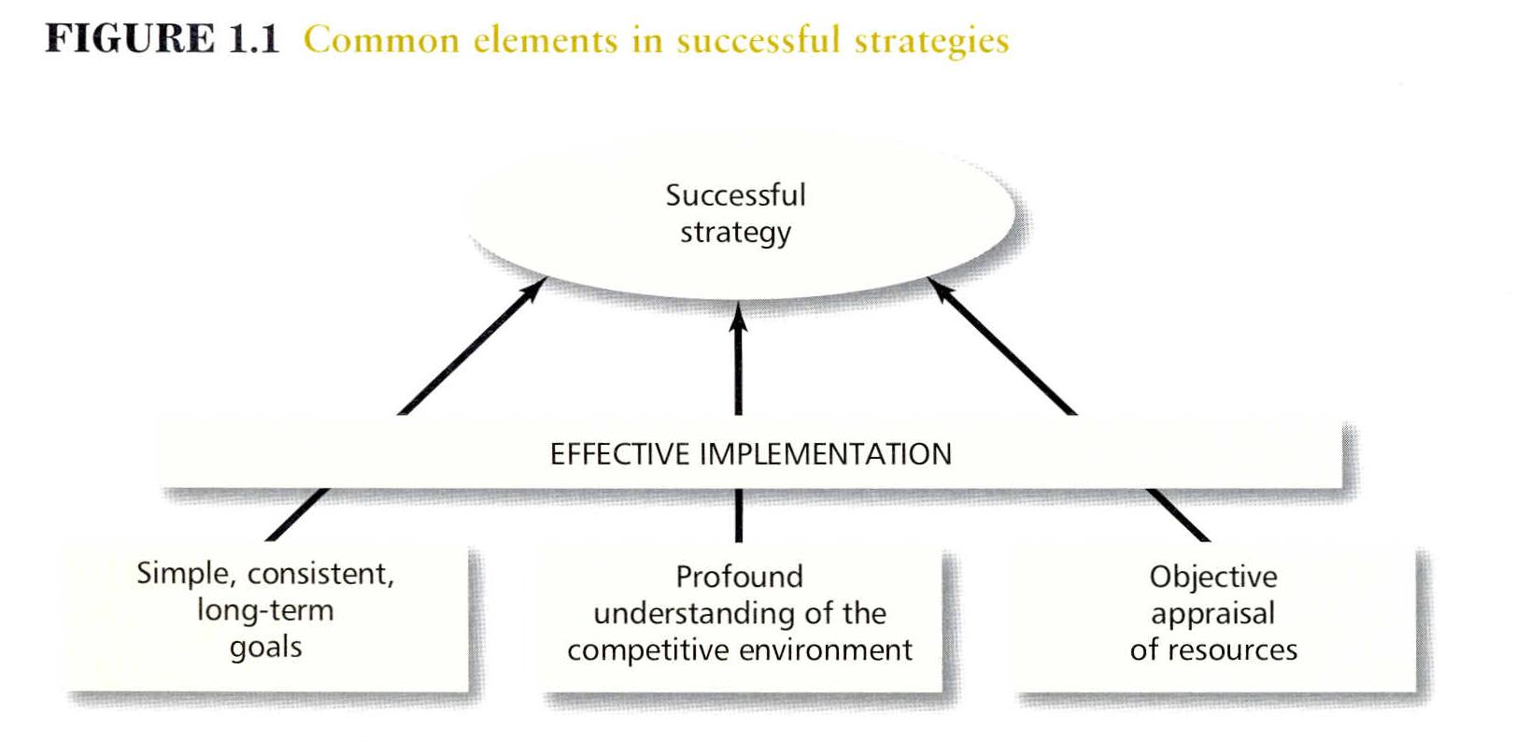

Slide 8
How is Strategy made?
Intended – top management team
Realised and
Emergent
Or: planned emergence – depending on the stability of the environment - Mintzberg

Slide 9
Roles of Strategy
Decision support – communication device
Co-ordinating device
Target

Slide 11
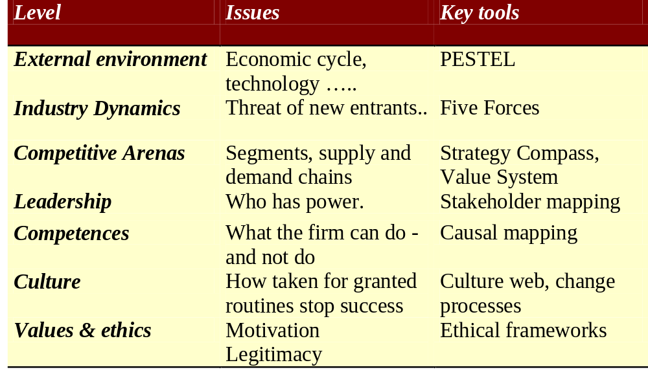
Levels, Issues and Tools

Slide 12
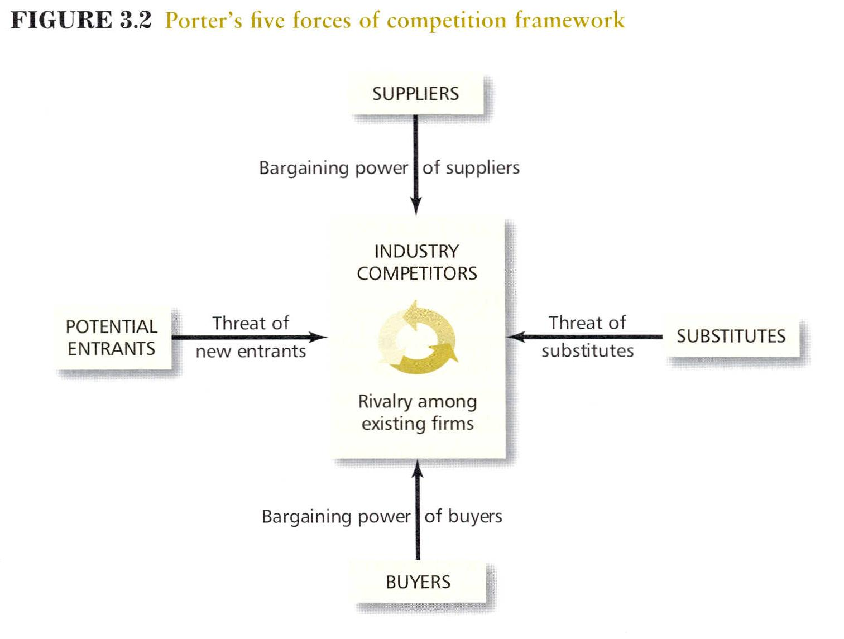
Birkbeck College 2010

Slide 13

Sport, computer games, plays, films, books, newspapers, merchandising
The media industry fills three basic human needs: the search for meaning, the search for knowledge, and the need to be entertained
Who controls it and in whose interest?

Slide 14
Case Study
Industries
Publishing, movies, manufacturers, game designers, finance, marketing, distribution, advertising, law of copyright and intellectual property
Products
Books
Films
Merchandise: toys, clothes
Computer games
Harry Potter
But even a children’s book can be political…………..

Slide 15
Harry Potter- Factors
Politics
  Author was a poor single mother. Now campaigns on the issue
Economics
  currency exchanges
Social
  attitude to witchcraft in US and UK
Technology
  internet
Environmental
  use recycled paper?
Legal/Regulations
  copyright law

Slide 16
Some Strategic Issues
Is it worth while running free chat rooms that attract bad publicity? Should we exit?
Where is value created in media? Is it through making the boxes, commissioning content, or owning the channels to market?
Are traditional daily newspapers going to disappear in the next 10 years?
Will people watch movies over the internet?
How should we react to software piracy in China?

Slide 17
Political
What type of political system
How do you influence politicians
How do you change the law or regulations?

Slide 18
Economic
What stage of the economic cycle: growth or decline? Normally analysed in terms of the main markets: China/Japan/Asia: Europe: Americas- the Triad
Currency exchange rates?
Costs of production: capital;labour;land; know-how
Business and consumer confidence?

Slide 19
Social
Demographic profile of the population
Labour mobility
Cultural attitudes: case study Bollywood versus Hollywood
Power of religion and ethical considerations

Slide 20
Technology
What technologies could affect industry over the next 5 -10 years?
Is basic science changing?
Is there a disruptive technology about to arrive?

Slide 21
Environmental
What will global warming do?
What are people’s attitude to the environment?
How does climate affect people’s behaviour?
What is the firm’s ethical position on the environment?

Slide 22
Legal
What laws and regulations affect everyone including this industry?
How will they change in the next 5- 10 years?
What are the rules of business especially in terms of ownership?

Slide 23
What will the global media industry look like in 2015?
Politics: Will the internet be more controlled? How powerful will China be?
Economics: Exchange rates, business cycle, growth in markets, cost of paper, cost of ICT
Social: Increase in leisure, older populations in America & Western Europe; younger populations in N.Africa
Technology: How powerful will computers be then?
Environmental: more recycling of paper?
Legal: Is censorship likely? Who can own media firms?

Slide 24
Stakeholder Questions
Who are the primary stakeholders?
  Owners, customers, competitors, suppliers, employees, top managers, banks
Who are the secondary stakeholders?
  Governments, natural world, other industries
What are the consequences for firm strategy?
  Who has power?

Slide 25
Stakeholders and Strategy
What strategy do you want to achieve?
Who are the key stakeholders- past, present and future?
What matters to them:
What is their attitude to your strategy?
How powerful are they?
How are they affected by the global situation?

Slide 26
Seminar Task
Who are the key stakeholders in the global media?
How will they be affected by the PESTEL analysis I carried out? What else would you add to the analysis?

