Slide 1
Sampling theory

Slide 2

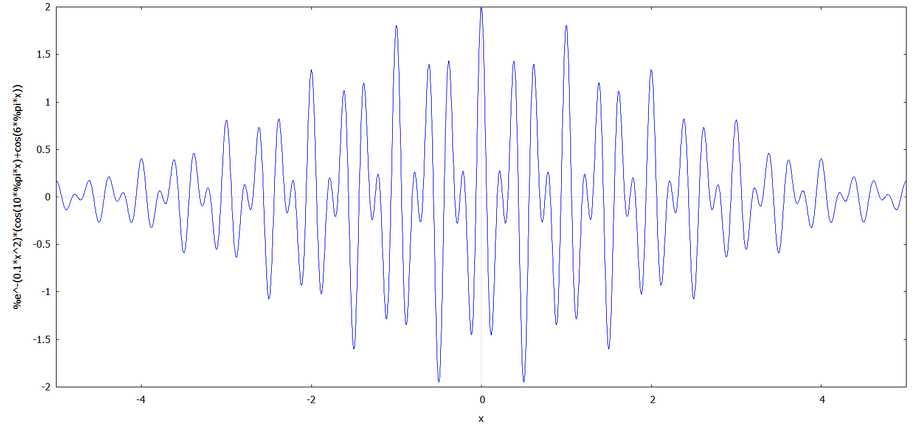
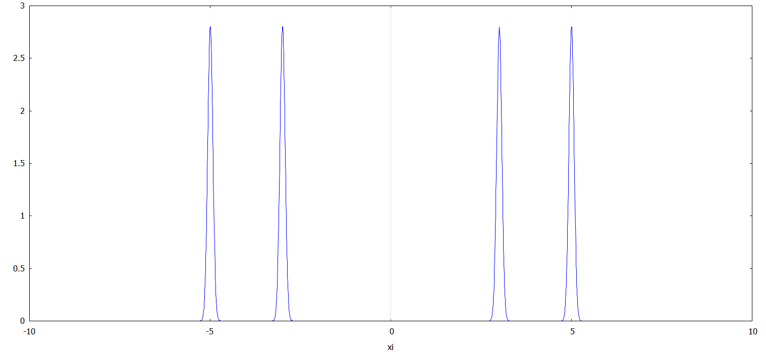
Review of Fourier analysis
Spatial domain
Fourier transform
Inverse Fourier transform
Frequency domain

Slide 3
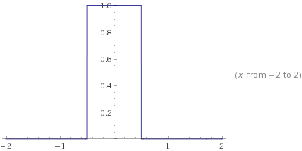
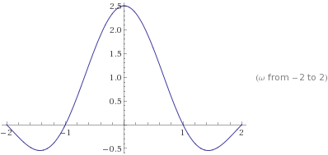
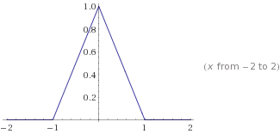
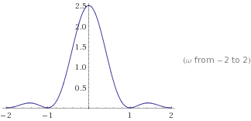
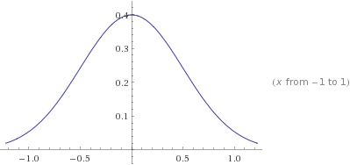
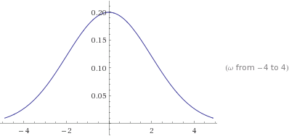
Common functions & their Fourier transform
Frequency domain
Spatial domain

Slide 4
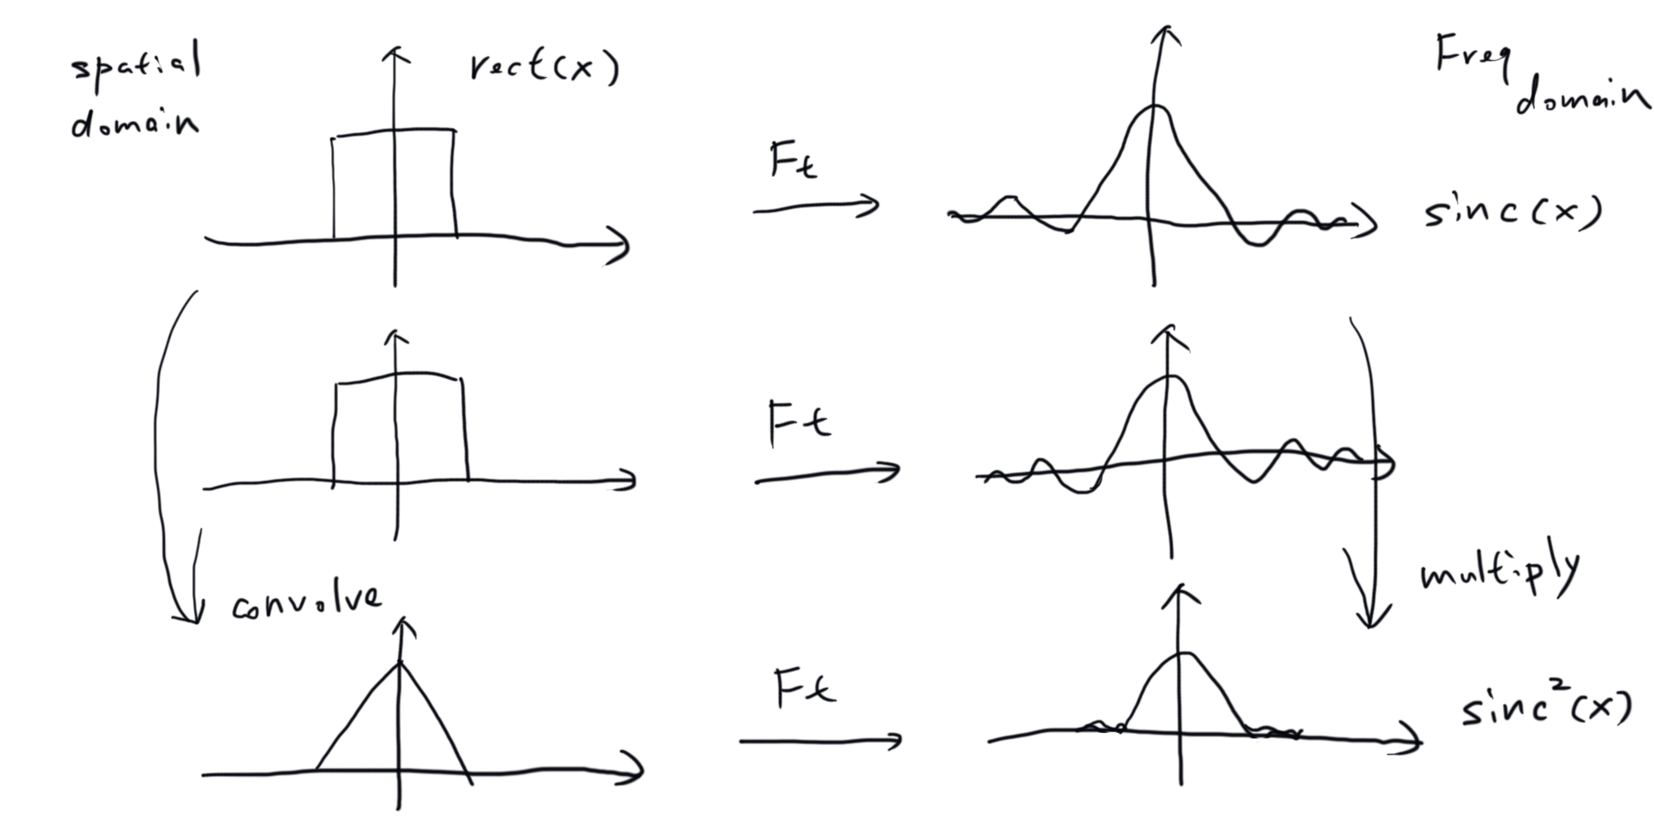
Convolution theorem

Slide 5
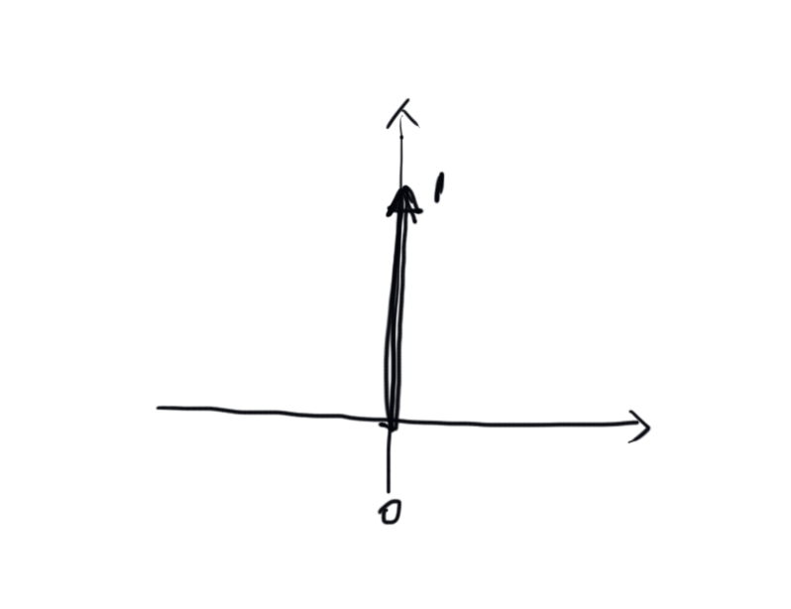
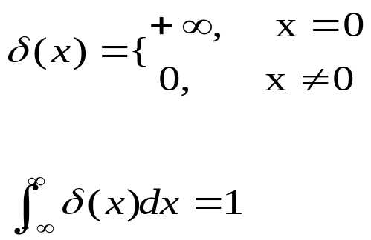
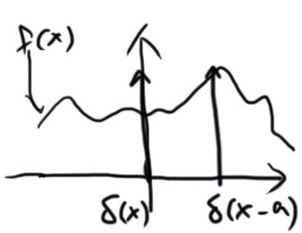
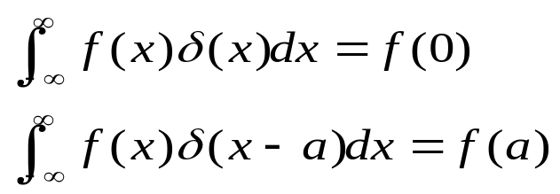
Sampling theory
Impulse function
  Or Dirac delta function
Impulse function as a measure

Slide 6
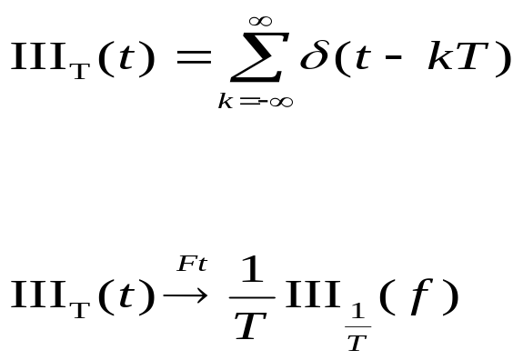
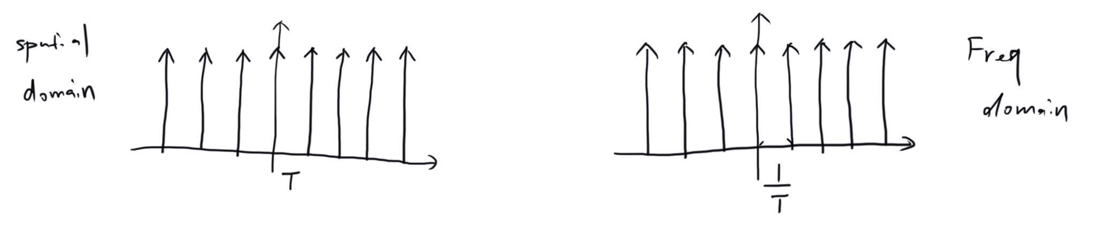
Impulse train
Or Dirac Comb, or Shah

Slide 7
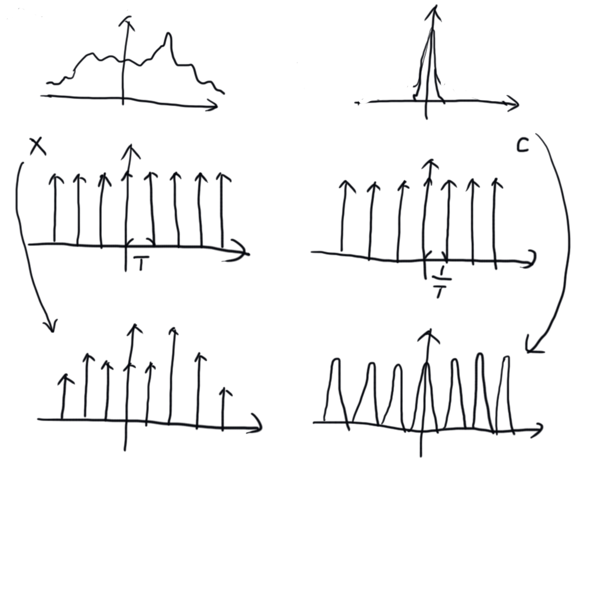
What is sampling
If signal is band limited
Frequency domain
Spatial domain

Slide 8
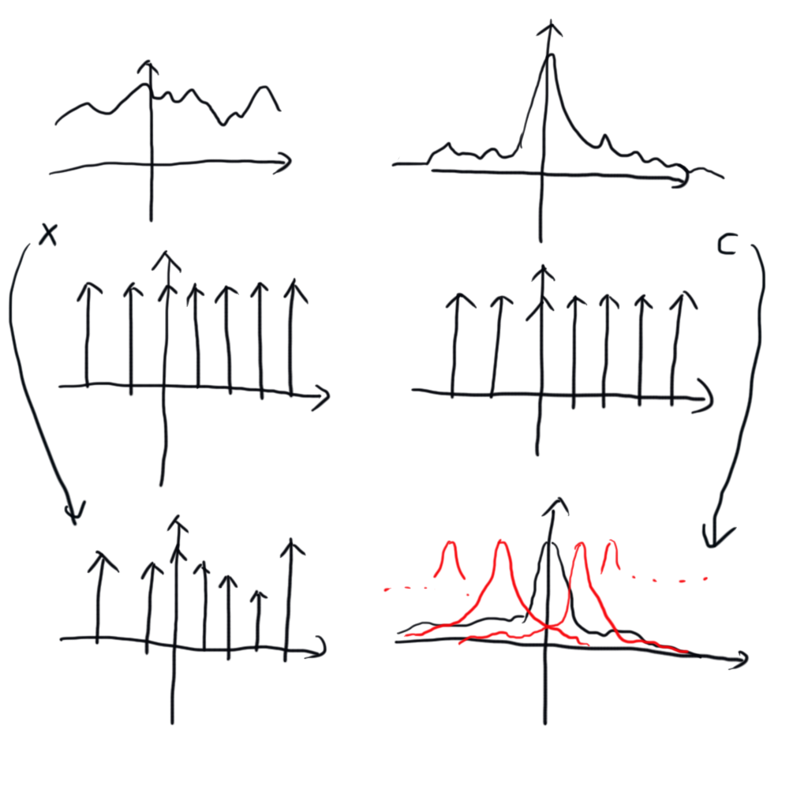
What is aliasing
In real world, signal often is not band limited

Slide 9
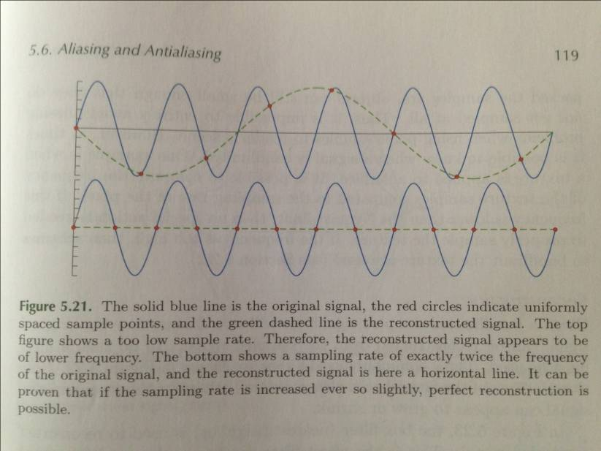
Aliasing
Sampling rate過低的狀況下，無法分辨高頻與低頻訊號，因為看起來是一樣的
在frequency domain上，高頻訊號會被混入低頻，造成reconstruction error

Slide 10
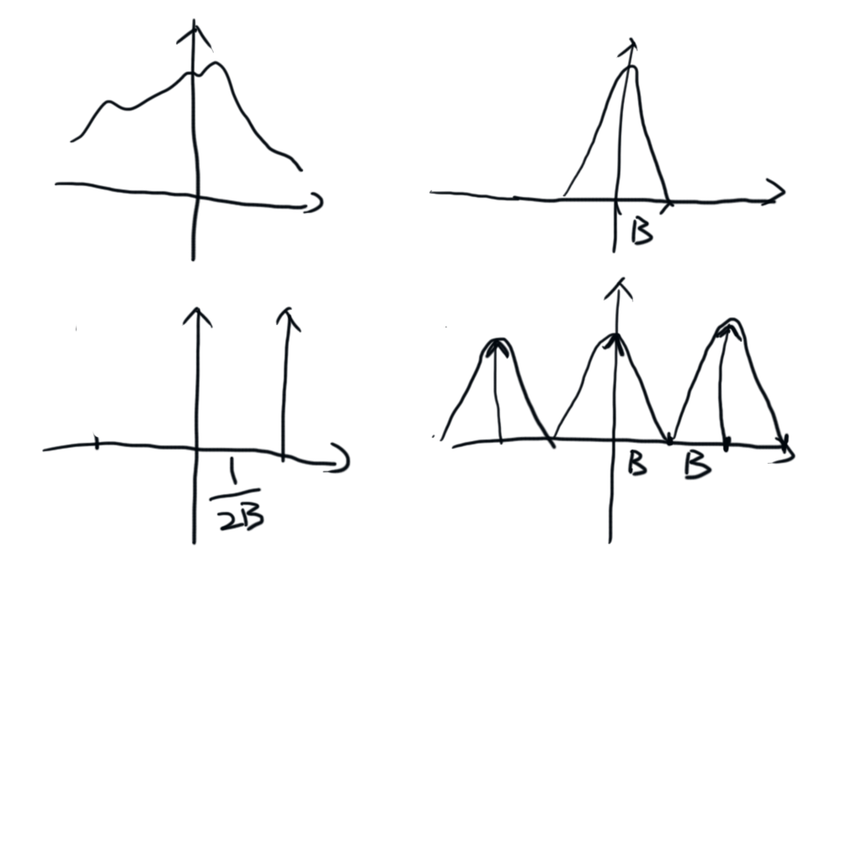
Nyquist rate
The sampling rate that we can perfectly recover the signal from the samples

Slide 11
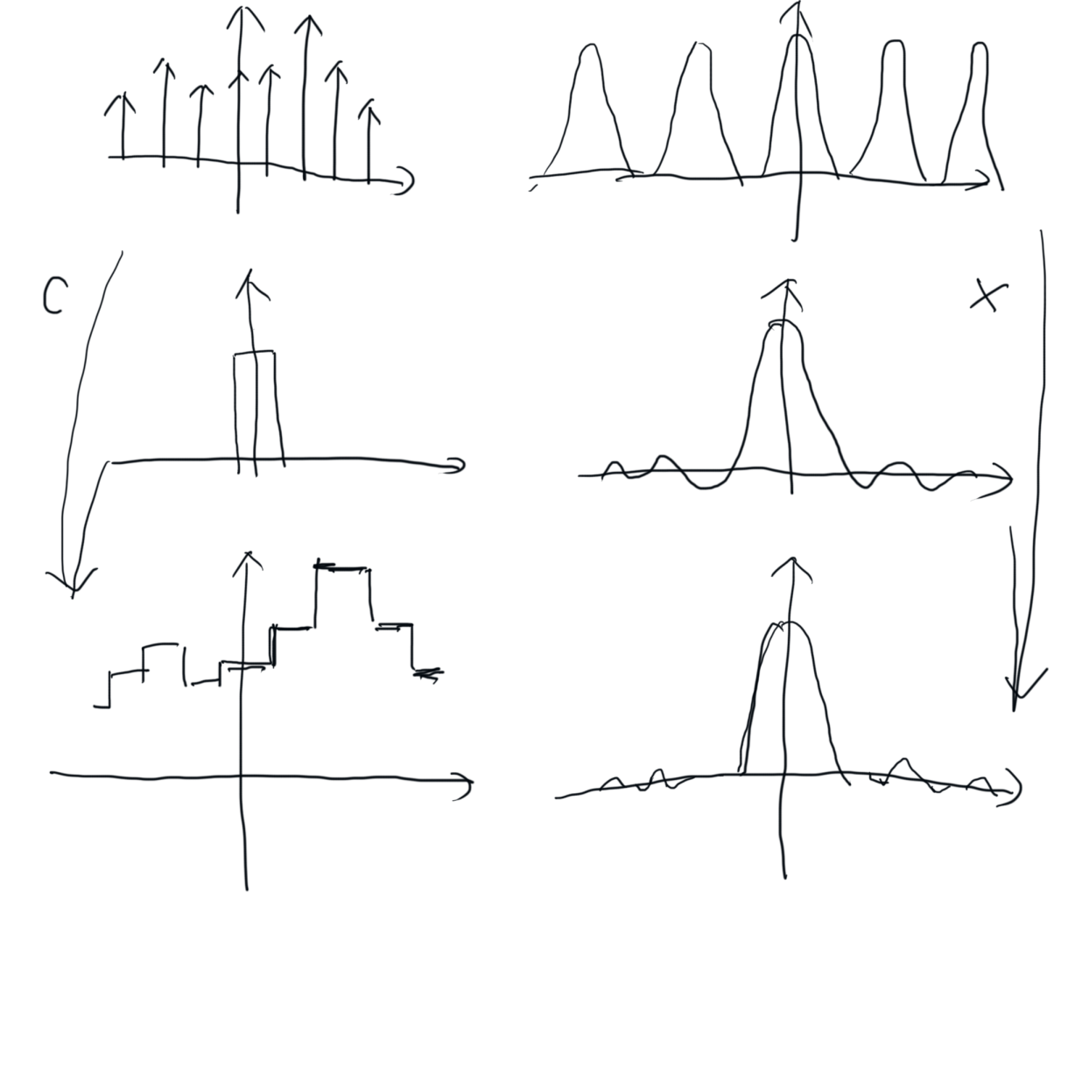
Reconstruction
Box filter

Slide 12
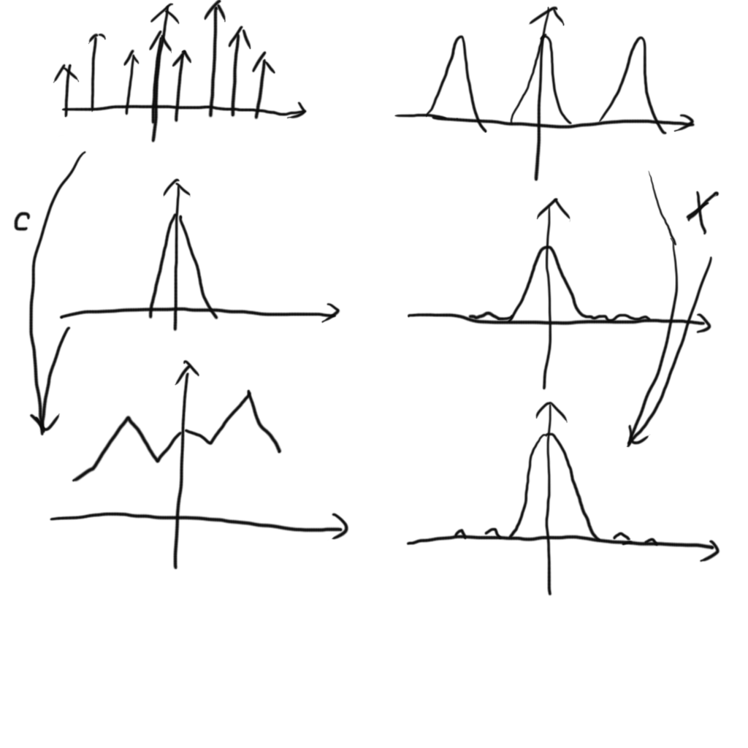
Reconstruction
Triangle filter

Slide 13
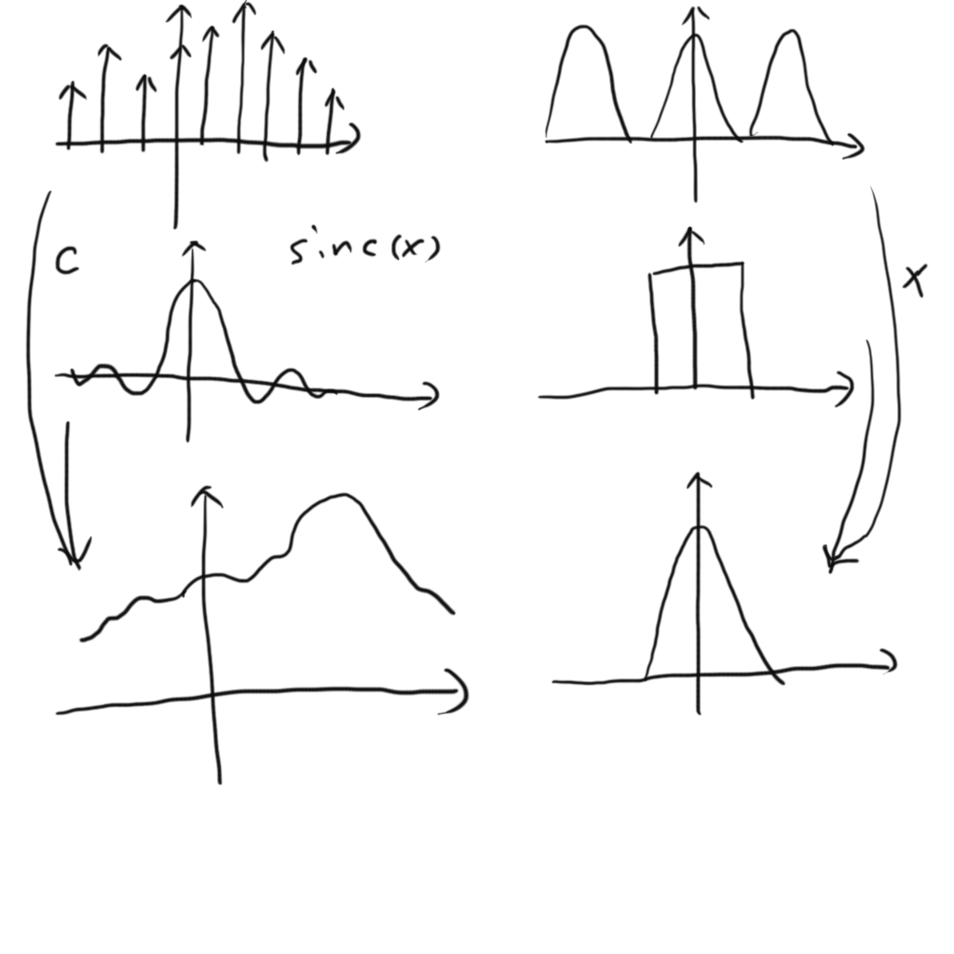
Ideal sampling & reconstruction
Ideal filter

Slide 14
Anti aliasing technique
Pre filtering
  Texture filtering: Mipmap, lean map
Multi samples
  MSAA, SSAA, PCF shadow map
Post filtering
  Post process AA(FXAA, MLAA, etc…)

Slide 15
Prefiltering
在取樣之前，高頻訊號還沒汙染就把他殺了
只要知道sample rate，就把高於sample rate 1/2以上的訊號濾掉，反正取樣過高頻率的訊號也是無法被重建的

Slide 16
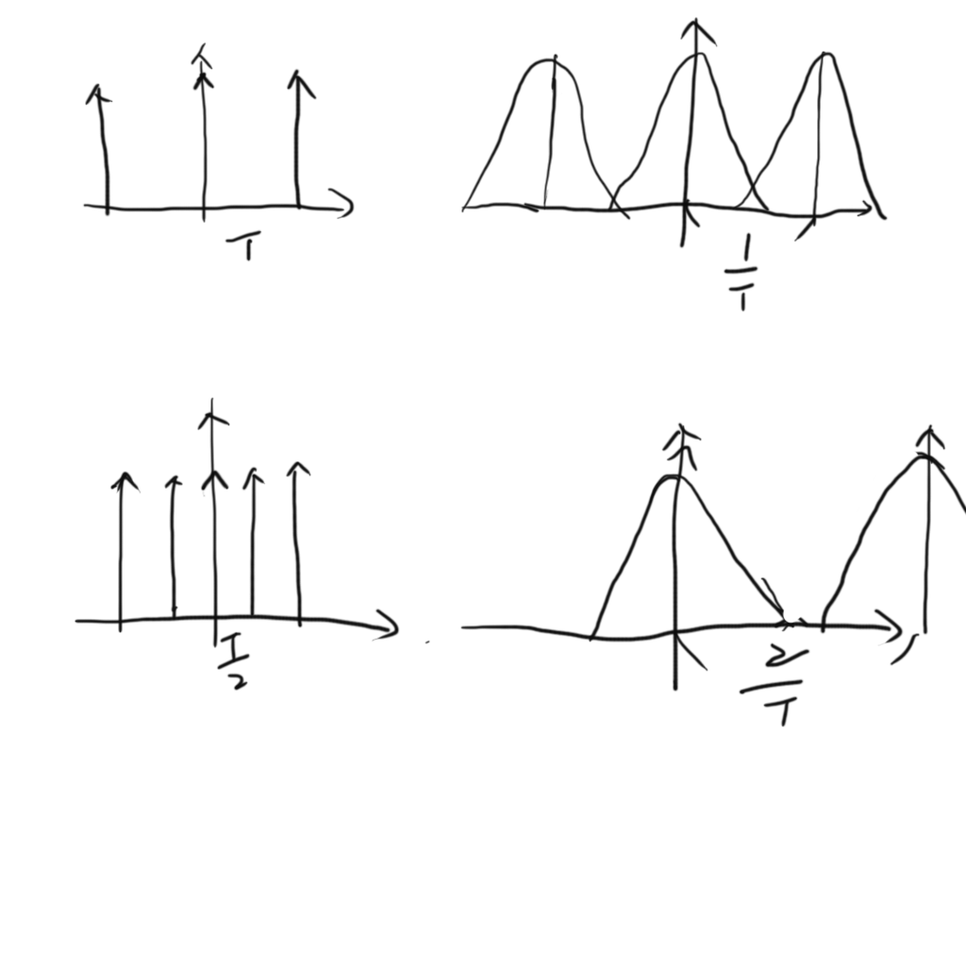
Multi samples
讓高頻訊號有多一些空間

Slide 17
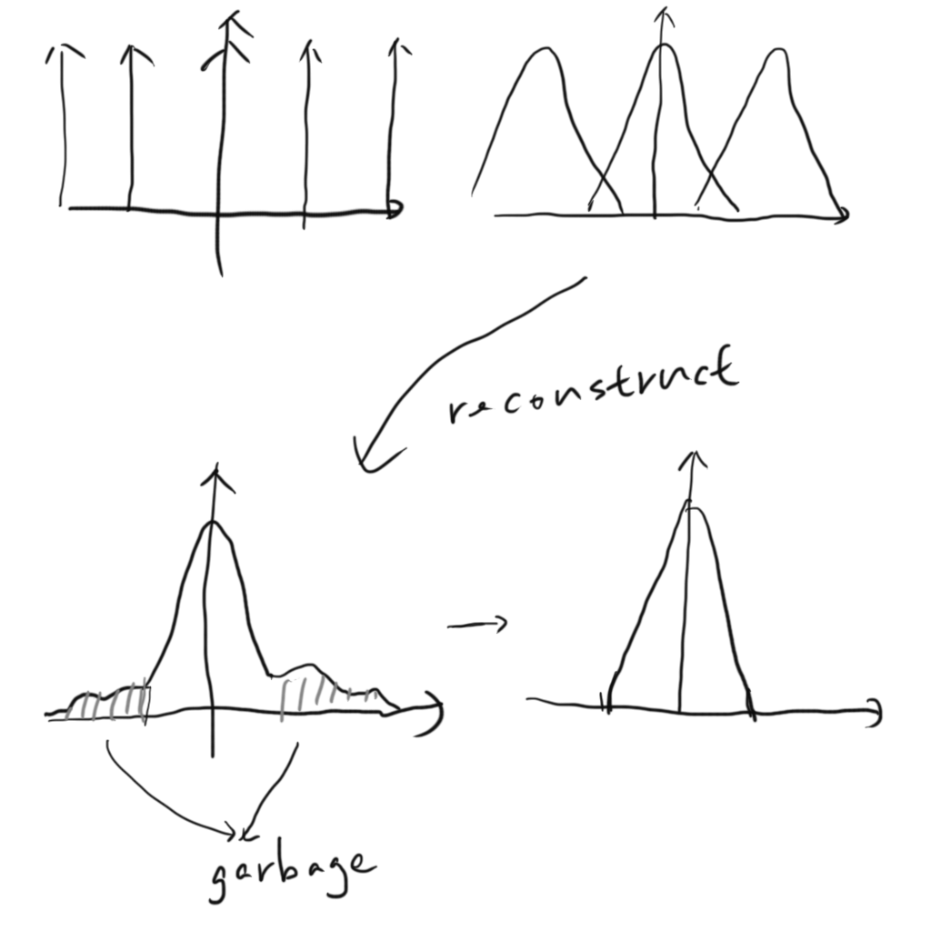
Post filtering
訊號已經被高頻訊號汙染了，不過高頻的部分大都是雜訊，所以就blur高頻的部分吧

Slide 18
Reality
Sampling
  訊號不會是band limited
  常常無法prefilter(很多情況無法知道sample rate)
Reconstruction
  Sinc(x)會延伸到+-無限遠，基本上無法完美實作
  computer graphics中大多數情況都用box或triangle filter
  對於最後在螢幕上的成像而言，reconstruction filter是螢幕的像素，我們無法控制reconstruction filter
  大致上螢幕是Gaussian filter

