Slide 1
Monte Carlo:
Sampling

Slide 2
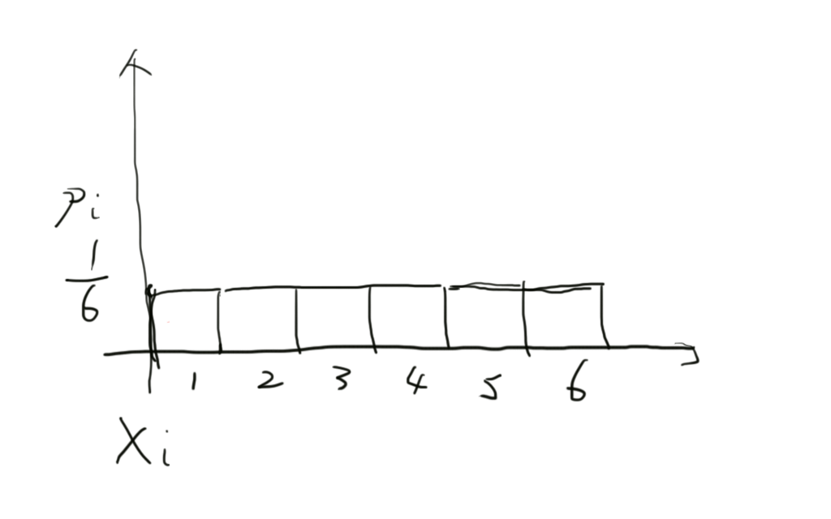
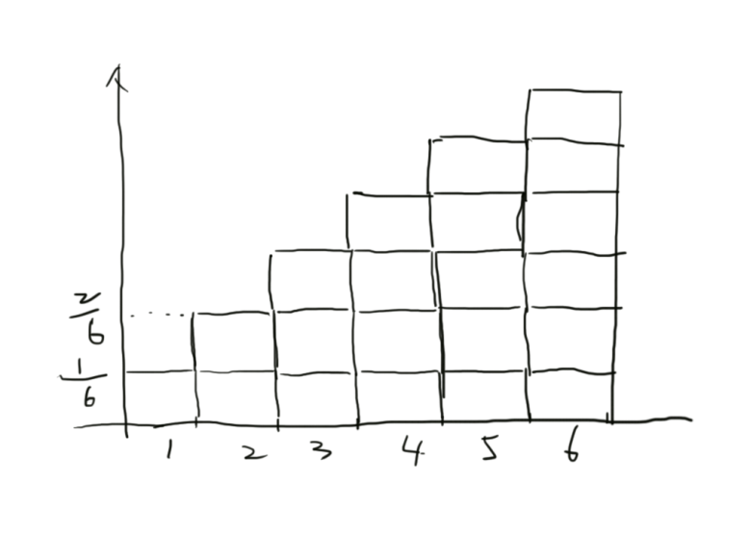
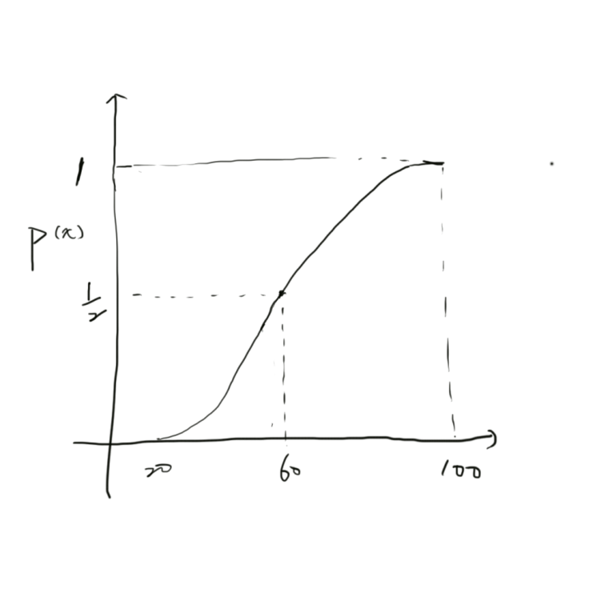
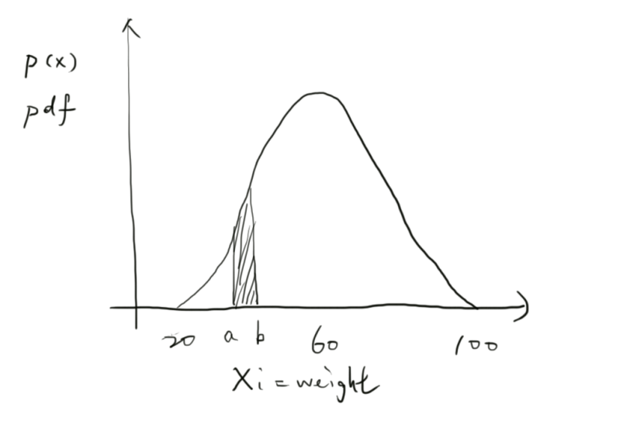
Review of Probability
Discrete
Continuous
pdf
cdf

Slide 3
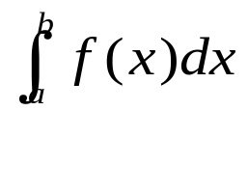
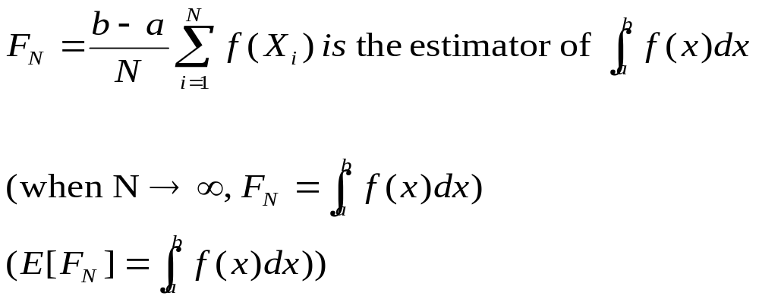
Review of Monte Carlo Integration
Function to integrate:
Monte Carlo estimator

Slide 4

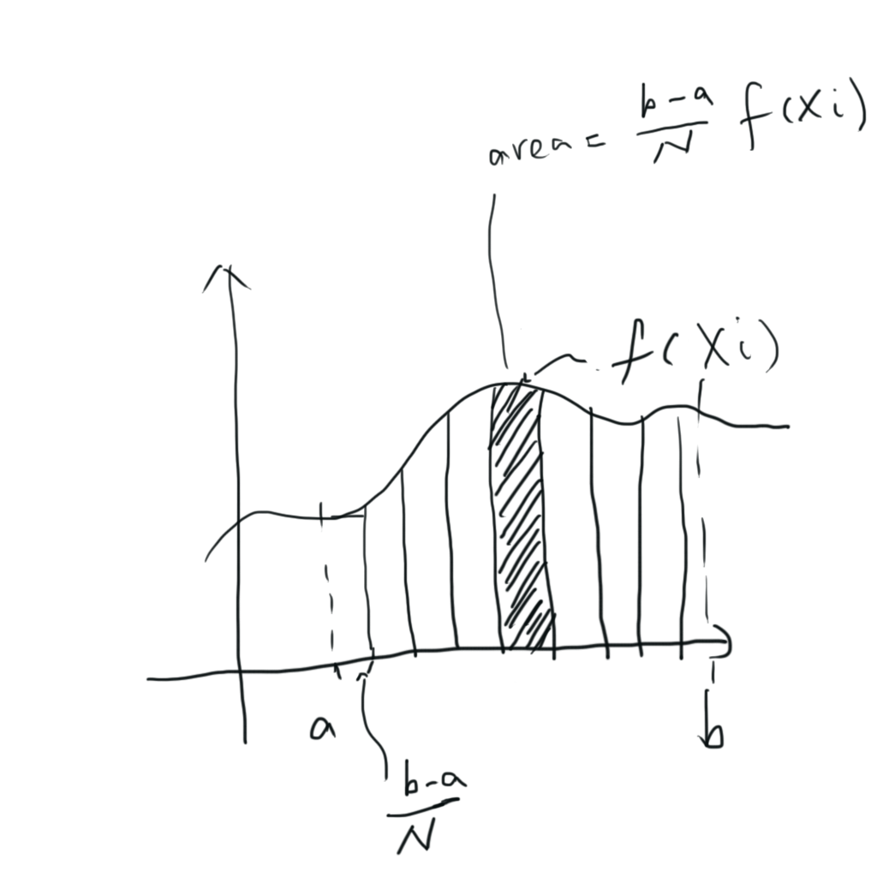

Slide 5
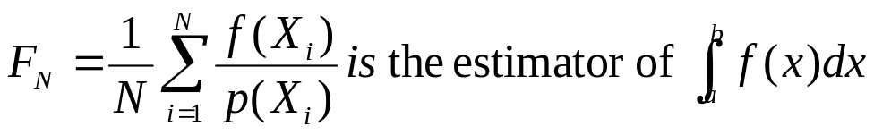
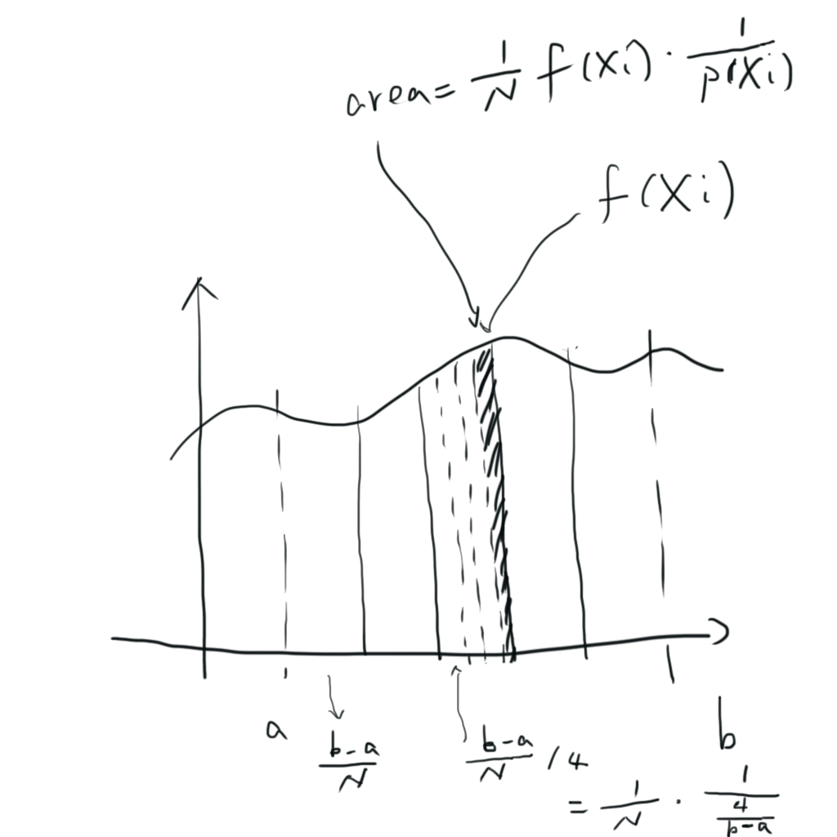
Review of Monte Carlo Integration
More general form

Slide 6
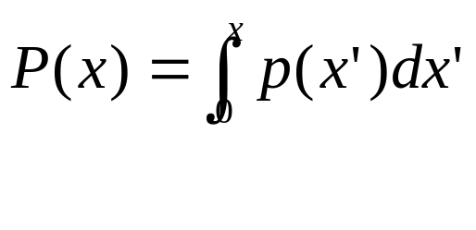
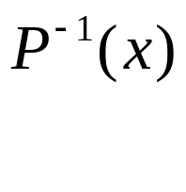

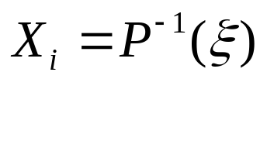
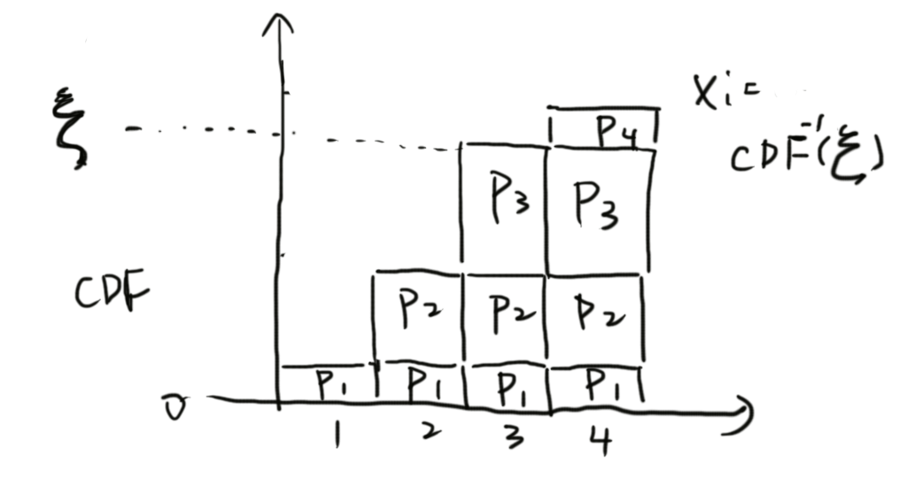
Review of Inversion method
Compute the CDF
Compute the inverse
Obtain a uniformly distributed random number
Compute

Slide 7
Example
Blinn NDF
Piecewise-constant 1D function

Slide 8
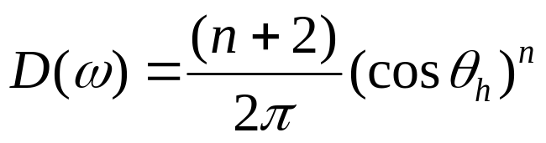
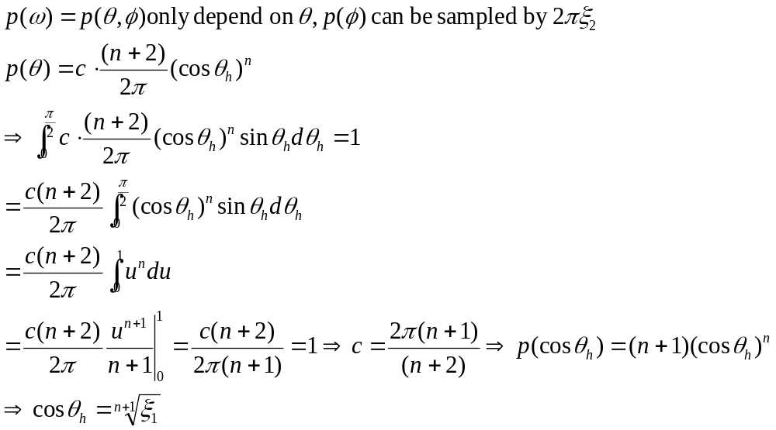
Sampling Blinn NDF
Sample cos(n‧h)

Slide 9
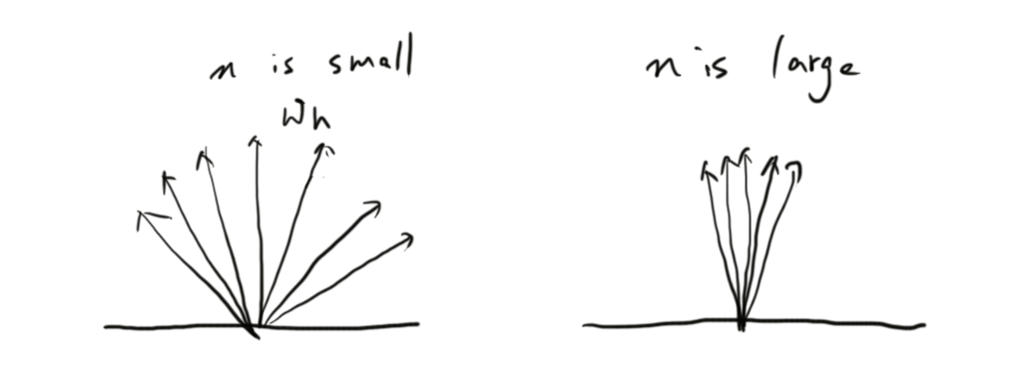
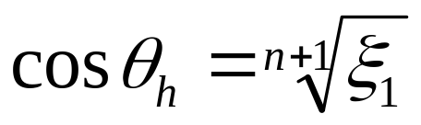
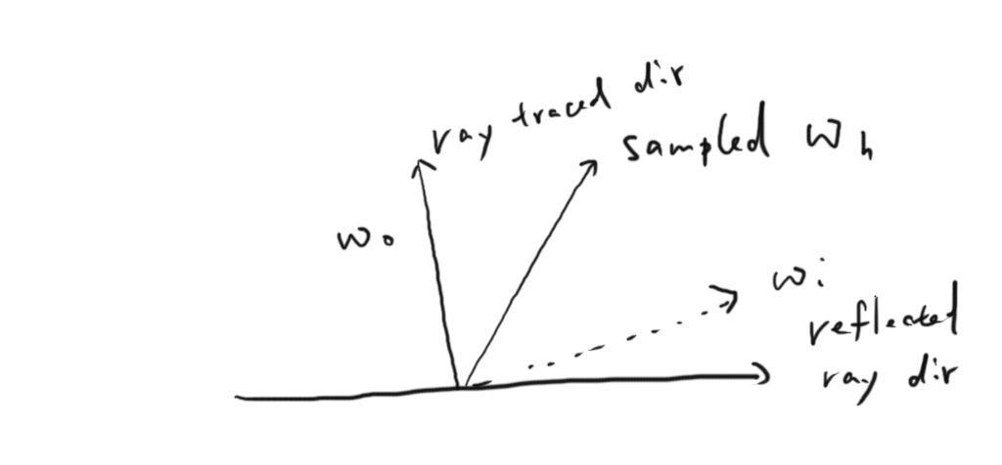
Blinn NDF
Sample reflection direction

Slide 10
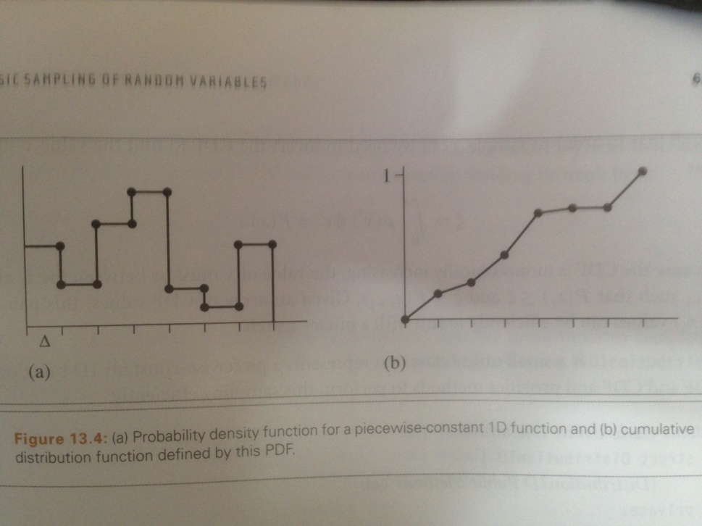
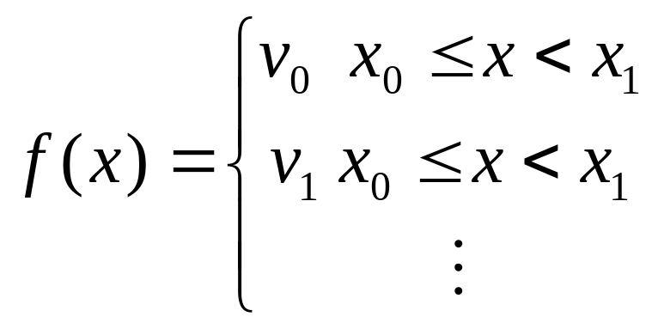
Piecewise constant 1D function

Slide 11
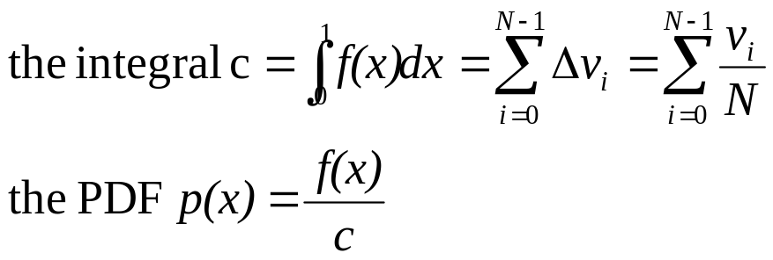
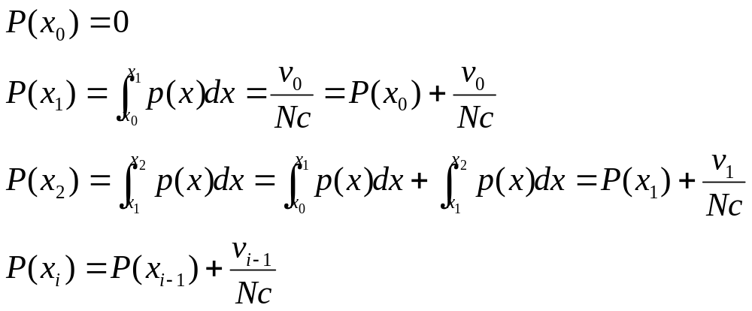
Piecewise constant 1D function
Compute PDF
Compute CDF
Sampling by binary search the interval, then interpolate the pdf

Slide 12
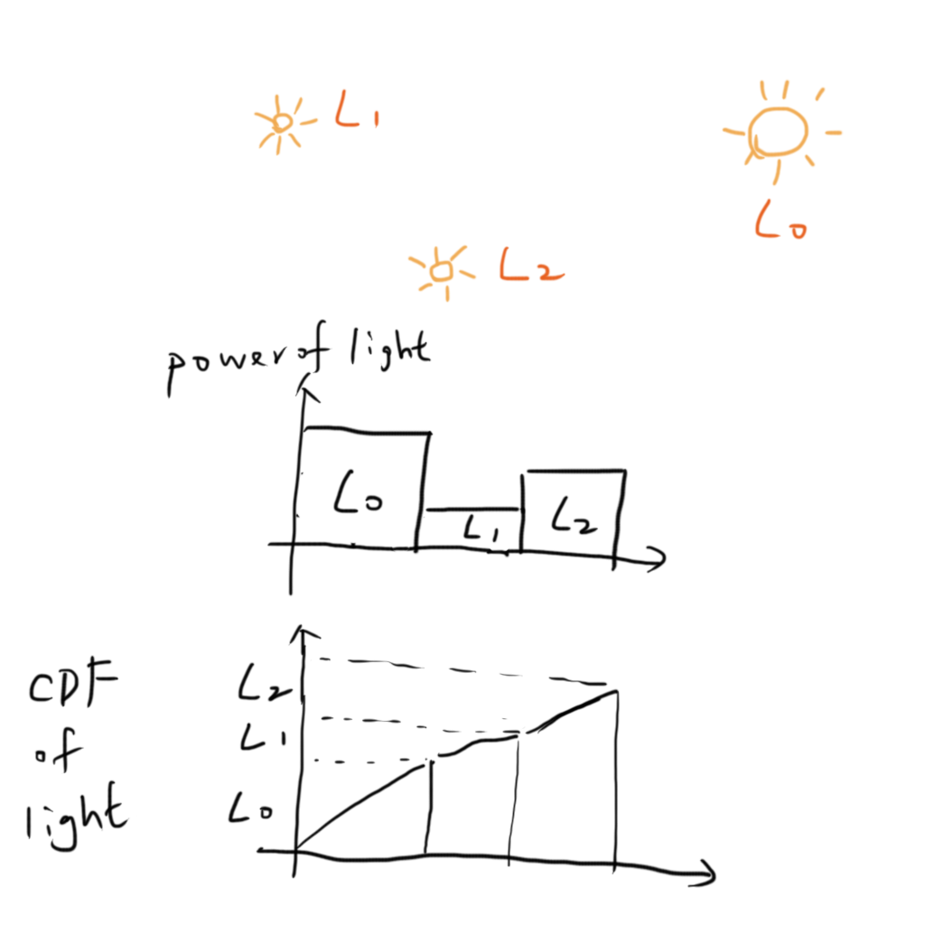
Piecewise constant 1D function
Example: Sample multiple lights

Slide 13
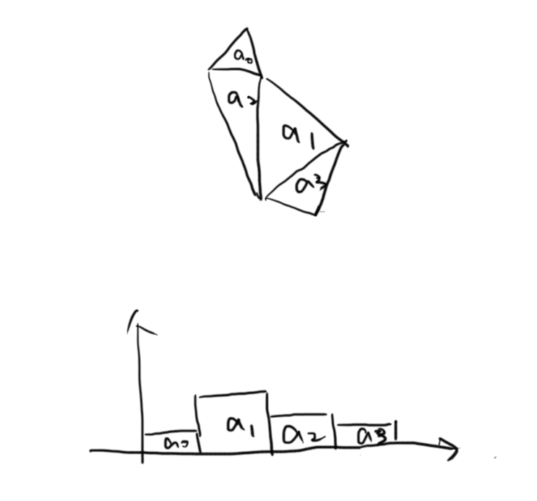
Piecewise constant 1D function
Example: Sampling mesh surface

Slide 14
2D Sampling
Hemisphere
Disk
Triangle
Mesh

Slide 15

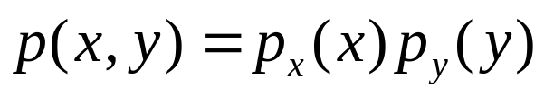


2D sampling
How to sample a 2D joint density function?
  ex. Hemisphere direction
Simpler case, if the density function is separable
Then random variable (X, Y) can be found by independently sampling X from and Y from
  Example: Blinn NDF

Slide 16
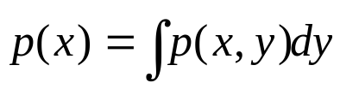
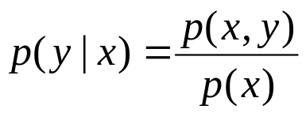
2D sampling
General case
First calculate marginal density function
  Average density for a particular x over all possible y
Then we can calculate the conditional density function
  Density function for y given some particular x has been chosen

Slide 17

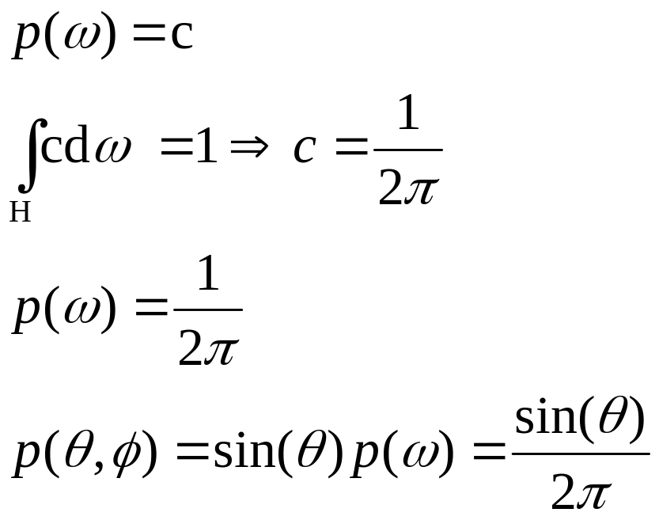
Uniform sampling hemisphere
Uniform means

Slide 18



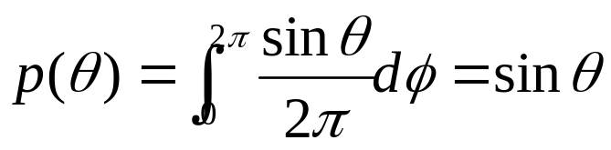

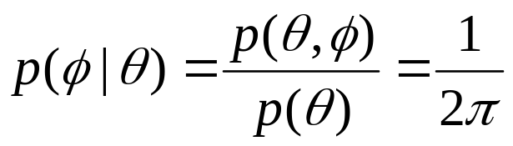
Uniform sampling hemisphere
Sampling by marginal density function
Compute conditional density for

Slide 19
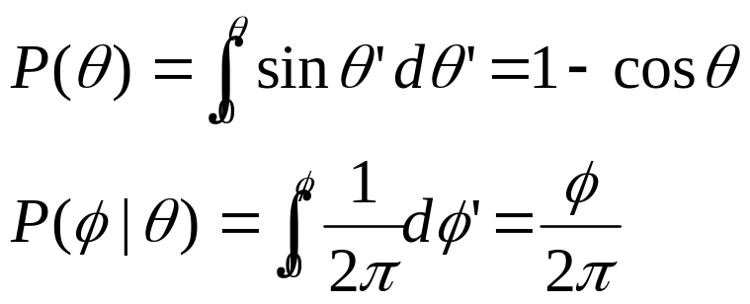
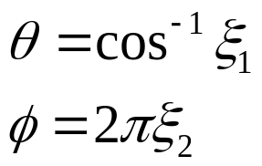
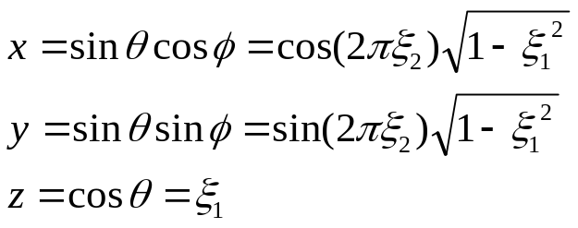
Uniform sampling hemisphere
Use the inverse method, integrate to get CDF
Then inverse
Then transform to cartesian coordinate

Slide 20
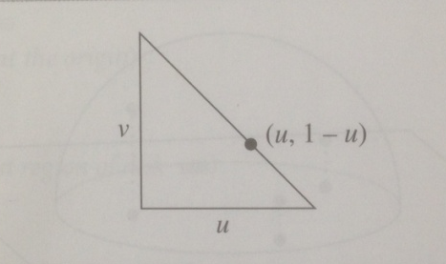

Uniform sampling triangle
We will assmue we are sampling an isosceles right triangle of area ½
Output is barycentric coordinate, so work for any triangle

Slide 21
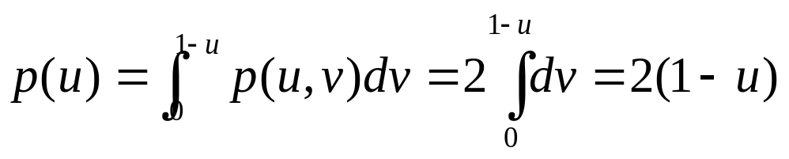
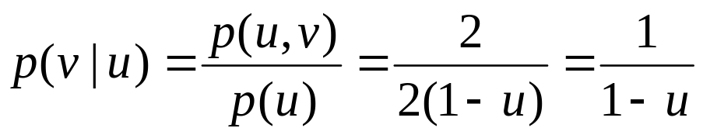
Uniform sampling triangle
First, find the marginal density
And conditional density

Slide 22
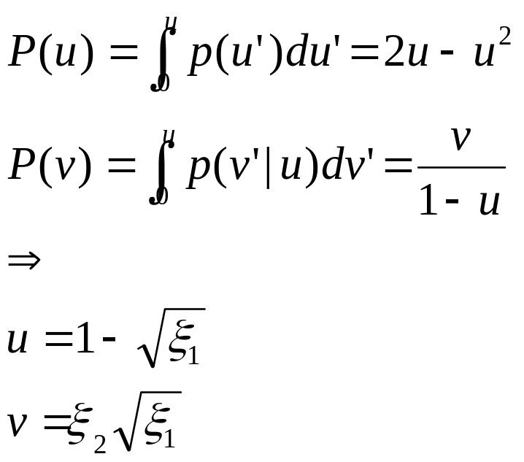
Sampling triangle
Inverse method as always

Slide 23
Uniform sampling mesh
Uniform sample triangle index, then uniform sample the triangle

Slide 24
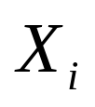

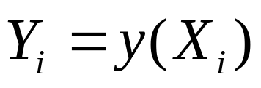

Transforming between distributions
If we are given random variables that are already drawn from some PDF
Give another random variable
What is ?

Slide 25
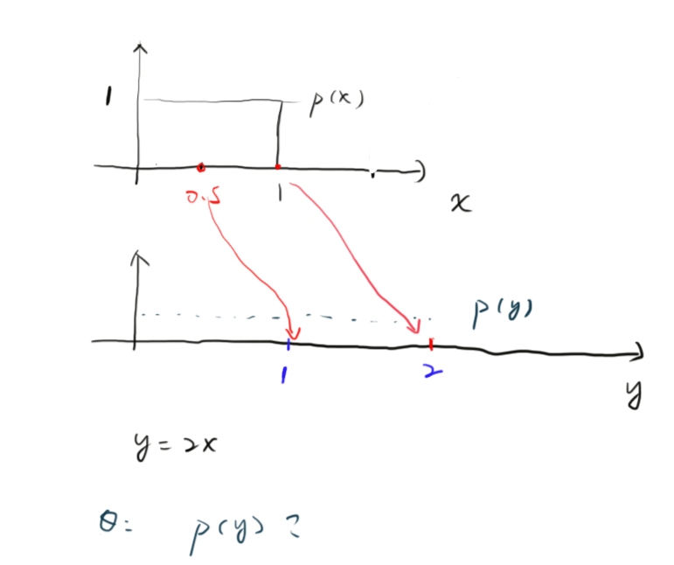
Transforming between distributions

Slide 26
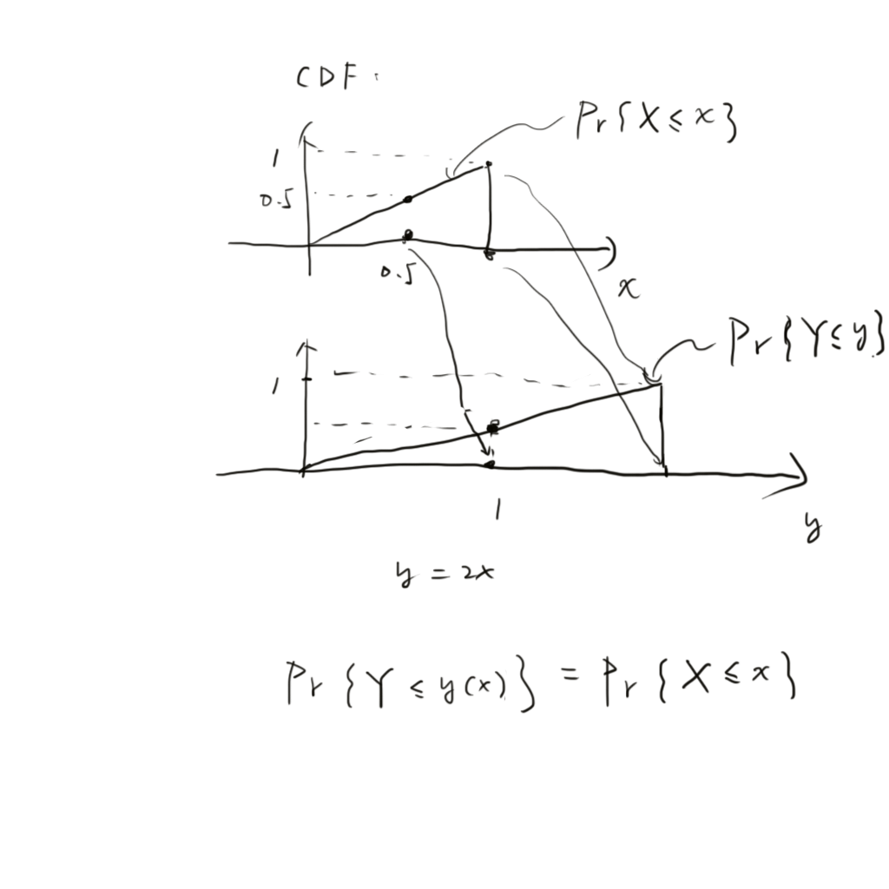
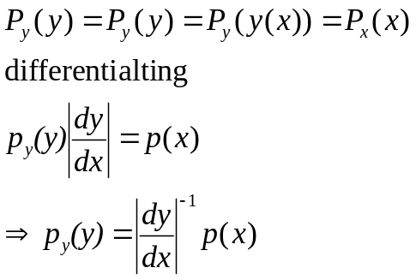
Transforming between distributions

Slide 27


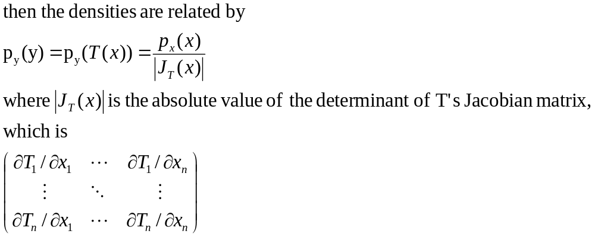
Transformation in multiple dimensions
If x is an n-dimensional random variable X with density function and

