Slide 1
Path Tracing: Monte Carlo integration

Slide 2
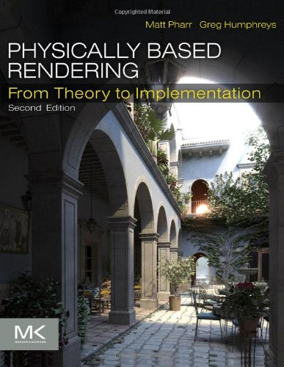
Physically based rendering
Oscar winner
https://www.youtube.com/watch?v=7d9juPsv1QU

Slide 3
Randomize algorithm
Monte Carlo
Monte Carlo integration
Las Vegas
Quick sort

Slide 4
Probability Review
Random Variable:
X
A value chosen by some random process
Discrete
Row a Dice and see it’s outcome
Continuous
A random person’s weight

Slide 5
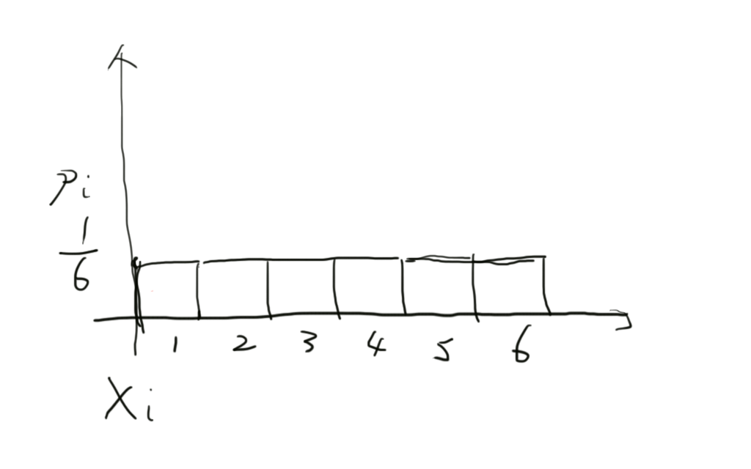
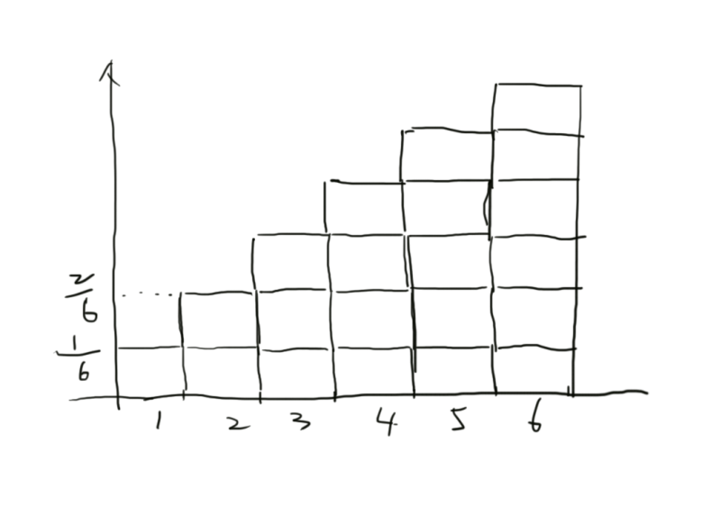
Dice

Slide 6
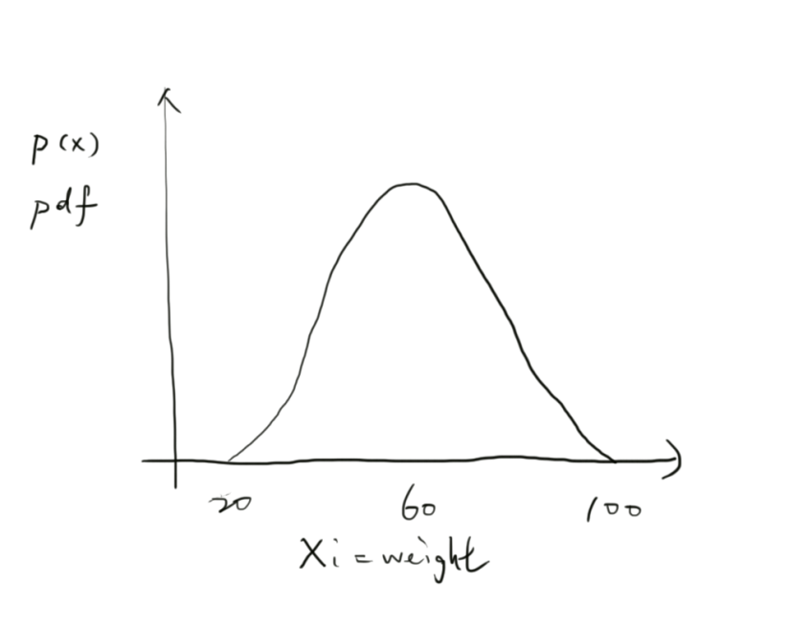
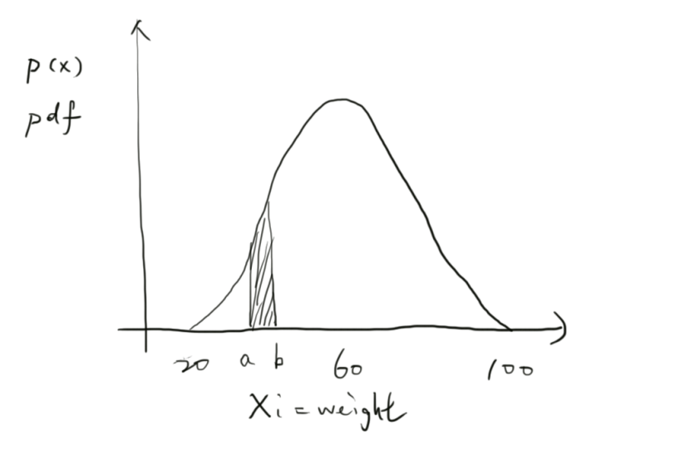
Continuous random variables

Slide 7
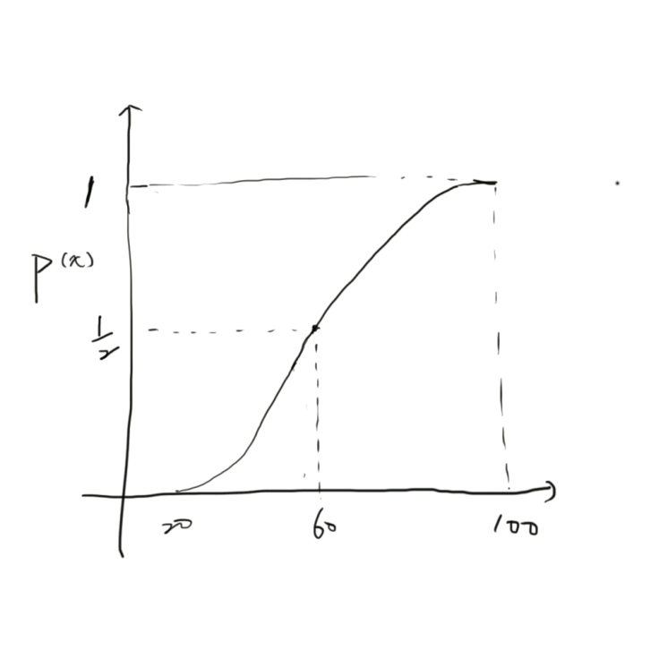
Continuous random variables

Slide 8
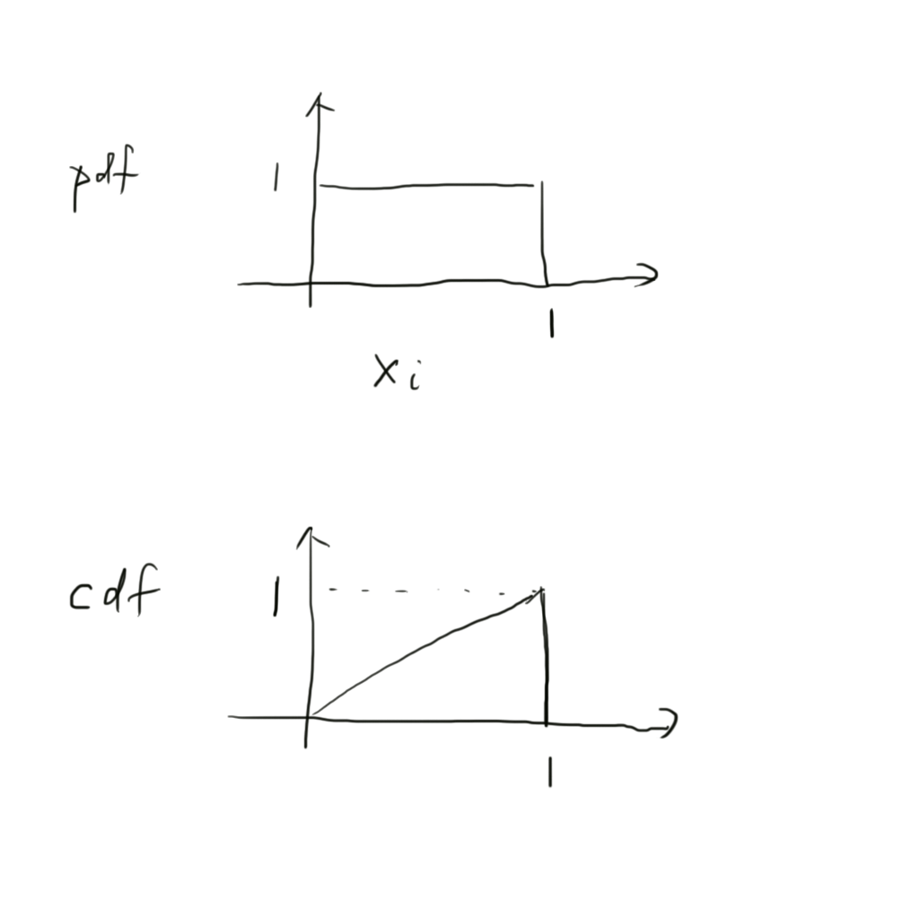
Uniform random variable

Slide 9
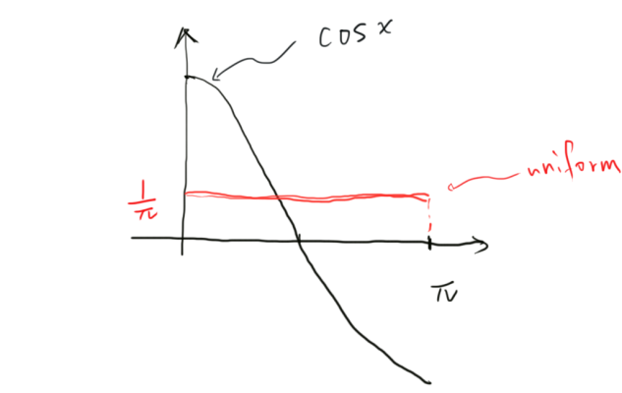
Expected values
Expected value of a function f
Average value of the function over some distribution p
If p is uniform, we drop the subscript p from Ep
Example
Expected value of cos(x), x between 0 and Pi

Slide 10
Properties of E

Slide 11
The Monte Carlo estimator
Suppose we want to evaluate the integral
Given uniform random variables
We claim

Slide 12
Proof

Slide 13
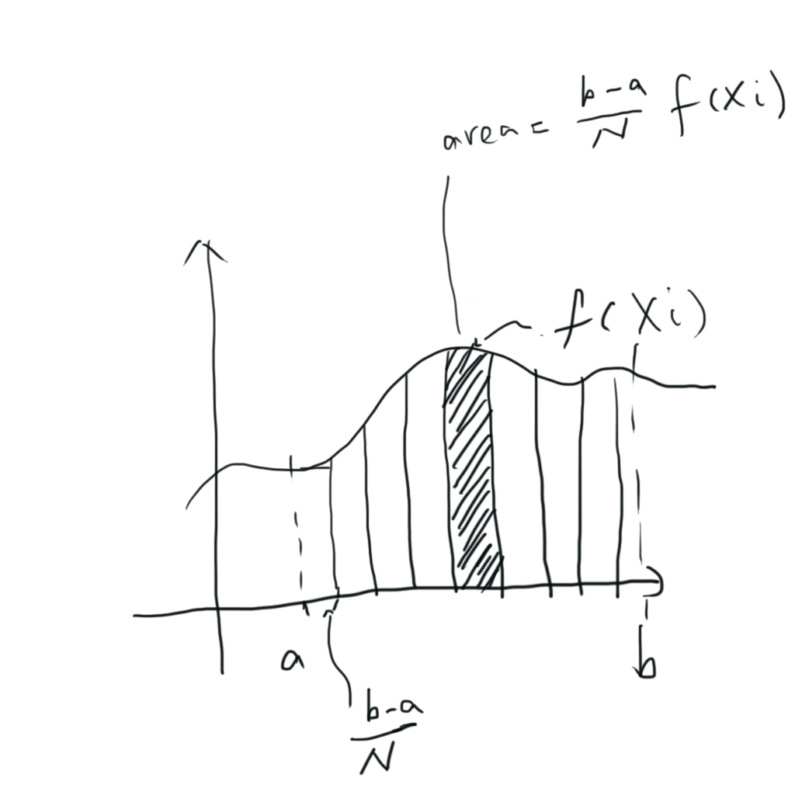
Geometric interpretation

Slide 14
More general form
Given a probability density function

Slide 15
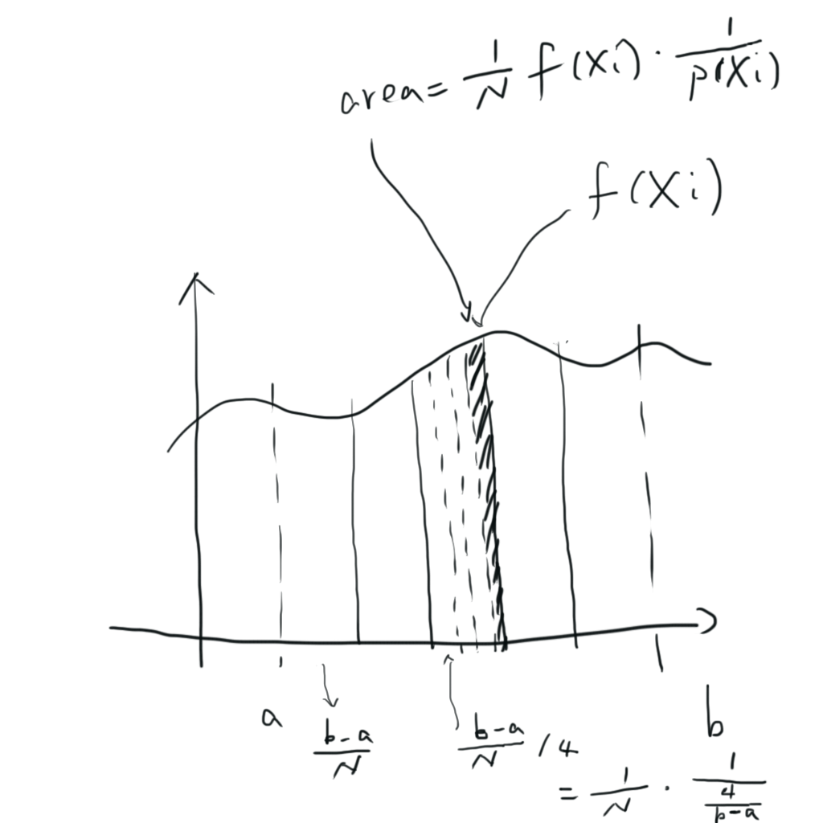
Geometric interpretation

Slide 16
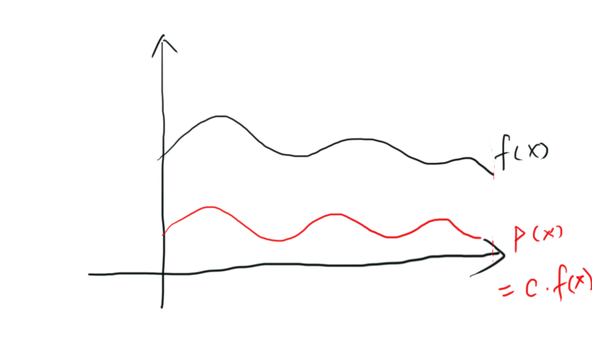
Why we need this form
Suppose we have a pdf
Then the Monte Carlo estimator

Slide 17
Extending to multiple dimensions
Extending to multiple dimensions is straightforward
Consider the three-dimensional integral
If we use uniform sampling

Slide 18
Multiple dimensions
The number of samples N is independent of the dimensionality of the integral
Error in Monte Carlo estimator decreases at a rate of

Slide 19
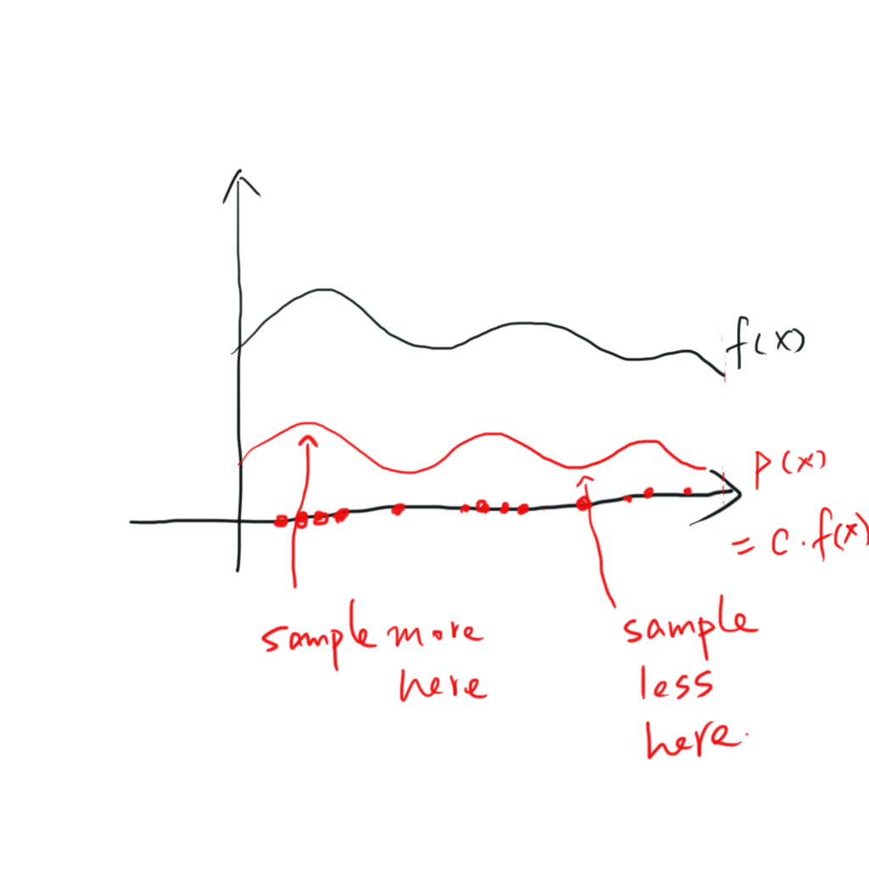
Sampling of random variables

Slide 20
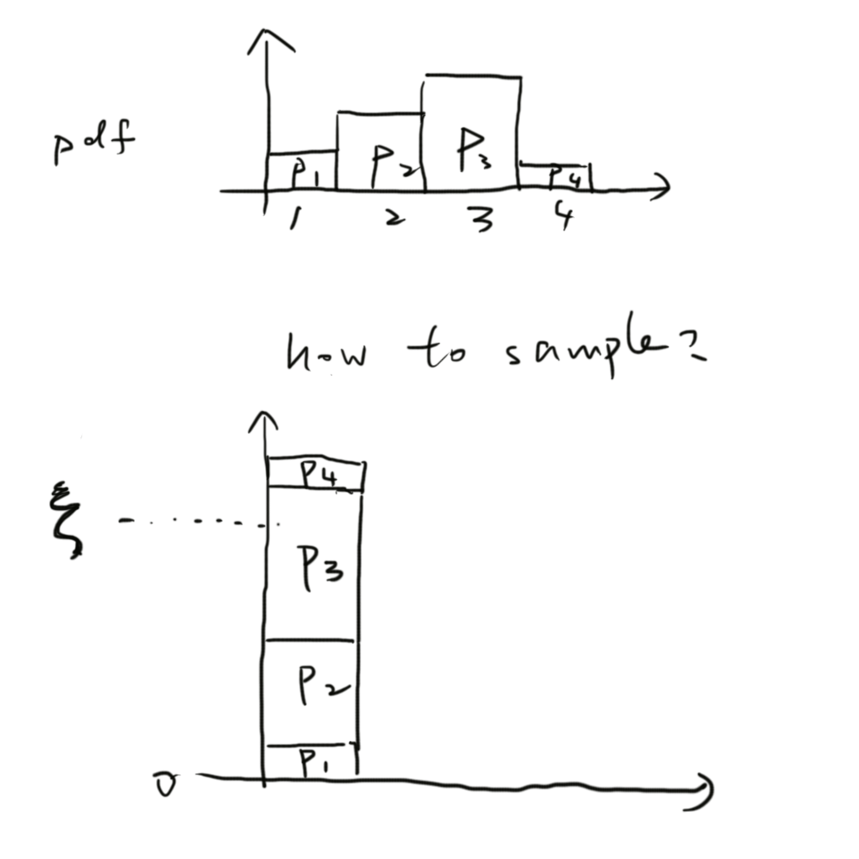
How to sample from a PDF

Slide 21
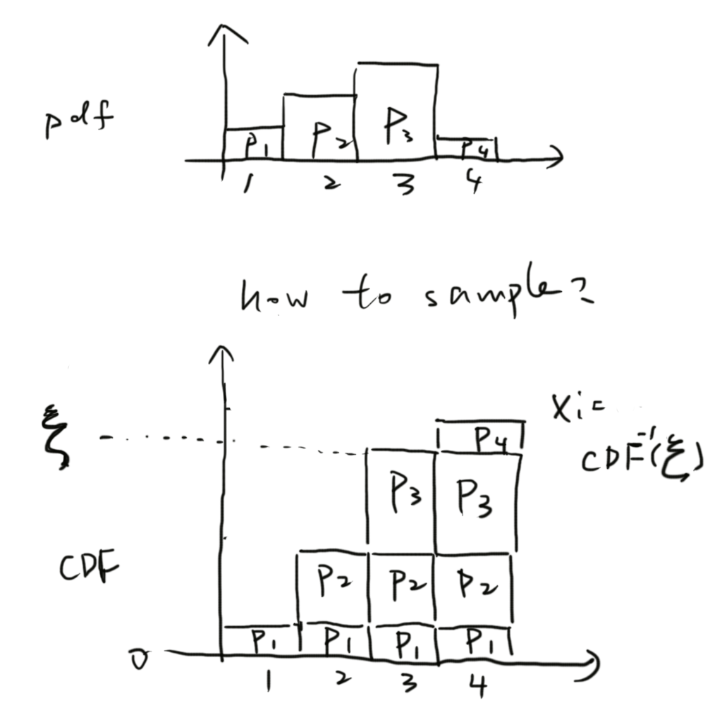
Inversion method

Slide 22
Inversion method
Compute the CDF
Compute the inverse
Obtain a uniformly distributed random number
Compute

