Slide 1
Course 5 solid

Slide 2
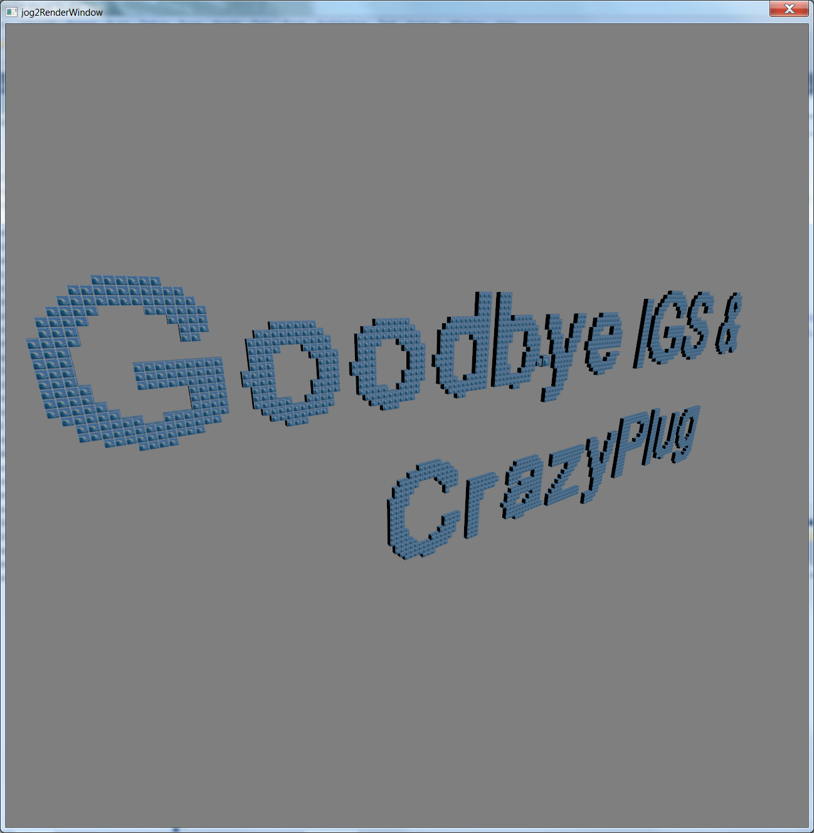

Slide 3
Perspective matrix
Z buffer
Lighting

Slide 4
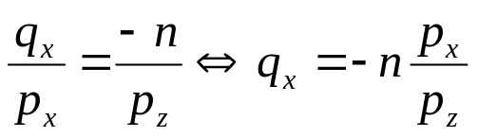
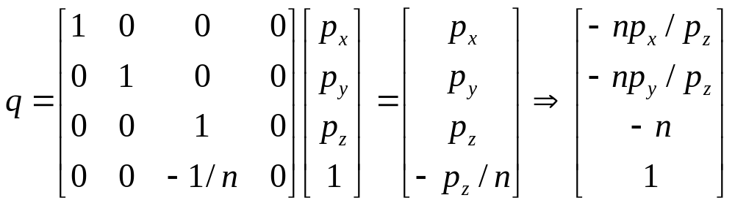
Simple perspective, 3D->2D projection
projection plane, z=-n
p
pz
y
p
q
z=-n
q
x
qx
px
x
z
z

Slide 5

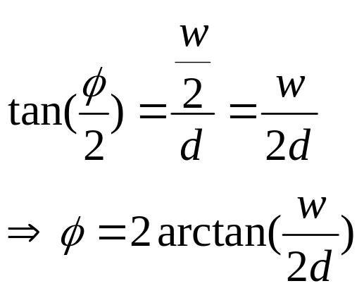
Field of view
Fov
Camera example
  A standard 50 mm lens for a 35 mm camera (which has a 36 mm wide frame size)
w
z=-d
px
x
z

Slide 6
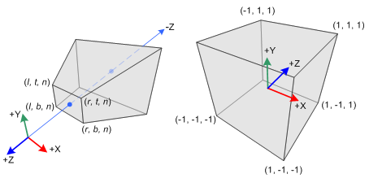
Perspective matrix
Normalized device coordinate(NDC)
Specified by l, r, t, b, n, f
Homogeneous clip space
  Before division by w
Normalized device coordinate
  After division by w
View space

Slide 7
Note
Sign of n, f
  Actually 0 > n > f
  But practically we specify f > n > 0
Normalized device coordinate is in left hand coordinate
  Both OpenGL & DirectX
View space can be in right or left hand coordinate

Slide 8
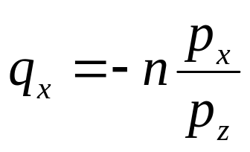
Perspective matrix derivation
We want to map [l, r] ranges to [-1, 1]

Slide 9
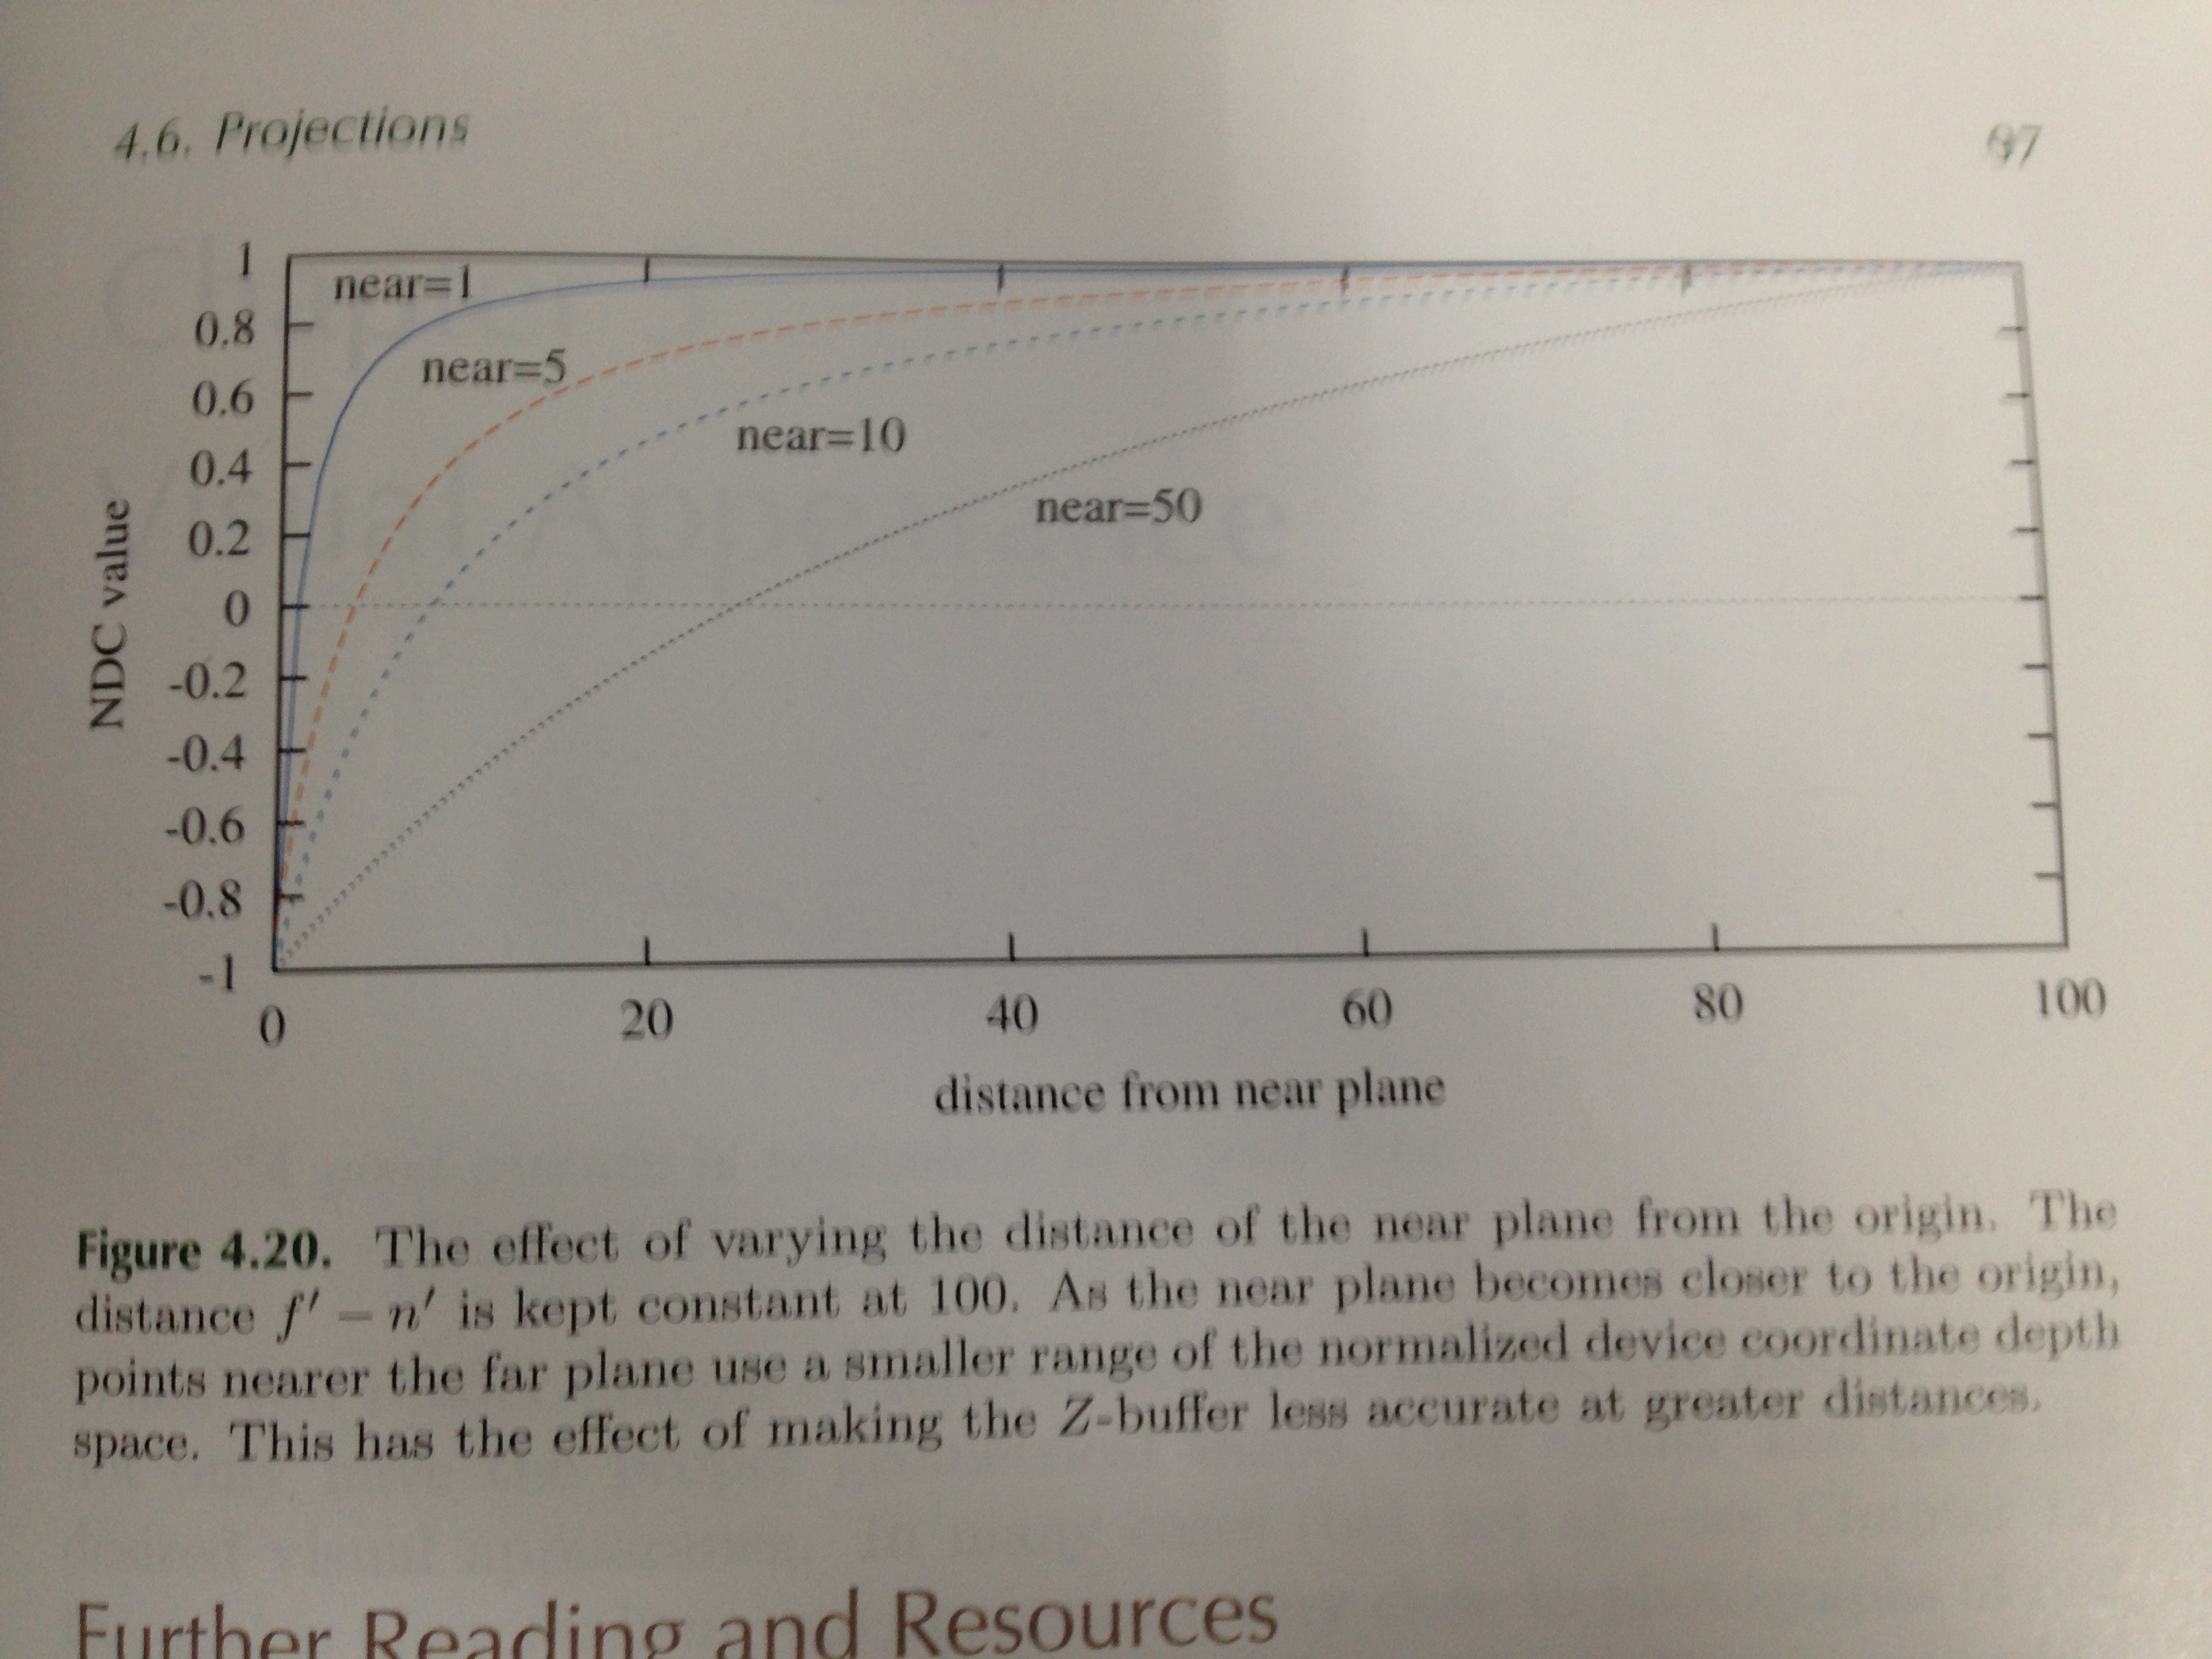
Z range

Slide 10
Visibility problem

Slide 11
GPU
Vertex buffer
Vertex assembly
Index buffer
vertices
Vertex shader
Uniform(constant) buffer
shaded vertices
GPU memory
Primitive assembly
Primitives(e.g. triangles)
rasterizer
Pixels(interpolated values)
Frame buffer
Pixel Shader
Shaded pixels

Slide 12
ZBuffer, ROP
Pixels(interpolated values)
Z buffer
Pixel Shader
Shaded pixels
Frame buffer
ROP
survived pixels

Slide 13
In OpenGL
Z buffer steps
  Create Context with Z buffer
  Enable z test & set z function
  Clear z to 1 at the begin of each frame
Notes:
Double buffer / triple buffer etc

Slide 14
Other ROP operation

Slide 15
Buffering
Double / triple buffer

Slide 16
Lighting & Material

Slide 17
Phong Reflection Model

Slide 18
Light type

Slide 19
Gouraud Shading and Phong Shading
Frequency of lighting
  Gouraud Shading - calculate lighting per vertex then interpolated inside triangle
  Phong shading – calculate lighting per pixel

Slide 20
Physics of Light
God said, "Let there be light," and there was light

Slide 21
Wave vs Particle

Slide 22
Physics of light - Radiometry

