Slide 1
JADE

Slide 2
JADE
Just Another Dysfunctional Engine

Slide 3
Function
A simple renderer
  Support real time rendering & ray tracing
  Course homework framework

Slide 4
Design goal
Simple
Lazy
  Use stl, etc…
  But prefer less external dependency
  Not lousy
    Proper resource management, no resource leak
Clear separation of interface/implementation

Slide 5
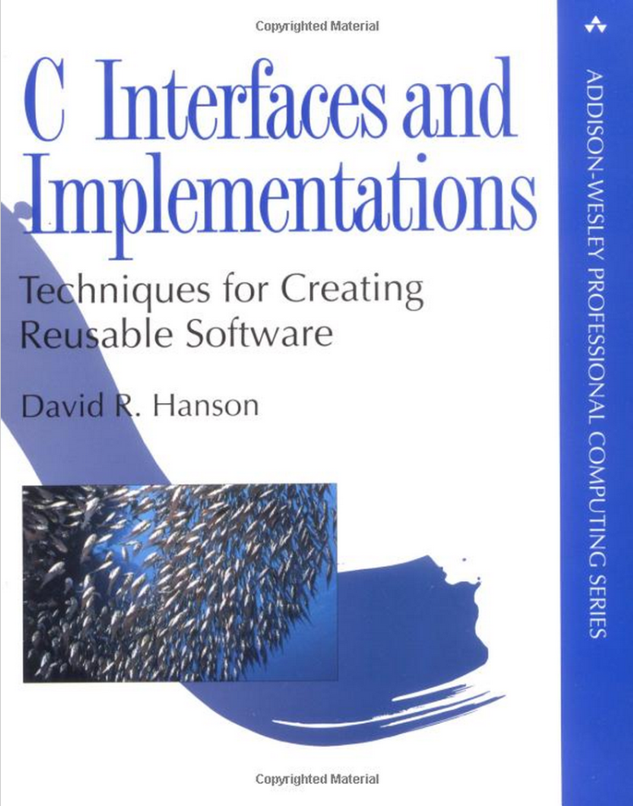
Interface & implementation
Abstraction
  != object oriented programming/design

Slide 6
JADE structure
General purpose utility function
  ~/course/image.h … etc
JADE
  ~/course/jade/render_device.h …etc
  Under jade namespace
  Hardware device
  Resource & management
  Renderer

Slide 7
JADE structure
Hardware device interface
  render_device.h
Hardware device implementation
  Platform independent
    Render_device.cpp
  Platform dependent
    Render_device_gl.h
    Render_device_gl.cpp

Slide 8
JADE structure
Renderer
  Platform dependent
    Renderer_gl.h, renderer_gl.cpp
  Platform independent
    Renderer.h
    Mesh.h
    Primitive.h
    Camera.h
    Texture.h
    Material.h

