Slide 1
Radiometry, Phtometry and Color

Slide 2
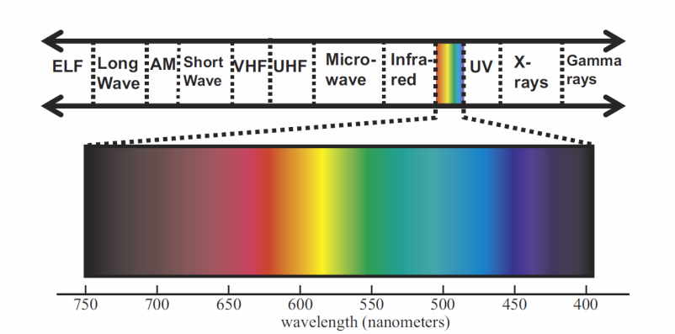
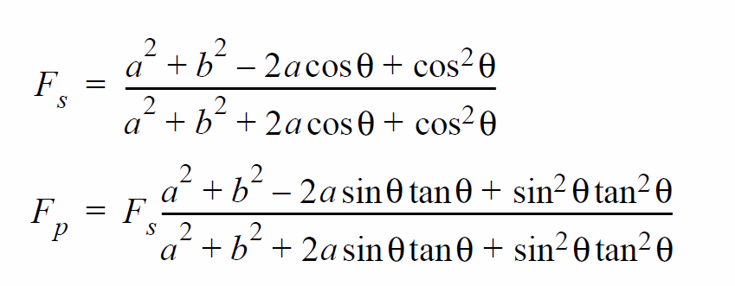




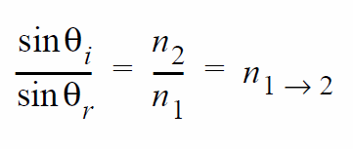

Review of physic of light

Slide 3
Engineering
Radiometry – Physics
Photometry – Perception
Colorimetry - Display

Slide 4
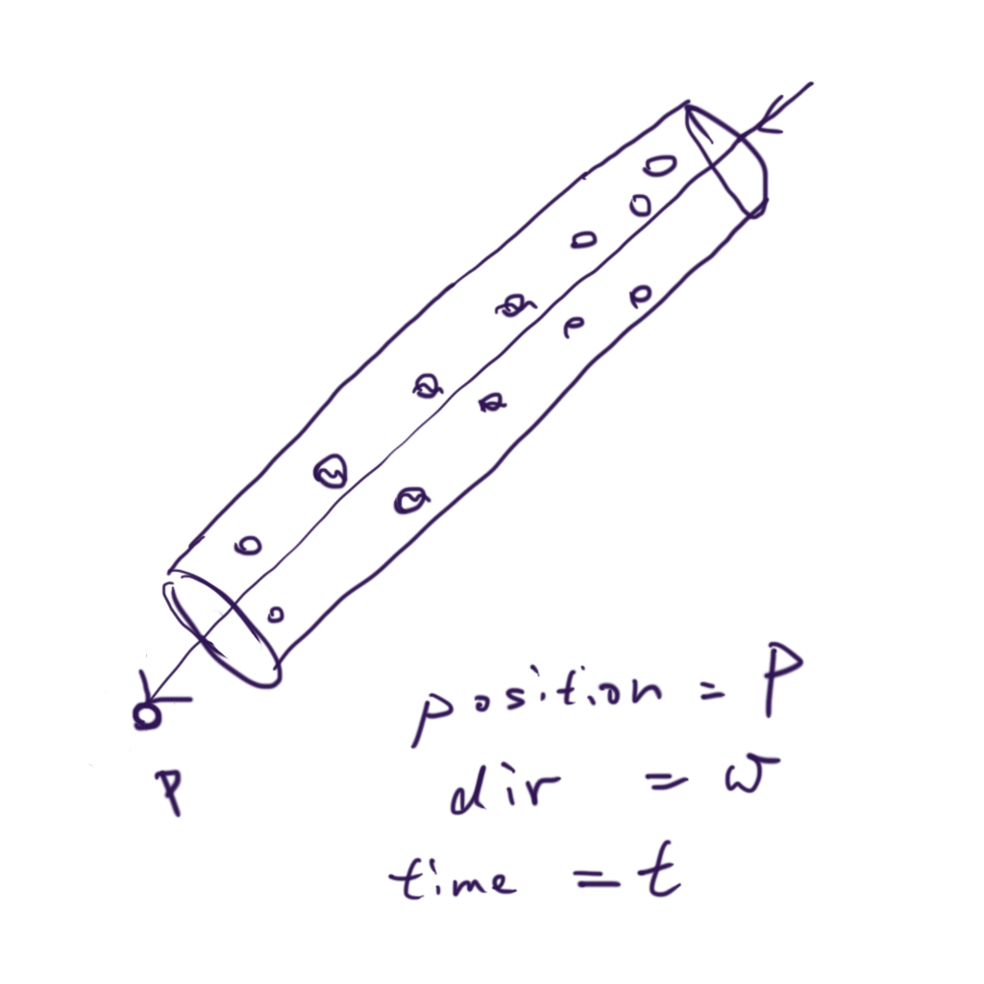

Radiance
Radiance
  在時間點t，通過物體表面上一點p，
  方向為w的能量
  單位是甚麼?

Slide 5
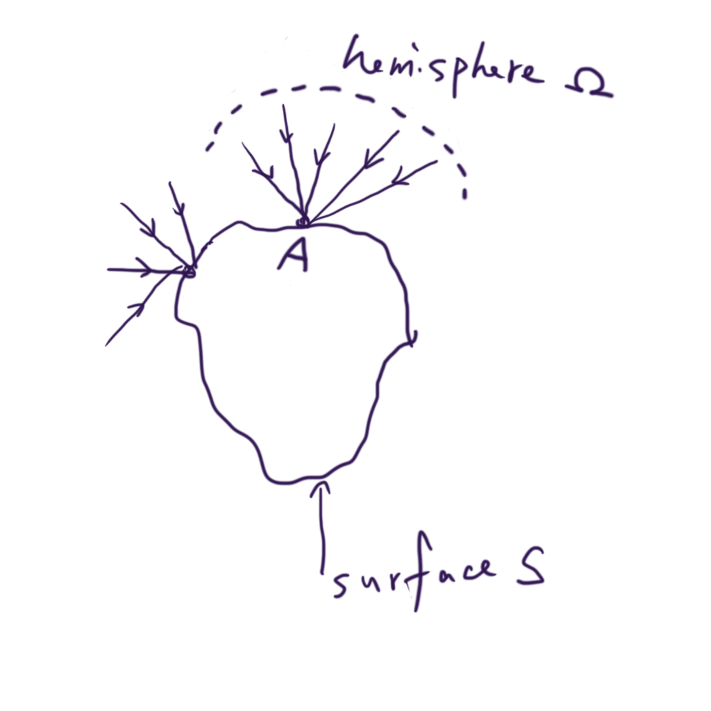
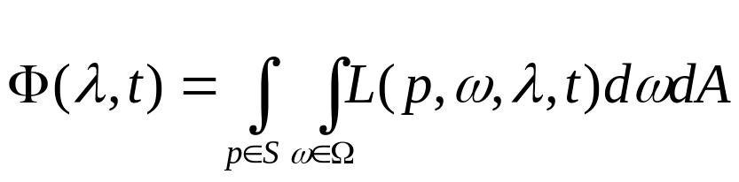
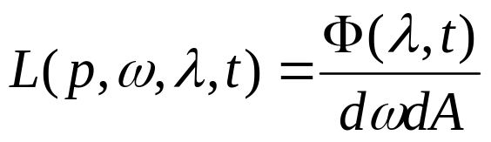
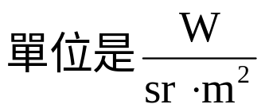
Flux
某一時間點，通過一物體表面的總能量，單位是功率
  瓦特(W)
所以radiance

Slide 6
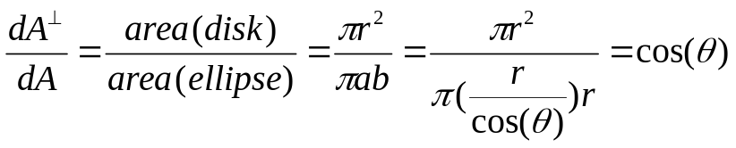
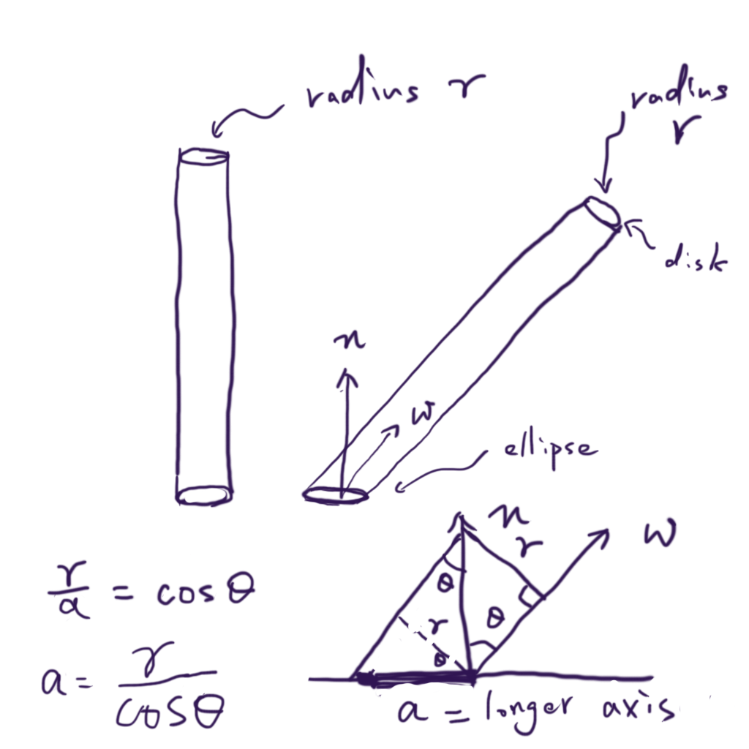
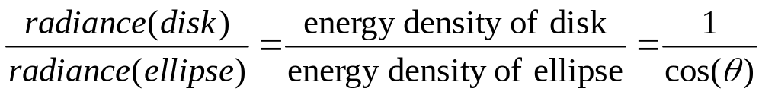
Looks more closely

Slide 7
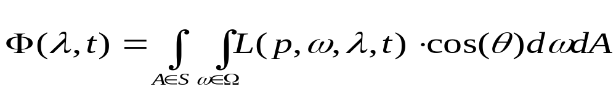
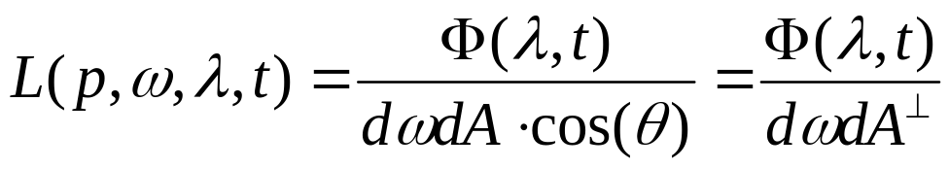
Looks more closely
正確版本

Slide 8
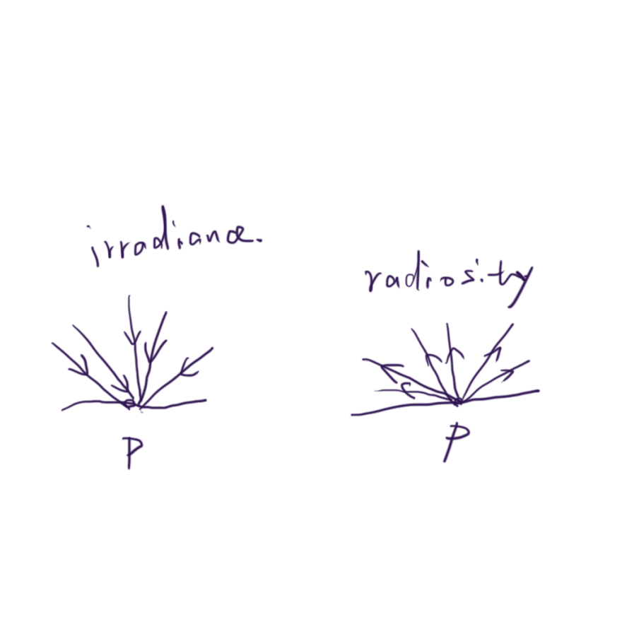
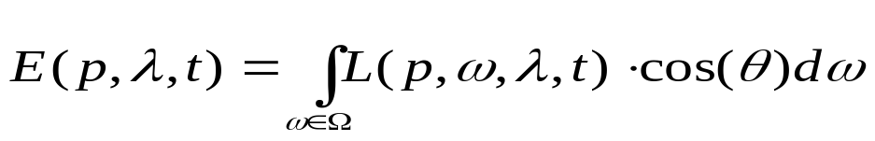
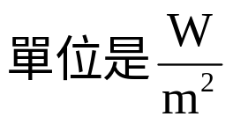
Irradiance/radiosity
Irradiance/radiosity
  通過某一點p的總能量
  Irradiance定義為進入的能量，radiosity(radiant exitance)為離開的能量

Slide 9
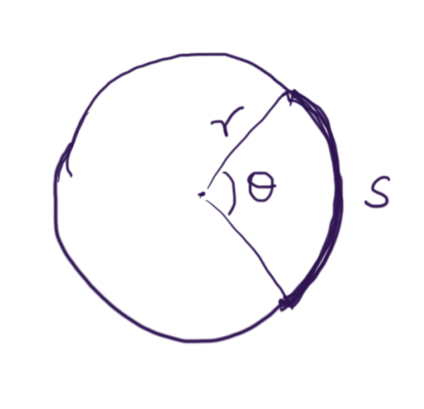
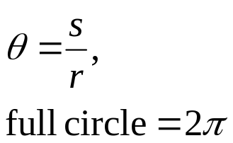
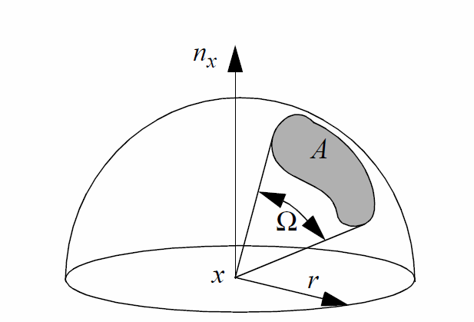
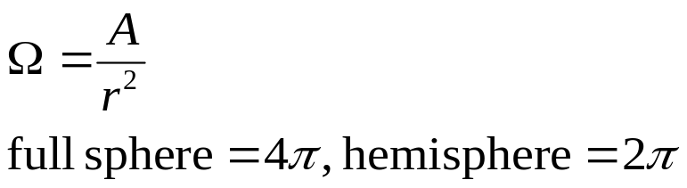
Solid angle
Planar angle
  Radian
3D angles
  steradian

Slide 10
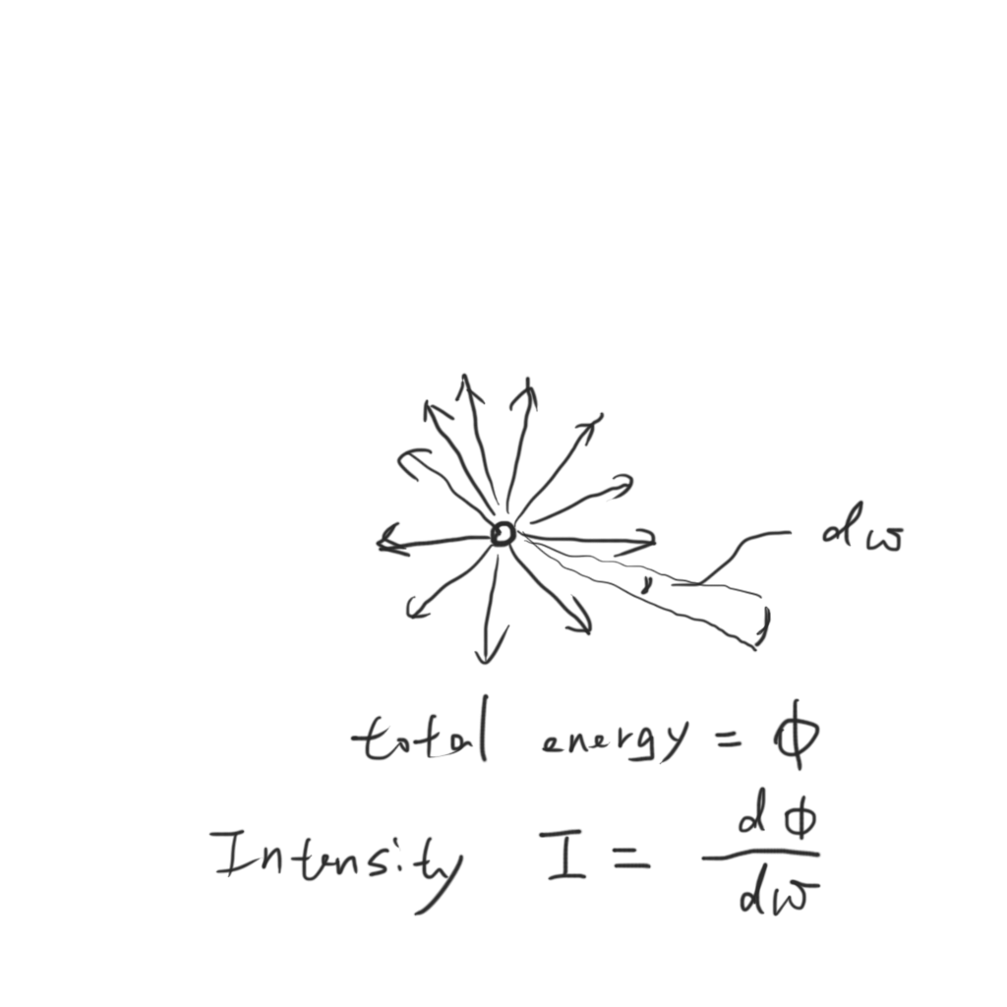
Solid angle & Intensity
Directional distribution of light, only meaningful for point light sources

Slide 11
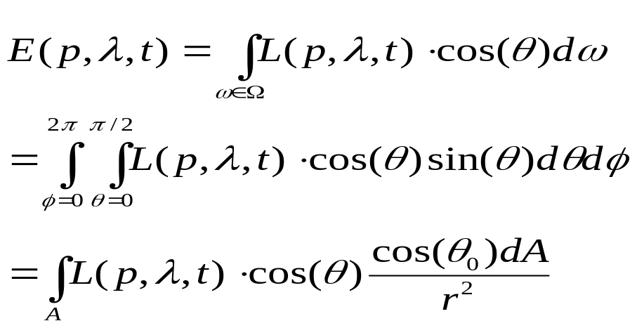
Solid angle & hemispherical integration
Integration over hemisphere
  Have may parameterizations, see [Global illumination Compendium]
  Source of many confusions
  Ex. irradiance

Slide 12

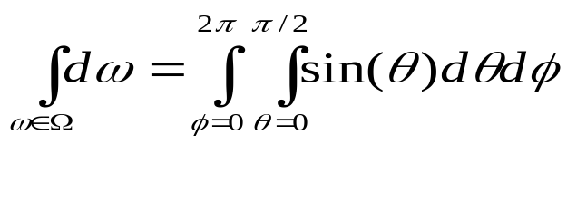
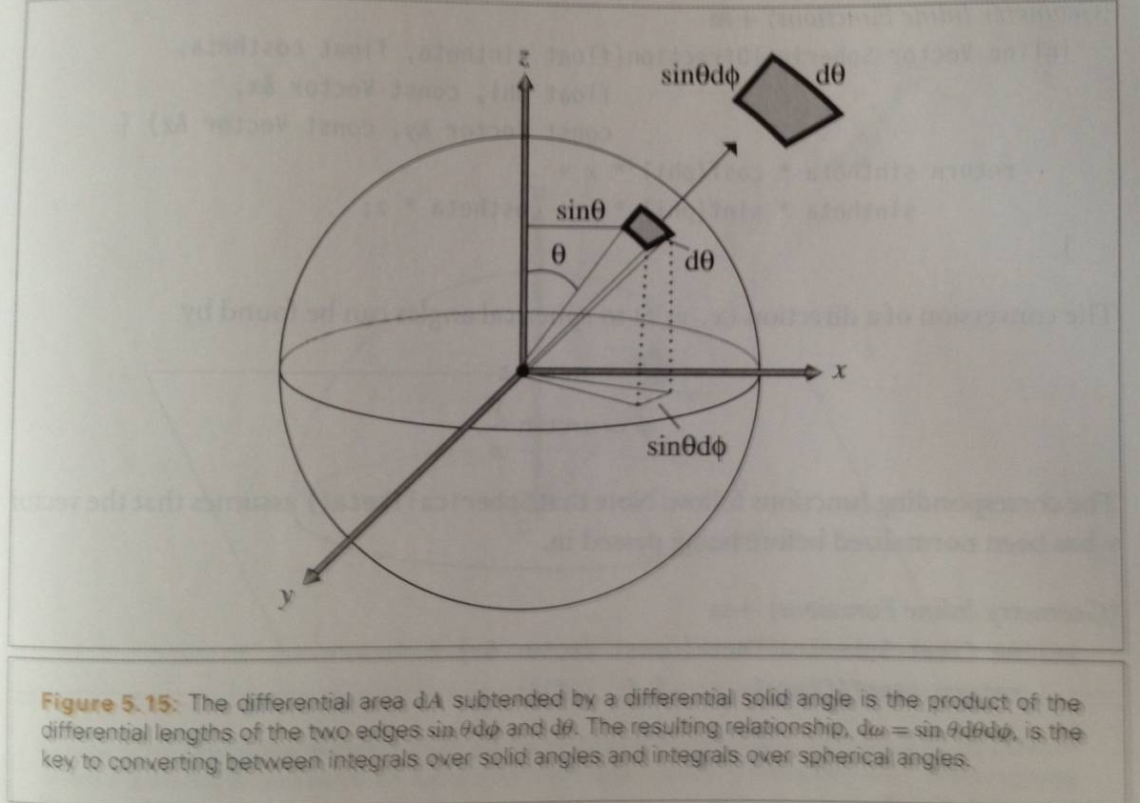
Solid angle & hemispherical integration

Slide 13
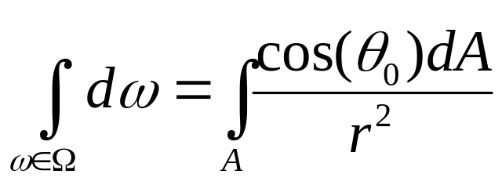
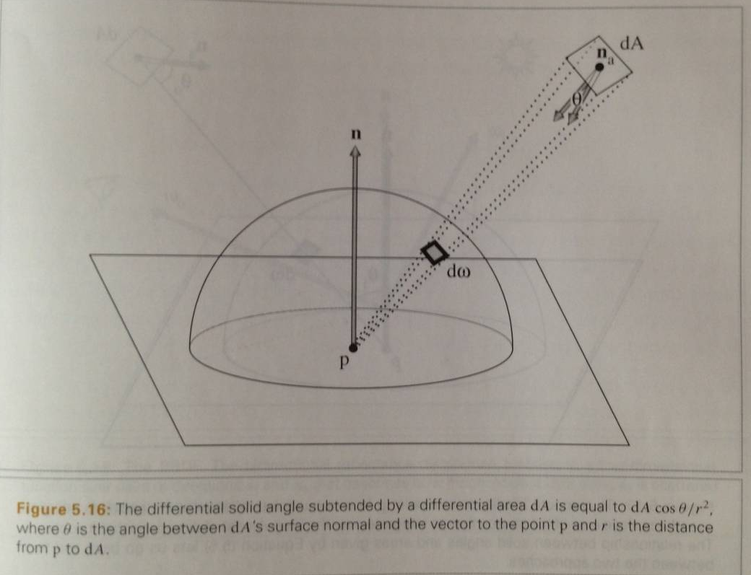
Solid angle & hemispherical integration

Slide 14
Examples of radiometry measure
Light transport & BRDF
Point light source
Human eyes/camera
Light map, environment map, light probe

Slide 15
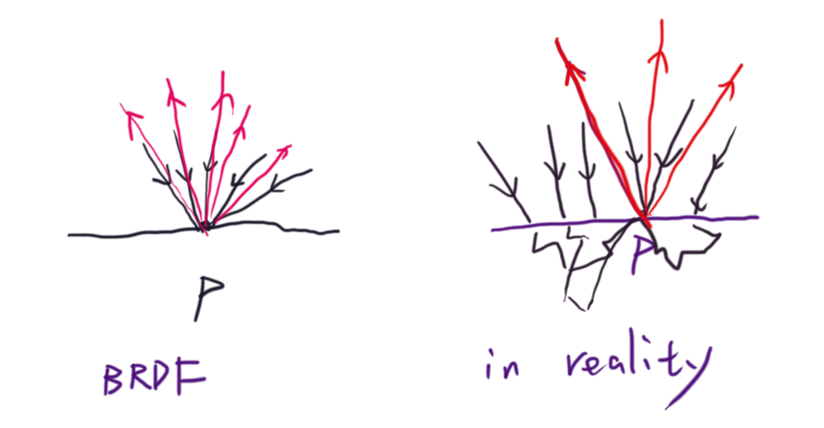
Light transport & BRDF
假設物體表面點p的反射光只受到入射p的光影響，我們想求某一個方向的反射radiance

Slide 16
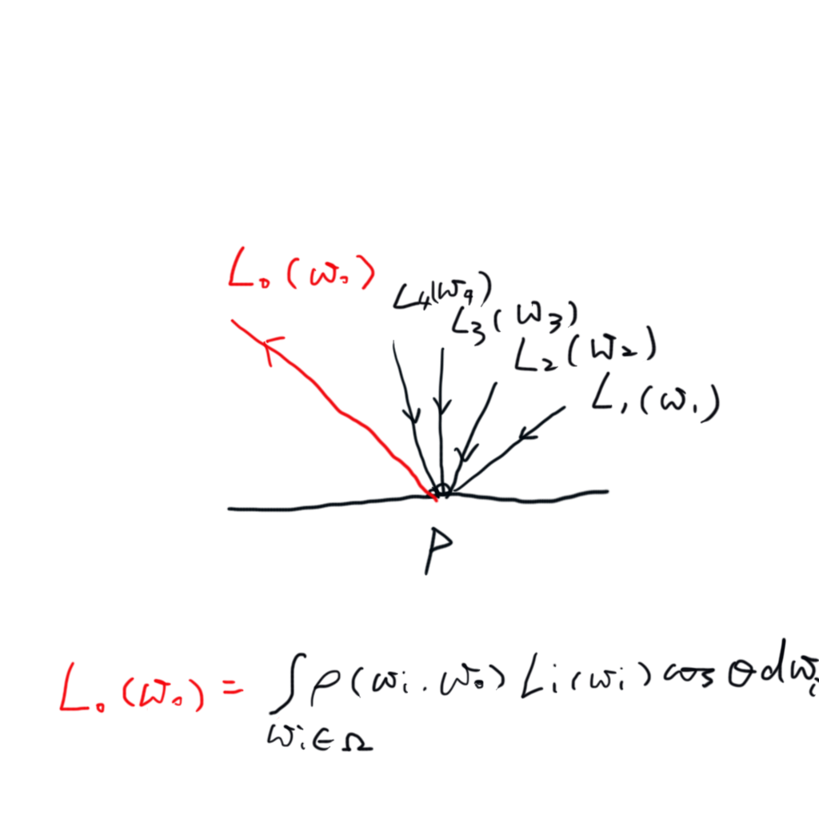
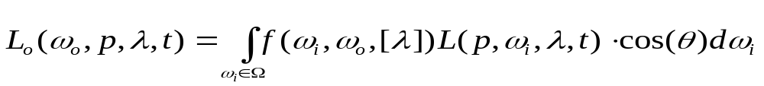
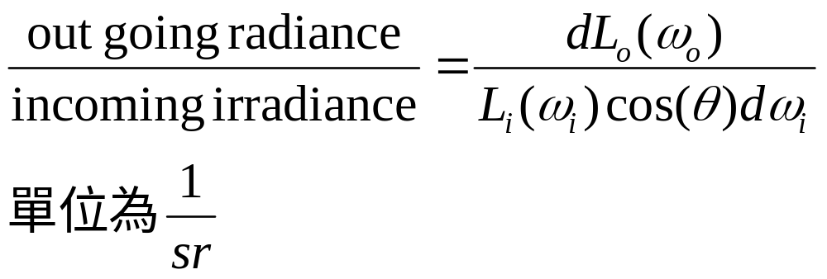
Light transport & BRDF
Rendering equation, ver. 1
Definition of BRDF

Slide 17
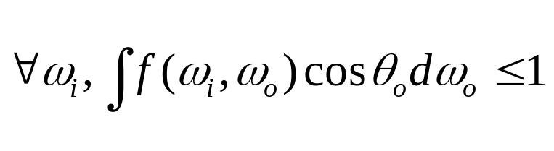
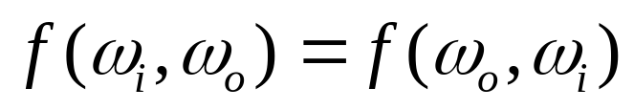
Properties of physically based BRDF
Positivity f>=0
Energy conservation
Reciprocity

Slide 18
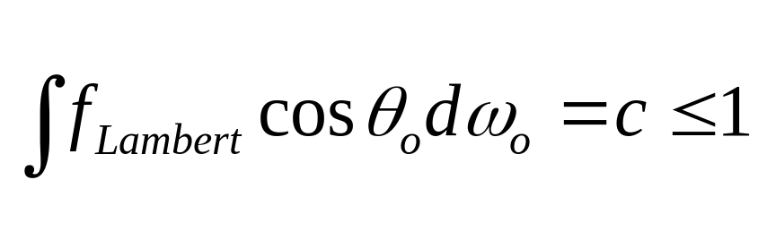
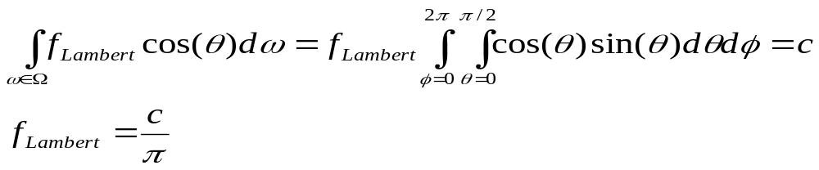
Ex. Lambertian surface
與入射光反射光方向無關，平均反射一定量的入射光

Slide 19
Examples
Point light source
Light map, environment map, light probe
Human eyes/camera

Slide 20
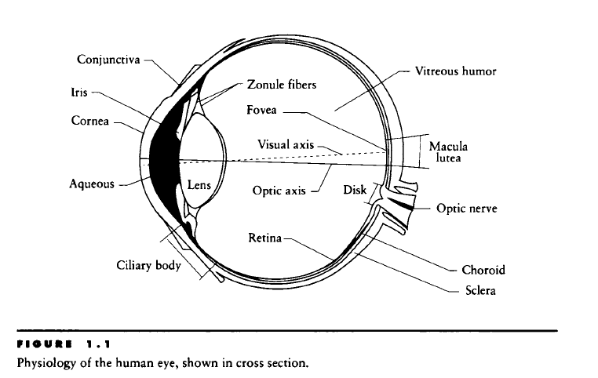
Photometry

Slide 21
Perception
Receptors of human eyes
  Three types of Cone
  Rod
Perception
  Photopic (high light, color, cone)
  Scotopic (low light, only brightness, rod)

Slide 22
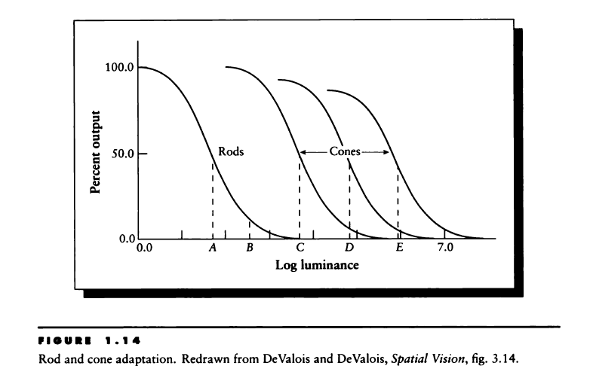

Slide 23
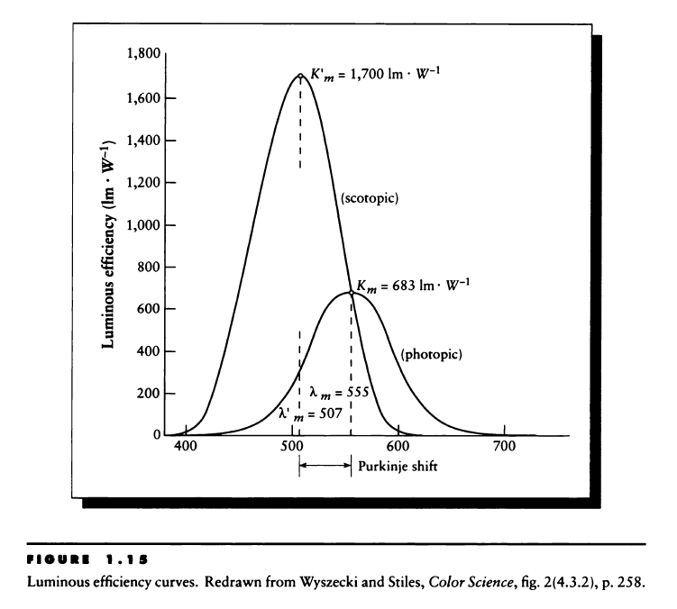

Slide 24
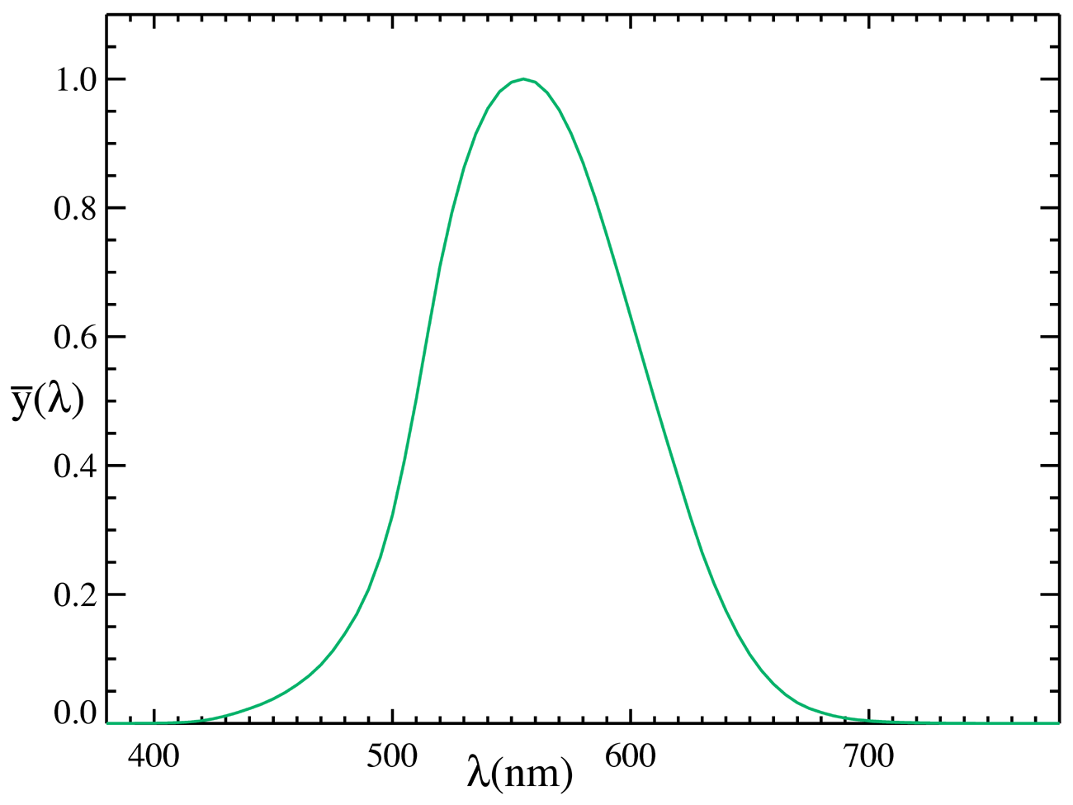
Luminous efficiency curve

Slide 25







Radiometry vs Photometry measure
radiance |  | Luminance(Nit)
intensity |  | Candela(cd)
irradiance |  | Lux(lx)
flux | W | Lumen(lm)

Slide 26
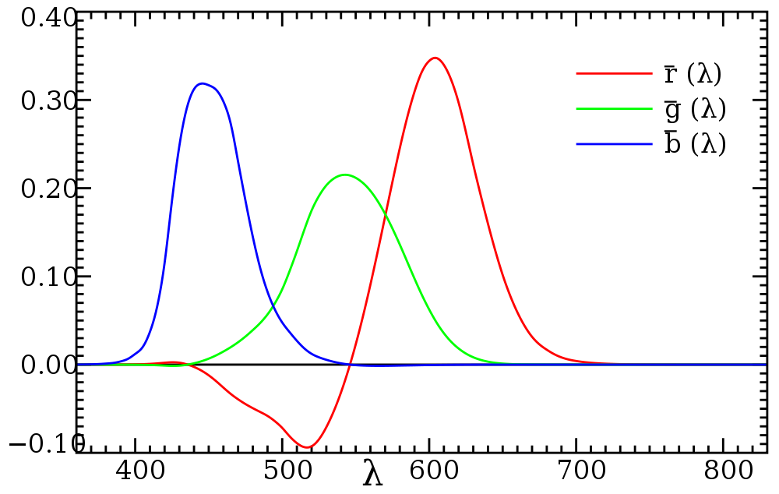
CIE RGB color space

Slide 27
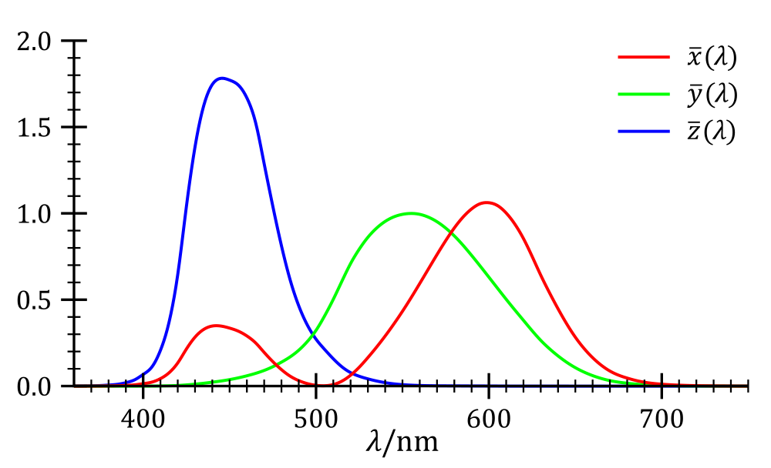
CIE XYZ color space

Slide 28
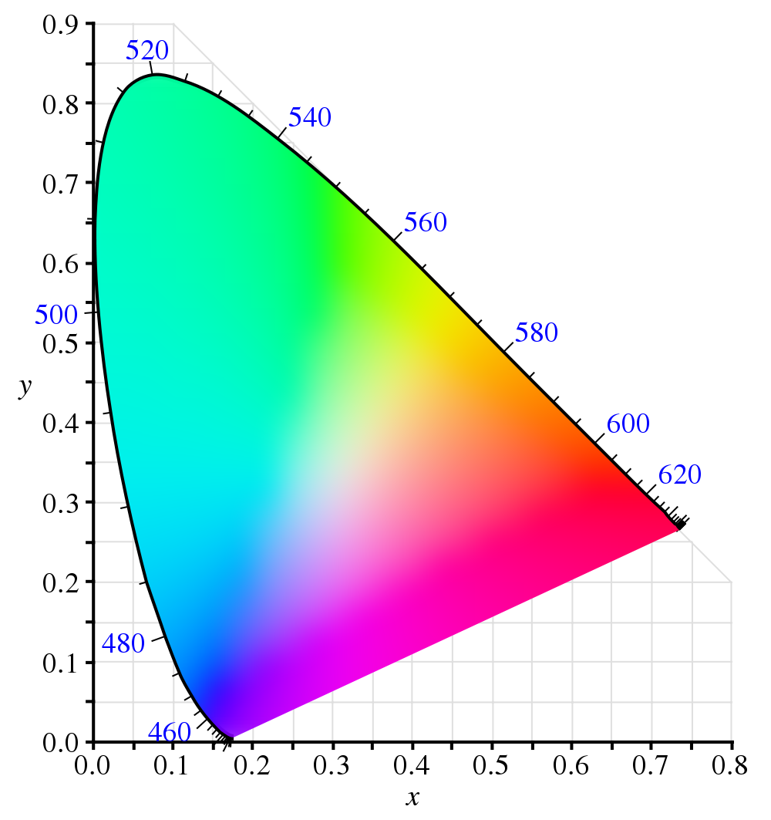
xy

Slide 29
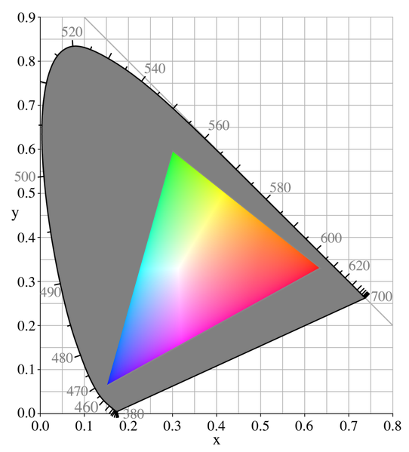
Display gamut

Slide 30
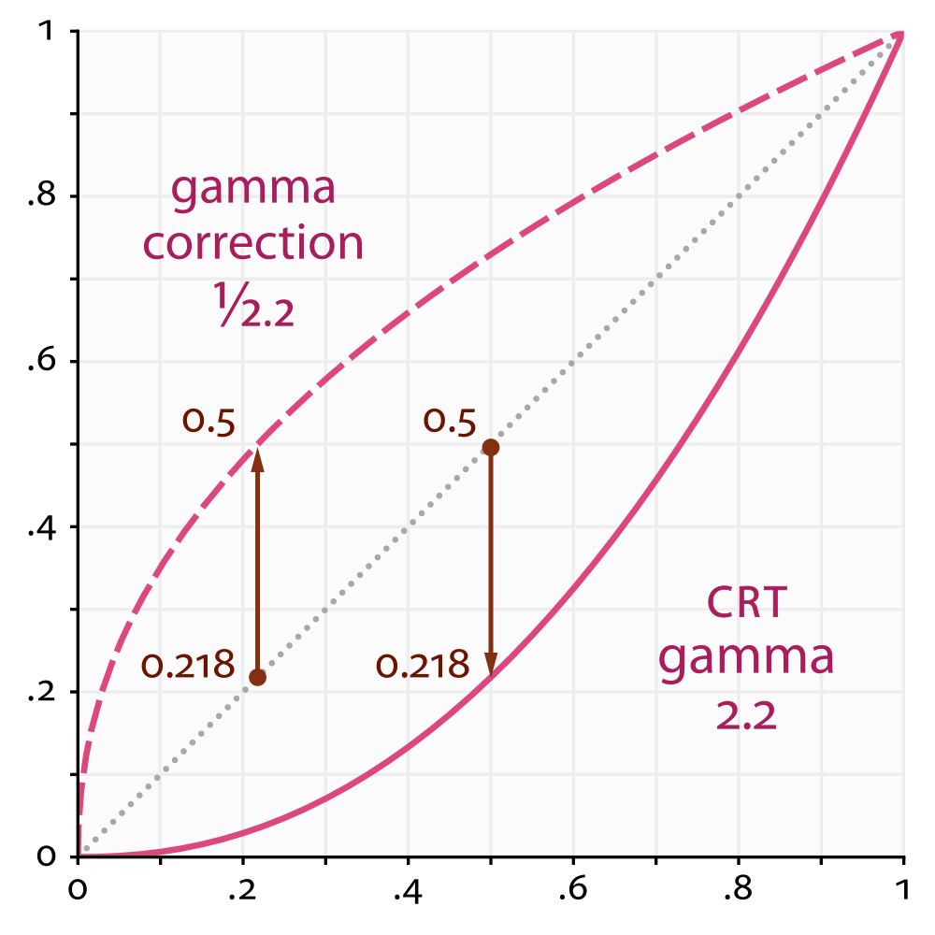
Gamma

Slide 31
Addendum
Why sky is blue
  Blue is scattered more than other color because it’s higher freqnency
  http://spaceplace.nasa.gov/blue-sky/
What’s generally not simulated in computer graphics
  Diffraction
  Polarization
  Fluorescence

Slide 32
References
Real time rendering 3rd ed Chpater 7
Siggraph 2012 Physically based shading course
  Background: Physics and Math of Shading
Computer graphics principles and practice 3 rd chapter 26
Physically based rendering: from theory to implementation second ed chapter 5

