Slide 1
Monte Carlo:
Direct Lighting & Importance sampling

Slide 2
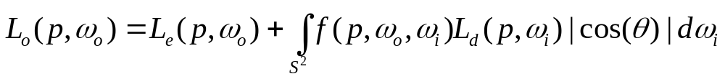
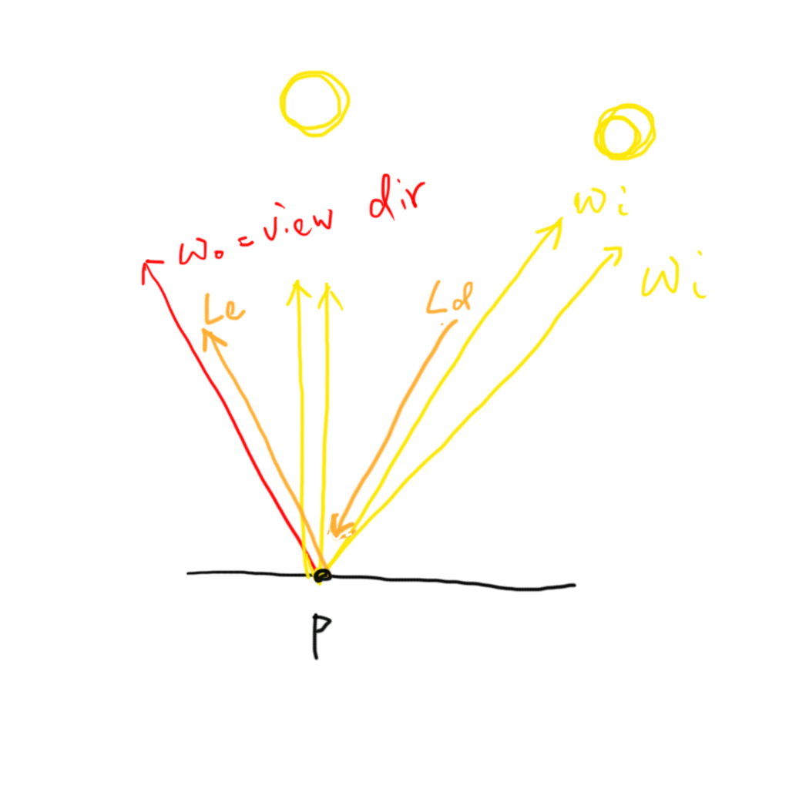
Direct lighting

Slide 3
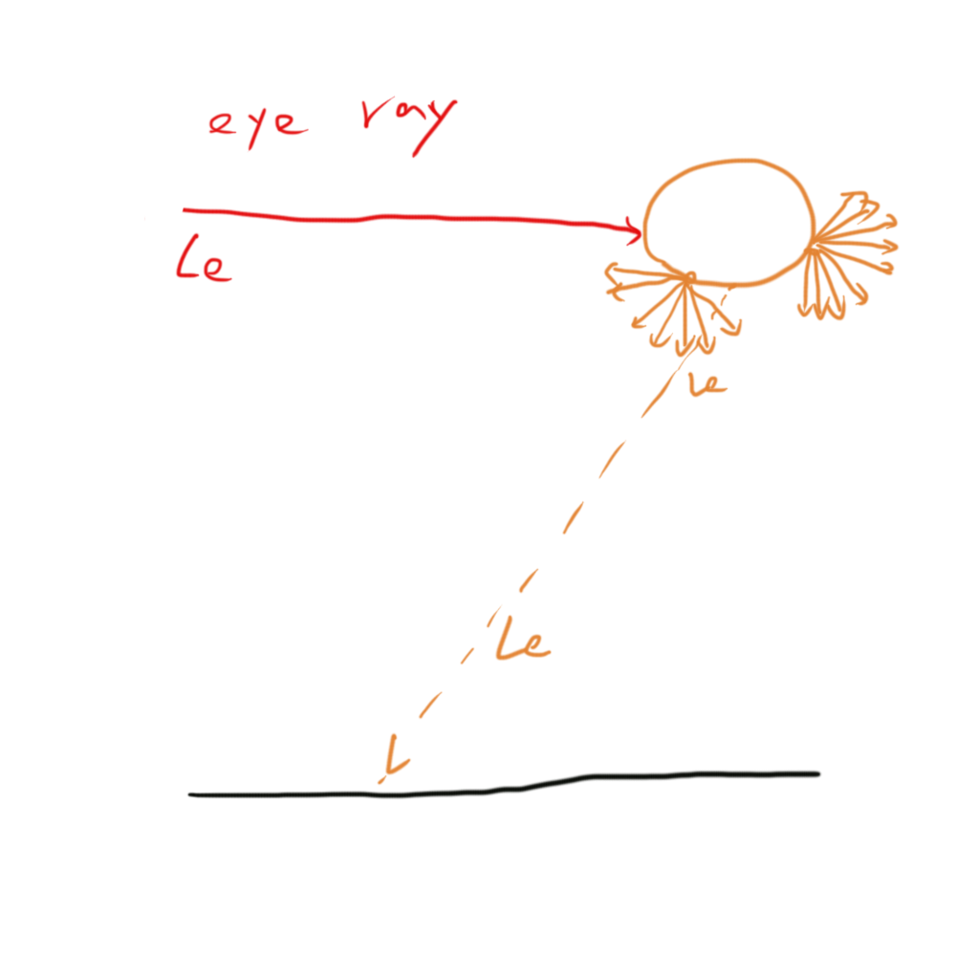
Light
Suppose we only deal with diffuse area light

Slide 4
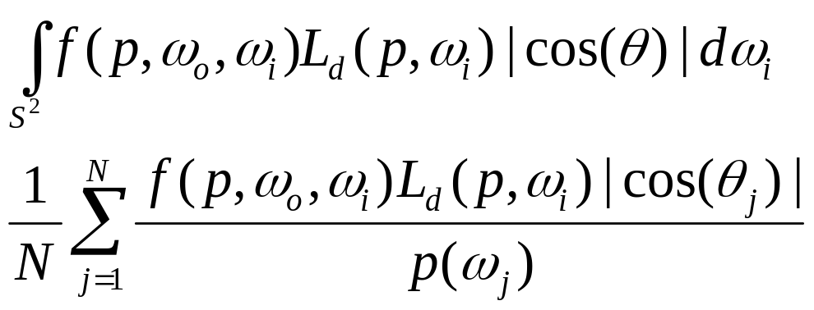
Estimating the direct lighting integral

Slide 5
Sampling strategy
Uniform sample
Sample each lights
Sample one light at a time

Slide 6
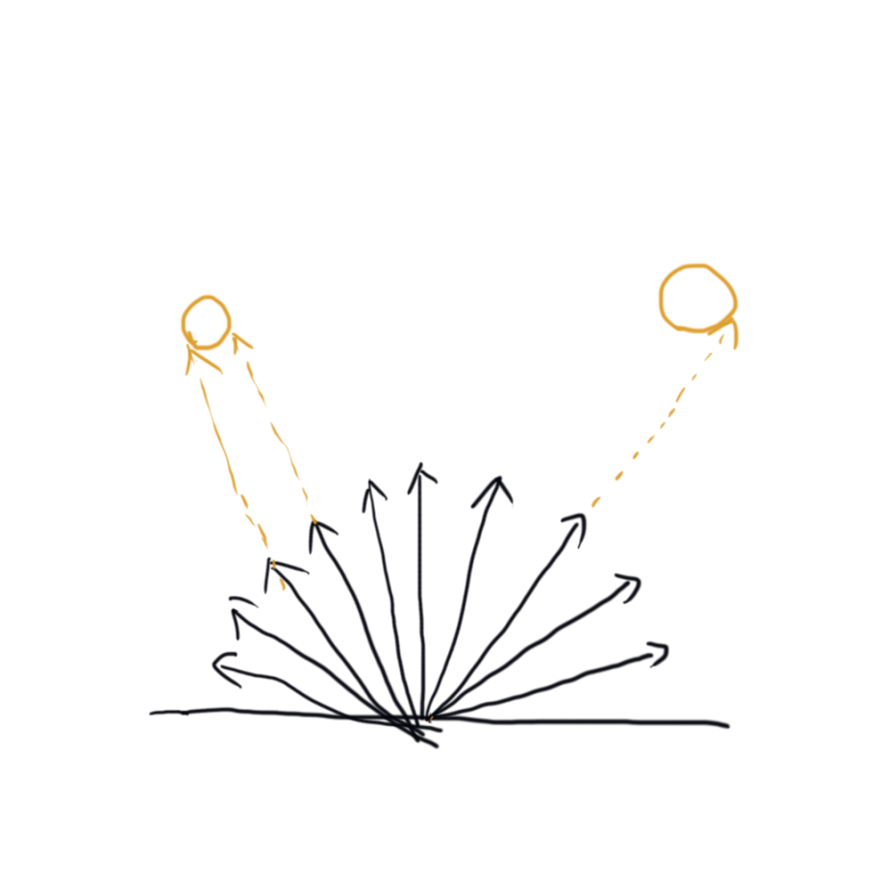
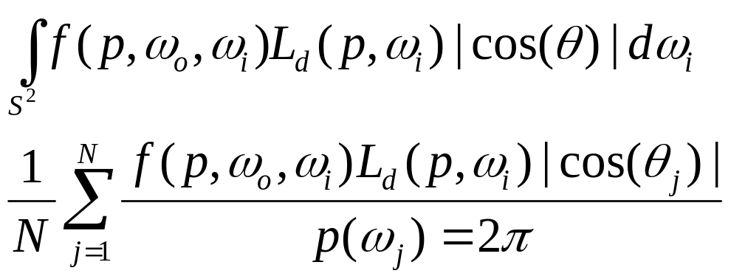
Uniform sample

Slide 7
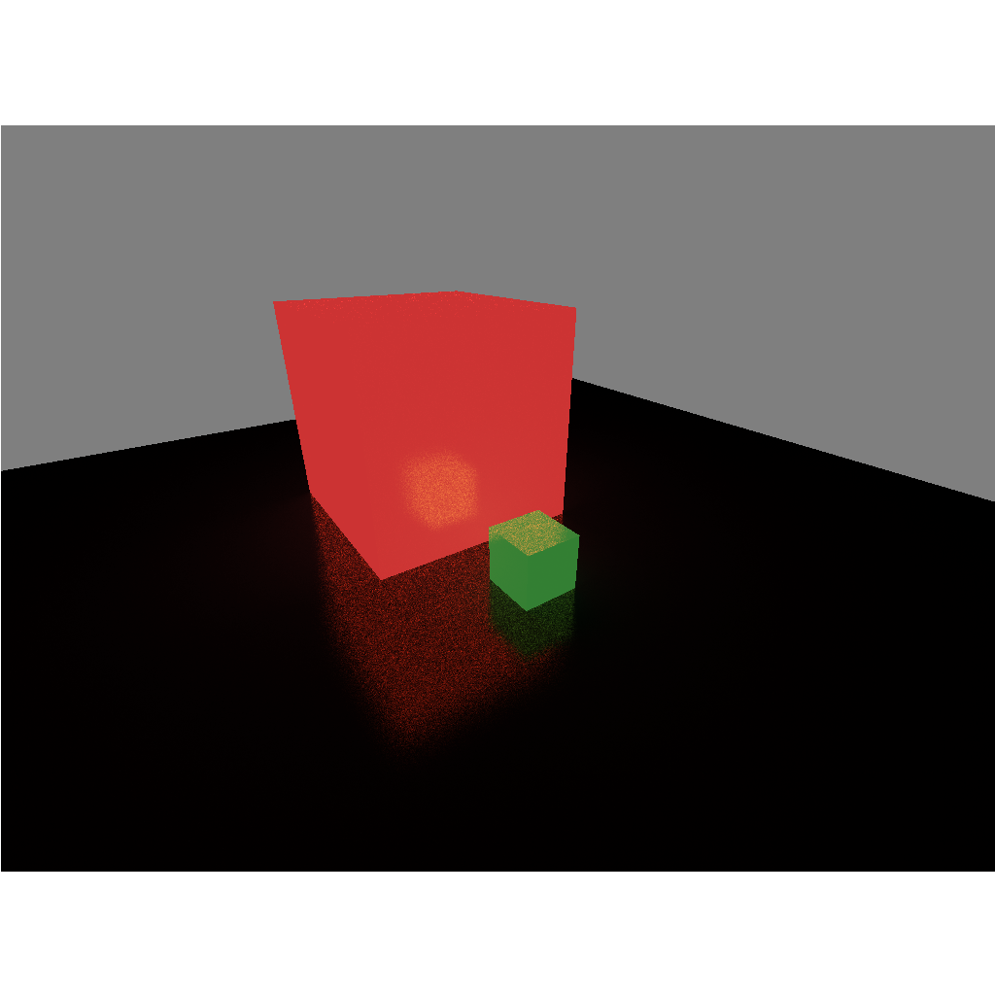
Uniform sample
1024 samples per pixel

Slide 8


Importance sample
Ideally, We want match
Practically, we can draw samples according to f or L

Slide 9
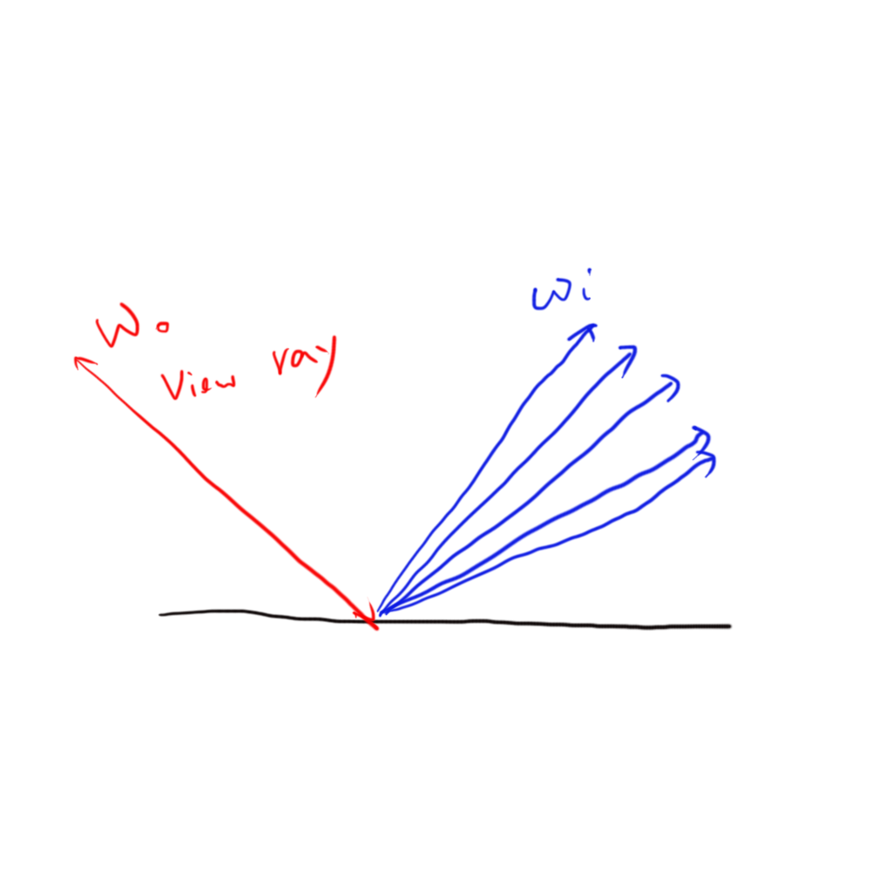
Importance sample BRDF

Slide 10
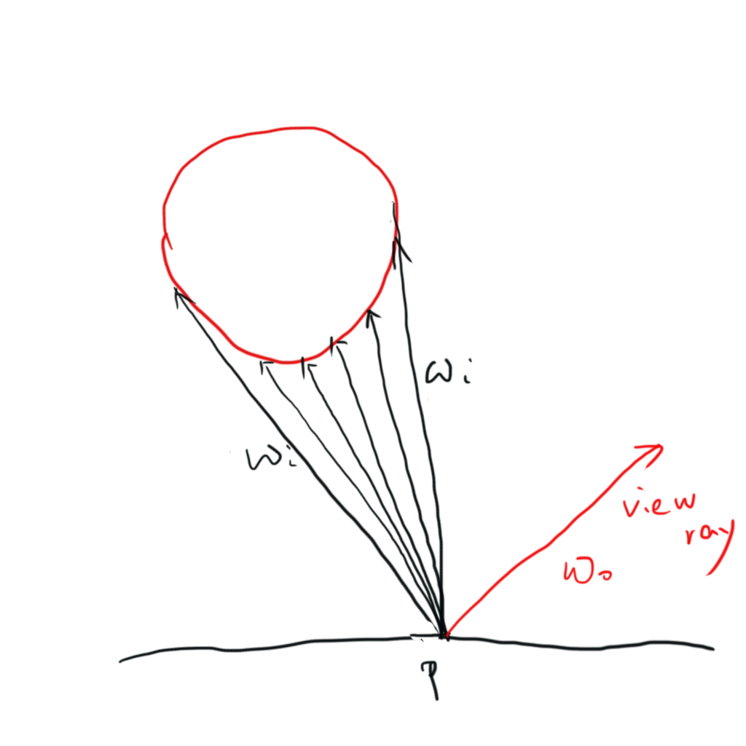
Importance sample light

Slide 11
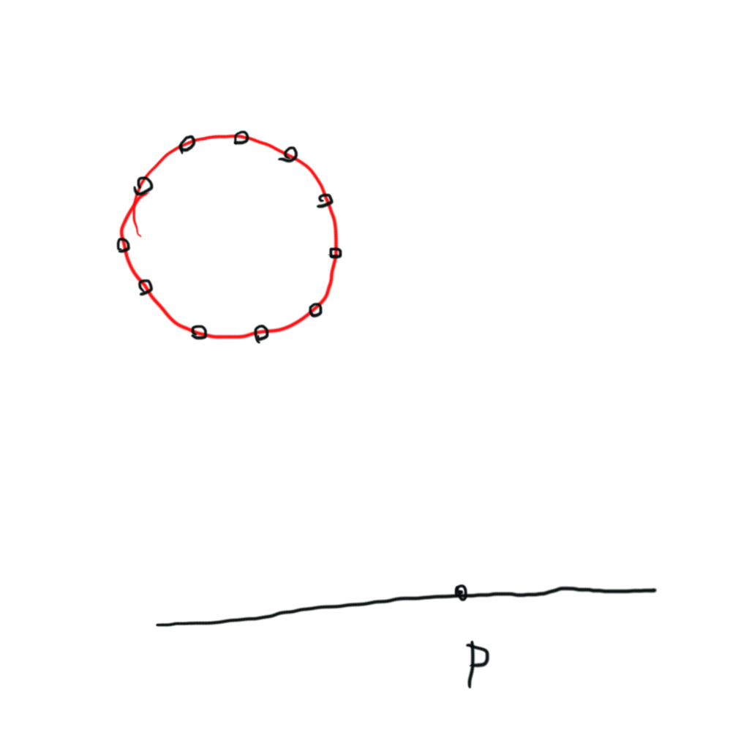
Importance sample light
Step 1: Uniform sample the shape of light

Slide 12
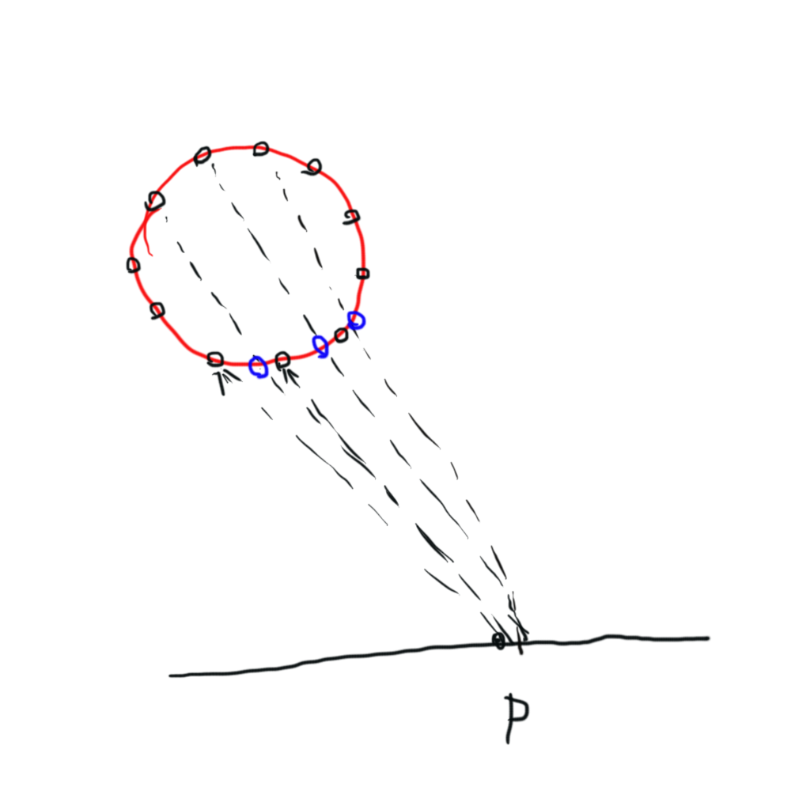
Importance sample light
Step 2: ray trace to get the nearest points on light

Slide 13
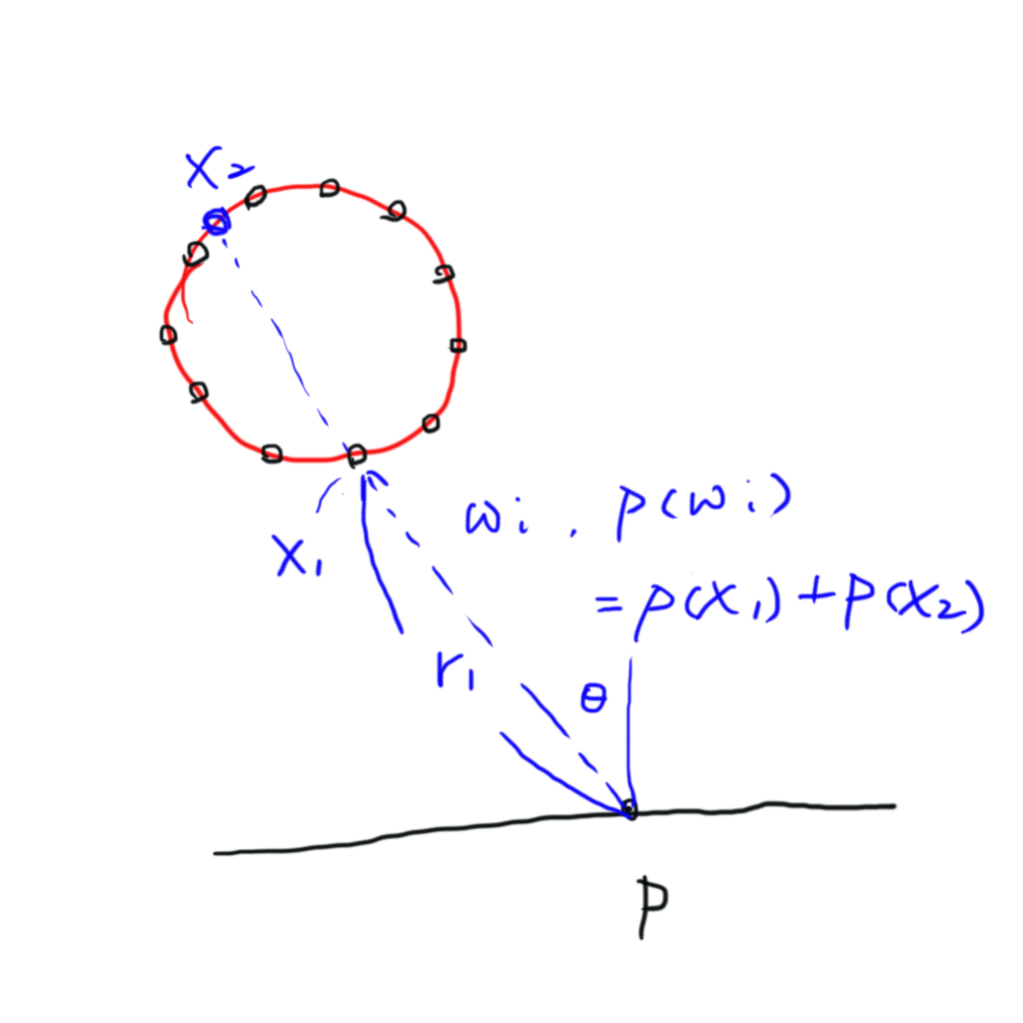
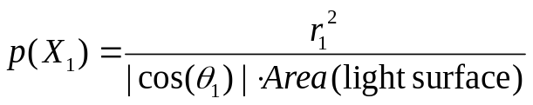
Importance sample light
Step 3: convert the pdf from light surface to position angle

Slide 14
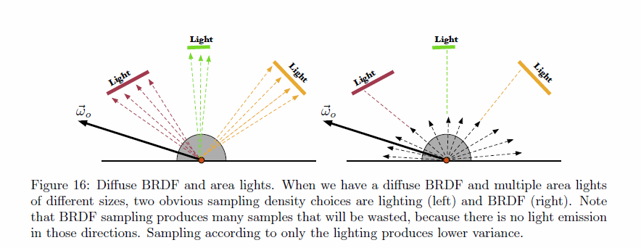
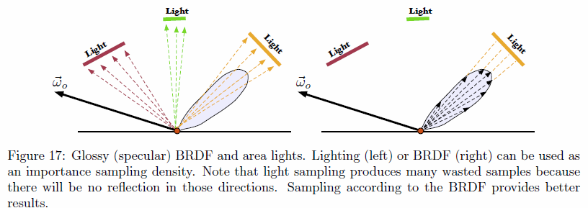
Multiple importance sampling
Sample BRDF works poorly on diffuse surface
Sample Light works poorly on glossy surface
Pictures from“Importance sampling for production rendering”

Slide 15
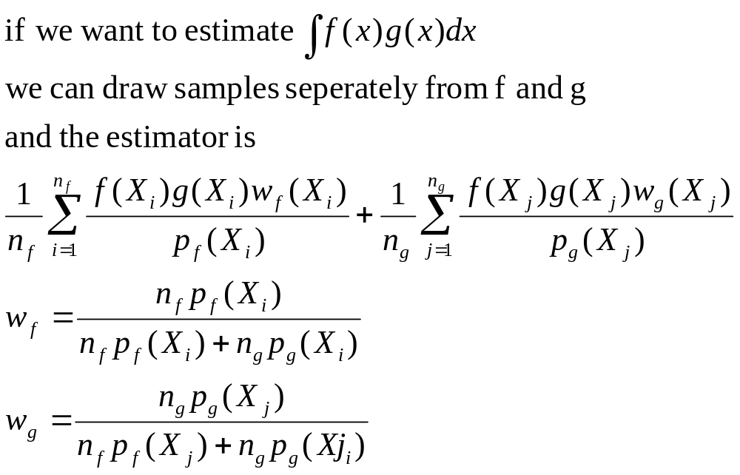
Multiple importance sampling
Mix two distributions

Slide 16
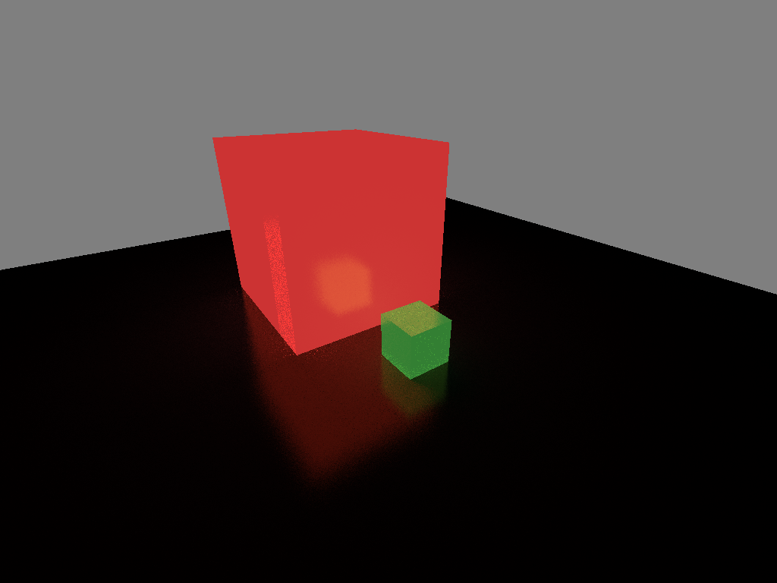
Multiple importance sampling
Multiple importance sampling
32 light samples + 32 BRDF samples
Uniform sampling
1024 samples

Slide 17
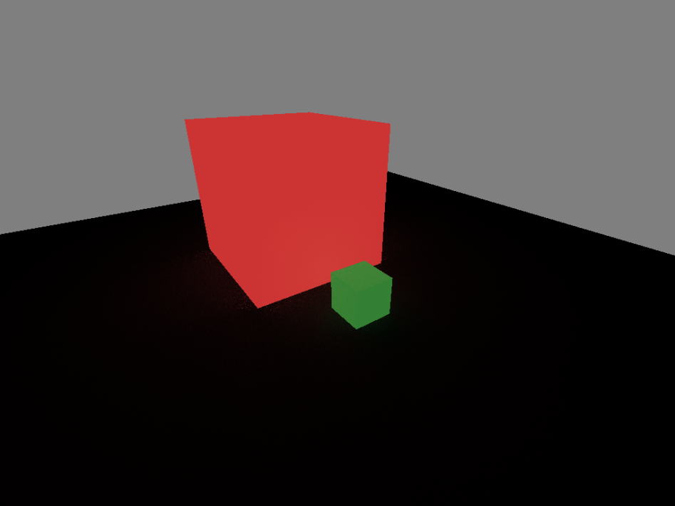
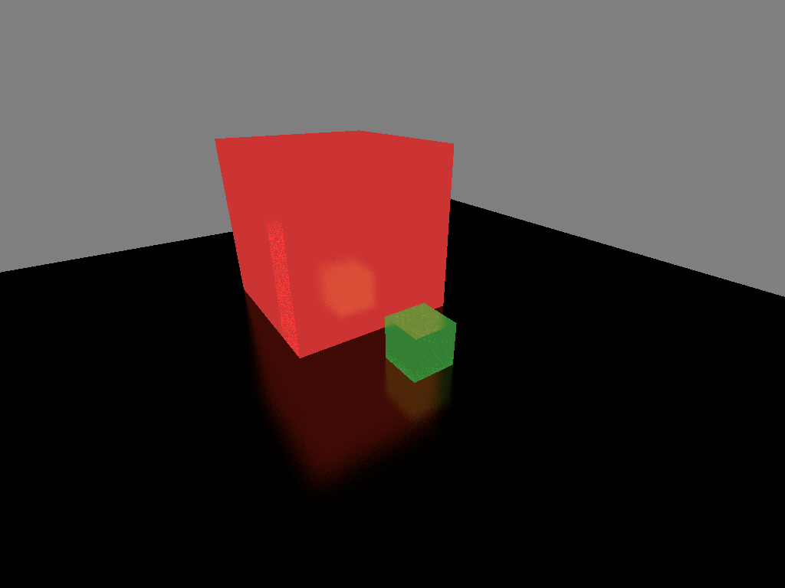
Multiple importance sampling
Light samples contribution
BRDF samples contribution

Slide 18
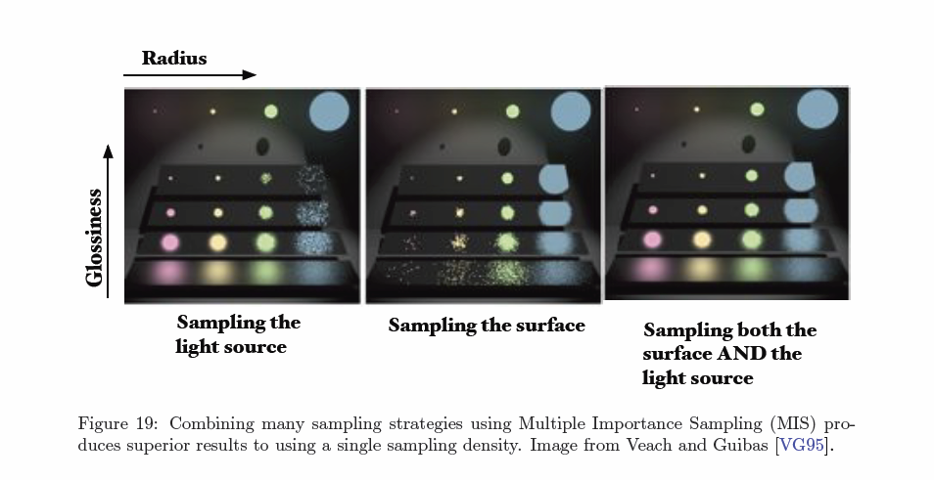
Multiple importance sampling
Pictures from“Importance sampling for production rendering”

Slide 19
Special case
“Delta” light
  Point light
  Directional light

