Slide 1
Signal processing

Slide 2
Signal processing
Fourier Transform
  Very important
Applications
  Image processing
    Filtering
    Anti aliasing
  Image compression
    JPEG - Discrete cosine transform
  Rendering
    Spherical harmonic lighting

Slide 3
Function
Function
  Spatial domain
Twilight zone
  Frequency domain

Slide 4
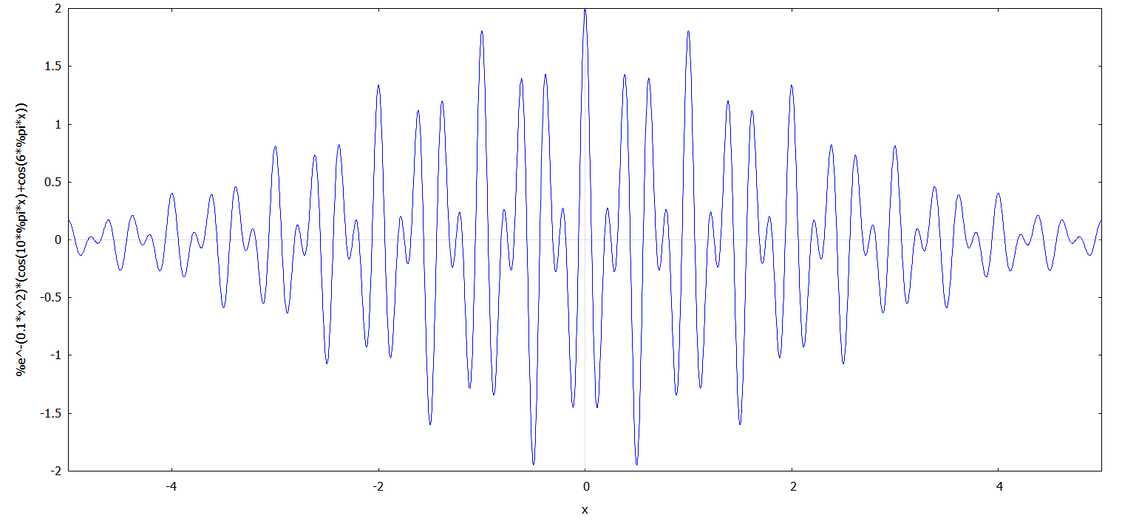

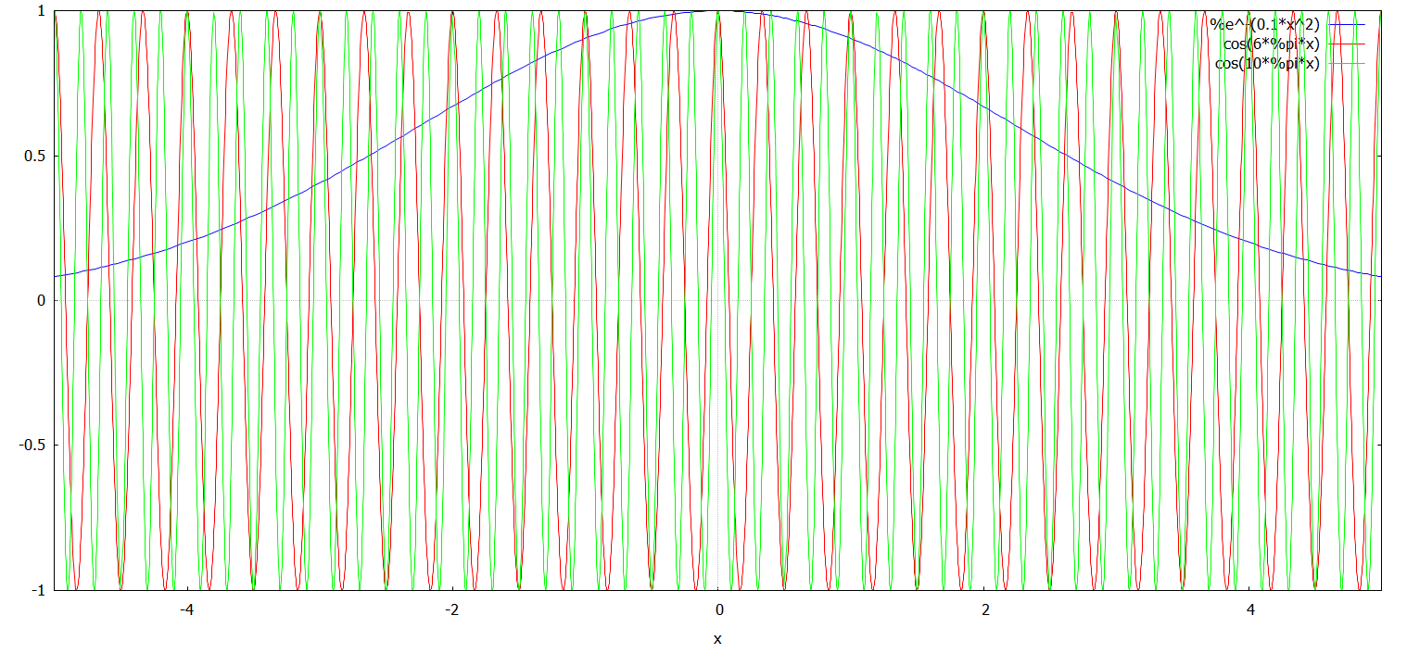

Slide 5

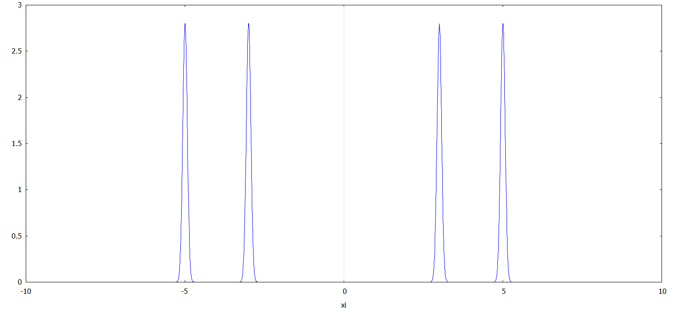
Spatial domain
Fourier transform
Frequency domain

Slide 6

Frequency domain
Inverse Fourier transform
Spatial domain

Slide 7

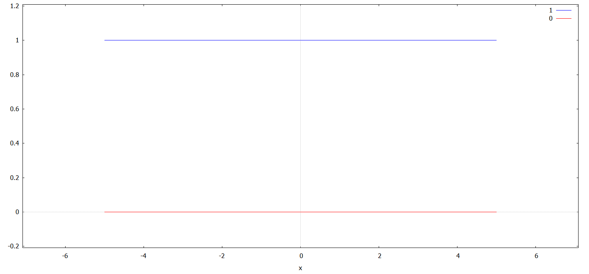
Fourier transform explained
Basis function
=
b(x, 0)

Slide 8
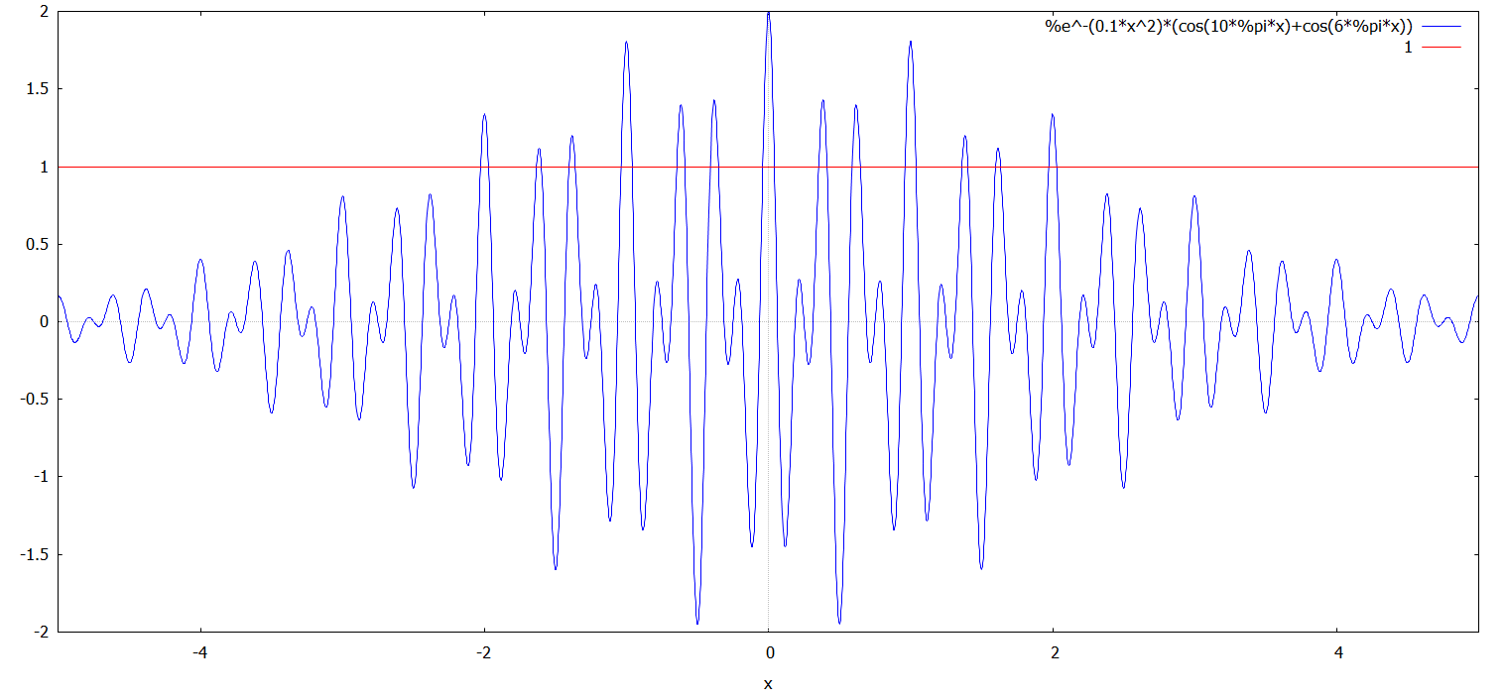
H(x), b(x, 0)
H(x) * b(x, 0)

Slide 9
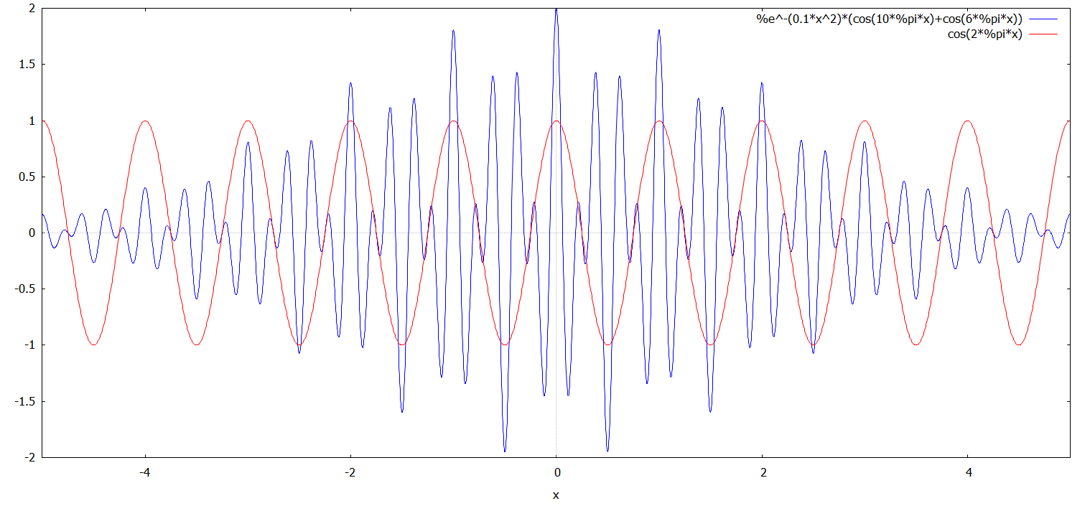
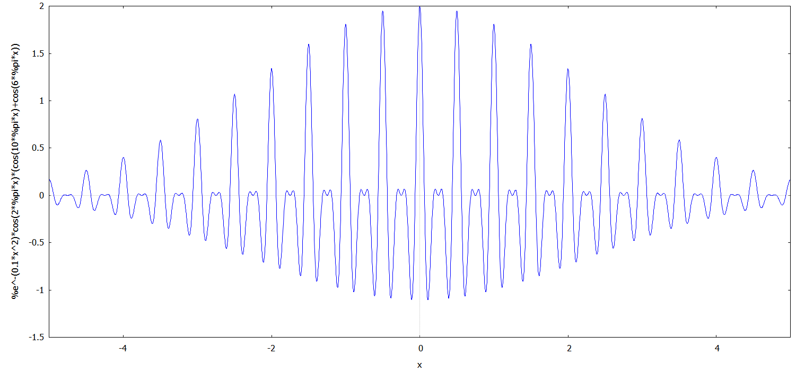
H(x), b(x, 1)
H(x)*b(x, 1)

Slide 10
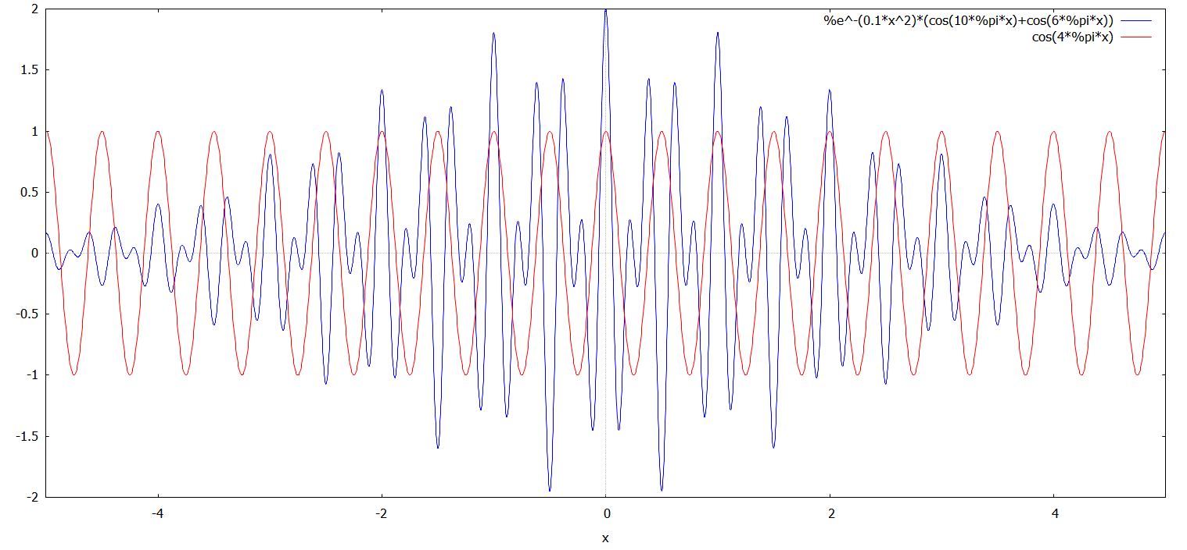
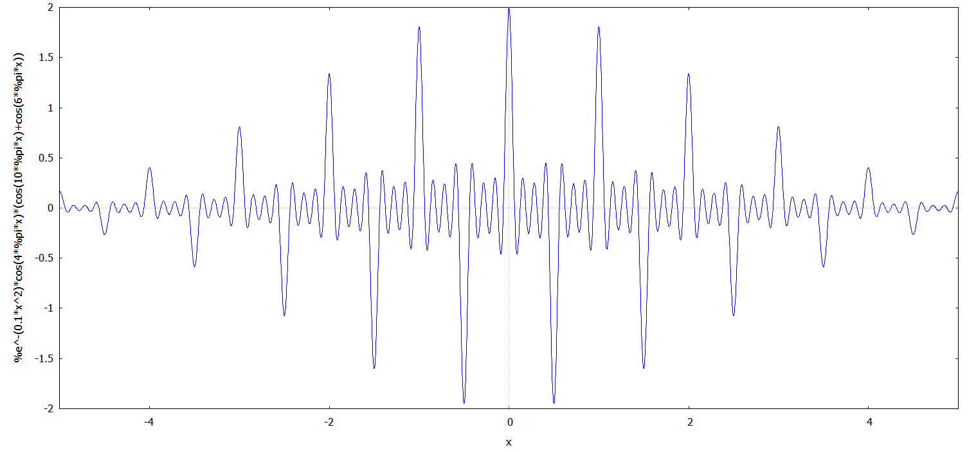
H(x), b(x, 2)
H(x)*b(x, 2)

Slide 11
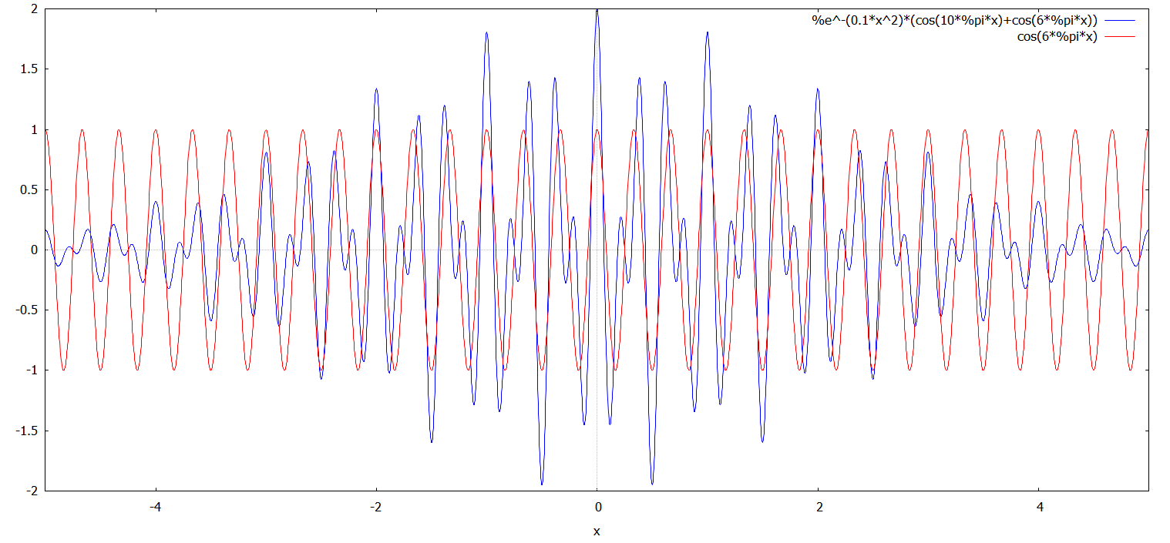
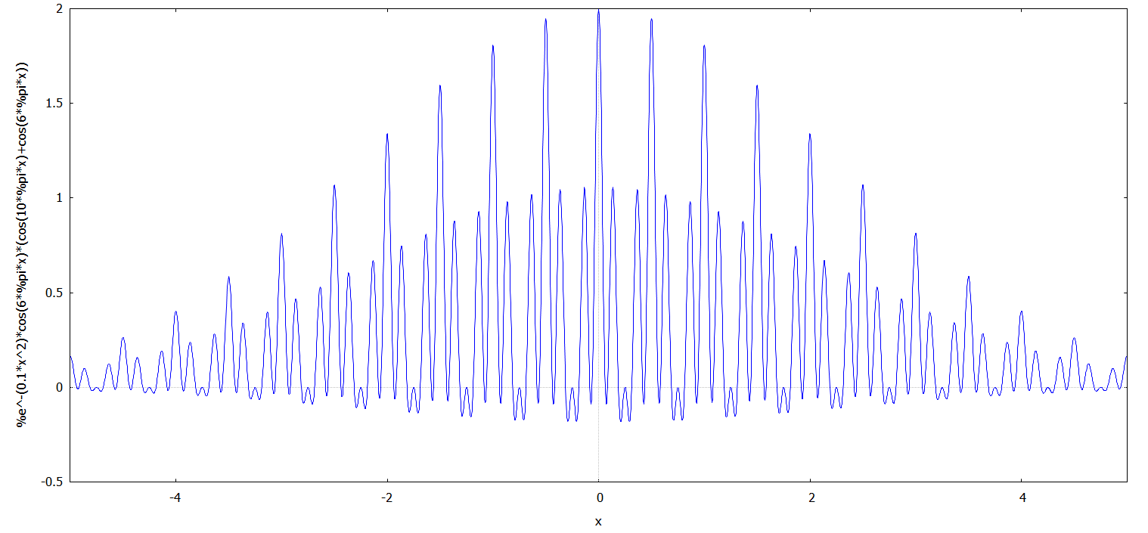
H(x), b(x, 3)
H(x)*b(x, 3)

Slide 12
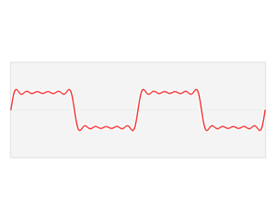
Fourier transform explained
From wiki
  http://en.wikipedia.org/wiki/Fourier_transform
The Fourier transform relates the function's time domain, shown in red, to the function's frequency domain, shown in blue. The component frequencies, spread across the frequency spectrum, are represented as peaks in the frequency domain.

Slide 13
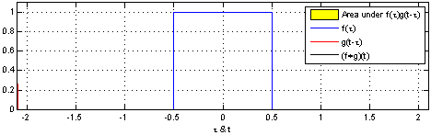


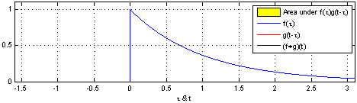
Convolution
From wiki
Or in computer graphics term
  filtering

Slide 14
Fourier transform & convolution
Convolution theorem
  Convolution in spatial domain becomes multiplication in frequency domain
  Multiplication in frequency domain becomes convolution in spatial domain

Slide 15
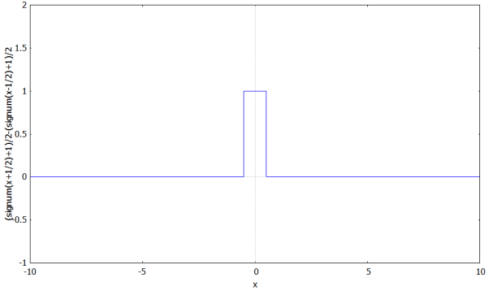
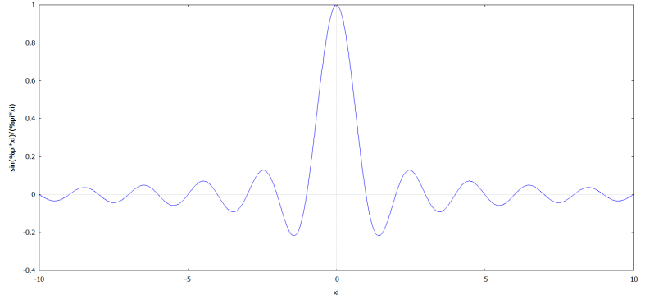
Filtering example
Box filter
Ideal low pass filter
Multiply in Frequency domain
Convolve in Spatial domain
Convolve in Spatial domain
Multiply in Frequency domain

Slide 16
Introduction to Maxima
Maxima is a free Computer algebra system
  Symbolic and numerical
  http://maxima.sourceforge.net/
Like Mathematica
Has it’s problems, but I am poor
An online 10 mins tutorial
  http://math-blog.com/2007/06/04/a-10-minute-tutorial-for-solving-math-problems-with-maxima/

Slide 17
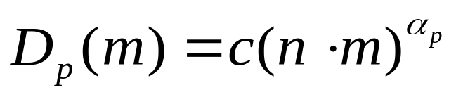
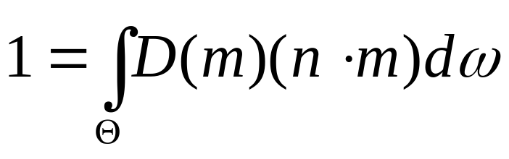
Solve graphics problems using Maxima
Example:
Blinn-phong Normal Distribution Function
  Normalization, solve c
  Visualization

