Slide 1
Implementing basic shadow map

Slide 2
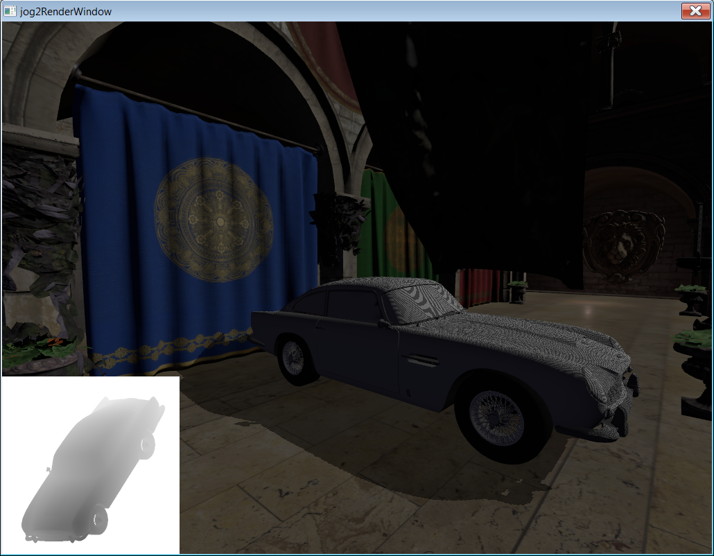
Shadow map
Render shadow caster from light’s view into a depth map
Render scene, calculate position in light space
Fetch shadow map depth with position.xy
Compare calculated depth (position.z) with shadow map depth
If( shadowMapZ < position.z)
pixel is under shadow

Slide 3
Implementation note
Shadow map
  Depth texture, format GL_DEPTH_COMPONENT32F
  Frame buffer object with only depth attachment

Slide 4
Implementation note
Currently only implement directional light shadow map
Matrices construction
  View matrix – look at direction == -light dir, choose random right, up direction and orthogonalize
  Projection matrix
    Minimize the bound in light space

Slide 5
Shadow map projection matrix construction
Calculate world space bounding box
Calculate light space bounding box
  Using light’s view matrix (Mview * bound)
Construct projection matrix with light space’s bound
See code

Slide 6
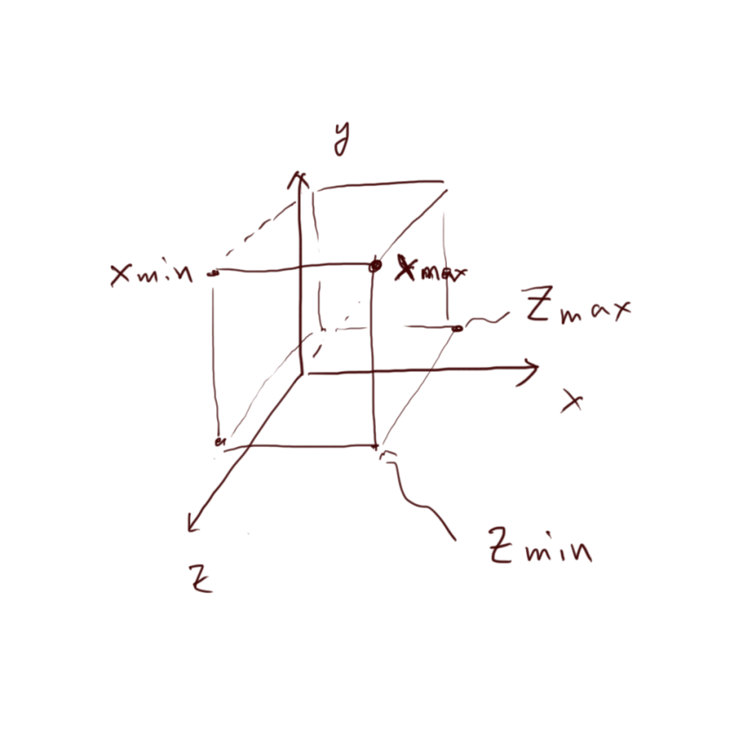
Projection matrix note
Because we are using the right hand system. Note the direction of the z axis (znear > zfar)
float xmax = center.x + radius.x;
float xmin = center.x - radius.x;
float ymax = center.y + radius.y;
float ymin = center.y - radius.y;
float zmax = center.z - radius.z;
float zmin = center.z + radius.z;
float width = xmax - xmin;
float height= ymax - ymin;
return Matrix4x4(2.f / width, 0, 0, -(xmax + xmin) / width,
0, 2.f / height, 0, -(ymax + ymin) / height,
0, 0, 2.f / (zmax - zmin), -(zmax + zmin) / (zmax - zmin),
0, 0, 0, 1);

Slide 7
Shader note
Note that when rendering scene, it is possible that calculated light space z (or x, y) is greater than 1
  because there is no auto clipping in shader
  So, shadow map tex addressing mode must be clamp
  And clamp calculated z to 1
if(textureProj(shadowMap, shadow_coord).r < min(shadow_coord.z, 1.f))
shadow = 0.7f;

Slide 8
Light space to texture space
Texture space is in (0, 1), but after projection , position is in (-1, 1)
So before fetch shadow map, multiply
Matrix4x4(0.5, 0, 0, 0.5,
0, 0.5, 0, 0.5,
0, 0, 0.5, 0.5,
0, 0, 0, 1);

