Slide 1
OpenGL Render to Texture tutorial

Slide 2
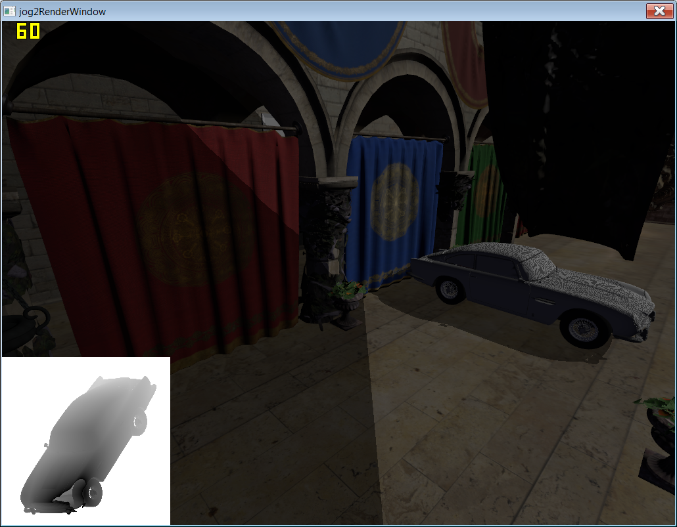

Broken shadow map…

Slide 3
Frame buffer
OpenGL frame buffer
  Provided by Window system, created with OpenGL context
  Off screen (frame buffer object)
    Managed by OpenGL
    Can be
      Texture
      Render buffer

Slide 4
Frame buffer object
Color attachment 0
…
Color attachment n
Depth attachment
Stencil attachment
Texture
or
Render buffer

Slide 5
Note
Frame buffer object is just a container, it does not manage resource
  Delete a frame buffer object dose not delete texture & render buffer it is attached to

Slide 6
What is render buffer
Render buffer is OpenGL managed memory, but it is not texture, it can’t be accessed directly by shaders
Why we need render buffer
  On older hardware, we have no access to multi sampled texture (or depth buffer) in shaders
  Multi sampled render buffer must be resolved (blit) to texture, then we use the non-MSAA texture
But on modern hardware (DX11+), basically we can treat everything as textures

Slide 7
Frame buffer object API
Red books Chapter 4 & 7
Create, bind, delete
  glGenFramebuffers(GLsizei n, GLuint *ids);
  glBindFramebuffer(GLenum target, GLuint framebuffer)
    target : DRAW_FREAMEBUFFER or READ_FRAMEBUFFER (blit source)
  glDeleteRenderbuffers(GLsize n, const GLuint* ids);

Slide 8
Frame buffer object API
Attach textures to a FBO
  glFramebufferTexture2D(GLenum target, GLenum attachment, GLenum texturetarget, GLuint texture, GLint level)
    Ex. glFramebufferTexture2D(GL_DRAW_FRAMEBUFFER, GL_COLOR_ATTACHMENT0, GL_TEXTURE2D, texID, 0)
Attach render buffers to a FBO
  glFramebufferRenderbuffer(GLenum target, GLenum attachment, Glenum renderbuffertarget, Gluint renderbuffer)
    Ex. glFramebufferRenderbuffer(GL_DRAW_FRAMEBUFFER, GL_DEPTH_ATTACHMENT, GL_RENDERBUFFER, rboID)

Slide 9
Frame buffer object API
Check if fbo is ready to use
glCheckFramebufferStatus(GLenum target);
  target : DRAW_FREAMEBUFFER or READ_FRAMEBUFFER (blit source)
  Return GL_FRAMEBUFFER_COMPLETE when everything is fine
  Other error code see red book p191

Slide 10
Render buffer API
glGenRenderbuffers(GLsizei n, GLuint* ids)
glBindRenderbuffer(GLenum target, GLuint renderbuffer)
  Target must be GL_RENDERBUFFER…
glRenderbufferStorage(GLenum target, GLenum internalformat, GLsizei width, GLsizei height)
glRenderbufferStorageMultisample(GLenum target, GLsizei samples, GLenum internalformat, GLsizei width, )

Slide 11
example
//create an empty texture
glGenTextures(1, &texture);
glBindTexture(GL_TEXTURE_2D, texture);
glTexImage2D(GL_TEXTURE_2D, 0, GL_RGBA8, 256, 256, 0, GL_RGBA, GL_UNSIGNED_BYTE, NULL)
//create a depth render buffer
glGenRenderbuffers(1, &renderbuffer);
glBindRenderbuffer(GL_RENDERBUFFER, renderbuffer);
glRenderbufferStorage(GL_RENDERBUFFER, GL_DEPTH_COMPONENT24, 256, 256);
//attach the texture and depth buffer to the framebuffer
glGenFramebuffers(1, &framebuffer);
glBindFramebuffer(GL_DRAW_FRAMEBUFFER, framebuffer);
glFramebufferTexture2D(GL_DRAW_FRAMEBUFFER, GL_COLOR_ATTACHMENT0, GL_TEXTURE_2D, texture, 0)
glFramebufferRenderbuffer(GL_DRAW_FRAMEBUFFER, GL_DEPTH_ATTACHMENT, GL_RENDERBUFFER, renderbuffer)

Slide 12
When render
Render to FBO
  glBindFramebuffer(GL_DRAW_FRAMEBUFFER, framebuffer)
  glViewport(0, 0, texWidth, texHeight);
Render to default framebuffer (window)
  glBindFramebuffer(GL_DRAW_FRAMEBUFFER, 0)
  glViewport(0, 0, windowWidth, windowHeight);

Slide 13
Multiple render target
In fragment shader
layout (location = 0) out vec4 color; //draw to color attachment 0
layout (location = 1) out vec4 normal; //draw to color attachment 1

Slide 14
Blit/resolve MSAA from render buffer to texture
glBindFramebuffer(GL_READ_FRAMEBUFFER , source_fbo);
glBindFramebuffer(GL_DRAW_FRAMEBUFFER, dest_fbo);
glBlitFramebuffer(0, 0, texWidth, texHeight, 0, 0, texWidth, texHeight,
GL_COLOR_BUFFER_BIT, GL_LINEAR);

