Slide 1
Light Transport

Slide 2
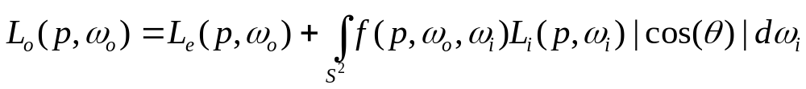
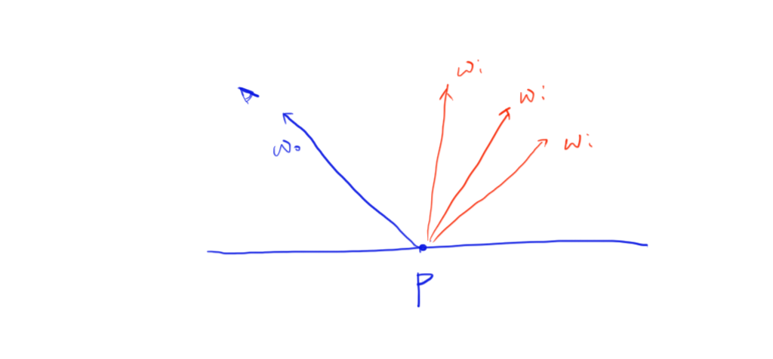
Rendering equation

Slide 3
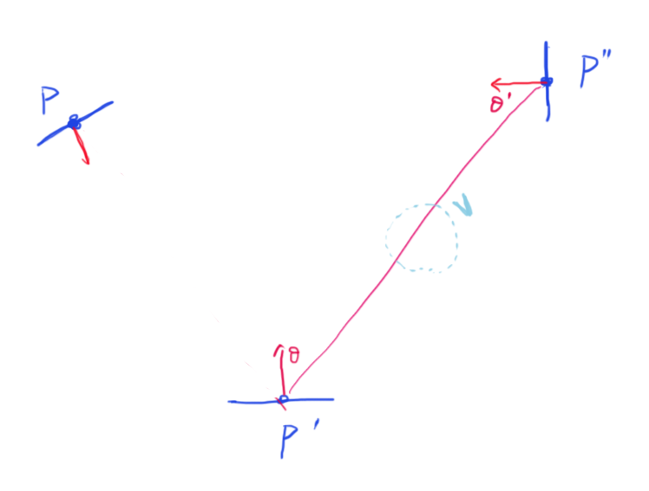


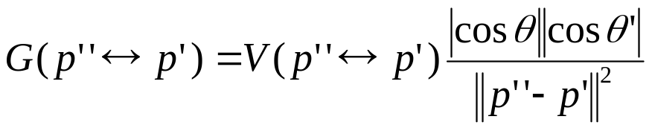
Surface form of the LTE

Slide 4
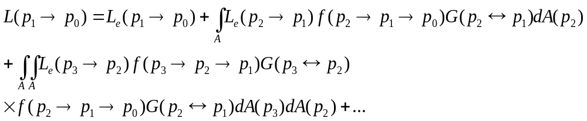
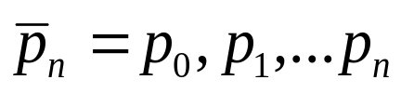
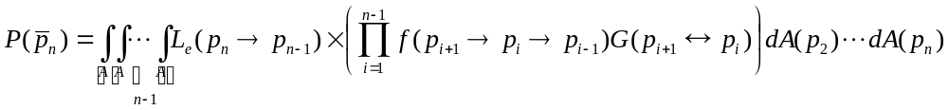
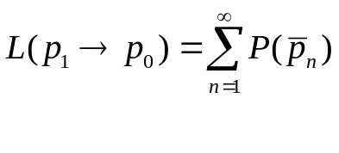
Integral over paths
Expand L on the right hand side
For the path , we define
Then

Slide 5

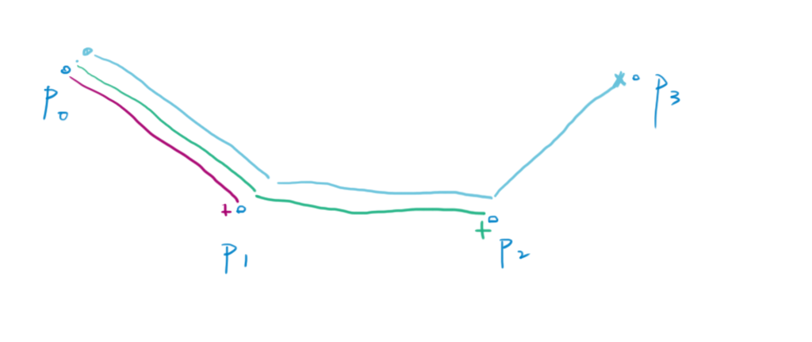
Integral over paths

Slide 6
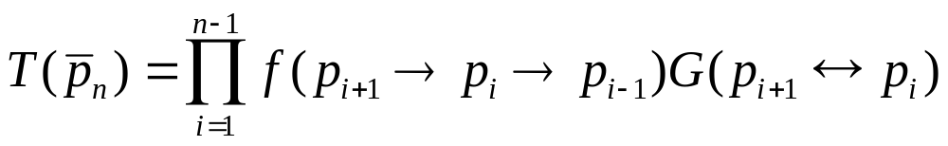
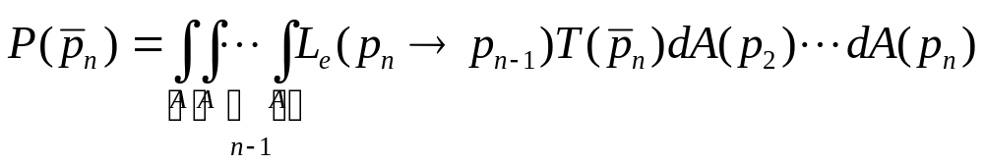
Integral over paths
Define as the throughput as the path

Slide 7
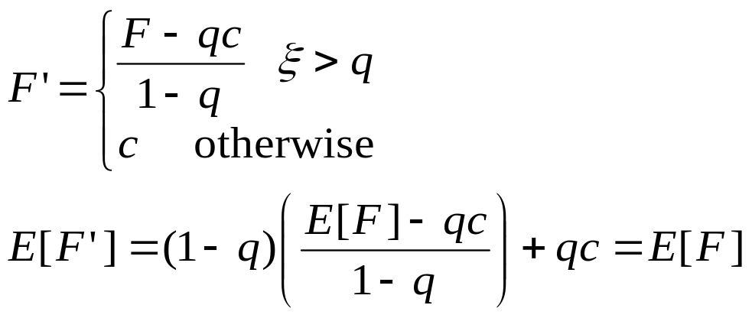
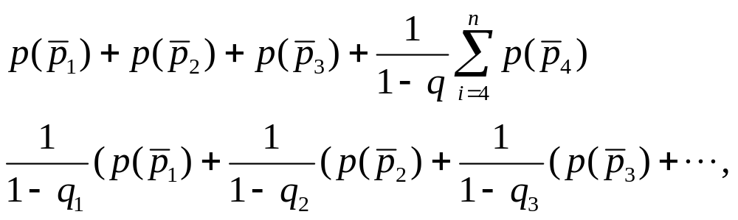
Termination
For unbiased render
Russian Roulette
For example

Slide 8
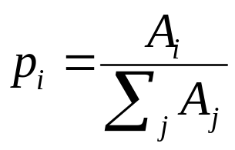
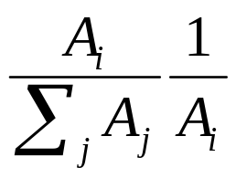

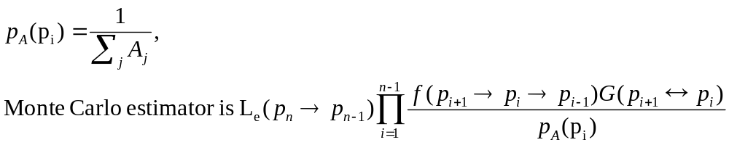
Path sampling
Uniform area sampling
Form j objects, sample the i-the object, the pdf is
Then uniform sample the surface of the object i, pdf is
Then for each sample point

Slide 9
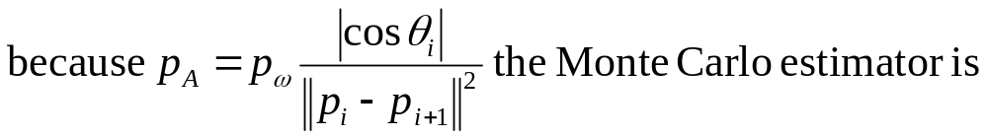
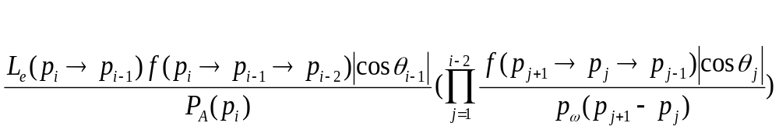
Path sampling
Path tracing
Incremental path construction
  At each vertex, the BSDF is sampled to generate a new direction and find the closest intersection.
  from last vertex, sample the surface of the light source

Slide 10
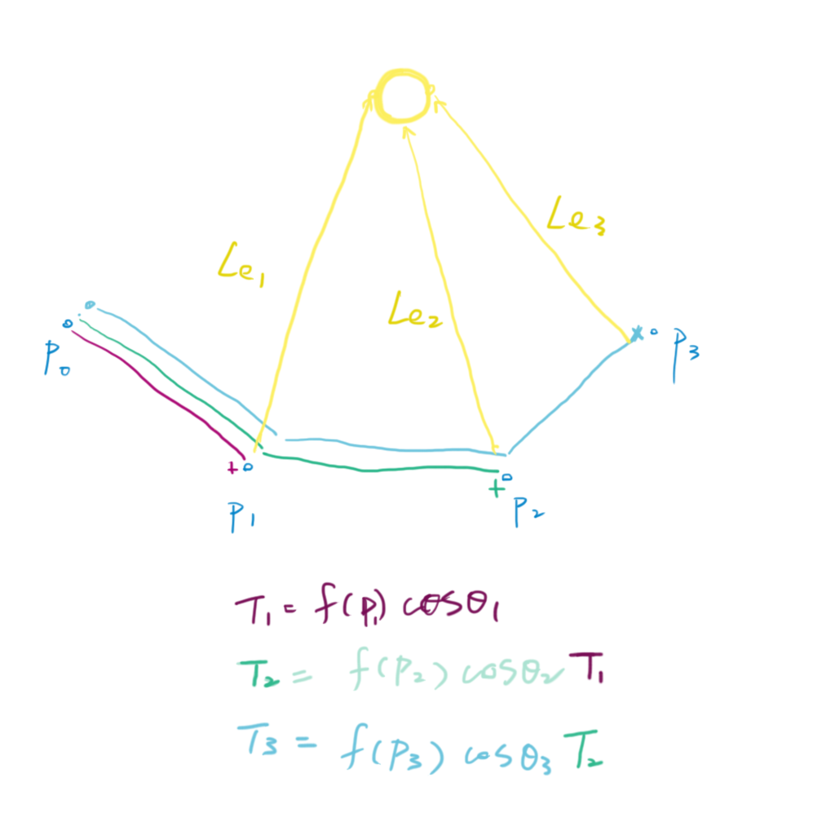

Implementation

Slide 11
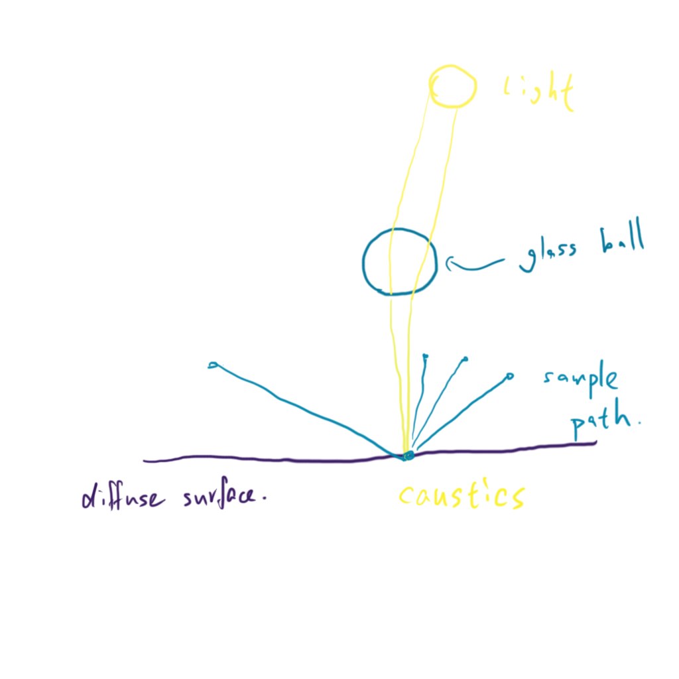
Difficult case for path tracing

Slide 12
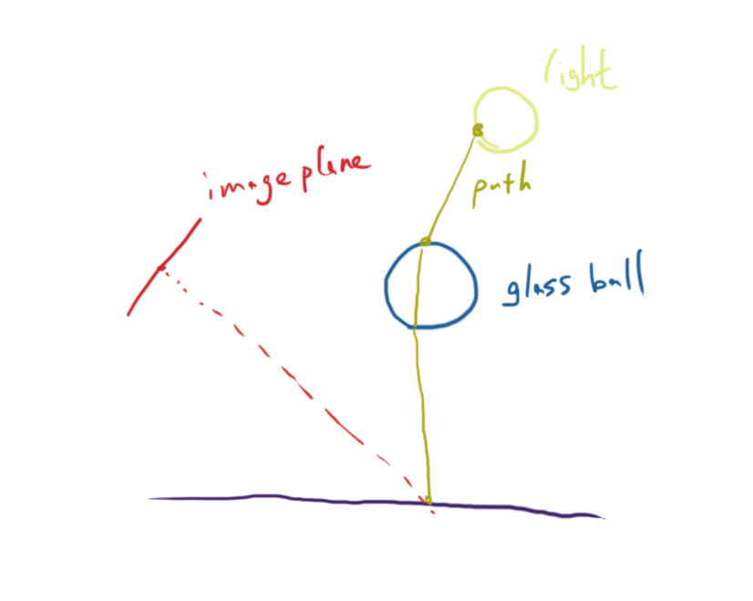
Light tracing
Reverse of the path tracing
  Incremental path construction from light
  Other variants: photon map, instant radiosity (virtual point lights)

Slide 13
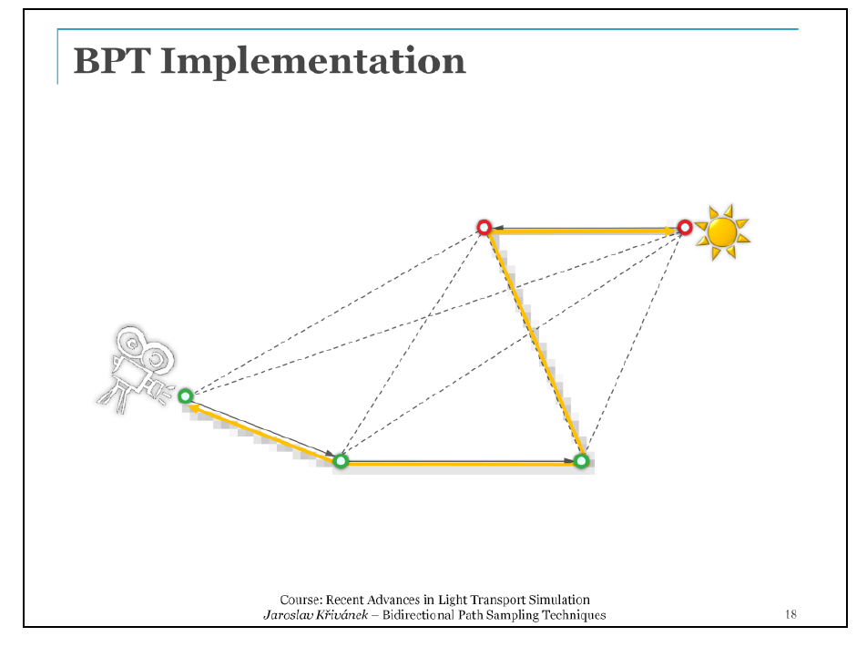
Combining path sampling techniques
Bidirectional path tracing
For more detail, see SIGGRAPH 2013 course
  “Recent Advances in Light Transport Simulation: Theory & Practice”

