Slide 1
Shadow Map implementation detail – dealing with shadow acne

Slide 2

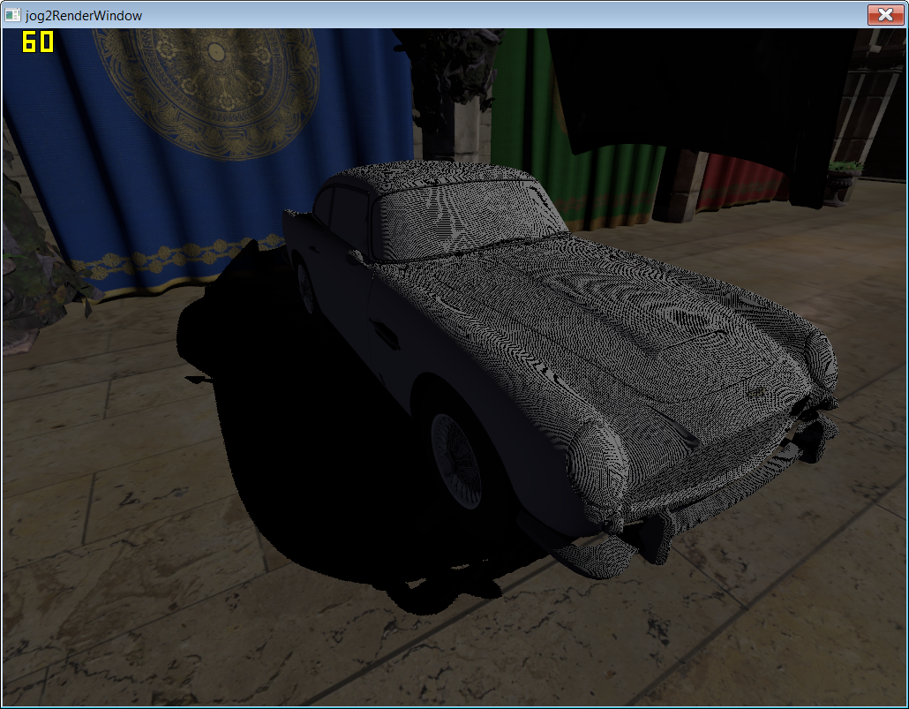
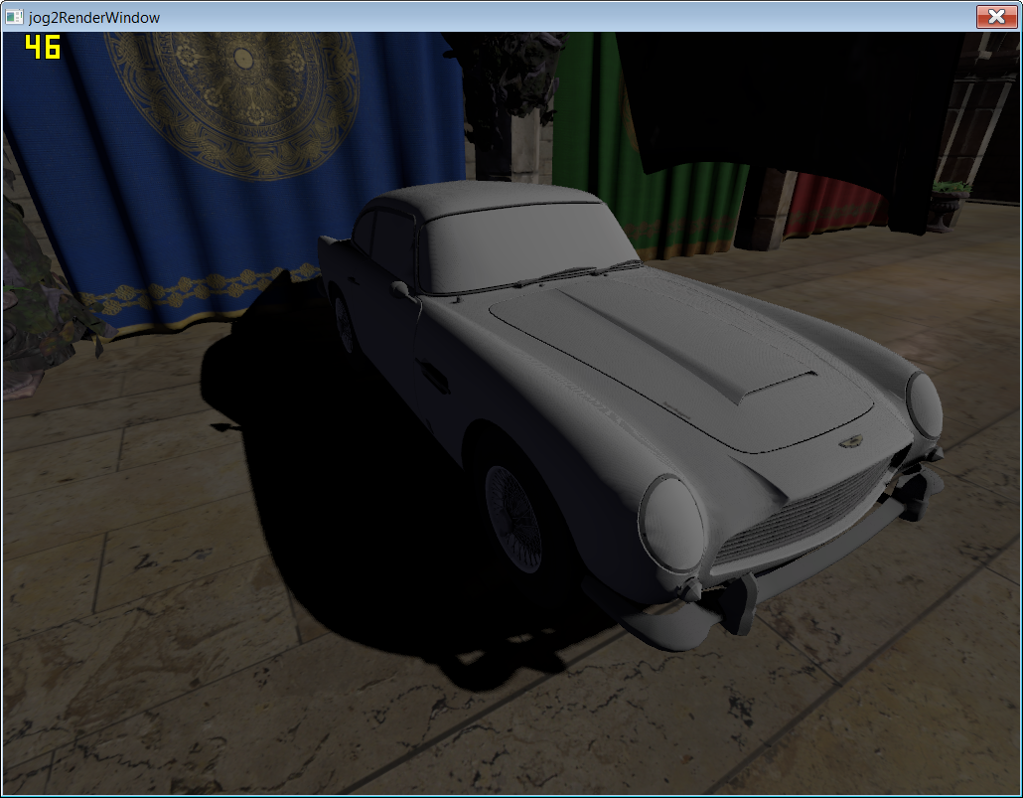
Self shadow acne

Slide 3
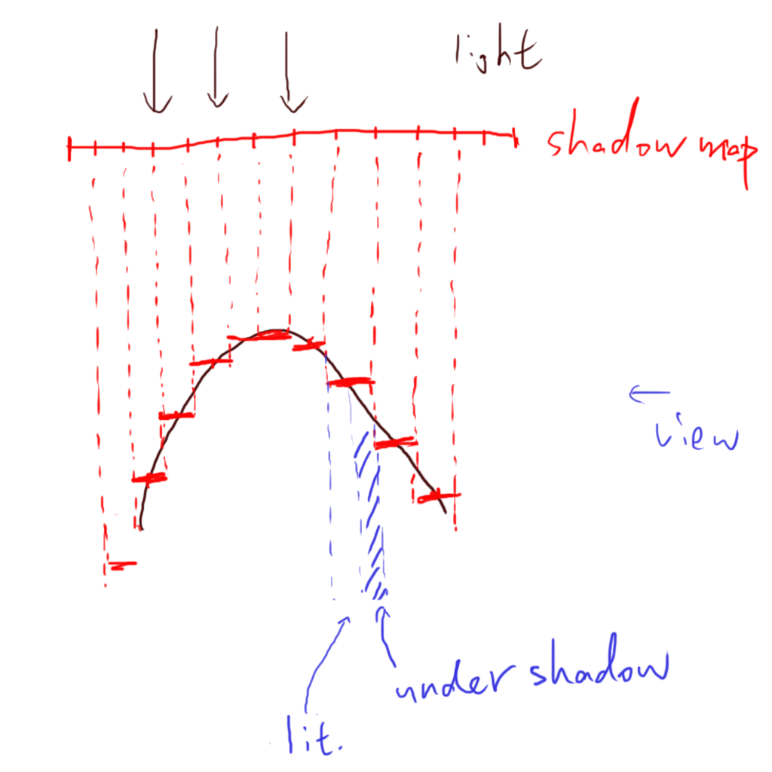
Cause of acne

Slide 4
Solution
Render back face or mid point
Better reconstruction & fuzzy comparison
  Gradient shadow map
Bias shadow map
  Constant
  Slop scaled offset
Offset surface
  Normal scaled offset
Demo

Slide 5
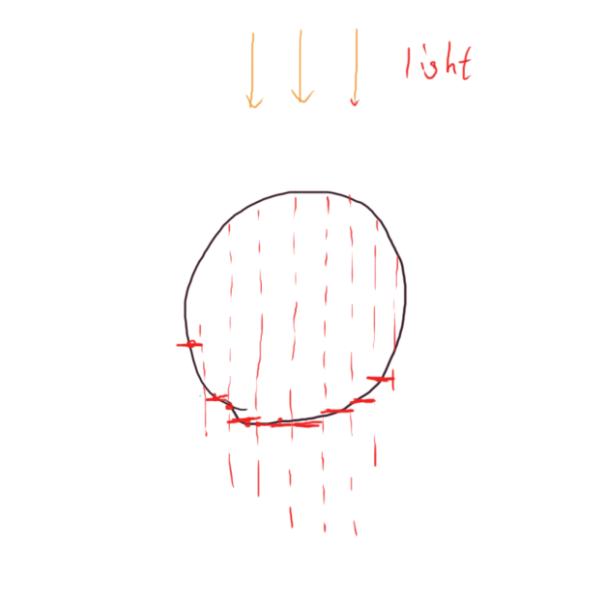
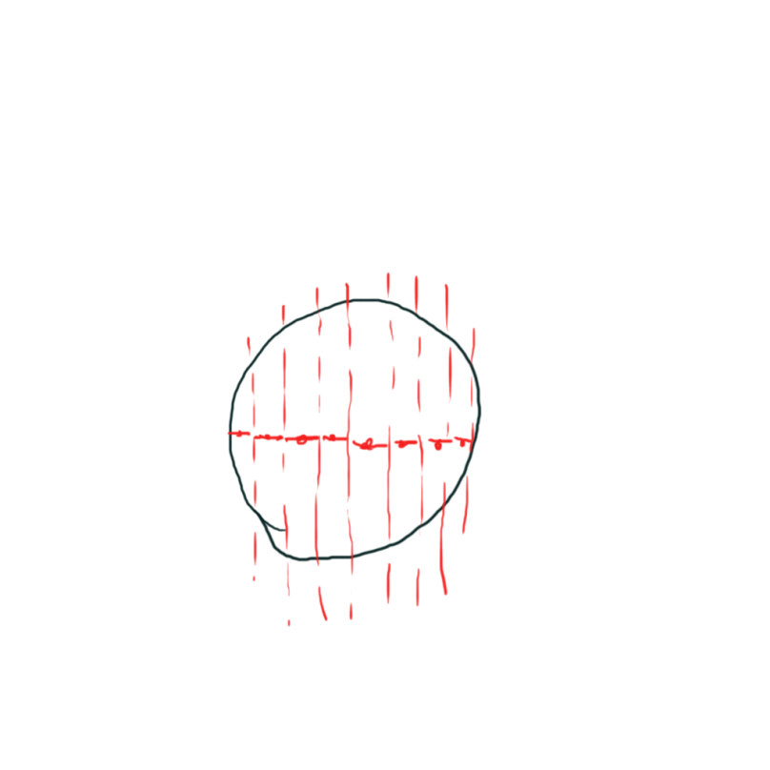
Render back face, mid point
Render back face
  No acne on front face
  Acne(light leak) on back face, but under proper lighting, back face is darker, so less noticible
  Don’t deal with flat surface
Render mid point
  Generally good quality
  More expensive
  Don’t deal with flat surface

Slide 6
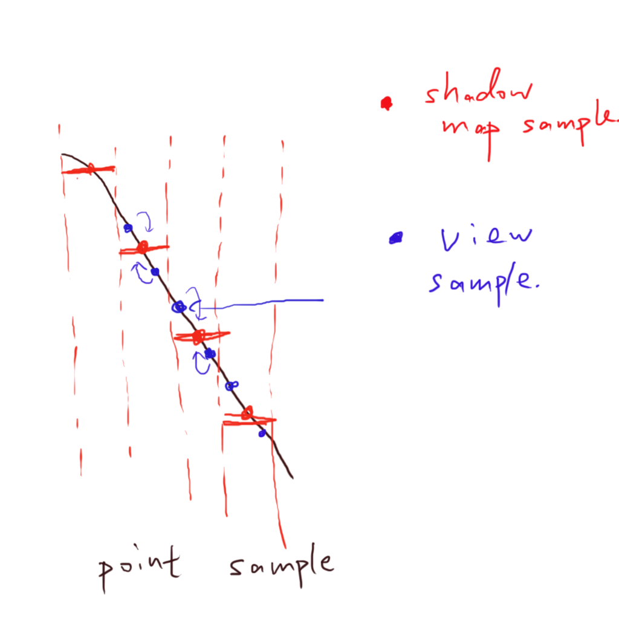
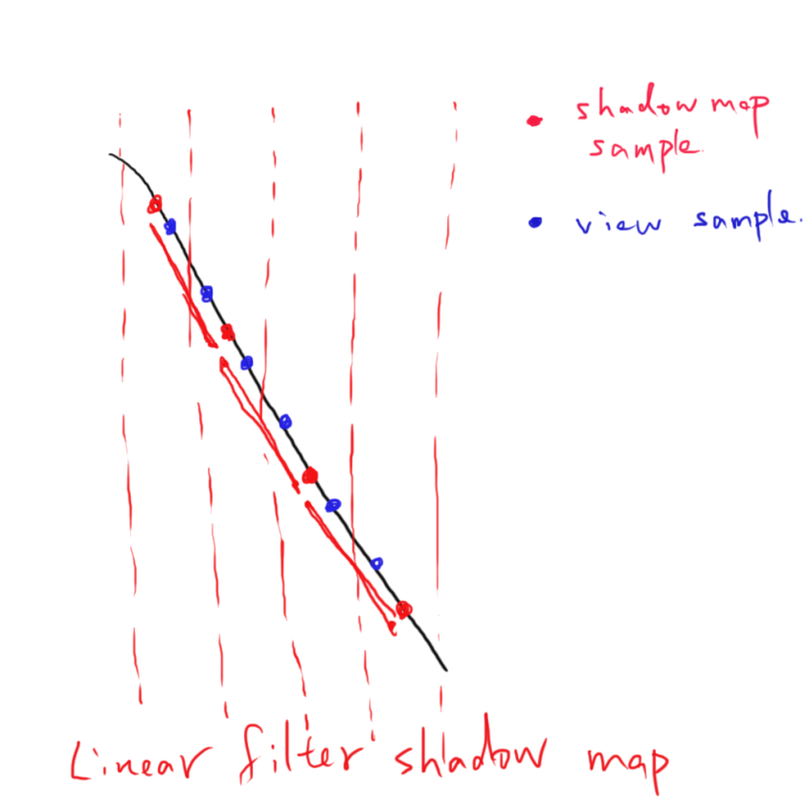
Better reconstruction – gradient shadow mapping
ShaderX 4.2, “Eliminating surface acne with gradient shadow mapping”

Slide 7
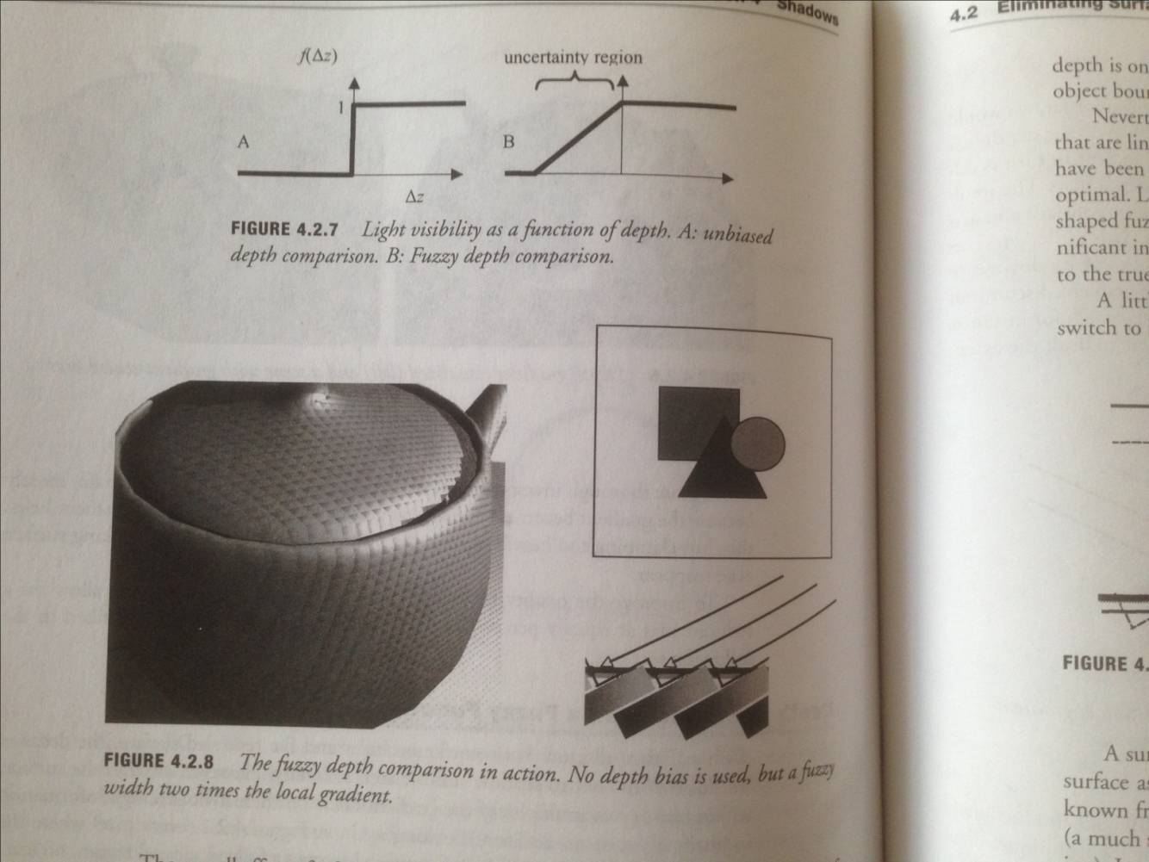
Fuzzy comparison
ShaderX 4.2, “Eliminating surface acne with gradient shadow mapping”

Slide 8
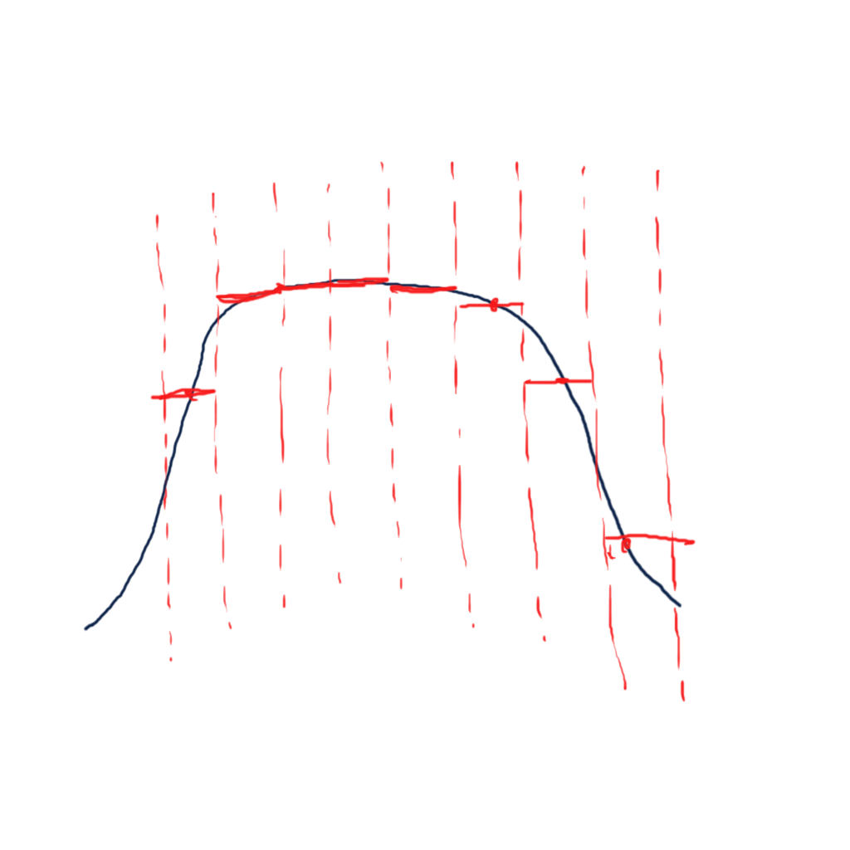
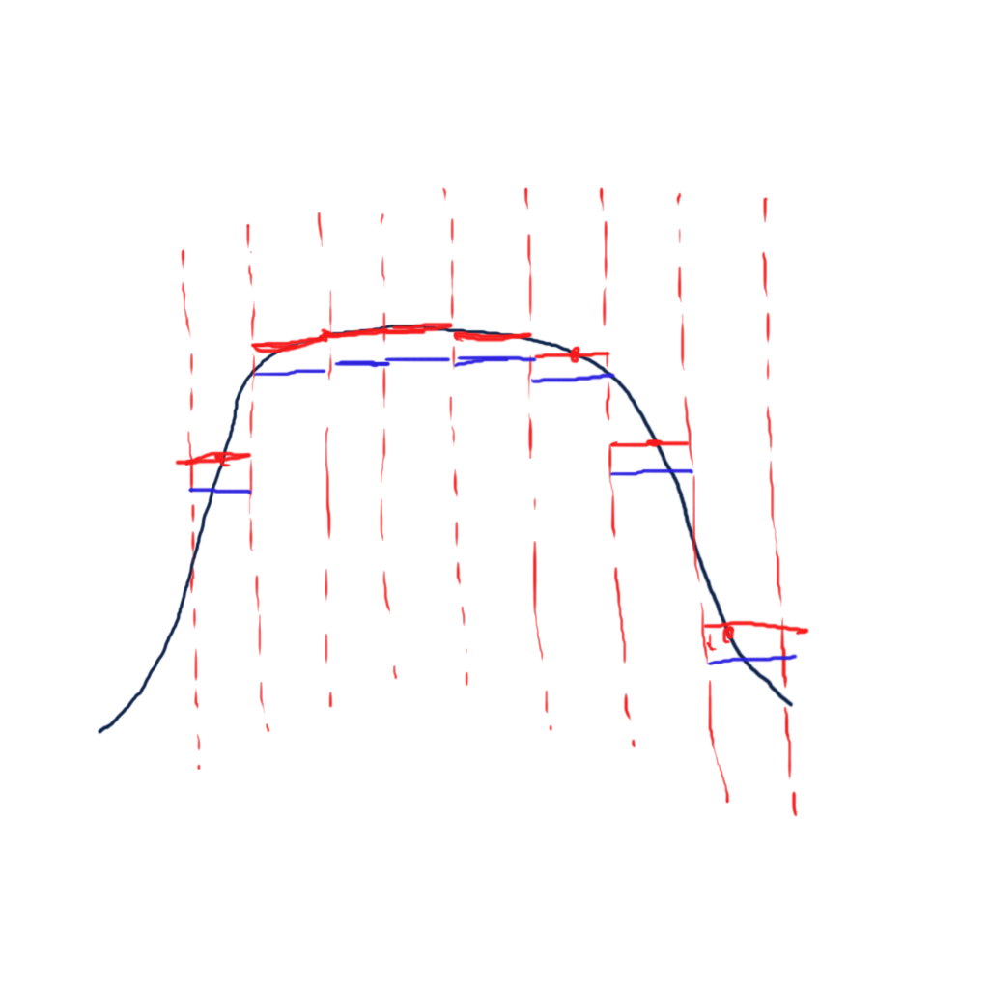
Bias shadow map
Constant bias

Slide 9
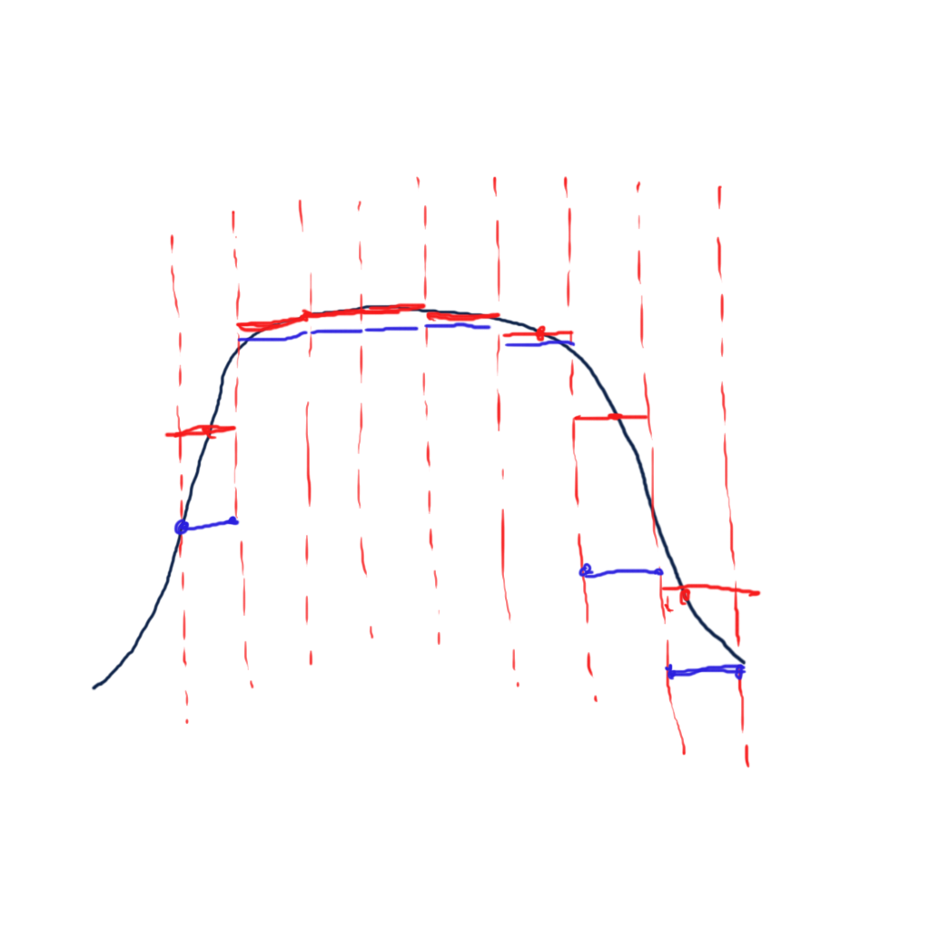
Bias shadow map
Slope scaled bias

Slide 10
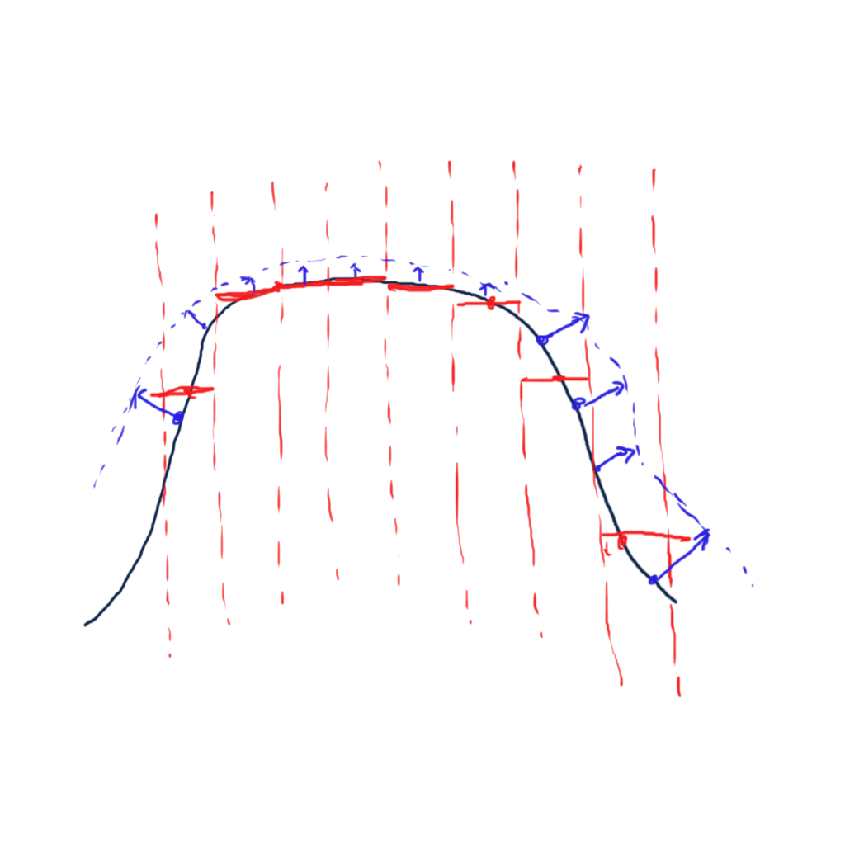
Offset surface
Offset surface along normal direction
  “Normal Offset Shadows”, GDC 2011

Slide 11
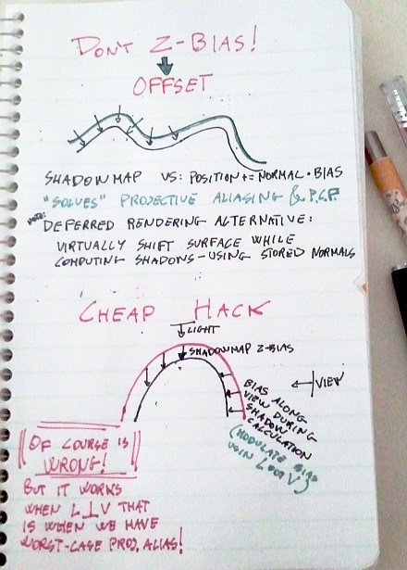
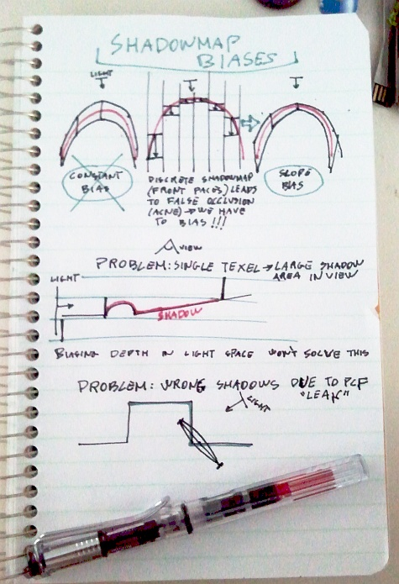
Offset surface
http://c0de517e.blogspot.tw/2011/05/shadowmap-bias-notes.html

Slide 12
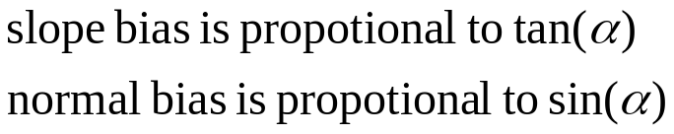
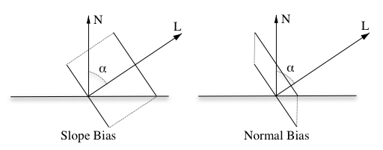
Slope & normal offset details
http://the-witness.net/news/2013/09/shadow-mapping-summary-part-1/

Slide 13
Slope & normal offset details
float2 get_shadow_offsets(float3 N, float3 L) {
float cos_alpha = saturate(dot(N, L));
float offset_scale_N = sqrt(1 - cos_alpha*cos_alpha); // sin(acos(L·N))
float offset_scale_L = offset_scale_N / cos_alpha; // tan(acos(L·N))
return float2(offset_scale_N, min(2, offset_scale_L));
}

Slide 14
Demo & opinion
Mix & match normal, slope & constant offset
Beware of normal offset, this is NOT apply to shadow map depth, but surface position
Normal offset is more effective (easier tuning) than constant or slop scaled bias, but can cause offset of shadow

