Slide 1
Texture & lighting

Slide 2
Implementation detail
  Correct linear space lighting
  Tangent space normal map

Slide 3
Color space
Color space
  Diffuse textures are usually stored in gamma space
  Normal maps(or other physical value) in linear space
  Lighting calculation must be done in linear space
  Final output must be in gamma space

Slide 4
Gamma
John Hable’s Linear space lighting page
  http://filmicgames.com/archives/299
  http://filmicgames.com/archives/581
“This problem is HUGE. If your goal is photoreal-ish visuals and you do not solve this problem then you are screwed. You MUST deal with this problem.”

Slide 5
In OpenGL
Texture side
Framebuffer side

Slide 6

OpenGL texture
Stored texture color space
gamma
linear
Hardware support sRGB texture format?
Load, internal format GL_RGBA8
done
yes
no
Load using sRGB texture internal format
GL_SRGB8_ALPHA8
in shader, before lighting
pow(texValue, 2.2)
Lighting calculation

Slide 7
OpenGL framebuffer
Hardware support sRGB framebuffer?
Accumulate all lighting calculation, output is in linear space
glEnable(
GL_FRAMEBUFFER_SRGB
)
Full screen blit
Source: lighting result
Dest: pow(source, 0.45)

Slide 8
Physically based rendering: Problems must be solved
How to know my diffuse textures’ color space?
  I don’t know, ask TA
  If no source of information, always assume diffuse textures are in gamma space
How to know my engine’s color space?
  Turn off all post effects
  Clear frame buffer to 0.1 & compare with wiki ramp
  http://en.wikipedia.org/wiki/Gamma_correction
  Render only diffuse & compare with photoshop
How to know my monitor’s color space?
  Buy better monitor?
  Calibrate

Slide 9
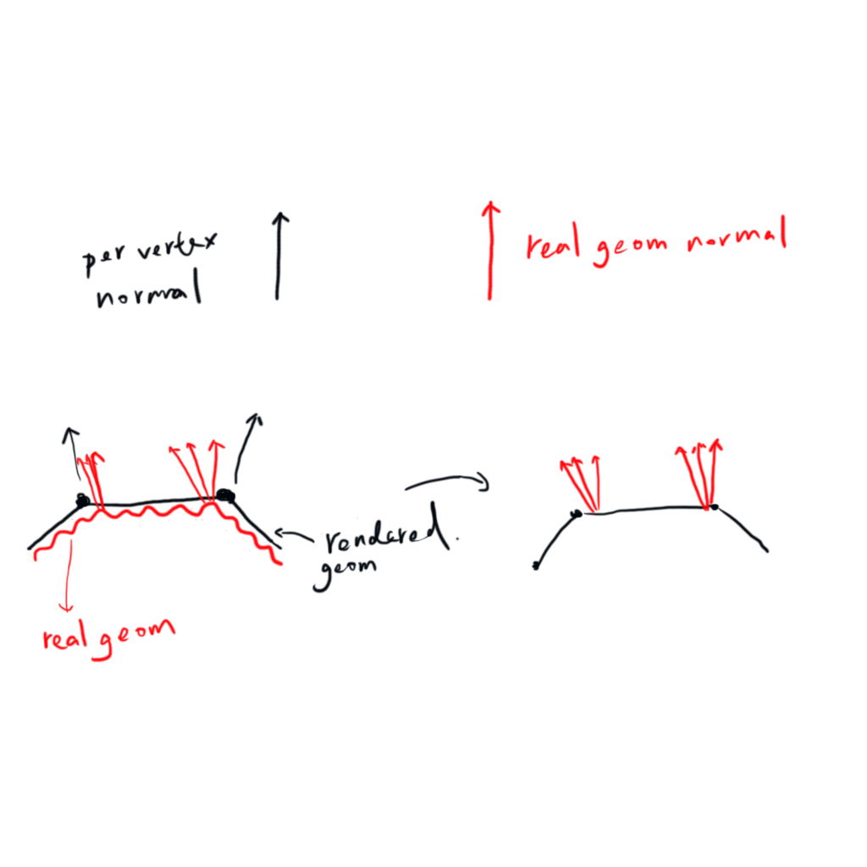
Normal map

Slide 10

Normal map
World space, Object space
  Object can translate/rotate, but can’t deform
  Hard to share normal maps
Tangent space (per triangle space)
  Can deform the mesh, as long as the triangle is not stretched too much

Slide 11
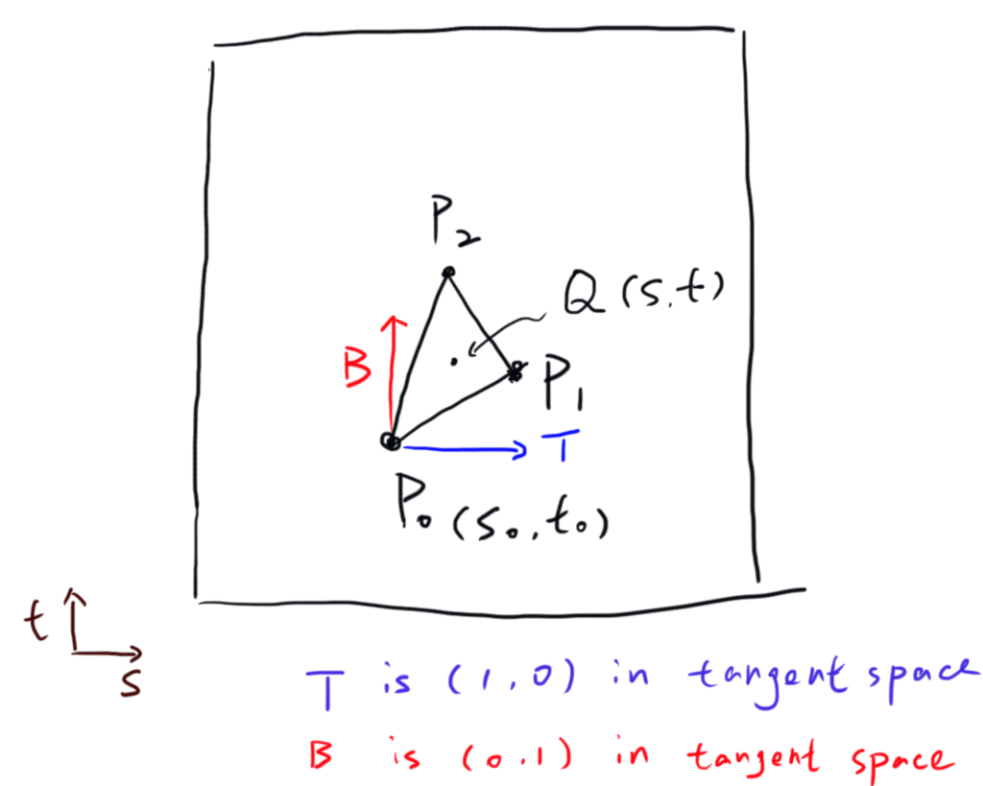

Tangent space
We wan to find T, B in Object space

Slide 12
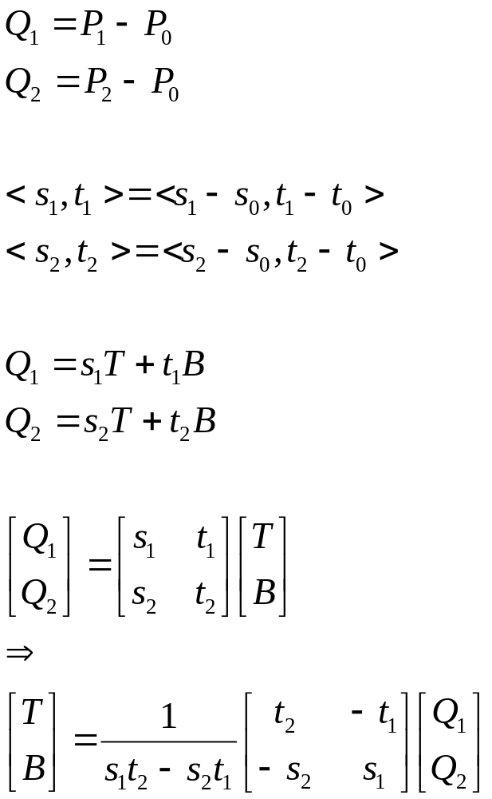
Tangent space calculation

Slide 13
Tangent space calculation
T, B and N are not necessarily orthogonal to each other
But we can assume they are not too far away from orthogonal, so they can be orthogonalized

Slide 14
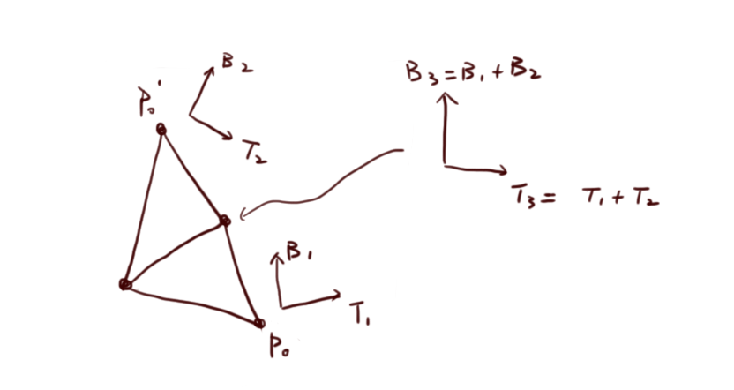
Tangent space – per vertex
In order to minimize vertex count, vertices are often shared
Tangent space are accumulated, then averaged for every vertices
For more detail, see
  http://www.terathon.com/code/tangent.html

Slide 15
Problem of averaged tangent space
Biggest problem: mirrored texture coordinate
  Seams/inverted lighting
  Details later
Smaller problems
  Small triangles, L shape
    For more detail, see ShaderX 4 2.2, “Triangle Mesh Tangent space calculation”

Slide 16
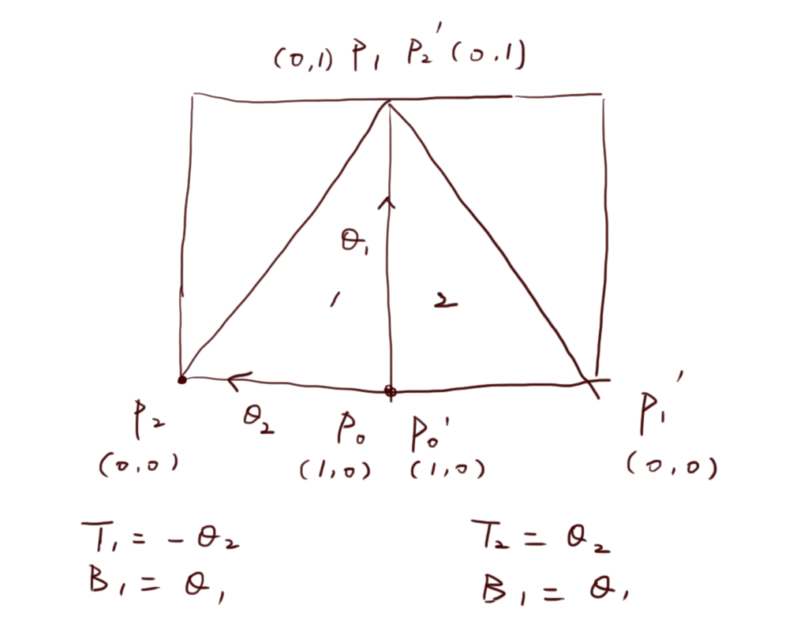
Mirrored texture coordinate

Slide 17
Mirrored texture coordinate
Correct solution
  Split vertices along mirrored boundary
  Don’t mirror texture coordinate, always use tiling on mesh UV, use mirrored sampler state
    http://www.polycount.com/forum/showthread.php?t=116922
Artistic solution
  Add noise, tweak normal map
  http://wiki.polycount.com/NormalMap/
Demo

Slide 18
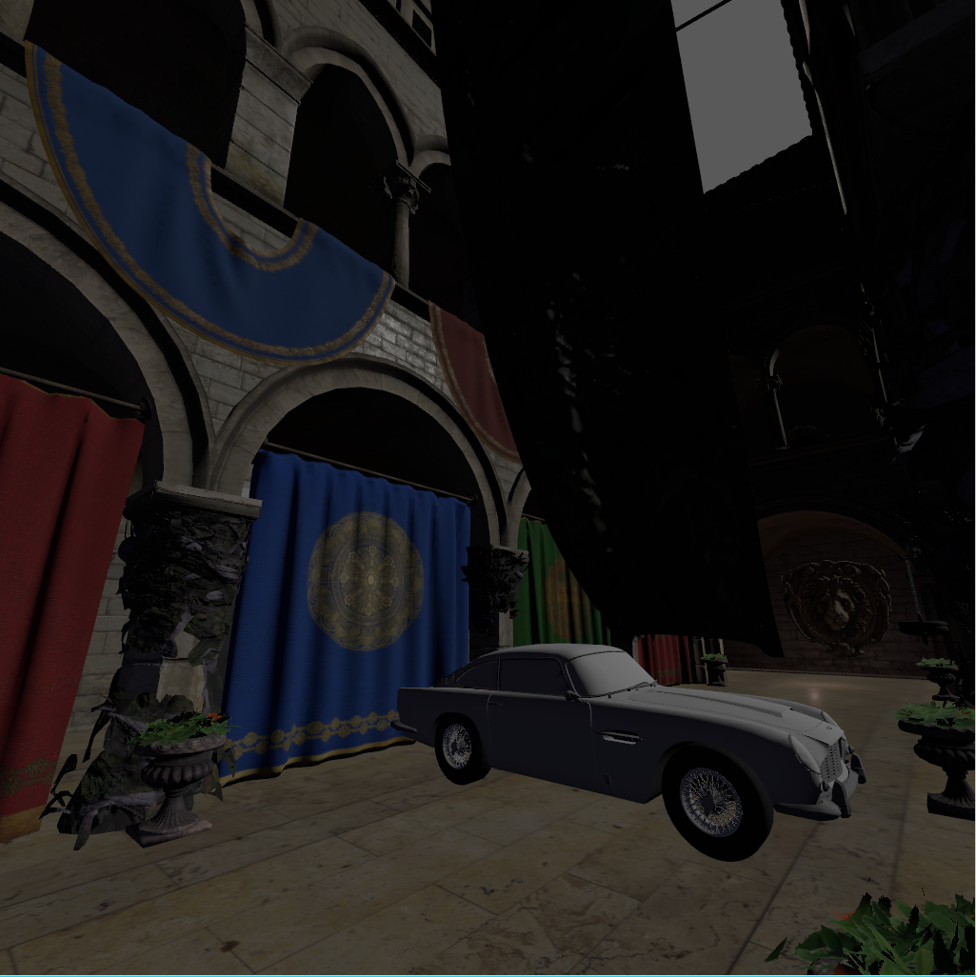
Homework assignment 1

Slide 19
Homework assignment 1
Implement a simple renderer
  physically based BRDF
  Linear space lighting
  Goal
    First strive for physically correct, then good looking
    Ex. Gamma space lighting(make the scene darker) + no Fresnel(make the scene lighter) may looks good, but this is NOT CORRECT
    Limitation: no real world light & material unit

Slide 20
Homework reference renderer
Scene
Renderer
Primitive
Light
Camera
Mesh
material
transform
Diffuse map
Normal map
Specular map
Mask map
Vertex/index buffer
create
RenderDevice

Slide 21
If you have time
Re-implement blocks in red
Scene
Renderer
Primitive
Light
Camera
Mesh
material
transform
Diffuse map
Normal map
Specular map
Mask map
Vertex/index buffer
create
RenderDevice

Slide 22
How
https://github.com/ianslayer/gpu_course
render_device.h
Implement every functions in render_device_hw1.cpp & renderer_hw1.cpp
Choose a BRDF, write shaders
#define USE_DEVICE_GL
#ifdef USE_DEVICE_GL
#include "render_device_gl.h"
#elif defined (USE_DEVICE_HW1)
#include "render_device_hw1.h"
#endif
#define USE_DEVICE_HW1
#ifdef USE_DEVICE_GL
#include "render_device_gl.h"
#elif defined (USE_DEVICE_HW1)
#include "render_device_hw1.h"
#endif

Slide 23
How
In main.cpp
void Init()
{
…
jade::InitRendererGL(device, &renderer);
//jade::InitRendererHW(device, &renderer);
…
}
void Init()
{
…
//jade::InitRendererGL(device, &renderer);
jade::InitRendererHW(device, &renderer);
…
}

Slide 24
If you have less time
You can re-implement only renderer or device
Scene
Renderer
Primitive
Light
Camera
Mesh
material
transform
Diffuse map
Normal map
Specular map
Mask map
Vertex/index buffer
create
RenderDevice

Slide 25
If you are only interest in shader programming
Modify blinn_phong_vs.glsl, blinn_phong_ps.glsl
Press ‘r’ to reload shader on the fly

Slide 26
Homework assignment 1: Note
  material
    Texture addressing mode
      Wrap
    Normal map is encoded
  Color space
    See code
  Multiple lights
  NDF: notice the definition of “roughness”/“specular”

