Slide 1
An analysis of popular music lyrics
A poster by Ian Smeenk

Slide 2
Abstract
The lyrics of a song are the most explicit way to communicate message in music. They can convey joy, sorrow, lust, yearning and a wealth of other emotions. The distinctive differences between artists of different genres (ex. country and hip-hop) can make for an interesting contemplation of lyrical purpose. It may at times seem as if certain genres get repetitive in their style of rhetoric and evocation. A closer look, however, would indicate that there is more nuance buried within.
In this poster I will present insights that I have found within the composition of a dataset of nearly 400,000 song lyrics. I will discuss a pair of predictive models built to predict the genre of a song. I will also look into the particularly fascinating lyrical culture of hip-hop.

Slide 3
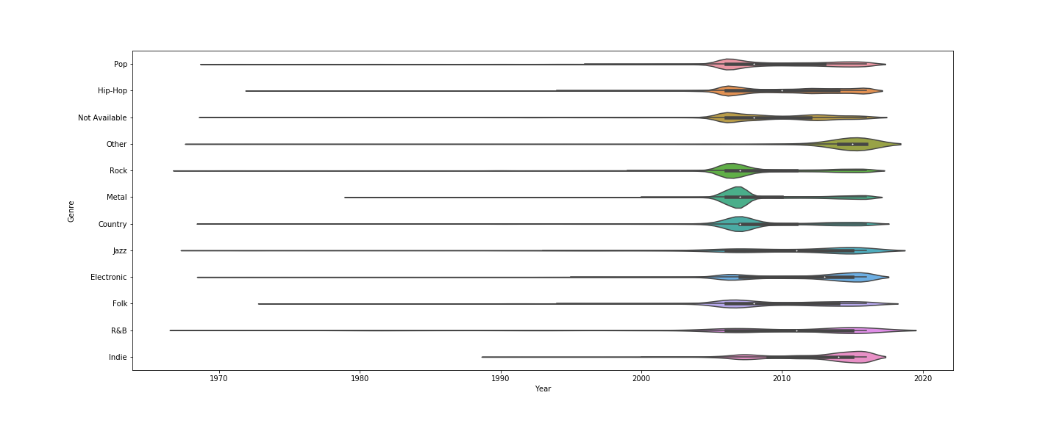
Data Description
The data used for analysis came from a Kaggle dataset of lyrics for over 380,000 songs. The songs from the data came from a variety of different genres as well as several eras.
The cleaning process involved removing newline characters and special punctuation via regular expressions, as well as filtering out songs with nonsensical values (ie. songs dated in the future).
As you can see in the plot below, the primary era from which most of the songs stem is fairly recent for all genres. The distribution centers around the mid-late 2000s as well as around the mid 2010s. The most common genre by far is rock the majority of songs have less than a thousand lyrics. The song with the most lyrics, Rap Monument, contained over 8000 lyrics as it was a collaborative rap song by over 40 different rappers.

Slide 4
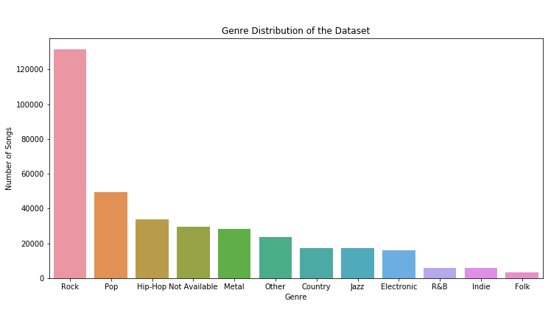
Modeling Genre
It is commonly assumed that different genres have different overarching lyrical concepts. There are far more country songs that discuss the importance of pickup trucks than there are R&B songs. These presumed differences are what inspired me to model genre using song lyrics.
The two different modeling approaches I tried were Multinomial Naïve Bayes as a baseline model and then Multiclass Logistic Regression as a hopeful improvement on the model. I used vectorized TFIDF as model features.
Unsurprisingly, the Logistic Regression predicted with a higher accuracy (~56%) vs the overly simplistic Naïve Bayes (~45%). Further iterations of this modeling step could involve pursuing tree based approaches (eg. XGBoost, Random Forest) or sequential models.
In considering why the model wasn’t more successful in its prediction, I hypothesize a variety of reasons.
First off, I did little to account for class imbalance. Due to the dataset being primarily rock songs, it would have been potentially useful to try to account for this with a better performance metric or by resampling from the data.
Neither modeling attempt involved any hyperparameter tuning which could have potentially improved things. It is also quite possible that vectorized TFIDF is not predictive enough on its own to accurately predict genre

Slide 5
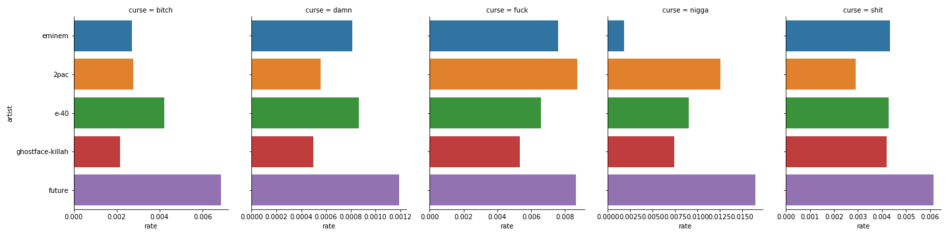
Rap Case Study: Analysis of Obscenity
It’s no secret that rap artists tend to use a great deal of foul language when it comes to their lyrics. Each rapper has a signature associated with their style, and part of that signature involves how much they use particular curses. Below is a comparison of five rappers from different temporal and regional groupings of hip-hop and the percentages of their lyrics are particular curse words.
A couple things that are interesting to note: Future is more vulgar than the others by a decent margin. It is also interesting to see that the n-word comes up as a non-zero number for Eminem, a white rapper who has notably neglected to use that word. This is likely because the analysis is done at the song level and not the verse level, and Slim Shady has likely had guest artists on his songs that have used the n-word.
The generally lowest MC when it comes to curse rates is Wu-Tang Clansman, Ghostface Killah. The musician occasionally referred to as Tony Starks is known for his vast vocabulary and creativity in his raps. This likely means that he does not have to rely on curse words to fill sound space.

Slide 6
Future Work
The continuation of this project will include developing an application that dynamically produces characteristics (eg. “wordiness score”, “profanity index”) and visualizations (much like the curse frequency one) for inputted artists.
Additionally including mean embeddings for particular rappers/vocalists which could be used to find similar musicians would be fun.
On the modeling front, trying to improve the model via hyperparameter tuning, better modeling frameworks and more predictive features would be a good next step.
It would also be good to try to split based on verses so that if a guest artist appears on a song, that is noted and listed as a separate entry.

