Slide 1
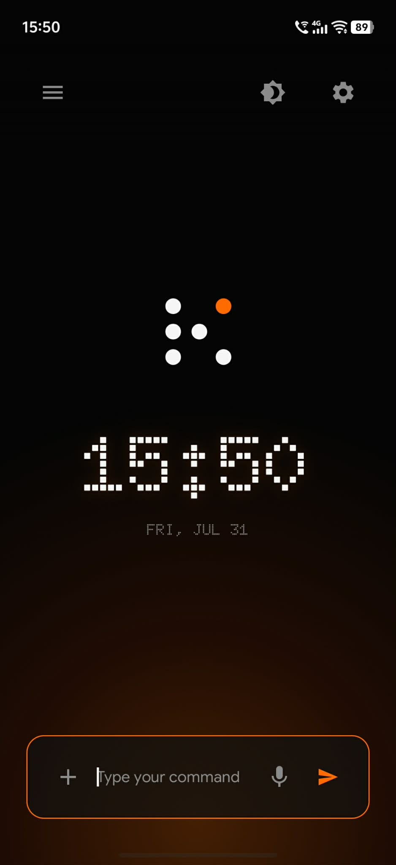
An agentic Android launcher that replaces the app grid
with a single line of intent.
FIT × OGIS Hackathon · Competition Presentation
Team KAIROS

Slide 2





THE PROBLEM
Phones were engineered
for engagement — not agency.
Visual bombardment
Notification overload
Colorful grids, badge counts, and infinite scrolls trigger dopamine loops.
Push alerts shatter focus by constantly pulling you out of the moment.
Zero-friction access
Broad & shallow
One tap opens any trap. Doomscrolling needs no conscious decision.
Quantity of interactions over quality — loneliness dressed as connection.
KaiOS
2

Slide 3
THE NARRATIVE
Two words for time.
Only one restores choice.
CHRONOS
KAIROS
khronos · sequential time
kairos · the right moment
The endless ticking clock.
The infinite scroll.
Hours lost without intention.
Modern OS default mode.
Qualitative time.
The opportune instant
for deliberate action.
Every tap must earn itself.
KaiOS · FIT × OGIS
3

Slide 4
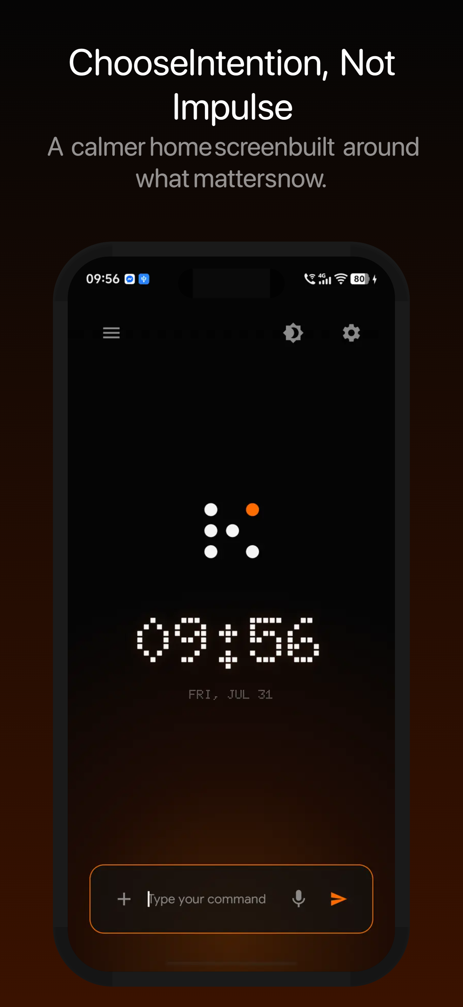
THE SOLUTION
Intentional friction,
by design.
KaiOS replaces the traditional home screen with a blank canvas and a blinking cursor. To do anything, you must consciously articulate what you want.
> @alarm set an alarm for 6am tomorrow
> @gmail display my most important emails
> @instagram /open — reason + 5m limit
KaiOS · FIT × OGIS
4

Slide 5
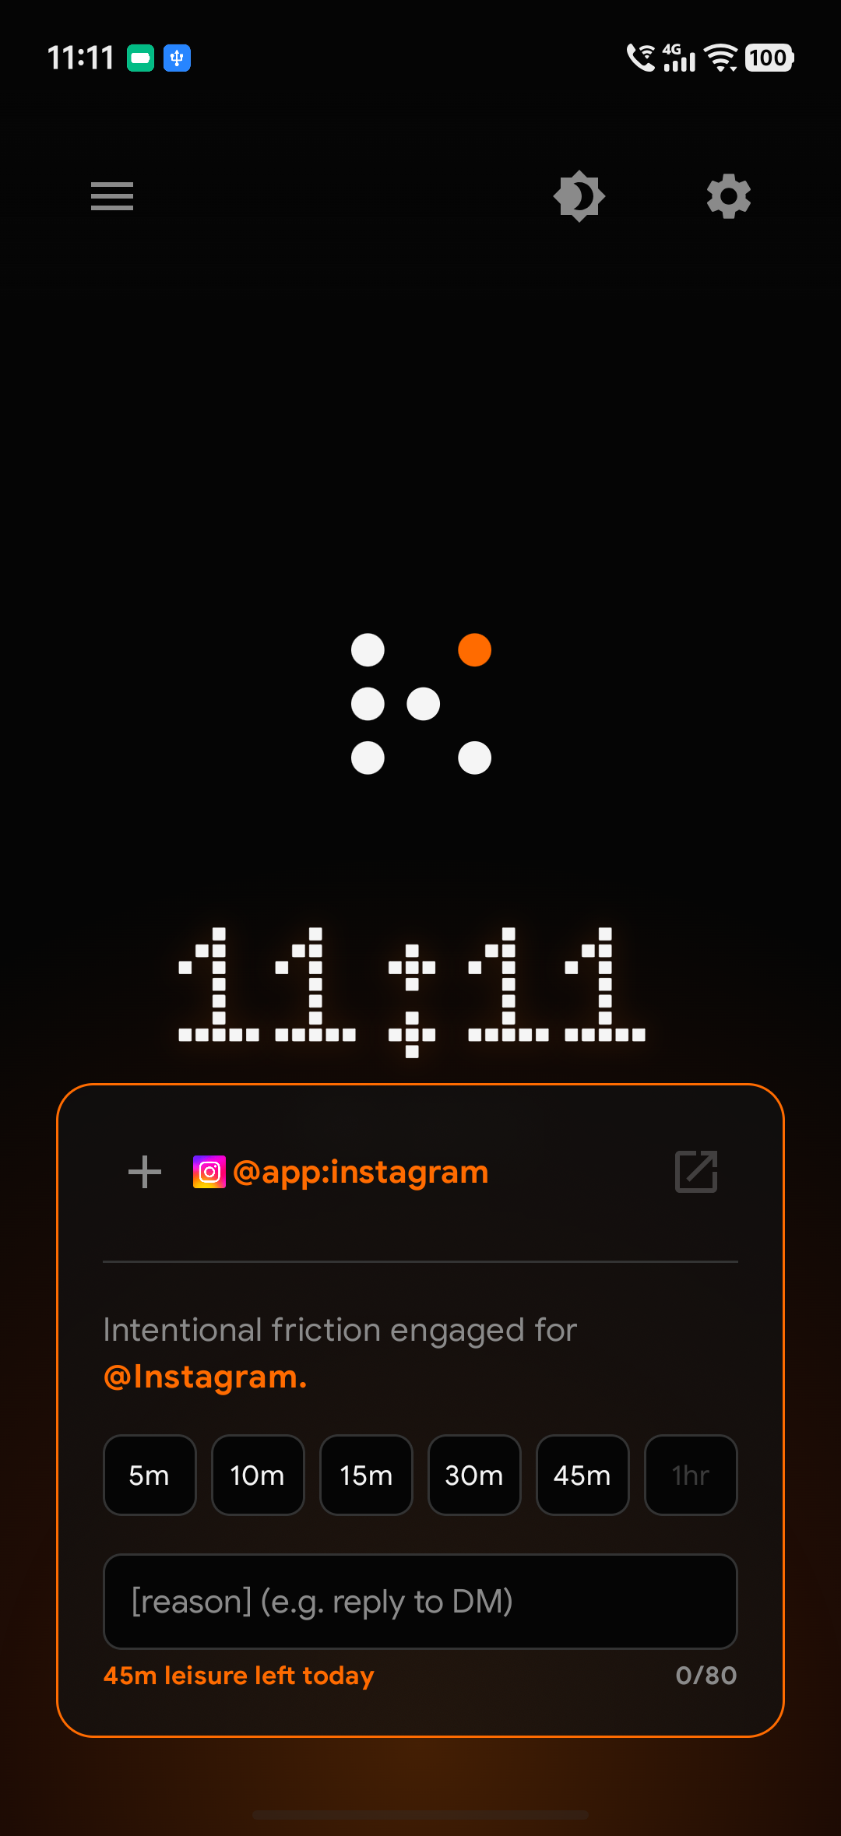
THESIS
Choose intention,
not impulse.
True connection requires the space to think. KaiOS transforms the smartphone from a landscape of distraction into an instrument of narrow, deep, and uncompromised focus.
01
02
03
Blank slate
Stated intent
Deep focus
KaiOS · FIT × OGIS
5

Slide 6
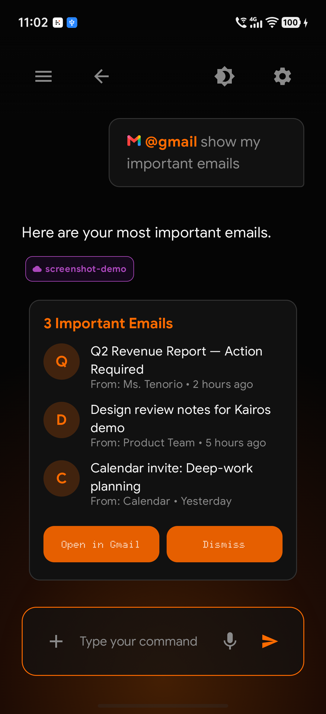


CORE EXPERIENCE
One command line.
Native widgets in return.
@app routing
Direct natural-language commands to Gmail, Calendar, Slack, Notion, and more.
Server-driven UI
Responses render as structured Compose widgets — not chatbot walls of text.
Read → Execute
Read via widgets. Act via deep links into the real apps you already use.
KaiOS · FIT × OGIS
6

Slide 7
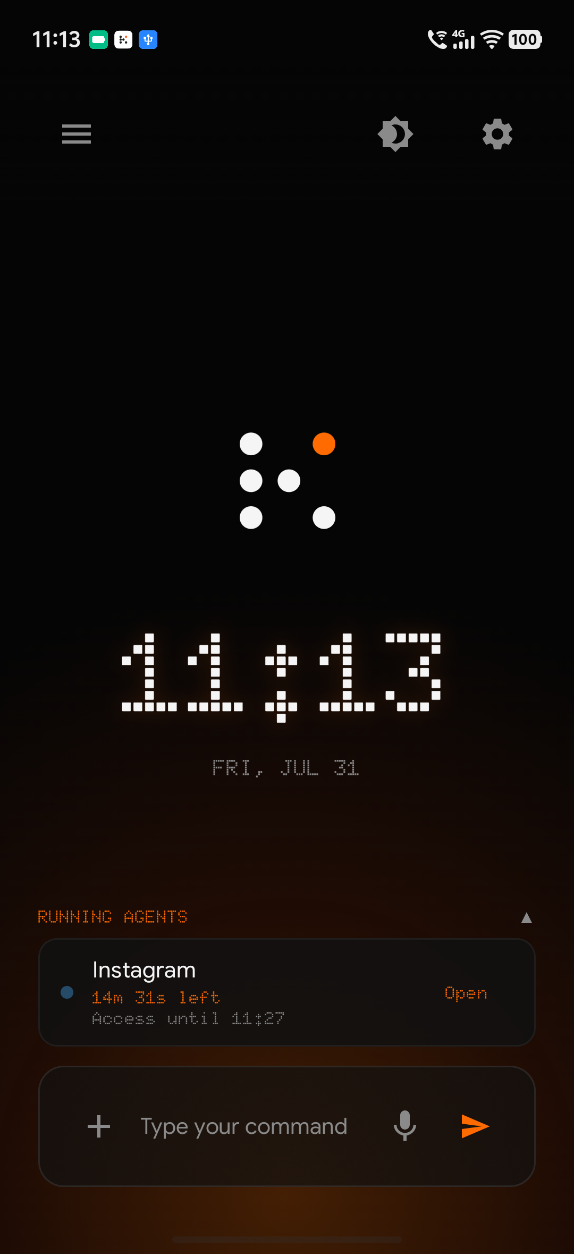
ANTI-DOOMSCROLL
Intent Gate.
Trap apps earn their time.
Utility apps open instantly. Trap apps require a reason and a time limit — then KaiOS enforces the contract.
Utility
Clock, Camera, Maps — immediate access
Trap
Instagram, TikTok, feeds — gated by reason + timer
Cooling-off
Guardrail changes wait 12 hours — no impulse undos
KaiOS · FIT × OGIS
7

Slide 8

ATTENTION HYGIENE
Silence the noise.
Surface what matters.
Critical
Calls, calendar alerts, VIP contacts — instant passthrough.
DIGEST
SCREENSHOT
Digest
Everything else is held, summarized by AI, and shown on request.
Drop your capture here
Ask for it
@digest daily digest — you choose when to engage.
KaiOS · FIT × OGIS
8

Slide 9
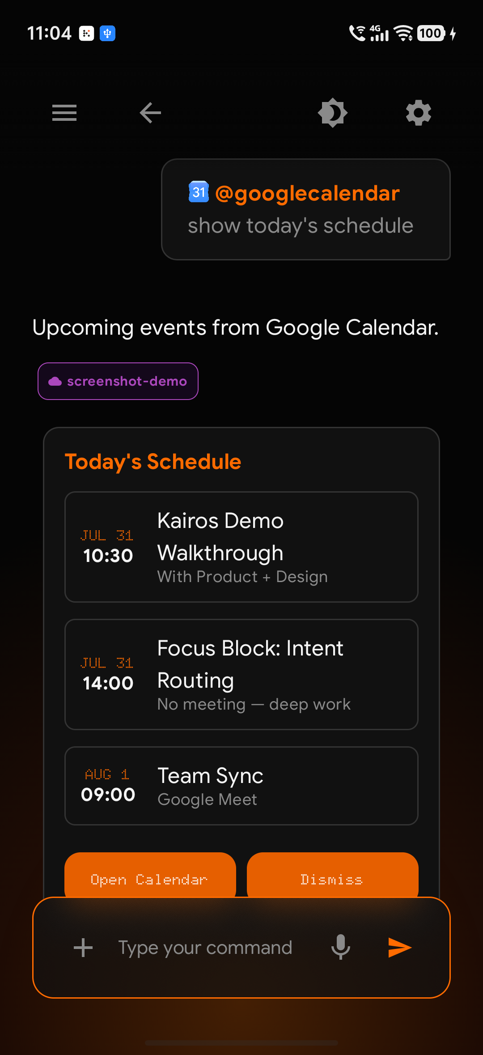
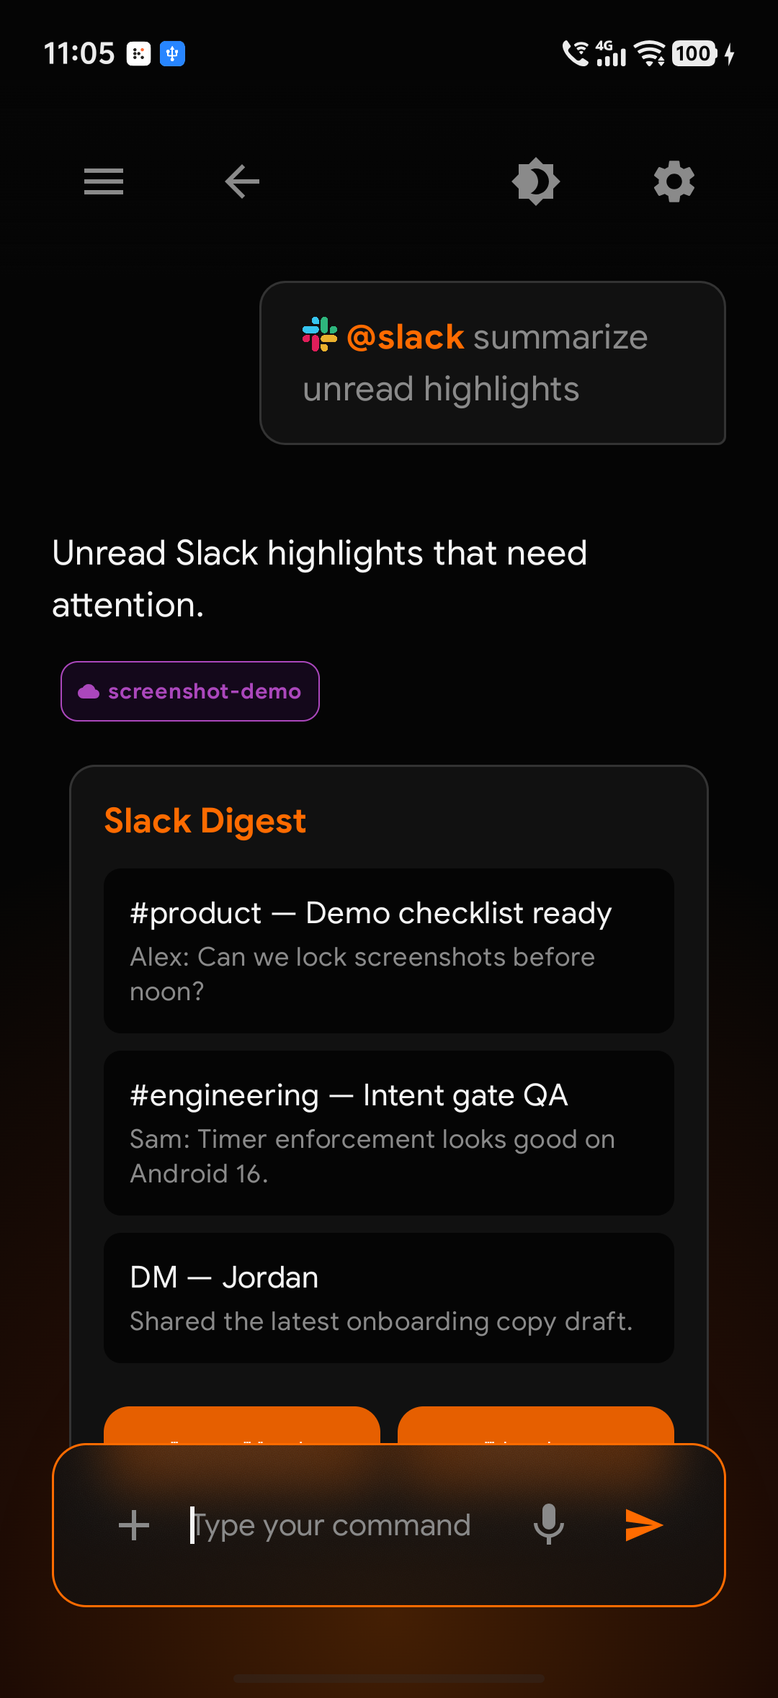
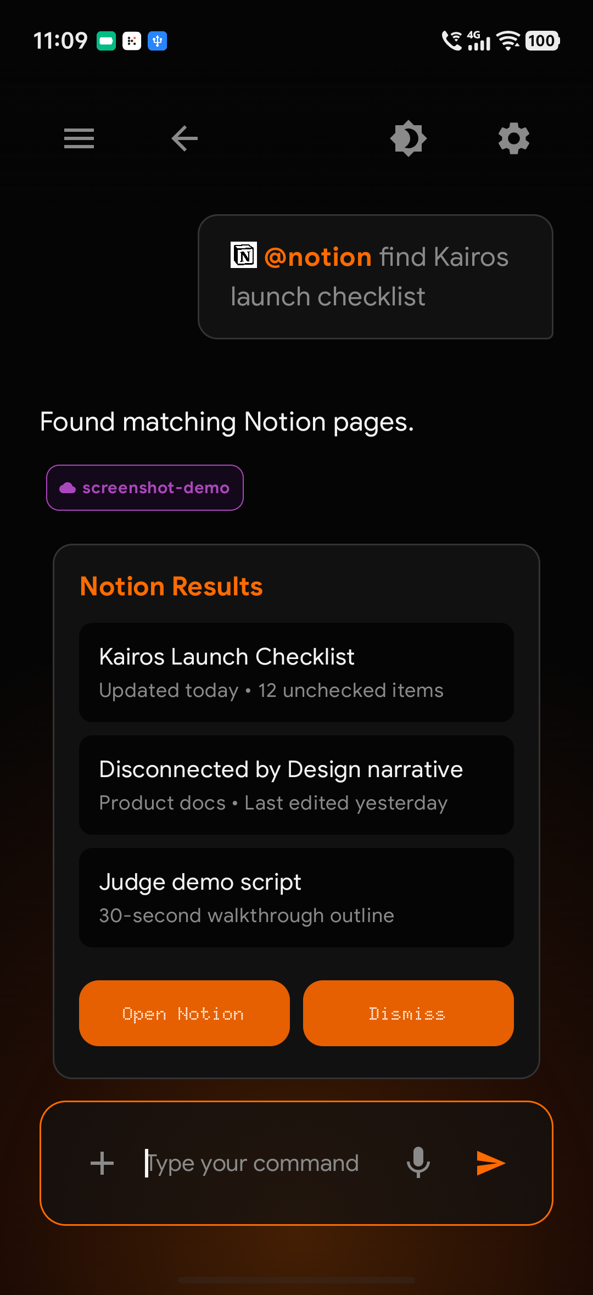
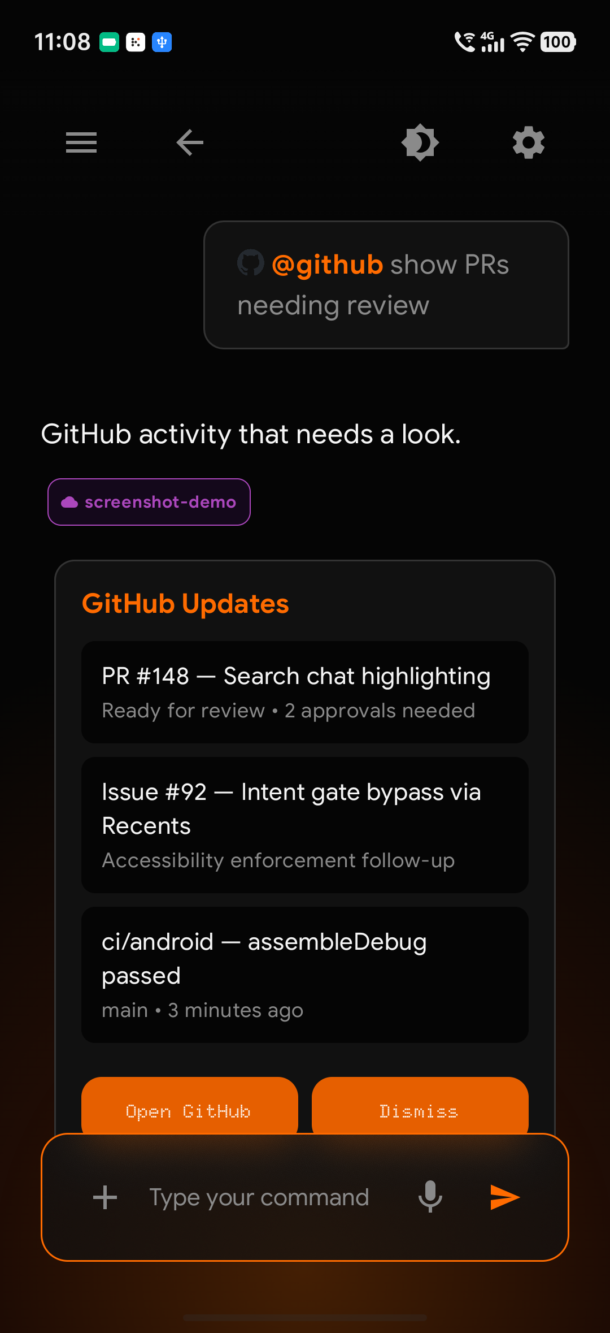
USEFULNESS
Your tools. One intent line.
Gmail
Calendar
Slack
Notion
GitHub
Intent Gate
KaiOS · FIT × OGIS
9

Slide 10



ARCHITECTURE
Thin client. Fat backend.
Hybrid intelligence.
Android Client
Next.js Backend
AI + Integrations
Kotlin + Jetpack Compose
Intent router & orchestrator
Gemini Flash / Pro tiers
Command input & widgets
Composio tool execution
Gmail · Calendar · Drive
Notification listener
Server-driven UI JSON
Slack · Notion · GitHub
Floating intent bubble
Session + context store
Spotify & utilities
On-device Gemma (AICore)
OAuth token vault
MCP / Composio toolkits
KaiOS · FIT × OGIS
10

Slide 11
ARCHITECTURE DEEP DIVE
Tiered routing.
Privacy meets performance.
TIER
WHERE
MODEL
USE CASE
LATENCY
T0
On device
No model
/open & heuristics
<200ms
T1
On device
Gemma via AICore
Simple intents, offline
<500ms
T2
Cloud
Gemini Flash
Tool calling & widgets
2–5s
T3
Cloud
Gemini Pro
Deep reasoning
5–10s
KaiOS · FIT × OGIS
11

Slide 12



PRIVACY
Your data. Your device.
Your time.
Local-first intelligence
Tokens stay on the server
Simple tasks never leave the phone. On-device Gemma classifies and executes offline.
OAuth tokens and API keys never touch the Android client. Backend vault only.
Notifications are ephemeral
Encrypted transport
Payloads are classified, then discarded. Only summaries persist — never the raw stream.
All client ↔ backend traffic over HTTPS. Sandboxed tool processes; no cross-app data bleed.
KaiOS · FIT × OGIS
12

Slide 13




BUSINESS FEASIBILITY
Deep-Work mode.
Enterprise-ready focus.
KaiOS is not only a personal detox - it is a command line for knowledge work.
Workspace native
Scheduled Deep-Work
Gmail, Calendar, Drive, Slack, Notion, GitHub — action-oriented briefs instead of tab chaos.
Activate manually or auto-trigger during working hours. Trap apps stay gated while work tools stay sharp.
Corporate path
Feasible stack
Managed profiles, policy-aligned distraction control, and B2B licensing as the distribution model.
Composio + Gemini + thin Kotlin client — production integrations without rebuilding OAuth from scratch.
KaiOS · FIT × OGIS
13

Slide 14
WHY KAIOS WINS
Mapped to the brief.
30%
Creativity
Chronos vs Kairos narrative · blank-slate UI · intentional friction as product
25%
Innovativeness
Hybrid on-device + cloud AI · MCP/Composio routing · server-driven widgets
20%
Feasibility
Shipped Android launcher · thin client · proven APIs · tiered models
15%
Usefulness
Real Workspace + Slack/Notion/GitHub workflows · Deep-Work enterprise path
10%
Interest
Visceral empty home screen · Intent Gate · floating bubble · daily digest
KaiOS · FIT × OGIS
14

Slide 15
THEME FIT
Disconnected by Design —
every requirement, met.
Convenience is not benefit
Choose disconnection
Narrow & deep
One-tap grids are replaced by stated intent.
Blank home screen creates a digital pause.
Targeted commands — no feeds, no suggestions.
Less information exposure
Everyday discomfort
Unique · AI-driven · Futuristic
Notifications batched into digests you request.
The blinking cursor is the designed friction.
Post-app paradigm: intent replaces icons.
KaiOS · FIT × OGIS
15

Slide 16
Choose intention,
not impulse.
KaiOS rescues attention from Chronos —
so every interaction can happen in Kairos.
FIT × OGIS · Disconnected by Design
[ Team names ]

