Slide 1
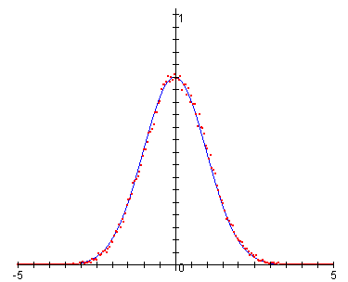
Diffusion Monte Carlo Simulation:
A Java Based Simulation and Visualization
by Ian Terrell
Advisor: Prof. Zhang

Slide 2
Overview
Background
  Monte Carlo Simulation
  Quantum Monte Carlo
  Project Description
Theory
  Quantum Mechanics
  Diffusion Monte Carlo Algorithm
Project
  Simulation
  Visualization
0101010100101111101001010010101001011100001
0101010100101111101001010010101001011100001
0101010100101111101001010010101001011100001

Slide 3

Monte Carlo Simulation
Stochastic numerical technique
Solve deterministic and stochastic problems
Use N iterations to estimate property P
0101010100101111101001010010101001011100001
y
0101010100101111101001010010101001011100001
f(x)
x
0101010100101111101001010010101001011100001

Slide 4
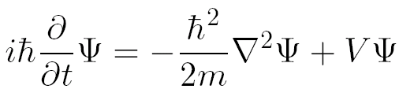
Quantum Monte Carlo
0101010100101111101001010010101001011100001
Ouch!
Quantum Monte Carlo seeks to
  solve Schrödinger Equation
Variational Monte Carlo
Diffusion Monte Carlo
  Ground state wavefunction
  Ground state energy
0101010100101111101001010010101001011100001
0101010100101111101001010010101001011100001

Slide 5
Project Description
Purpose:
Construct a visual learning aid
Why?
Diffusion Monte Carlo can be a complex process
How?
Build simulation
Build GUI to experiment with simulation
0101010100101111101001010010101001011100001
0101010100101111101001010010101001011100001
0101010100101111101001010010101001011100001

Slide 6




Quantum Mechanics
Schrödinger Equation:
Time Independent
Schrödinger Equation:
0101010100101111101001010010101001011100001
Eigenfunction:
0101010100101111101001010010101001011100001
Wavefunction as
Linear Combination
of Eigenfunctions:
0101010100101111101001010010101001011100001

Slide 7
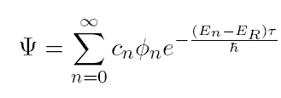
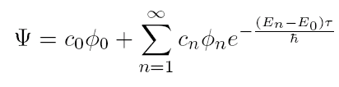




Quantum Mechanics
Wavefunction:
0101010100101111101001010010101001011100001
Nice limit behavior:
0101010100101111101001010010101001011100001
0101010100101111101001010010101001011100001

Slide 8
Diffusion Monte Carlo Algorithm
Unnormalized wavefunction is represented numerically as a distribution of walkers
At each iteration of the simulation,
  the walkers are moved randomly
  the walkers are created/destroyed
    based on weight
After many iterations,
  Average average potential of walkers
  approaches ground state energy
  Average distribution of walkers approaches
  ground state wavefunction
0101010100101111101001010010101001011100001
0101010100101111101001010010101001011100001
Ioan Kosztin, Byron Faber and Klaus Schulten, “Introduction
to the Diffusion Monte Carlo Method," American Journal of
Physics, May 1996, Volume 64, Issue 5, pp. 633-644.
0101010100101111101001010010101001011100001

Slide 9
Diffusion Monte Carlo Algorithm
initialize walkers’ positions
initialize reference energy
set τ = 0
Basic Algorithm:
Better Algorithm:
Initialize
Initialize
Walk
Walk
advance τ by Δτ
0101010100101111101001010010101001011100001
Branch
move each walker by Gaussian(0,σ)
update reference energy
Branch
warmup?
y
0101010100101111101001010010101001011100001
n
keep m copies of
  each walker
Walk
Branch
record and average energy
add walkers to histogram
Collect Data
done?
n
Ioan Kosztin, Byron Faber and Klaus Schulten, “Introduction
to the Diffusion Monte Carlo Method," American Journal of
Physics, May 1996, Volume 64, Issue 5, pp. 633-644.
y
0101010100101111101001010010101001011100001

Slide 10
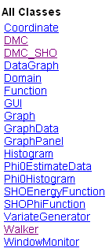
Simulation
/**
* A Diffusion Monte Carlo Simulation.
*/
public class DMC
{
public double V(double x);
public double Weight(Walker w);
public void Iterate();
public void walk();
public void branch();
}
0101010100101111101001010010101001011100001
0101010100101111101001010010101001011100001
0101010100101111101001010010101001011100001

Slide 11
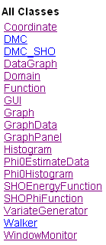
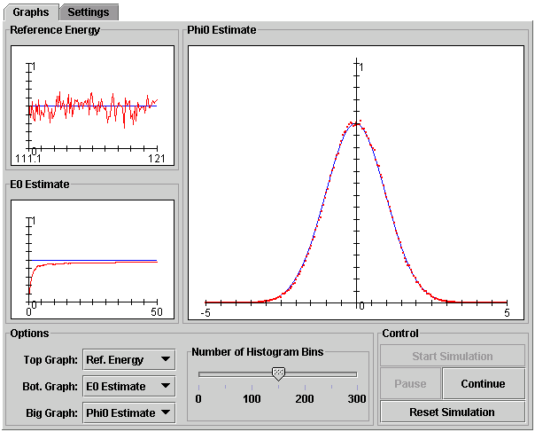
Visualization
0101010100101111101001010010101001011100001
0101010100101111101001010010101001011100001
0101010100101111101001010010101001011100001

