Slide 1



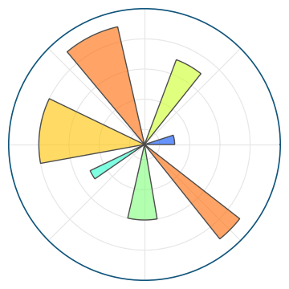
Visualising large datasets: everyone in the UK Census
Ian Thomas
Caerphilly
Anaconda

Slide 2
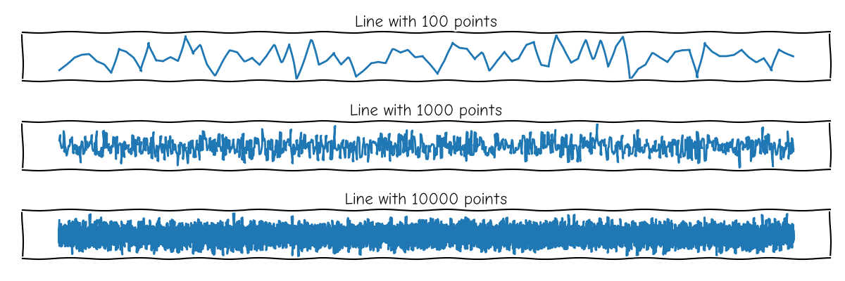
The problem of visualising large datasets
This is called overplotting

Slide 3
Real data: UK Census 2011
Relevant to everyone in the UK
63 million people
(x, y) locations and some categorical data
Want to know where they are, and something about them, visually
Source: Office for National Statistics

Slide 4
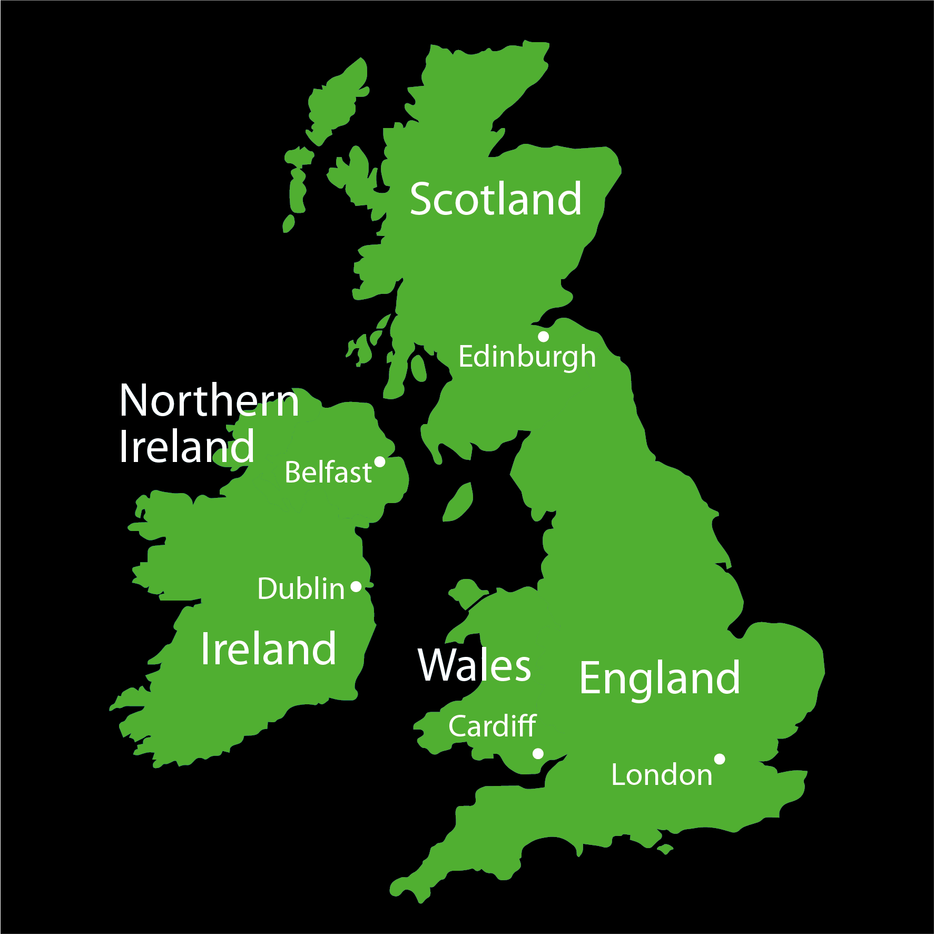


How many pixels required?
1 m
1000 km
Need ~1 million pixels to resolve everyone!
invented to solve problems like this.

Slide 5
Show some code Ian

Slide 6
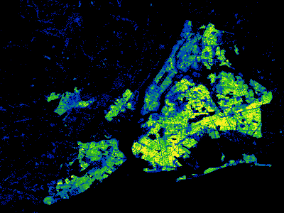
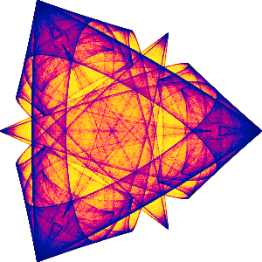

What else can Datashader do?
Other reductions: https://datashader.org/api.html#reductions
Lines, polygons, triangle meshes, etc
Can use Dask or cupy for larger datasets and better performance

Slide 7
Summary
Introduction to Datashader using UK Census data
Count of people per pixel
Nonlinear shading using a colourmap
Counts by category
hvPlot for interactive exploration

Slide 8
Contact information
Ian Thomas
GitHub repository
https://www.github.com/ianthomas23/pycon-uk-2022

