Slide 1
Round 1 Transparency Report
ycc.yale.edu/uofc

Slide 2
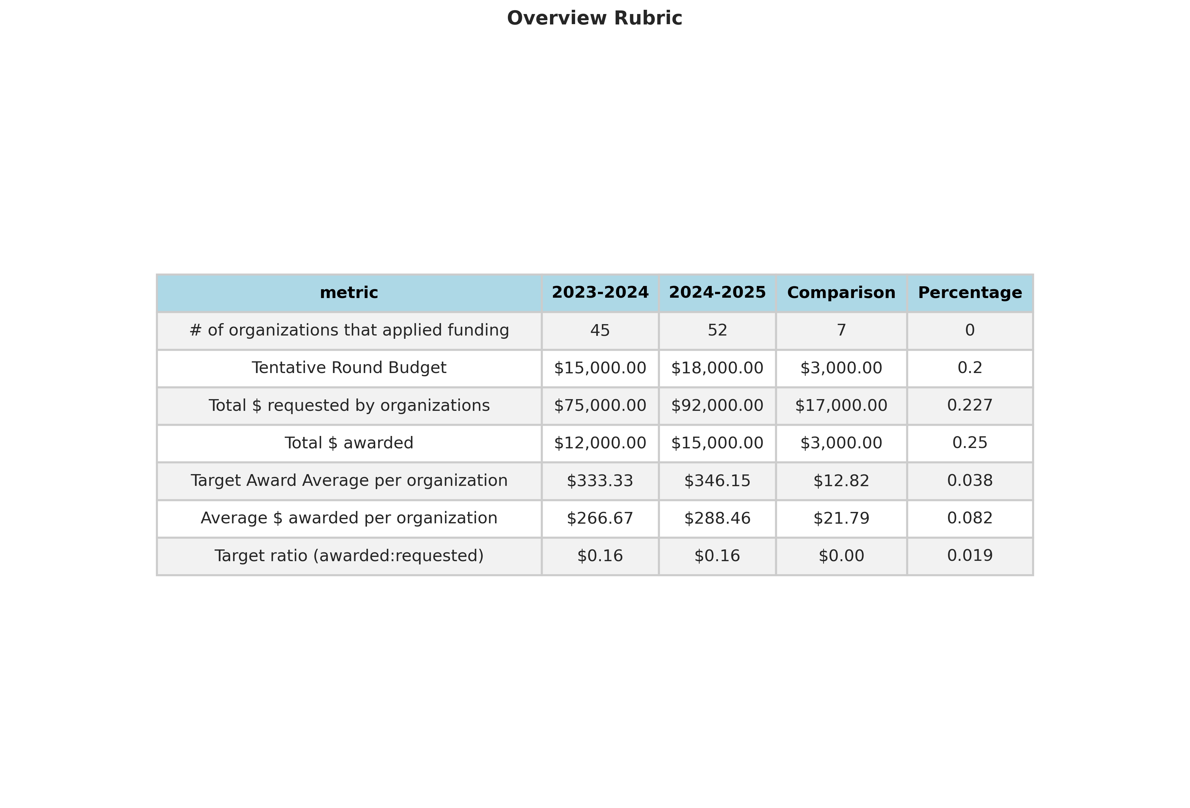
Round 1 Overview

Slide 3
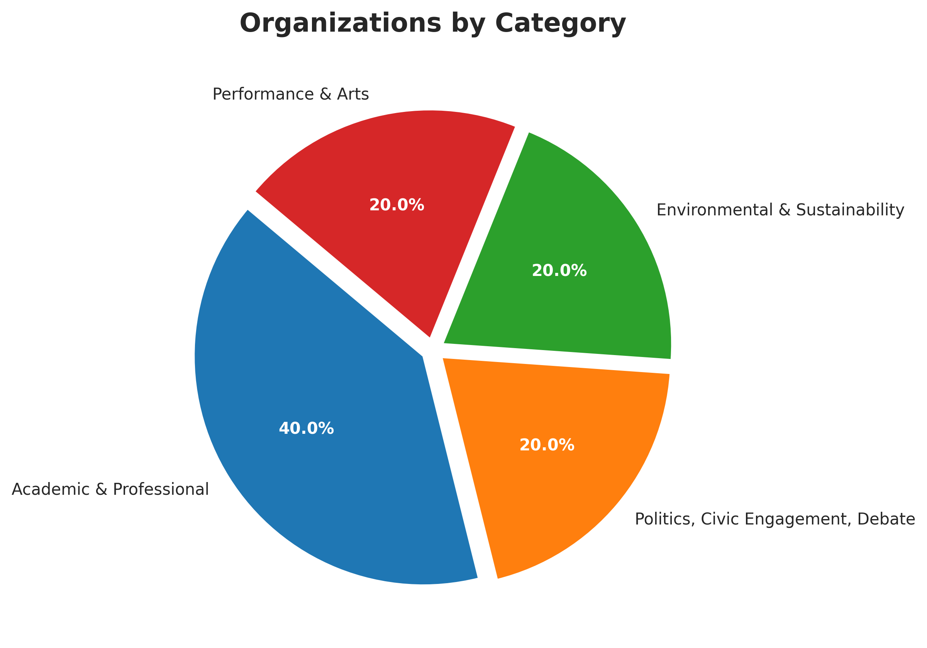
Number of Organizations Within Top 10 Categories
Organization Category | Number of Organizations | Percentage
Academic & Professional | 2 | 40.0
Politics, Civic Engagement, Debate | 1 | 20.0
Environmental & Sustainability | 1 | 20.0
Performance & Arts | 1 | 20.0

Slide 4
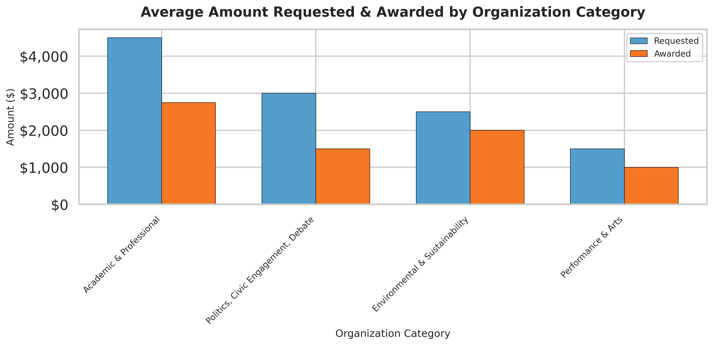
Average Amount Requested/Awarded by Category

Slide 5
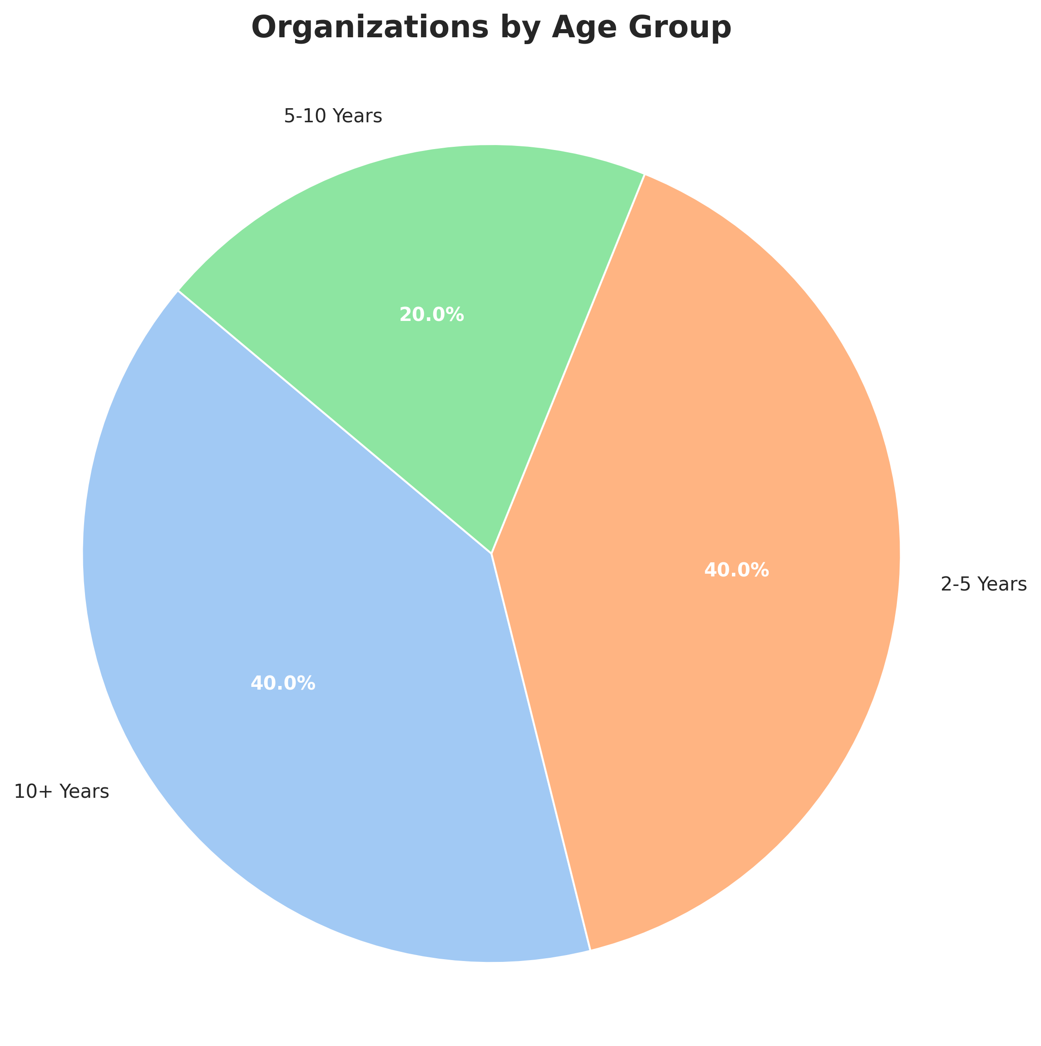
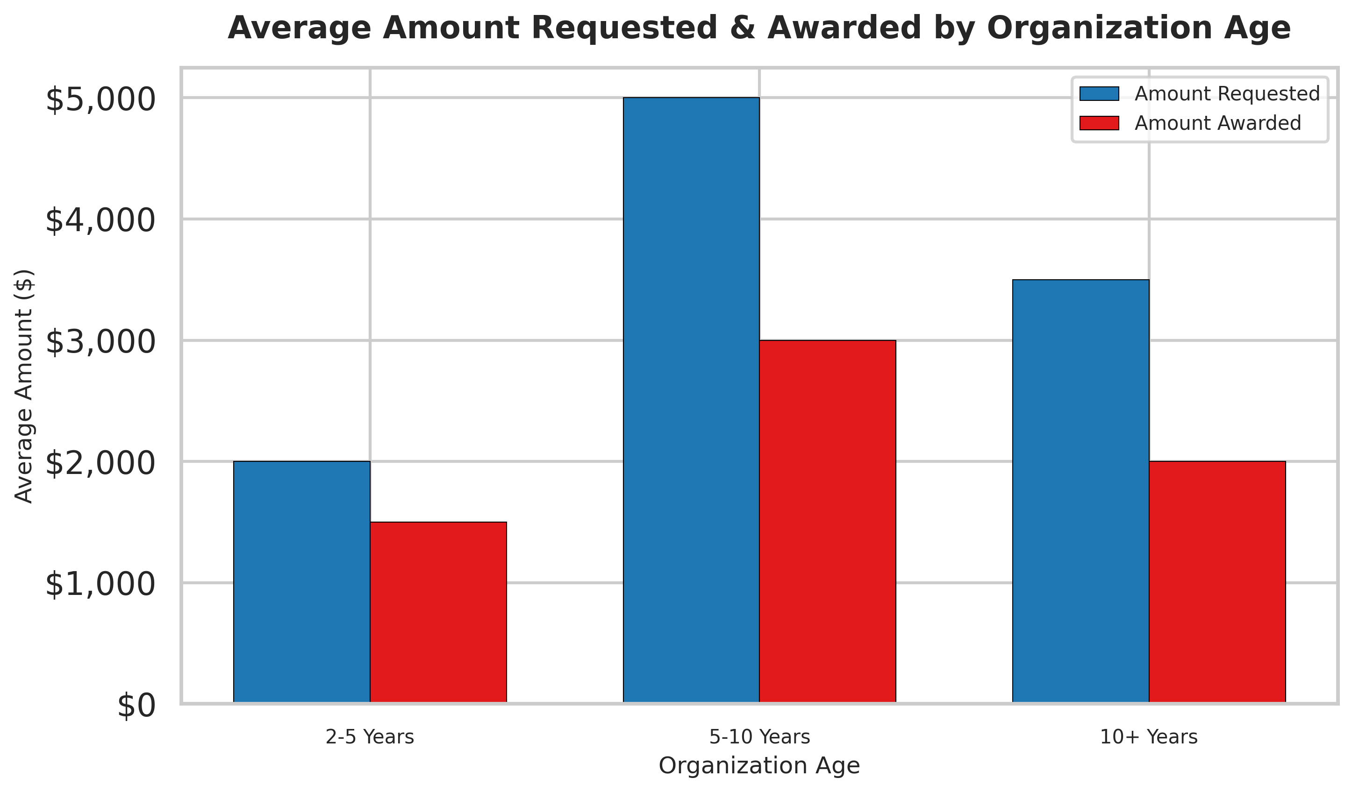
Amount Requested & Awarded by Organization Age
Organization Age | Count
10+ Years | 2
2-5 Years | 2
5-10 Years | 1
organization_age | amount_requested | amount_awarded
2-5 Years | 2000.0 | 1500.0
5-10 Years | 5000.0 | 3000.0
10+ Years | 3500.0 | 2000.0

Slide 6
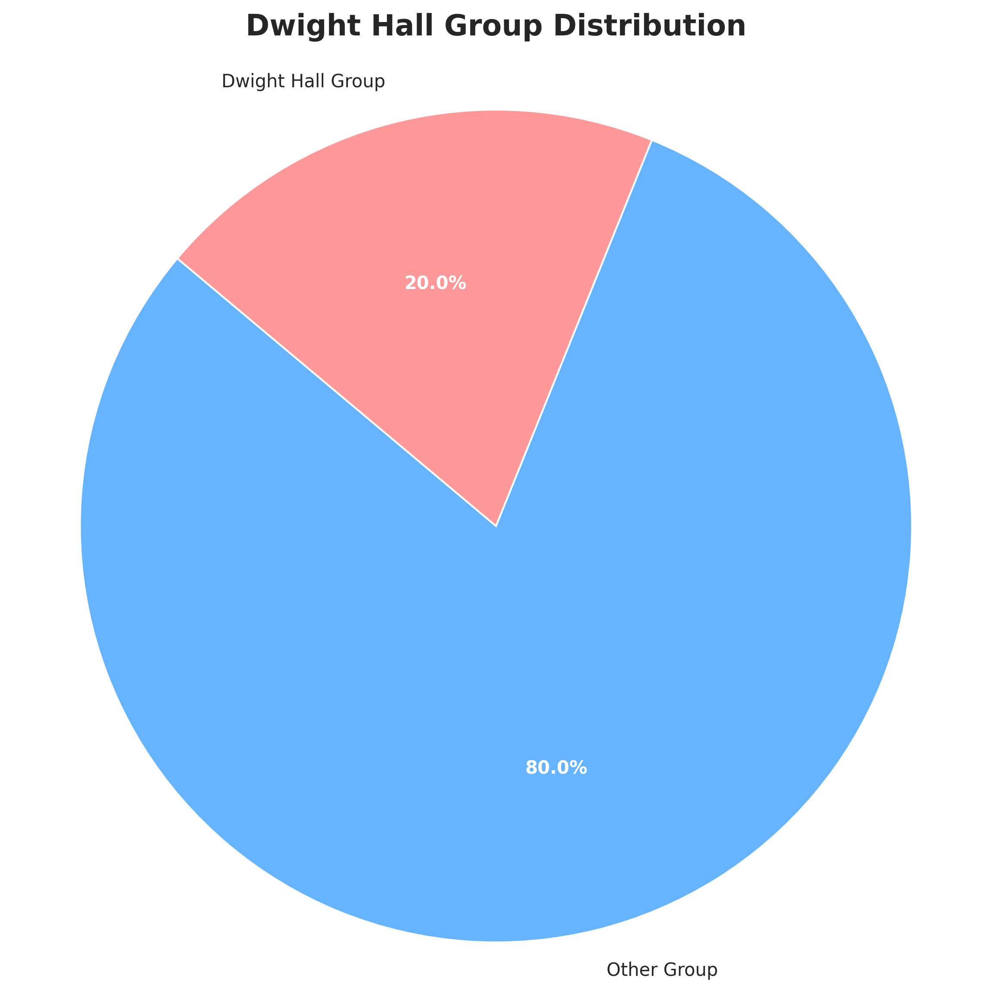
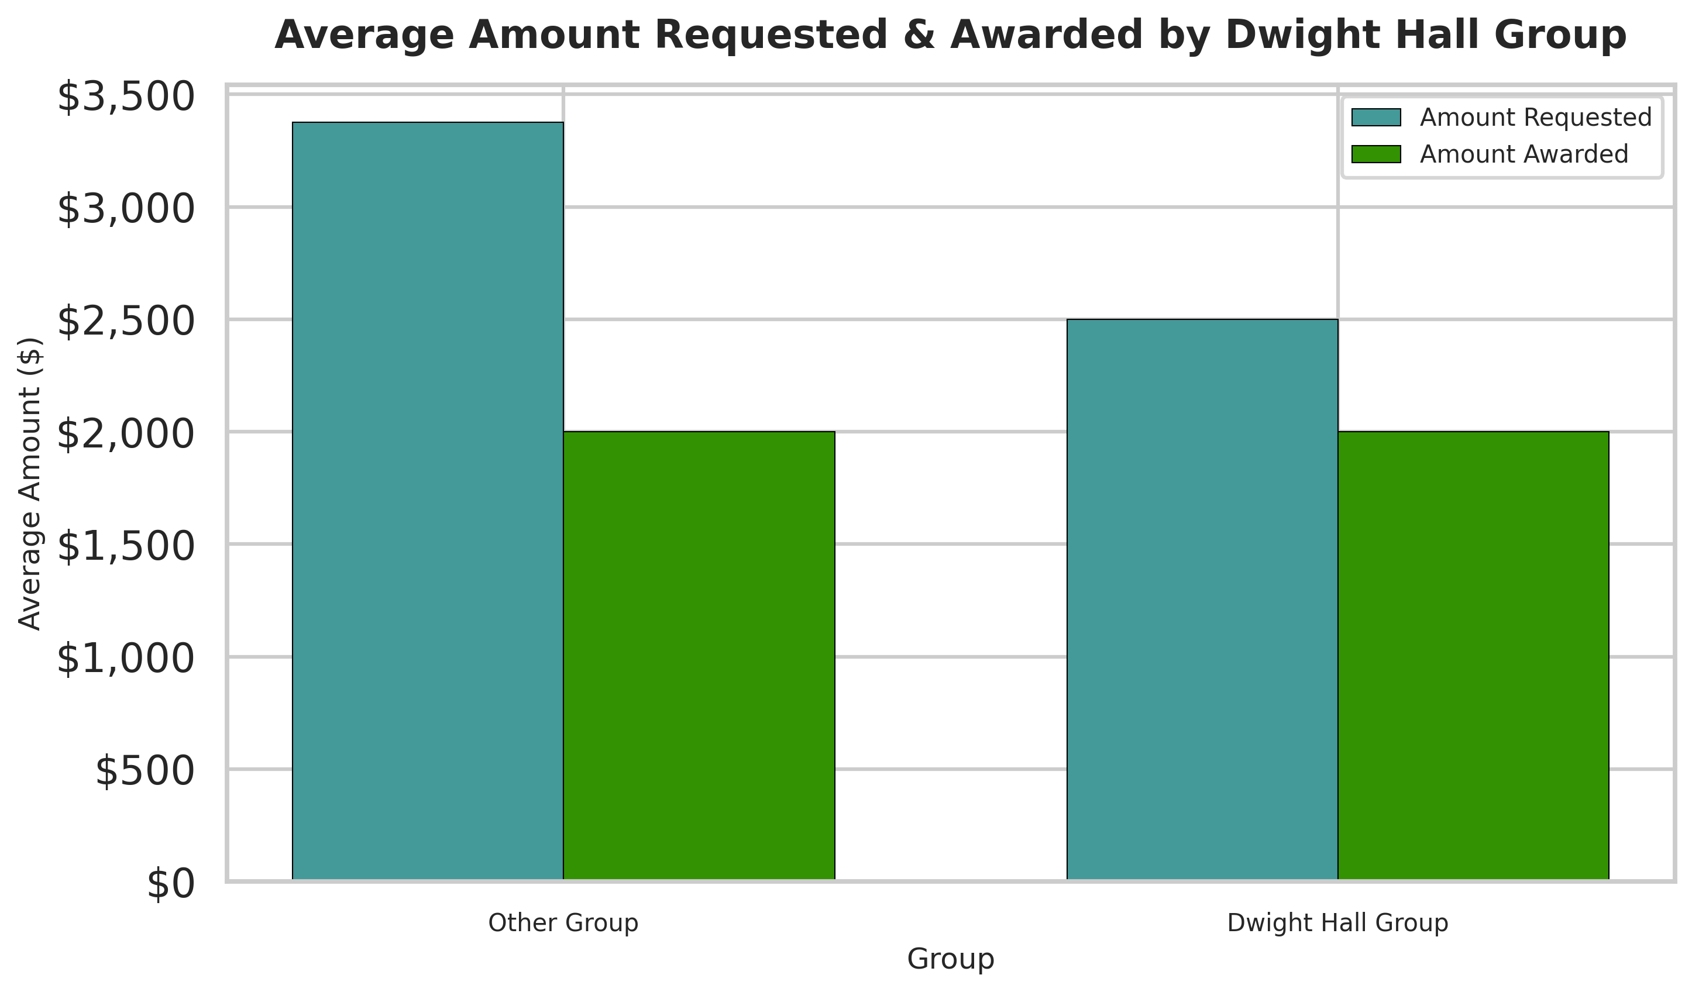
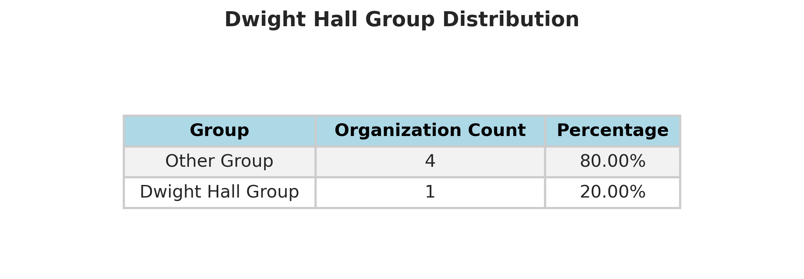
Amount Requested & Awarded by Dwight Hall Group

Slide 7
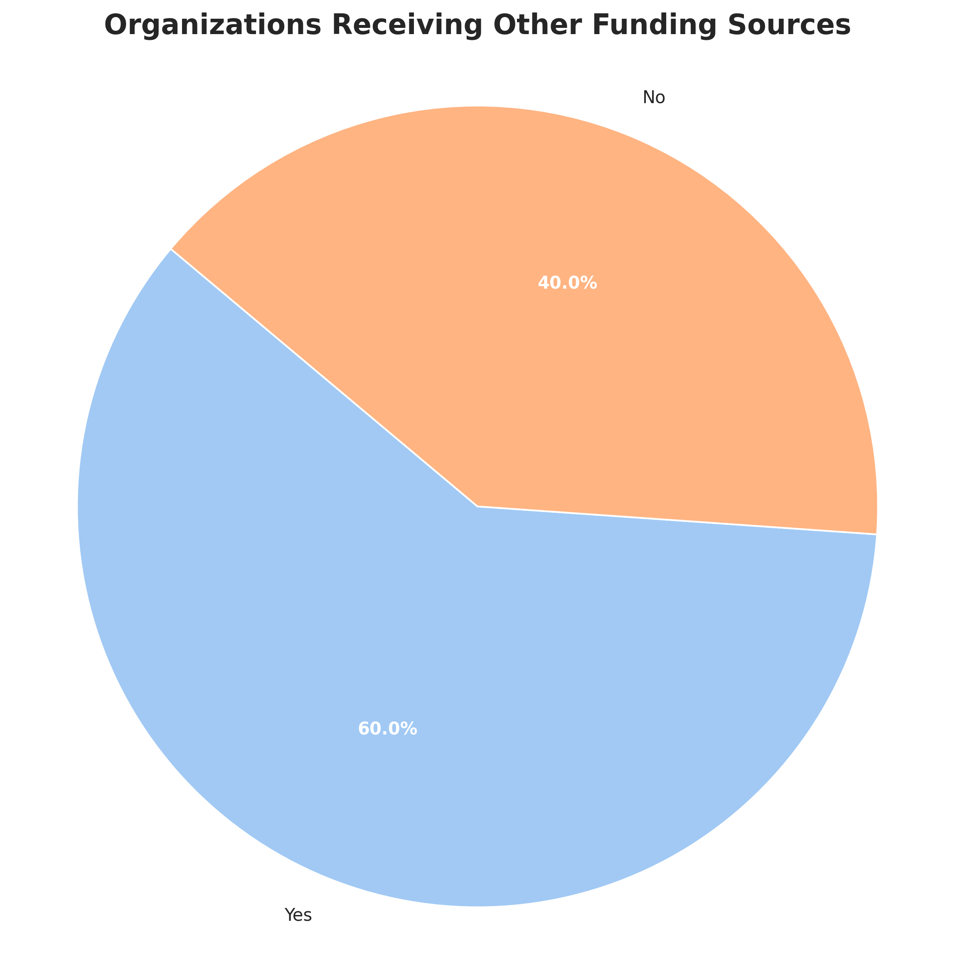
Other Funding Sources
Has Other Funding | Count
Yes | 3
No | 2

Slide 8
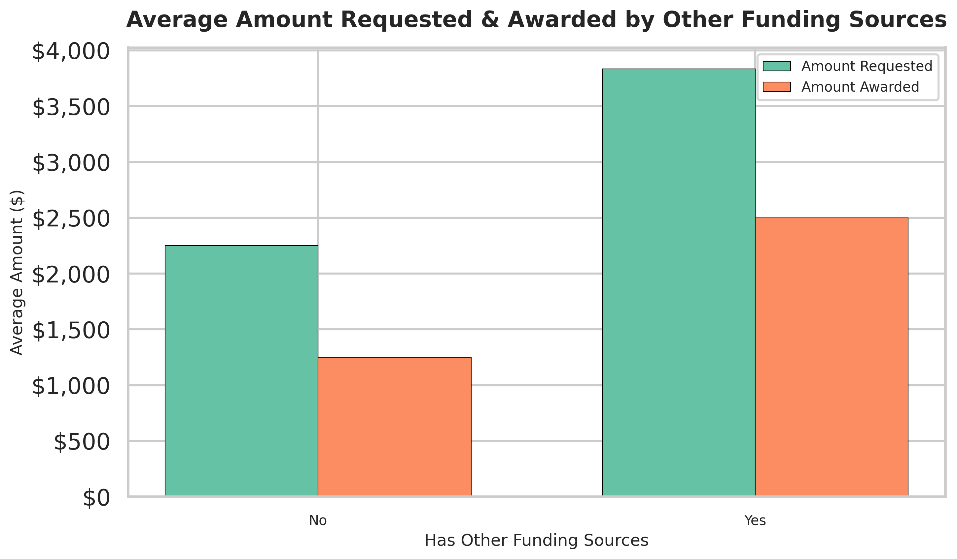
Amount Requested & Awarded vs Other Funding
has_other_funding | amount_requested | amount_awarded
No | 2250.0 | 1250.0
Yes | 3833.33 | 2500.0

Slide 9
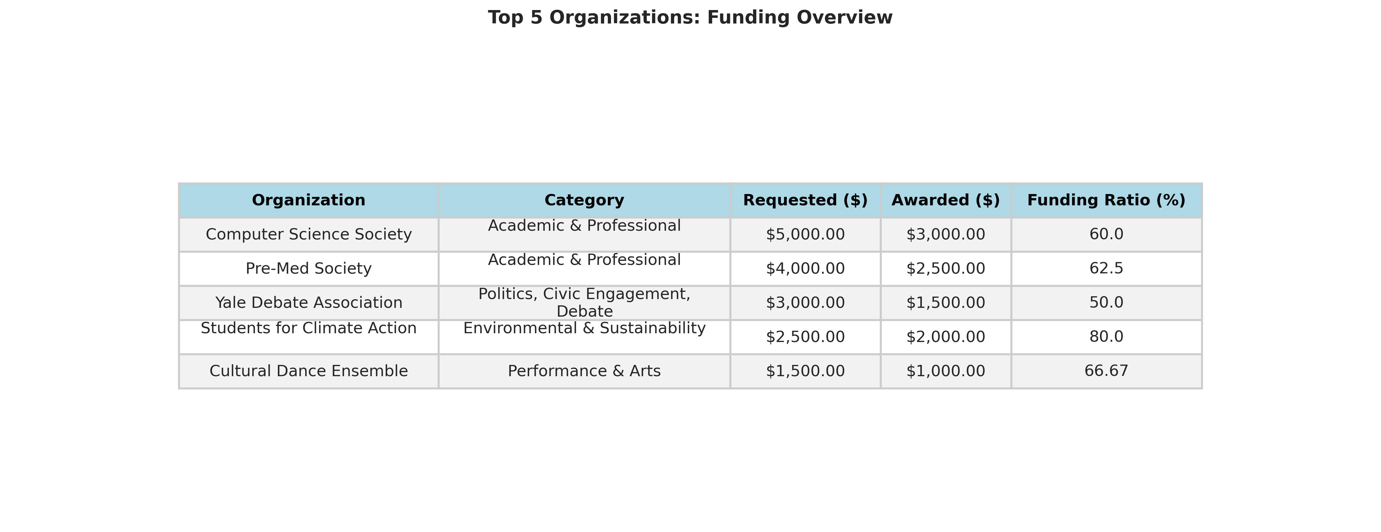
Top 5 Organizations Summary

