Slide 1
Bamazon
Iwona Antonik

Slide 2
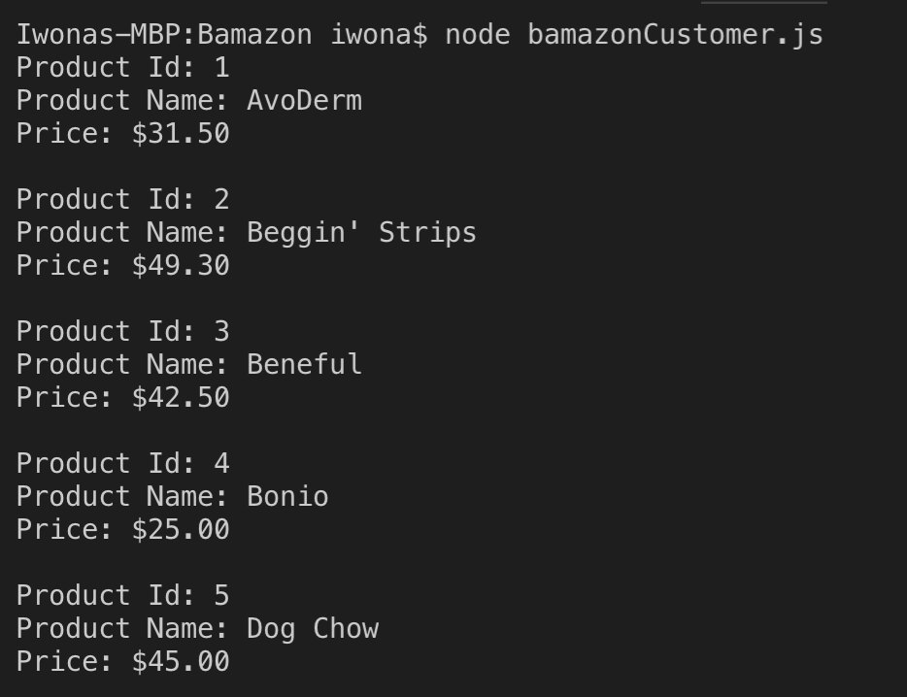
Customer Functionality
List of products is generated when customer is initiated.

Slide 3
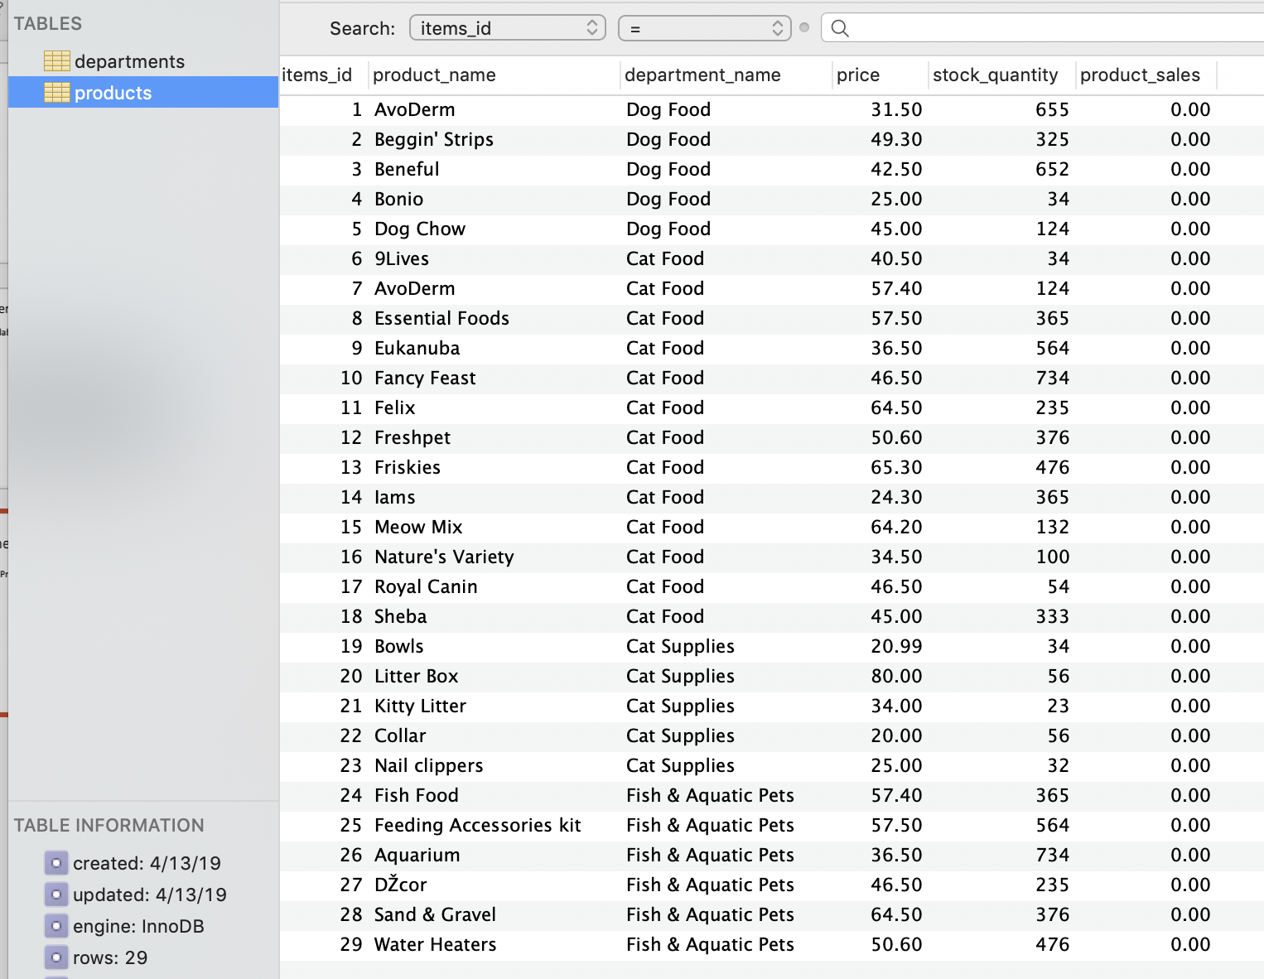



Customer purchase product
Customer purchased product id # 1
Note product_slales = 0 and quantity of product #1 = 655
DB reflects the purchase
Validation of Quantity

Slide 4

Manager functionality

Slide 5
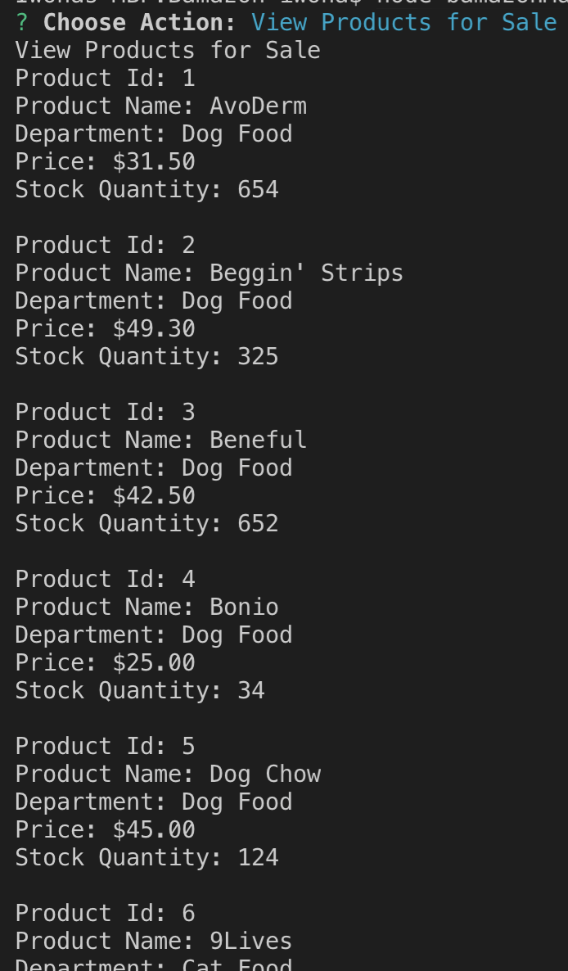
Manager view inventory

Slide 6
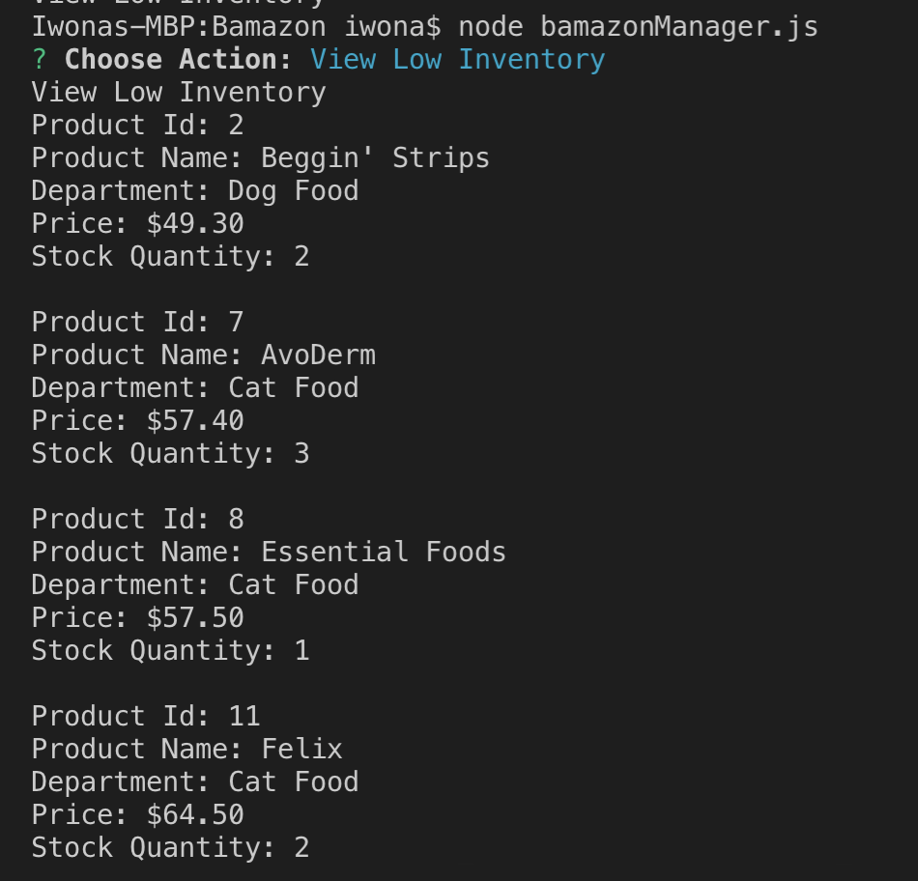
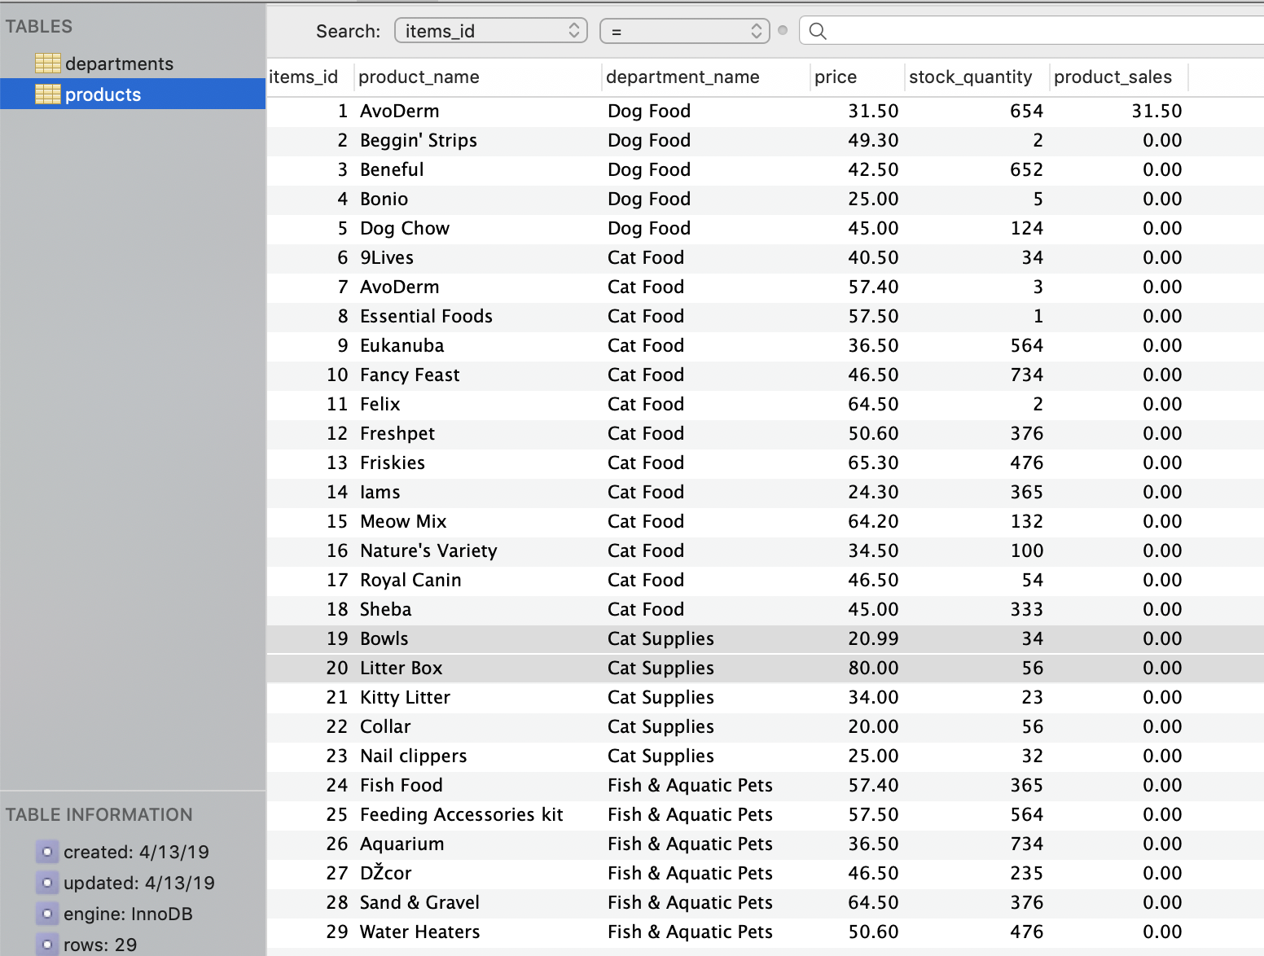
Manager – View low inventory

Slide 7


Manager - add to inventory

Slide 8


Manager - Add new product

Slide 9


Supervisor functionality

Slide 10

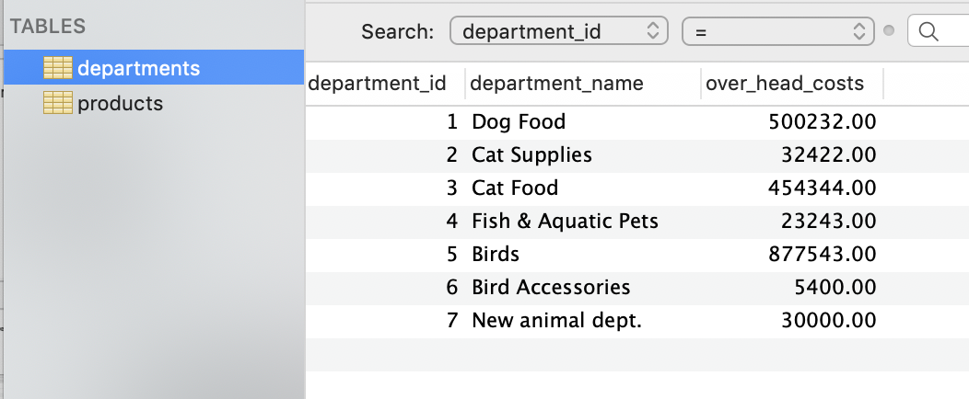
Supervisor – Add new dept.

