Slide 1
Student Learning Pattern Clustering using Particle Swarm Optimization
Bio-Inspired Computing | Unsupervised Learning | Problem 20
Clustering students by study hours, quiz performance, attendance and assignment completion
Hiya Vora (RA2311003010182)
Anushka Sharma (RA2311003010197)
Notes:
Introduce the project: we cluster students into learning patterns using a bio-inspired swarm algorithm (PSO).

Slide 2
The problem statement
Group students into distinct learning patterns so teachers can support each group differently, with no labels given in advance.
1
2
Study hours
Quiz performance
hours per week
average quiz score %
Unsupervised learning problem solved with a Bio-Inspired Computing technique.
3
4
Attendance
Assignments
classes attended %
completion rate %
Four input features

Slide 3
Dataset and preprocessing
400
4
4
students
features
hidden patterns (validation only)
Synthetic students generated from four behaviours: high achievers, hard workers, smart skippers, disengaged.
Hidden labels are never used for training, only to check results at the end.
Z-score standardisation, because PSO uses Euclidean distance and hours and percentages have different scales.
PCA to 2-D, used only for visualisation. You can also upload your own CSV.

Slide 4
Bio-inspired concept: PSO
Inspired by how bird flocks and fish schools find food: each individual remembers its own best spot and follows the best spot found by the group.
w
Inertia
c1
Cognitive pull
c2
Social pull
keep moving in the current direction
return toward my own best position (pbest)
move toward the swarm's best position (gbest)
v(t+1) = w·v(t) + c1·r1·(pbest − x) + c2·r2·(gbest − x)
x(t+1) = x(t) + v(t+1) r1, r2 are random numbers in [0, 1]

Slide 5
Mapping PSO to clustering
PSO element | Meaning in this problem
Particle | One full set of k centroids (a k × 4 vector)
Position | Centroid locations in standardised feature space
Velocity | How the centroids move at the next iteration
pbest / gbest | Best centroids found by one particle / by the whole swarm
Fitness (minimise) | Mean squared distance of each student to its nearest centroid
Added safeguards: decreasing inertia (0.9 to 0.4) to explore first then refine, velocity clamping, boundary clipping, and a penalty for empty clusters.

Slide 6
Our pipeline
1
Data
2
Scale
3
PSO
>
>
400 students, 4 features
z-score + PCA view
swarm of 40, 150 iterations
4
Pick k
5
Profile
6
Validate
>
>
4 validity metrics
name each pattern
vs K-Means, 15 runs
Everything runs in one Google Colab notebook, with the PSO written from scratch in NumPy.

Slide 7
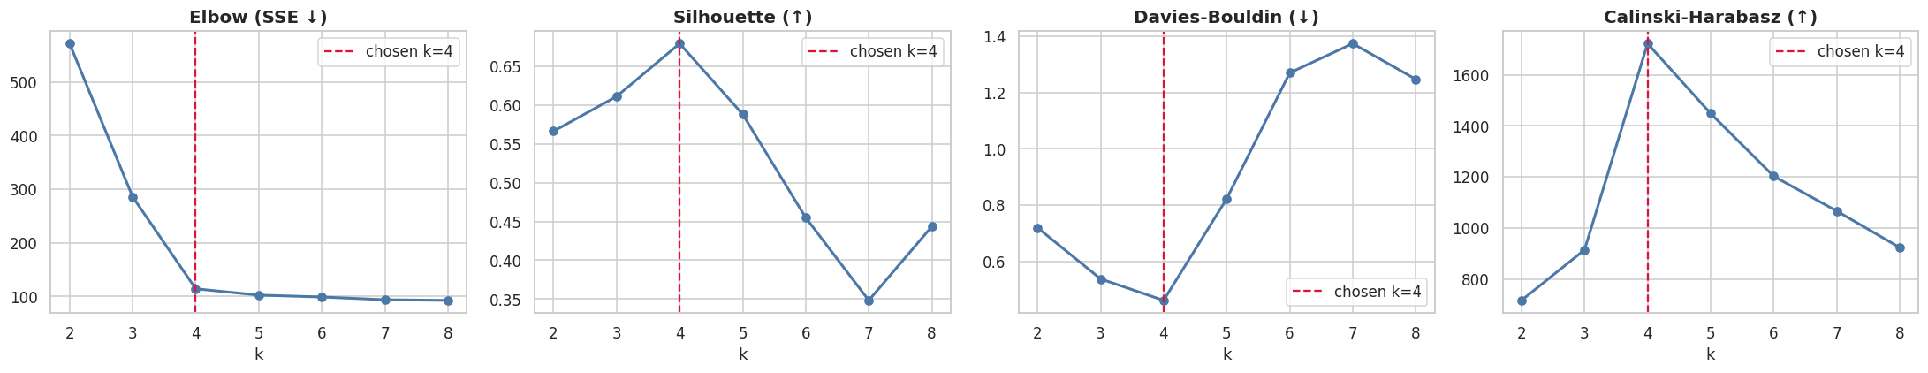
Choosing the number of clusters
PSO was run for k = 2 to 8. Elbow, silhouette, Davies-Bouldin and Calinski-Harabasz were combined by rank aggregation.
k = 4
four learning patterns found

Slide 8
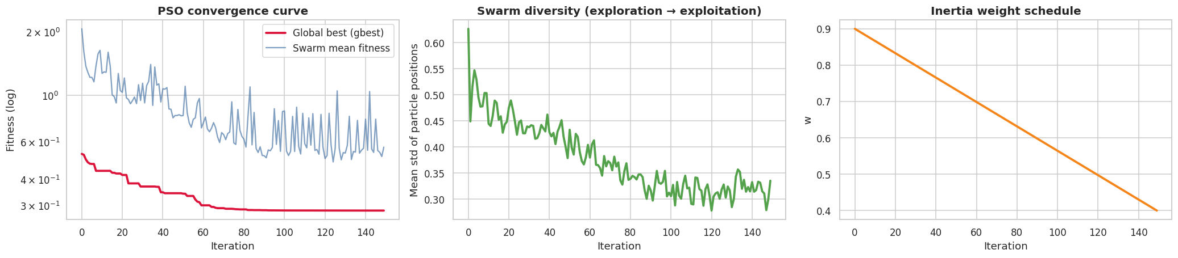
PSO convergence
Fitness drops fast
Diversity shrinks
Inertia decays
global best falls steeply in the first iterations, then settles at 0.285 MSE
the swarm spreads out early (explore) and clusters tightly later (exploit)
w goes from 0.9 to 0.4, shifting the swarm from exploration to refinement

Slide 9
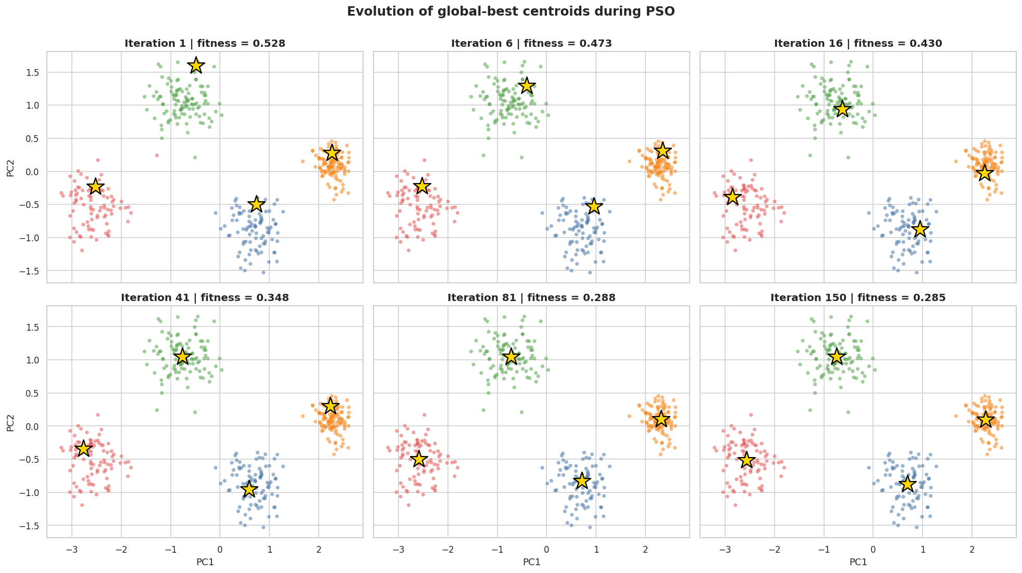
How the swarm finds the clusters
Gold stars are the global-best centroids.
They start at poor positions, then migrate step by step to the centre of each student group, and stop moving once the swarm agrees.

Slide 10
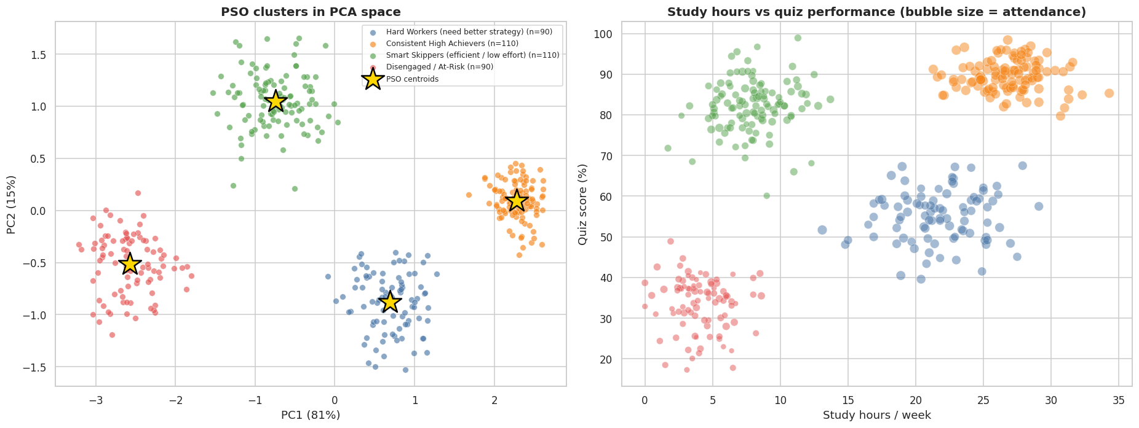
Discovered clusters
Four well-separated groups in PCA space. Silhouette 0.679, Davies-Bouldin 0.461, Calinski-Harabasz 1722.

Slide 11
The four learning patterns
1
Consistent High Achievers
n = 110
2
Hard Workers
n = 90
26.8 h
89.6%
95.1%
95.9%
21.7 h
55.1%
82.1%
77.5%
Study
Quiz
Attend.
Assign.
Study
Quiz
Attend.
Assign.
3
Smart Skippers
n = 110
4
Disengaged / At-Risk
n = 90
8.0 h
82.1%
57.2%
52.0%
4.1 h
33.5%
44.1%
30.7%
Study
Quiz
Attend.
Assign.
Study
Quiz
Attend.
Assign.
Cluster means in original units.

Slide 12
PSO vs K-Means
Over 15 random seeds | PSO | K-Means (1 init)
Mean SSE | 116.8 | 194.5
SSE spread (std) | 3.5 | 108.6
Mean silhouette | 0.679 | 0.591
Silhouette range | 0.679 to 0.679 | 0.414 to 0.679
1.00
Adjusted Rand Index vs the hidden true patterns: PSO recovers every group
With 10 restarts, K-Means reaches the same best solution as PSO (SSE 113.9).
PSO's advantage is reliability: nearly identical results on every run, with no restarts needed.

Slide 13
From clusters to action
1
Consistent High Achievers
Enrichment, peer mentoring, advanced projects
2
Hard Workers
Teach study strategy: active recall, spaced practice, targeted tutoring
3
Smart Skippers
Strong grasp but low engagement: challenge tasks and clear deadlines
4
Disengaged / At-Risk
Early warning: counselling, attendance follow-up, catch-up plan

Slide 14
Conclusion
PSO, written from scratch, clustered 400 students into four clear learning patterns.
Swarm search was stable across seeds and matched the best K-Means result.
Future work: PSO + K-Means hybrid, multi-objective PSO, real LMS data, fuzzy membership.

