Slide 1
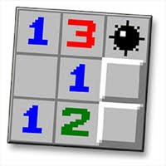


Notes:
Meet, UiPath versus Minesweeper!
What started out as a conceptually neat idea for a small and simple UiPath training project resulted in much, much more than that! At face value attempting to teach a UiPath bot to play a game of Minesweeper might sound like a simple proposition, but the more I dug into the problem I ended up quickly learning that this is logically no simple feat. In computer science terms I have even learned that there have been scholarly articles written on this topic that have proven that, mathematically speaking, this is what is categorized as an “NP-complete” problem. NP-complete essentially means that the time required to solve the problem increases rapidly as the size of the problem grows; in our case the size of the Minesweeper grid itself.
Long story short I’ve learned that I will not be adopting this project at what originally was supposed to become an introductory or intermediate skill level training project. However, this project does have merit in becoming a potential project for a more advanced skill level. Nevertheless, the more I dug into this project I knew I had to crack it, so I did devise a solution that appears to perform relatively well. Of course, there is always room for continuous improvement and enhancements given enough time. However, since I currently have a solution does successfully “win” at the Introductory, Intermediate, and even the Expert levels of Minesweeper, I wanted to take a moment to walk you through the logic I developed and then show you the bot in action attempting to win at all 3 Minesweeper levels!

Slide 2
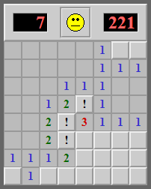
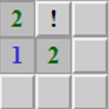
Thought Process…
How many “uncovered” or “unknown” squares are there immediately adjacent to the current space on the board?
How many “detected mine” squares are there immediately adjacent to the current “known” square on the board?
What is the probability (as a percentage) that a mine exists in any single “unknown” or “uncovered” square?
Notes:
Through multiple trials and experiments that I initially conducted when trying to develop the required algorithm, I ultimately settled on a concept or approach that focused 100% on trying to determine the probability of a mine existing in any single space on the Minesweeper grid.
In order to successfully make this determination, 2 key factors had to be determined first. The first factor was to count all of the “uncovered squares” that surround a single known value that has already been exposed. The second being to count up all of the squares that have been previously identified as containing a mine; with a 100% probability or certainty when making that determination. More to come on those specific details in a few moments.
The ultimate goal was to have the bot click on squares that have the lowest risk, probability speaking, until the game ultimately ends in a win or unfortunately the occasional loss. Minesweeper in the very end still contains moments of chance or risk, where even with a relatively low probability of a mine being present, the bot will still unfortunately lose the game.

Slide 3
Probability Calculation
Start with a square that has a known value
Count all the immediately adjacent squares that have a “detected mine”
Count all the immediately adjacent squares that have not been “uncovered”
Compute the probability (percentage) that a mine might exist in any of the remaining “uncovered” or “unknown” squares:
( Total Number of Known Squares – Total Number of “Detected Mines” )
---------------------------------------------------------------------------------------------------------
Total Number of Uncovered Squares
Notes:
An interesting formula needed to be derived in order to compute the amount of risk, again probability speaking, that any single space contains a mine. The higher the computed risk score; approaching and including computed values of 100% means that there is a higher risk that a mine exists under any given space on the Minesweeper grid. The inverse of that is true approaching 0%; meaning that there is a lower risk that a mine exists under any given space on the Minesweeper grid.
The formula is as outlined here –
First, traverse through the entire Minesweeper grid, searching for squares that have known values; these are the squares on the Minesweeper grid that describes how many known mines exist in the immediately adjacent squares surrounding this single square (upper left, upper, upper right, left, right, lower left, lower, and lower right locations to be more exact). Once a square that contains a known value has been encountered; secondly, look at all the immediately adjacent squares and determine how many of those squares have already been flagged as containing a “detected mine” – simply count the total number of those squares that contain a known mine in all the immediately adjacent squares. Thirdly, take the exact same approach for detected mines and instead perform a count on squares that have not yet been uncovered yet. Once a single square that contains a known value has obtained counts of total known detected mines and uncovered squares; the following calculation is performed; Take the total number of known squares and subtract the total number of detected mines. Take this result and divide that result by the total number of uncovered squares.
This calculation will determine precisely what the percentage risk, again probability speaking, that a mine exists in any of the immediately adjacent squares surrounding this single square is. One thing that likely is not immediately apparent is the likelihood that two or more immediately adjacent squares could be evaluated by multiple other known squares. In the case where a single unknown square is evaluated by other adjacent known squares; the previously computed probability, or risk score, is taken into consideration. If the previously computed risk score is lower than the current computed risk score, then the previously computed risk score is updated with the current computed risk score since there is a higher likelihood a mine is present in the uncovered square. If the previously computed risk score is higher than the current computed risk score, then the previously computed risk score will remain. There is an interesting exception that exists here, anytime a currently computed risk score comes back with a zero-percent probability of a mine existing in an uncovered square, the risk score for that specific unknown space will be updated to zero-percent; there is with absolute certainty, no mine that exists in this specific uncovered square.
In the next couple of slides that follow; I’ll discuss some specific examples of how these calculations are performed.

Slide 4
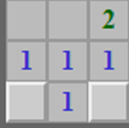
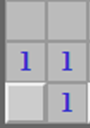
Probability Calculation Explained
Game Board Being Analyzed | Known Mines | Uncovered Squares | Detected Mines | Probability of Mines in Adjacent squares
 | 2 | 5 | 1
 | 1 | 2 | 0
 | 1 | 1 | 0
2 – 1 ---------------- 5 | = 20%
1 – 0 ---------------- 2 | = 50%
1 – 0 ---------------- 1 | = 100%
Notes:
Here are three specific examples and the resulting probability, or risk score, that is computed:
In the first example, notice there is an uncovered green number 2 present. In the immediately adjacent squares surrounding this single square, we know that there are exactly 2 mines (because of the green number 2 being present). From previous calculations performed the square immediately above the 2 was already determined that a mine is present (with again 100% certainty from the probability calculations previously performed). There are only 1 of these squares present in the immediately adjacent squares surrounding the green number 2 square. There are also 5 squares that have yet to be uncovered. Given that we already know where one of the 2 mines are located, this means that in the remaining 5 uncovered squares only 1 more mine is possibly present. Given that, the calculation, as shown, is 1 divided by 5, which results in a value of 0.20, or as a percentage, simply 20%. Therefore, there is a 20% likelihood that a mine exists in any of the 5 remaining uncovered squares.
In the second example, notice there is an uncovered blue number 1 present. In the immediately adjacent squares surrounding this single square, we know that there are exactly 1 mine (because of the blue number 1 being present). From previous calculations performed all the squares immediately adjacent to the blue number 1 were already determined that no known mines are present (with again 100% certainty from the probability calculations previously performed). There are 2 squares that have yet to be uncovered. We don’t know where the single mine might possibly be located in either of the remaining 2 uncovered squares. Given that, the calculation, as shown, is 1 divided by 2, which results in a value of 0.50, or as a percentage, simply 50%. Therefore, there is a 50% likelihood that a mine exists in any of the 2 remaining uncovered squares.
If you look closely, you will notice that from the first example with the green number 2 and the second example with the blue number 1, that both share a space in common. From the green number two the common space with the blue number one is the square located to the lower left of the green number two. From the blue number one the common space with the green number two is the square located to the lower right. Given what we know here, this space in common will receive a probability, or risk score, of 50% because of the higher probability that has been determined in the calculation made when analyzing the square containing the blue number 1.
In the third and final example here, notice again there is an uncovered blue number 1 present. Even though this square is also located on the edge of the Minesweeper grid, the probability or risk score calculation remains unchanged. From previous calculations performed all the squares immediately adjacent to this blue number 1 were already determined that no known mines are present (with again 100% certainty from the probability calculations previously performed). There is also only 1 square that has yet to be uncovered. We obviously know where the single mine has to be located. Given that, the calculation, as shown, is 1 divided by 1, which results in a value of 1.00, or as a percentage, exactly 100%. Therefore, it is with known certainty that there is an absolute 100% likelihood that a mine exists in the remaining uncovered square.
If you again look closely, between examples 2 and 3, you will notice that both number 1’s also share a space in common; the bottom left corner square on the Minesweeper grid. Given what we know here, this space in common will receive a probability, or risk score, of 100% and because of this absolute certain probability or risk, the only other remaining space in the 2nd example, located to the bottom right of the blue number 1 square, we now know with absolute certainty that this square now contains a 0% probability or risk of containing a mine.
It’s ultimately through the continued iterations of the game play that these unique discoveries are made.

Slide 5
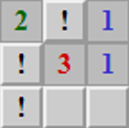
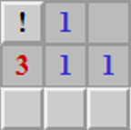
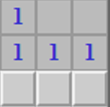
Probability Calculation Explained
Game Board Being Analyzed | Known Mines | Uncovered Squares | Detected Mines | Probability of Mines in Adjacent squares
 | 3 | 2 | 3
 | 1 | 3 | 1
 | 1 | 3 | 0
3 – 3 ---------------- 2 | = 0%
1 – 1 ---------------- 3 | = 0%
1 – 0 ---------------- 3 | = 33.33%
Notes:
Here are three more specific examples and the resulting probability, or risk score, that is computed:
In the first example, notice there is an uncovered red number 3 present. In the immediately adjacent squares surrounding this single square, we know that there are exactly 3 mines (because of the red number 3 being present). From previous calculations performed the squares immediately above, to the left, and to the lower left of the 3 were already determined that mines are present (with again 100% certainty from the probability calculations previously performed). There are 3 of these squares present in the immediately adjacent squares surrounding the red number 3 square. There are also 2 squares that have yet to be uncovered. Given that we already know where all 3 of the 3 mines are located, this means that in the remaining 2 uncovered squares there are with absolute certainty no more mines possibly present. Given that, the calculation, as shown, is 0 divided by 2, which results in a value of 0.00, or as a percentage, simply 0%. Therefore, there is with absolute certainty a 0% likelihood that a mine exists in any of the 2 remaining uncovered squares.
The second example is similar to the first, in which instead there is a blue number 1 present and there is a known adjacent square that has a known mine. Given that, the calculation, as shown, is 0 divided by 3 (there are no unknown mines around this space, with 3 uncovered squares also immediately adjacent), which results in a value of 0.00, or as a percentage, simply 0%. Therefore, there is with absolute certainty a 0% likelihood that a mine exists in any of the 3 remaining uncovered squares.
In the final example, we simply moved one square to the right from the blue number 1 in the second example provided; this new square is also showing a blue number 1. In the final example, the immediately adjacent squares surrounding this single square, a blue number 1, we know that there is exactly 1 mine present. From previous calculations performed no known mines are immediately adjacent to the blue number 1; known with 100% certainty from the probability calculations previously performed. There are also 3 squares that have yet to be uncovered. Given that there are no known mines immediately adjacent, this means that in the remaining 3 uncovered squares there is a 33% risk or probability of clicking on a mine. From a calculation perspective, as shown, is 1 divided by 3, which results in a value of 0.33, or as a percentage, simply 33%. Therefore, there is a 33% likelihood that a mine exists in any of the 3 remaining uncovered squares.
If you look closely, you will notice that from the second example to the third example; there are 2 squares in common. Therefore since the second example provided an absolute certainty that these squares in common do not contain a mine, this implies that the only square not in common in the third example must contain a mine. Again, it’s ultimately through the continued iterations of the game play that these unique discoveries will be made.

Slide 6
Utilization of 4 Data Tables
Game Board
Total Adjacent Unknown Squares
Total Adjacent Mine Squares
Computed Mine Probability
Notes:
So how does all of this work from a UiPath point-of-view?
Long story short there are 4 data tables that are constructed and used to build the calculations that were discussed on the previous slides.
There are data tables that contain a copy of the actual game board or Minesweeper grid. There is another data table that contains a count of the total number adjacent squares to any single known values, or uncovered squares. There is a third data table that is very similar to the second data table, but contains a count of the total number of adjacent mine squares to any single known values, or uncovered squares. Finally, the fourth data table contains the actual computed probability or risk scores for any squares that are located immediately adjacent to any single known value, or known squares.
On the following 4 slides, example of each data table is depicted against an actual game board or Minesweeper grid.

Slide 7
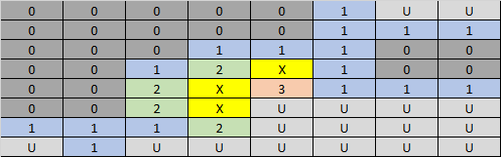
Data Table: Game Board
Notes:
Here is what the data table appears for the actual game board.
Notice that all uncovered square that contain no adjacent mines are denoted with a 0. All known uncovered squares that have adjacent mines are simply denoted accordingly with their respectful number. All squares that have been previously identified as containing a mine and have been marked accordingly are denoted with an “X” while all uncovered squares are denoted with a “U” for uncovered. It is from here that the additional three data tables can now be derived.

Slide 8
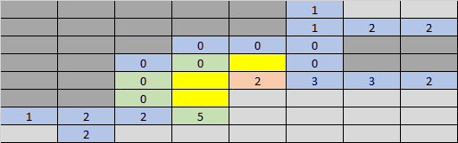
Data Table: Total Adjacent Uncovered Squares
Notes:
Here is what the data table table appears for the that contains a count of uncovered squares appears like.

Slide 9

Data Table: Total Adjacent Mine Squares

Slide 10
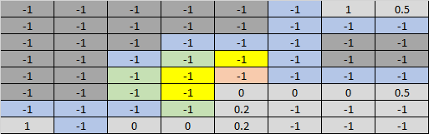
Data Table: Computed Mine Probability

Slide 11
Game Play Logic
Start A New Game
Randomly Click Any Square
(until a “non-mine” space has been clicked)
Get Game Board Details
Identify Uncovered and Detected Mine Squares
Calculate Mine Probability
(“uncovered” squares immediately adjacent to “known” squares)
Tag All Squares Known With Confirmed Mines
(100% probability)
Check Game Status:
Win or Lose?
Click All Squares Known Without Mines
(0% probability)
Yes
No
Have Any Squares Been Tagged or Clicked?
Click Square With Least Probability of a Mine
Yes
No

Slide 12

Live Demonstration!

