Slide 1
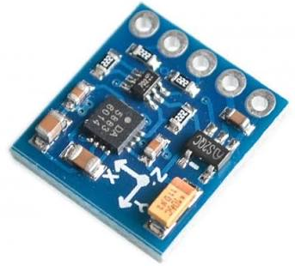
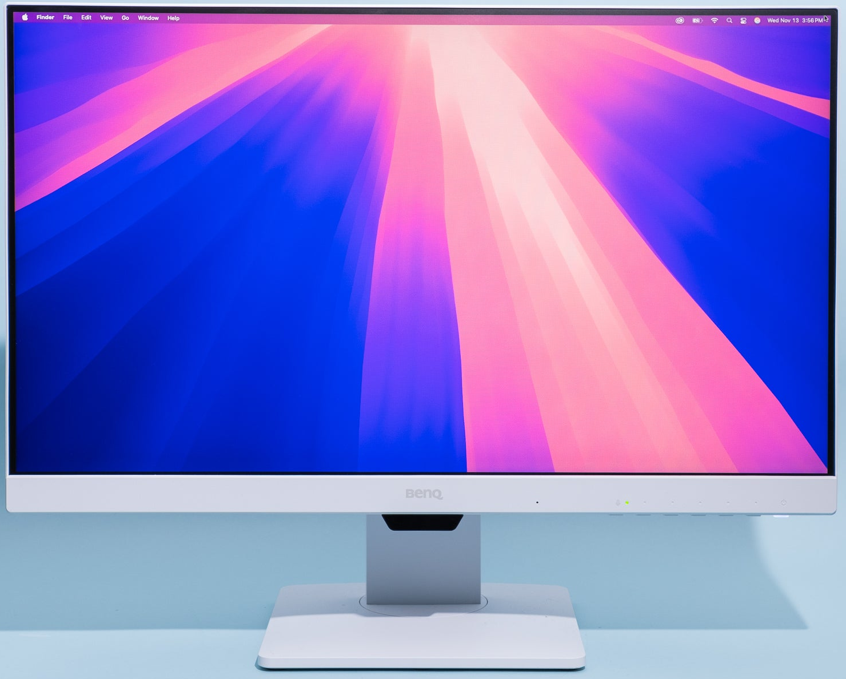
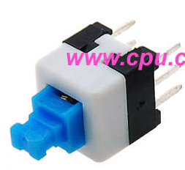
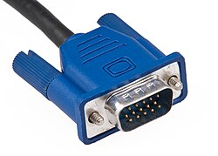
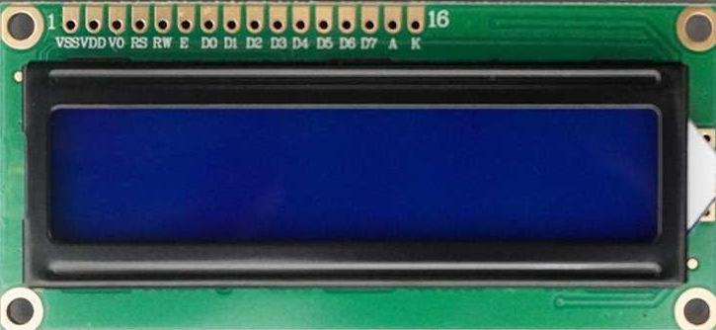
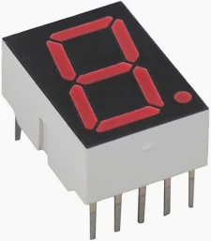
Top-level System Architecture - Magnetic Piano (75Hz / 45Hz Detection & Auto-Tracking Platform)
FPGA (Intel DE2-115)
1. Sensor Readout (I2C)
2. Calibration
3. Real-time Calibration
Sample Sync
& Tick
QMC5883P Magnetometers
qmc5883p_ctrl (x3)
Raw Data Outputs
mag_calibration_manager
mag_calibrator (x3)
sample_seen
mask
3-axis magnetic sensors
I2C-line interface (GPIO)
Data rate: 200 Hz
Output: 16-bit raw X, Y, Z
Init & register config
Periodic readout
Data assembly
mag1_x/y/z
mag2_x/y/z
mag3_x/y/z
Calibration Coefficients
Raw Data
Compute offset & radius
coeff.
All active
sensors
updated?
i2c_master (x3)
unsigned_divider
Calibrated Outputs
carrier_
sample_tick
(for average & scale calc)
PC (Windows)
Calibrated field
sample_tick
4. Reference Generators(Fs = 200 Hz)
5. Lock-in Detection (Per-Sensor)
10. UART Streaming to PC
UART_TXD
Python Application
Receive via UART
LUT Collection
Piano Key Monitor
(H2 Frames & KEY Frames)
Reference-75hz
Reference_45hz
mag_lockin_vector_75hz (x3)
mag_lockin_vector_75hz (x3)
Real time
H2 value
75 Hz = 3/8 cycle
8-entry LUT
45 Hz =9/40 cycle
40-entry LUT
Multiply with sin75/cos75
I/Q accumulation
H2 = X1^2 + Y1^2 + Z1^2
Multiply with sin45/cos45
I/Q accumulation
H2 = X1^2 + Y1^2 + Z1^2
Press Buttons (Active-High)
sin/cos q15
Outputs
Outputs
Outputs
Outputs
Button 0 –
75Hz Note
-> GPIO[11]
GPIO[11]
GPIO[12]
sin75_q15
cos75_q15
sin45_q15
cos45_q15
H75_S1, H75_S2, H75_S3
H45_S1,H45_S2, H45_S3
Button 1 –
45Hz Note
-> GPIO[12]
H2 frames
6. H2 Frame Averaging (Noise Smoothing)
7. LUT-based Classification (Per Frequency)
8. Platform Tracker (Auto-Follow)
9. Stepper Control (FPGA)
h2_lut_classifier_3sensor
key75/key45
Decision:
sum <= -2 -> move left
sum >= +2 -> move right
otherwise -> stay
Boundary check (K2 ~ K12)
Stable confirmation & cooldown
DRV8825
Stepper Driver
Debounced (10 ms)
Sent to PC as press state
avg_H2
Compute ratios
Compare with LUT ROM
stepper_drv8825_controller
h2_average_3sensor
(for 75Hz)
h2_average_3sensor
(for 45Hz)
Microstep (1/16)
VMOT / GND
A1/A2, B1/B2
unsigned_divider
STEP / DIR
EN
Outputs
Outputs
key75_id, key75_score, key75_valid
key45_id, key45_score, key45_valid
Step/DIR/EN
LUT
Stepper Motor
(NEMA17)
Display & Debug (On FPGA)
FPGA External Interface Summary
LUT Memory Files
Legend
Data Path
Sliding Platform / Bottom
LEDR
I2C-like (GPIO):
SCL1/SDA1 -> Sensor #1
SCL2/SDA2 -> Sensor #2
SCL3/SDA3 -> Sensor #3
Buttons: GPIO[11] (75Hz), GPIO[12] (45Hz)
Stepper Driver: GPIO[8] STEP, GPIO[9] DIR, GPIO[10] ENABLE_N
UART: RS232 TXD -> PC (115200 bps)
Stored in FPGA ROM via .mem files
h75_lut_3sensor.
h45_lut_3sensor.mem
Power / Mechanical
LCD 16x2
7-Segment HEX
LEDG
Control / Timing
VGA
Motor Control
Moves Left <-> Right
Show raw/calibrated values, H2 (75/45), keys, platform center, status
UART

