Slide 1
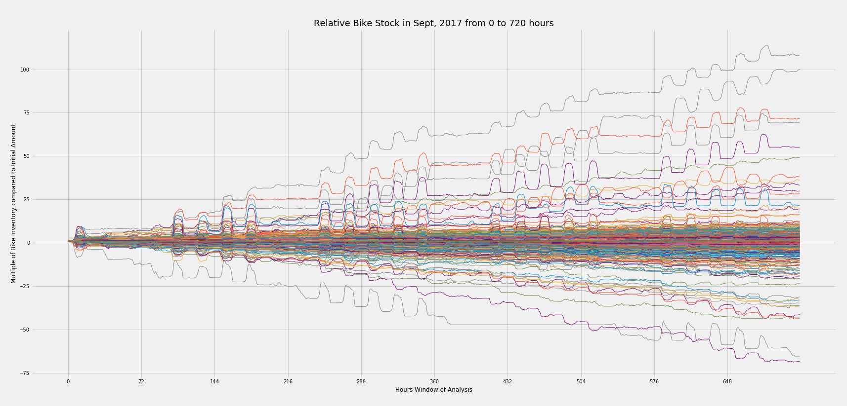
West St. & Chamber St.
E. 7 and Avenue A
Broadway & Battery
Broadway & W60
Grand Army Plaza &
Central Park
Columbus & W72

Slide 2
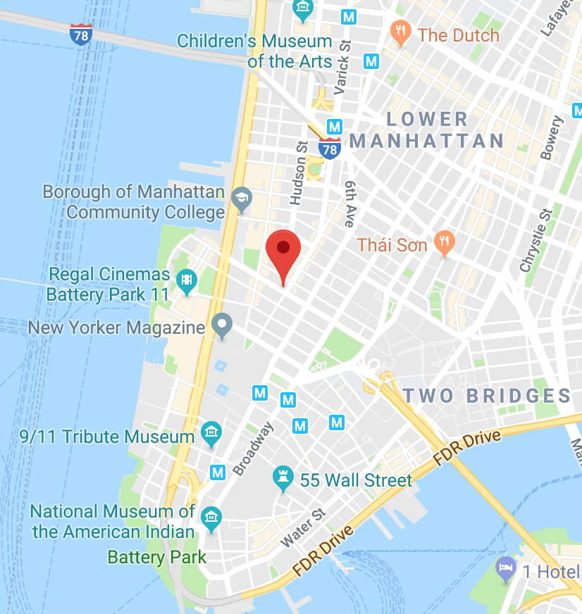
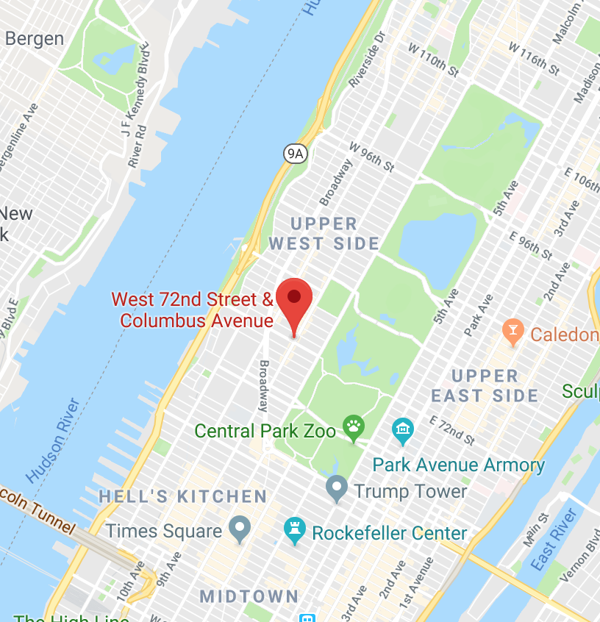
West St. & Chamber St. in Lower Manhattan
Columbus & W72 near Upper West Side

Slide 3
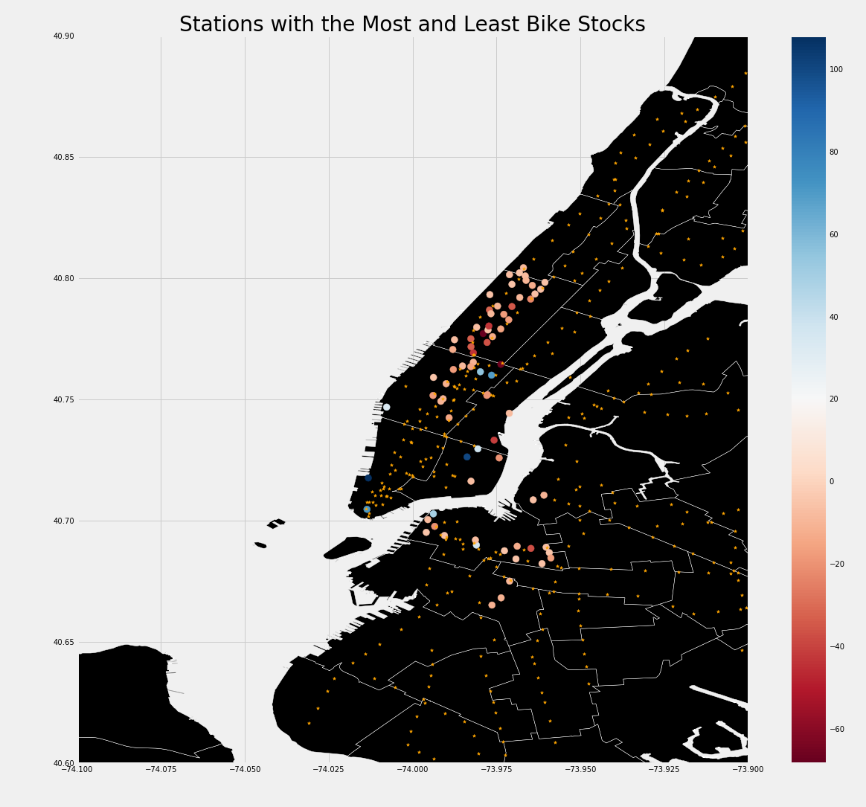

Slide 4
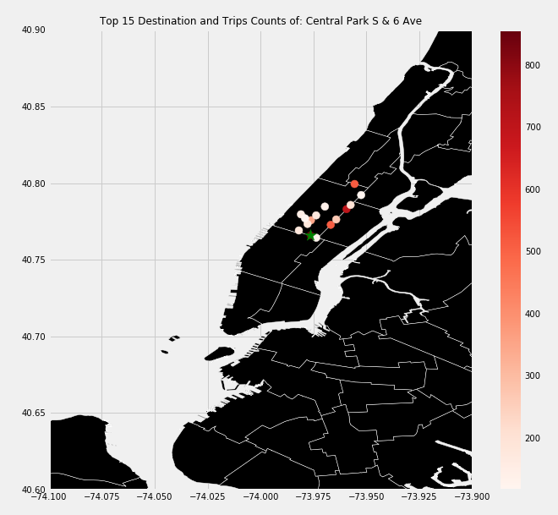
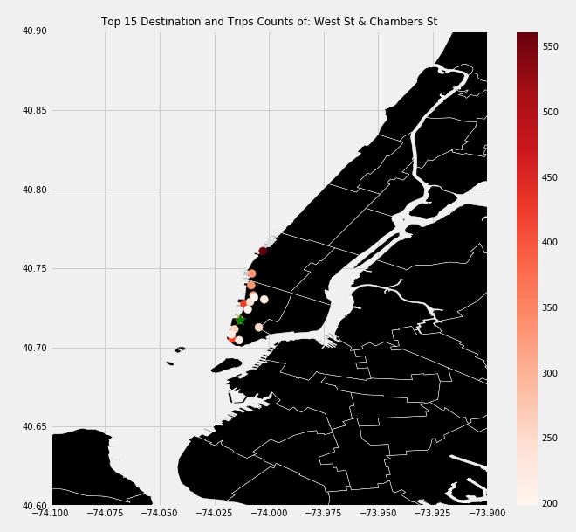
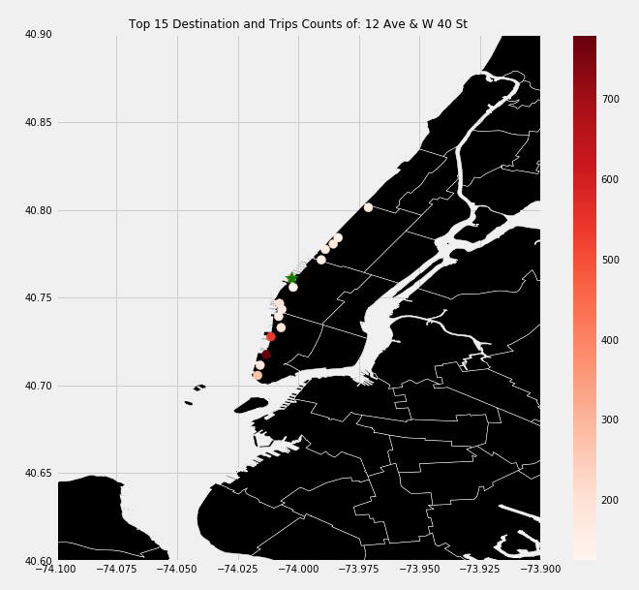
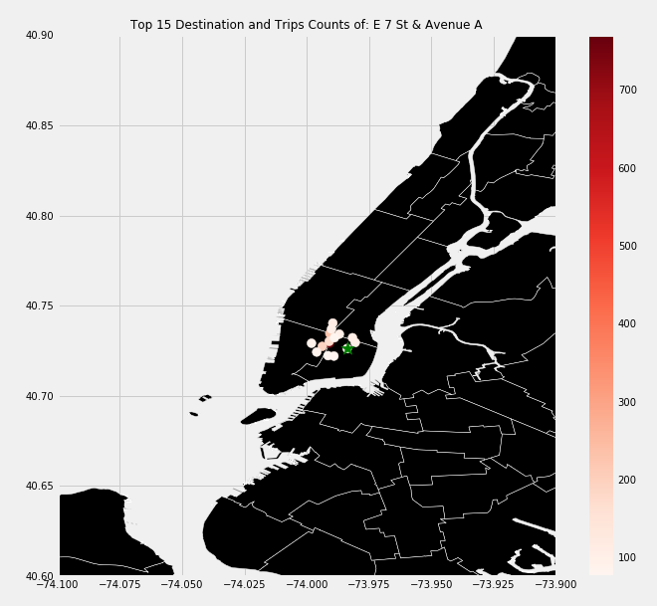
1
2
4
3

