Slide 1
How to evaluate output?
1042. Data Science in Practice
Week 4, 03/14
Jia-Ming Chang
http://www.cs.nccu.edu.tw/~jmchang/course/1042/datascience/
The slide isonly for educational purposes. If any infringement, please contact me, we will correct immediately.
Notes:
we’ll present the standard measures of model quality, which are useful in model construction.

Slide 2
Homework 1 @ 3/21
your.R -query max/min -files file1 file2 –out out.csv
Read in multiple files & Find one file which contains the max/min one
Inputs : test.1.csv
persons,weight,height,gender
person1,92.2445889841765,182.000744945835,F
person2,79.8850586637855,199.031132040545,F
person3,65.5903067067266,180.847714091651,F
person4,92.8903334774077,190.053740092553,F
person5,95.316689889878,198.946779500693,M
person6,83.461117176339,184.001802965067,F
Output : out.csv
Type,test.1,test.2,max
weight,95.31,80.1,test.1
Height,199.03,200.11,test.2
The number of input files is random

Slide 3
Homework 1: format
hw1_studentID_yourName.R
The subject of the mail should be
[Data Science] hw1
Grading
Homework 60%
Midterm 15%
Final project 25%
Attendance/Participation (bonus) ≤ 10%

Slide 4
Test commends
/Library/Frameworks/R.framework/Resources/Rscript ../codes/hw1_104761506_George.R -query max -files ../Data/test.1.csv ../Data/test.2.csv –out test0.hw1_104761506_George.csv > test0.hw1_104761506_George.log
/Library/Frameworks/R.framework/Resources/Rscript ../codes/hw1_104761506_George.R -query min -files ../Data/test.1.csv ../Data/test.2.csv –out test1.hw1_104761506_George.csv > test1.hw1_104761506_George.log
/Library/Frameworks/R.framework/Resources/Rscript ../codes/hw1_104761506_George.R -query max -files ../Data/test.1.csv ../Data/test.3.csv ../Data/test.8.csv –out test2.hw1_104761506_George.csv > test2.hw1_104761506_George.log
/Library/Frameworks/R.framework/Resources/Rscript ../codes/hw1_104761506_George.R -query min -files ../Data/test.1.csv ../Data/test.2.csv ../Data/test.8.csv –out test3.hw1_104761506_George.csv > test3.hw1_104761506_George.log
/Library/Frameworks/R.framework/Resources/Rscript ../codes/hw1_104761506_George.R -files ../Data/test.1.csv ../Data/test.3.csv ../Data/test.8.csv -query max –out test4.hw1_104761506_George.csv > test4.hw1_104761506_George.log
/Library/Frameworks/R.framework/Resources/Rscript ../codes/hw1_104761506_George.R -files ../Data/test.1.csv ../Data/test.2.csv ../Data/test.8.csv -query min –out test5.hw1_104761506_George.csv > test5.hw1_104761506_George.log

Slide 5
Does not use function
Hw1<-function() {
typedFile<-c()
allFiles<-c()
index_filename<-c()
a<-c() # temperary store the index value of files entered in allfiles set
height_value<-c() # Store the all the height value of typed files in the data frame
weight_value<-c() # Store the all the weight value of typed files in the data frame

Slide 6
Avoid setting environment inside your code
test.1 <- read.csv(file.choose(), header = TRUE, sep = ",")
test.3 <- read.csv(file.choose(), header = TRUE, sep = ",")
test.5 <- read.csv(file.choose(), header = TRUE, sep = ",")
test.7 <- read.csv(file.choose(), header = TRUE, sep = ",")
setwd("C:/Users/user/Desktop/Homework1/Data/")

Slide 7
Read inputs
if(identical(args[2],'max')){
x <- paste ("../Data/",args[4],sep="") #cobin two strings
d <- read.csv(x,header=TRUE,sep=",")
x <- paste ("../Data/",args[5],sep="")
e <- read.csv(x,header=TRUE,sep=",")
for( f_name in in_file ){
tmp <- paste("../Data/", f_name, sep="")

Slide 8
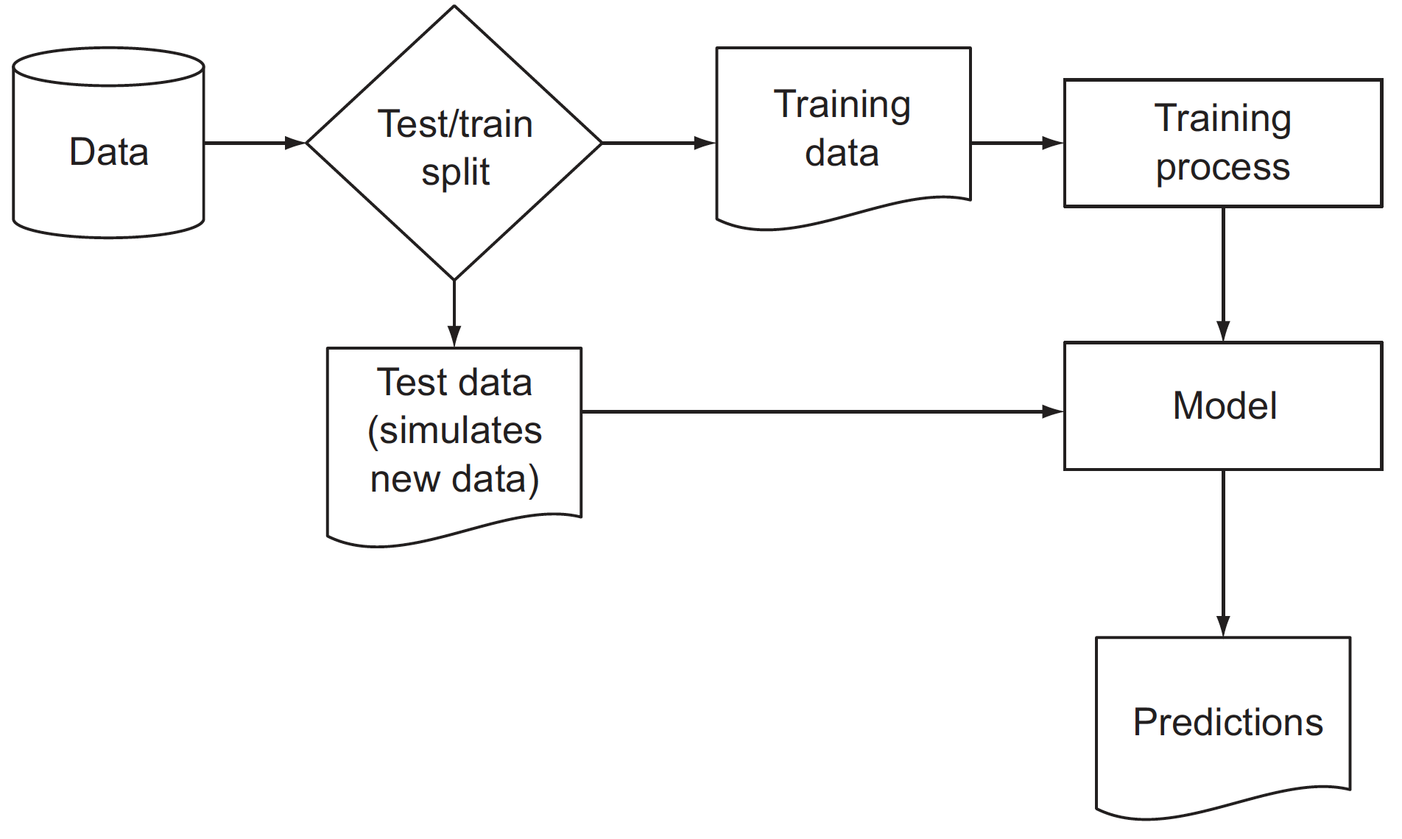
Schematic model construction and evaluation
model evaluation = quantifying the performance of a model that’s appropriate to both the original business goal and the chosen modeling technique.
a classification task (predicting who would default on loans) : precision and recall
a probability task
a scoring task (predicting revenue lost to defaulting loans) : root mean square error (RMSE)

Slide 9
Model evaluation and critique
Is it accurate enough for your needs? Does it generalize well?
Does it perform better than “the obvious guess”? Better than whatever estimate you currently use?
Do the results of the model (coefficients, clusters, rules) make sense in the context of the problem domain?

Slide 10
Model evaluation and critique
To decide if a given score is high or low:
a null model : tells us what low performance looks like
a Bayes rate model : tells us what high performance looks like
best single-variable model : tells us what a simple model can achieve

Slide 11
Determining lower and upper bounds on model performance
NULL MODEL: A LOWER BOUND ON PERFORMANCE
null model as being “the obvious guess”:
Single constant (returns the same answer for all situations)
independent (doesn’t record any important relation or interaction between inputs and outputs)
Common way to build
in a categorical problem => always return the most popular Category
A model that labels all loans as GoodLoan => 70% accurate
for a score model => often the average of all the outcomes
your model should out-perform the null model
the base error rate = the error rate of the simplest possible model
73% > 70% significantly better?

Slide 12
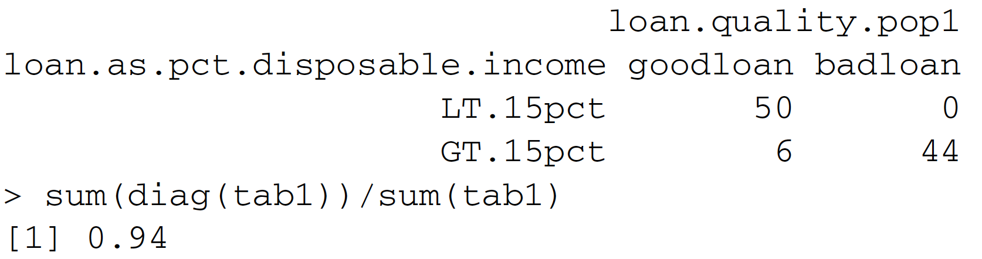
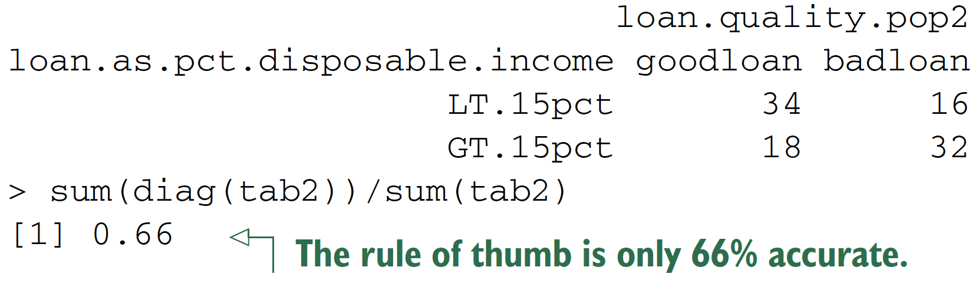
Determining lower and upper bounds on model performance
BAYES RATE MODEL (also saturated model): AN UPPER BOUND ON MODEL PERFORMANCE
only makes mistakes when there are multiple examples with the exact same set of known facts (same xs) but different outcomes (different ys)
unexplainable variance: how much of the variation in your output can’t be explained by your input variables.
An example: loans that equal more than 15% of the borrower’s disposable income will default; otherwise, loans are good.
Bayes rate : The limit on prediction accuracy due to unexplainable variance.
=> You can think of the Bayes rate as describing the best accuracy you can achieve given your data.

Slide 13
Single-variable models
We also suggest comparing any complicated model against the best single-variable model you have available

Slide 14
Confusion matrix
A good summary of classifier accuracy is the confusion matrix
which tabulates actual classifications against predicted ones
Codes:
Step1: A decision tree model for finding bad loan applications (11th week)
library('rpart')
load('GCDData.RData')
model <- rpart(Good.Loan ~
Duration.in.month +
Installment.rate.in.percentage.of.disposable.income +
Credit.amount +
Other.installment.plans,
data=d,
control=rpart.control(maxdepth=4),
method="class")

Slide 15
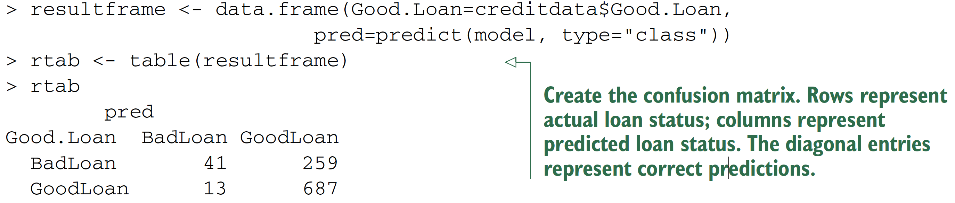
Confusion matrix
Step2: plotting the confusion matrix
creditdata <- d
resultframe <- data.frame(Good.Loan=creditdata$Good.Loan,
pred=predict(model, type="class"))
rtab <- table(resultframe) # Note: 1
Rtab
Confusion matrix
Rows represent actual loan status
columns represent predicted loan status.
The diagonal entries represent correct predictions.

Slide 16
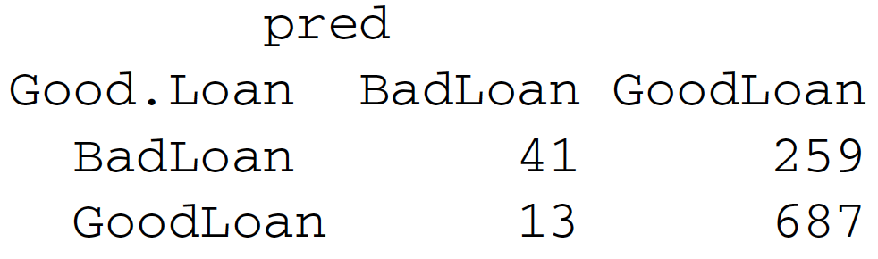
Evaluating classification models
Definition
True positive
False positive
True negative
False negative
TP
FN
FP
TN
Notes:
Why it important => show example to show some bias!

Slide 17
Evaluating classification models
Definition
Accuracy
# of items categorized correctly divided by #of items
(TP+TN)/(TP+TN+FP+FN)
Precision
fraction of the items the classifier flags as being in the class actually are in the class = how often a positive indication turns out to be correct
TP/(TP+FP)
Recall
what fraction of the things that are in the class are detected by the classifier
TP/(TP+FN)
False positive rate = FP/(FP+TN)
TP
FN
FP
TN
Notes:
Why it important => show example to show some bias!

Slide 18
Evaluating classification models
Spambase dataset (http://mng.bz/e8Rh)
Spambase/spamD.tsv @ https://github.com/WinVector/zmPDSwR/tree/master/Spambase

Slide 19
Building and applying a logistic regression spam model
spamD <- read.table('spamD.tsv',header=T,sep='\t')
spamTrain <- subset(spamD,spamD$rgroup>=10)
spamTest <- subset(spamD,spamD$rgroup<10)
spamVars <- setdiff(colnames(spamD),list('rgroup','spam'))
spamFormula <- as.formula(paste('spam=="spam"',
paste(spamVars,collapse=' + '),sep=' ~ '))
spamModel <- glm(spamFormula,family=binomial(link='logit'), data=spamTrain)
spamTrain$pred <- predict(spamModel,newdata=spamTrain, type='response')
spamTest$pred <- predict(spamModel,newdata=spamTest, type='response')
print(with(spamTest,table(y=spam,glmPred=pred>0.5)))
sample <- spamTest[c(7,35,224,327),c('spam','pred')]
print(sample)
## spam pred
## 115 spam 0.9903246227
## 361 spam 0.4800498077
## 2300 non-spam 0.0006846551
## 3428 non-spam 0.0001434345

Slide 20
Spam classifications
sample <- spamTest[c(7,35,224,327),c('spam','pred')]
print(sample)
## spam pred
## 115 spam 0.9903246227
## 361 spam 0.4800498077
## 2300 non-spam 0.0006846551
## 3428 non-spam 0.0001434345

Slide 21
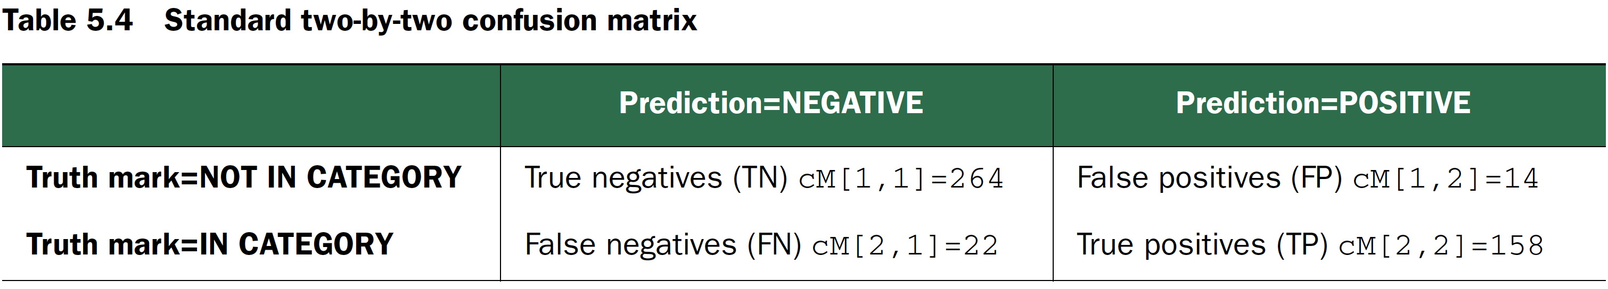
Spam confusion matrix
cM <- table(truth=spamTest$spam, prediction=spamTest$pred>0.5)
print(cM)
## prediction
## truth FALSE TRUE
## non-spam 264 14
## spam 22 158

Slide 22
Akismet filter
t <- as.table(matrix(data=c(288-1,17,1,13882-17),nrow=2,ncol=2))
rownames(t) <- rownames(cM)
colnames(t) <- colnames(cM)
print(t)
## FALSE TRUE
## non-spam 287 1
## spam 17 13865

Slide 23
ACCURACY
ACCURACY
Spam data?
Akismet filter?
ACCURACY IS AN INAPPROPRIATE MEASURE FOR UNBALANCED CLASSES
a situation where we have a rare event (say, severe complications during childbirth)
the null model—the rare event never happens— is very accurate
different costs of “type 1” and “type 2” errors

Slide 24
PRECISION AND RECALL
PRECISION
Spam data?
Akismet filter?
RECALL
Spam data?
Akismet filter?
precision is a measure of confirmation (when thec lassifier indicates positive, how often it is in fact correct)
Recall is a measure of utility (how much the classifier finds of what there actually is to find)
spam filtering application, which one is important?
precision is emphasized over recall

Slide 25
SENSITIVITY AND SPECIFICITY
Sensitivity = the true positive rate = recall
Spam data?
Akismet filter?
Specificity = the true negative rate
TN/(TN+FP)
Spam data?
Akismet filter?
Why use those two terms?
null classifiers always return a zero score on either sensitivity or specificity.

Slide 26
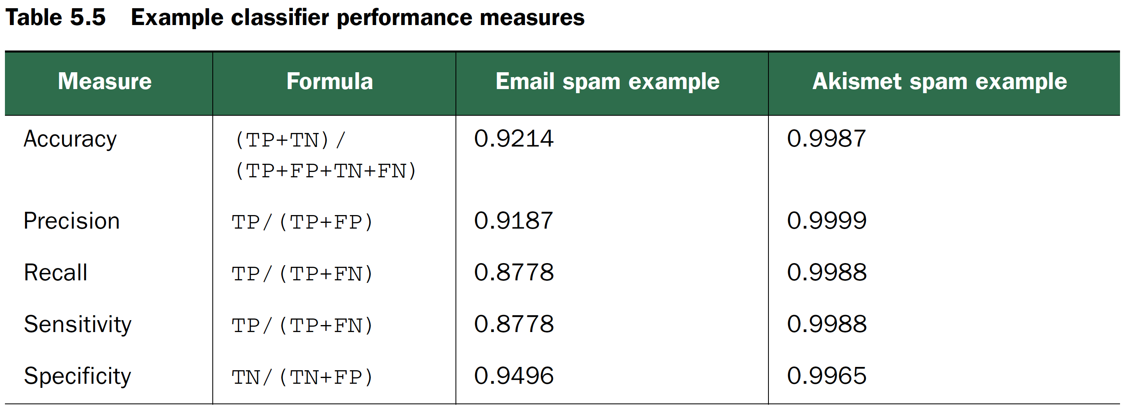
COMMON CLASSIFICATION PERFORMANCE MEASURES
Recommend writing the business goals as maximizing sensitivity while maintaining a specificity of at least 0.999.

Slide 27
CHANGING A SCORE TO A CLASSIFICATION
Picking thresholds other than 0.5 can allow the data scientist to trade precision for recall
The F1 score is a useful combination of precision and recall.
2*precision*recall/(precision+recall)

Slide 28
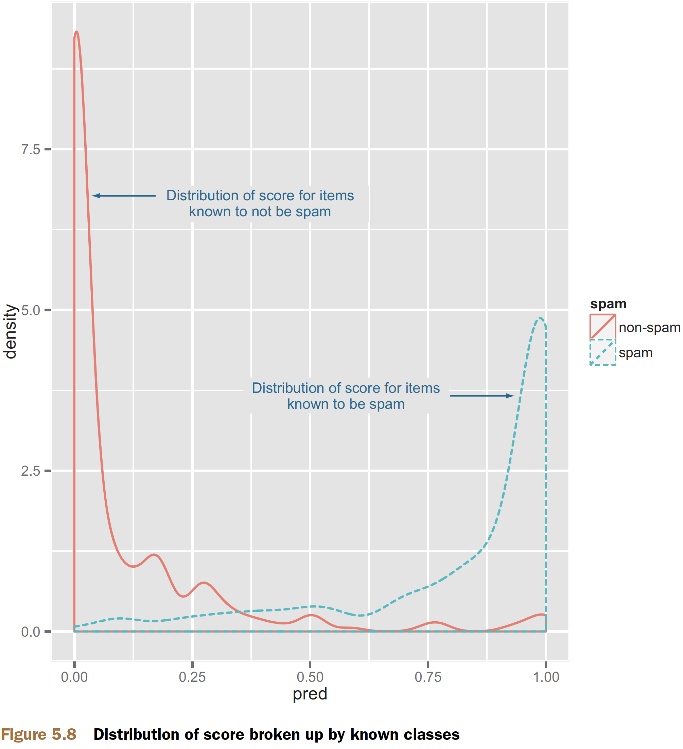
Evaluating probability models
Making a double density plot
ggplot(data=spamTest) + geom_density(aes(x=pred,color=spam,linetype=spam))

Slide 29
THE RECEIVER OPERATING CHARACTERISTIC CURVE
ROC curve
by picking a different score threshold between positive and negative determination
represents every possible trade-off between sensitivity and specificity
AUC or area under the curve
1.0 = perfect classifiers
0.5 = do no better than random guesses
Codes
library('ROCR')
eval <- prediction(spamTest$pred,spamTest$spam)
plot(performance(eval,"tpr","fpr"))
print(attributes(performance(eval,'auc'))$y.values[[1]])
## [1] 0.9660072

Slide 30
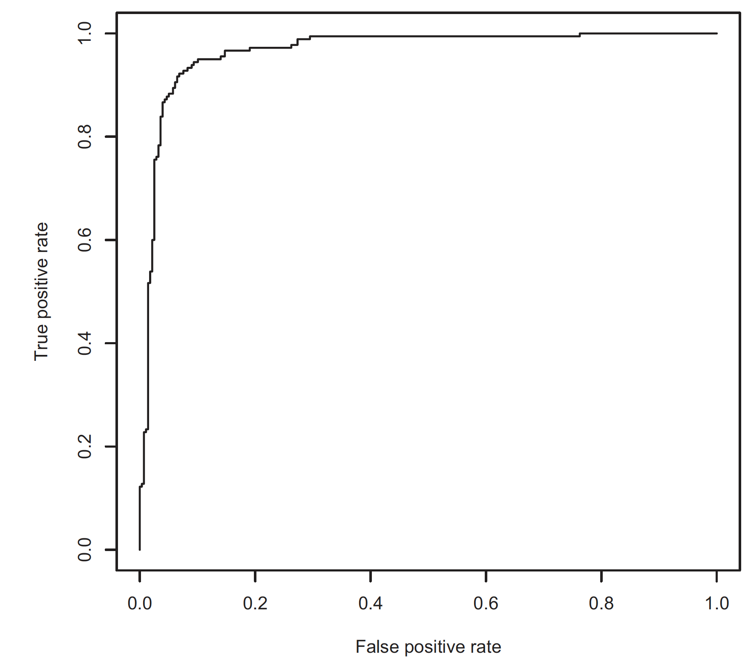
ROC curve

Slide 31
LOG LIKELIHOOD
log likelihood is the logarithm of the product of the probability the model assigned to each example
a spam with an estimated spam 0.9 => log(0.9)
a non-spam email an estimated spam 0.9 => log(0.1)
Codes
sum(ifelse(spamTest$spam=='spam',
log(spamTest$pred),
log(1-spamTest$pred)))
## [1] -134.9478
sum(ifelse(spamTest$spam=='spam',
log(spamTest$pred),
log(1-spamTest$pred)))/dim(spamTest)[[1]]
## [1] -0.2946458

Slide 32
Computing the null model’s log likelihood
pNull <- sum(ifelse(spamTest$spam=='spam',1,0))/dim(spamTest)[[1]]
sum(ifelse(spamTest$spam=='spam',1,0))*log(pNull) +
sum(ifelse(spamTest$spam=='spam',0,1))*log(1-pNull)
## [1] -306.8952
-134.9478 better than -306.8952.

Slide 33
Evaluating scoring models
residuals or difference between our predictions and actual outcomes
Plotting residuals
d <- data.frame(y=(1:10)^2,x=1:10)
model <- lm(y~x,data=d)
d$prediction <- predict(model,newdata=d)
library('ggplot2')
ggplot(data=d) + geom_point(aes(x=x,y=y)) +
geom_line(aes(x=x,y=prediction),color='blue') +
geom_segment(aes(x=x,y=prediction,yend=y,xend=x)) +
scale_y_continuous('')

Slide 34
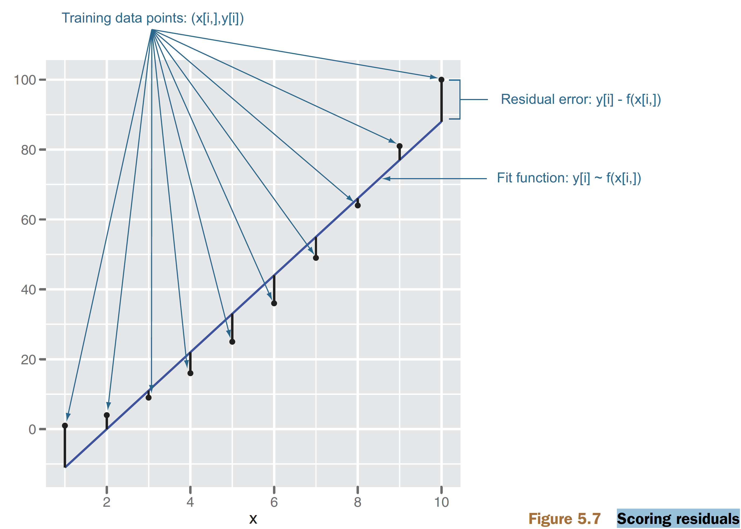
Scoring residuals

Slide 35
ABSOLUTE ERROR
absolute error
sum(abs(d$prediction-d$y))
mean absolute error
sum(abs(d$prediction-d$y))/length(d$y)
relative absolute error
sum(abs(d$prediction-d$y))/sum(abs(d$y))
three advertisement purchases returning $0, $0, and $25 respectively =>picking a single summary value not too far from the original three prices
0 or 8.33 is better?
Not advisable to make these measures the project goal

Slide 36
ROOT MEAN SQUARE ERROR
RMSE : the square root of the average square of the difference between our prediction and actual values
sqrt(mean((prediction-actualValues)^2))

Slide 37
R-SQUARED
R2 , the coefficient of determination
1.0 minus how much unexplained variance your model leaves
measured relative to a null model of just using the average y as a prediction
1 - sum((prediction-actualValues)^2)/sum((mean(actualValues)-actualValues)^2)
1 or 0 better?
can be thought of as a normalized version of RMSE

Slide 38
CORRELATION
at least three calculations
the Pearson coefficient : checks for linear relations
the Spearman coefficient : checks for rank or ordered relations
the Kendall coefficient: checks for degree of voting agreement.
Each of these coefficients performs a progressively more drastic transform than the one before and has well-known direct significance tests
R-squared = correlation² (or Pearson product-moment correlation coefficient or PPMCC or PCC or Pearson's r)
!!!DON’T USE CORRELATION TO EVALUATE MODEL QUALITY IN PRODUCTION
correlation ignores shifts and scaling factors

Slide 39
Evaluating ranking models
Ranking models are models that, given a set of examples, sort the rows or assign ranks to the rows.
measured by Spearman’s rank correlation coefficient (treating assigned rank as a numeric score)

Slide 40
Evaluating clustering models
Clustering random data in the plane
set.seed(32297)
d <- data.frame(x=runif(100),y=runif(100))
clus <- kmeans(d,centers=5)
d$cluster <- clus$cluster
Calculating the size of each cluster
table(d$cluster)
## 1 2 3 4 5
## 10 27 18 17 28
Plotting our clusters
library('ggplot2'); library('grDevices')
h <- do.call(rbind,
lapply(unique(clus$cluster),
function(c) { f <- subset(d,cluster==c); f[chull(f),]}))
ggplot() +
geom_text(data=d,aes(label=cluster,x=x,y=y,
color=cluster),size=3) +
geom_polygon(data=h,aes(x=x,y=y,group=cluster,fill=as.factor(cluster)),
alpha=0.4,linetype=0) +
theme(legend.position = "none")

Slide 41
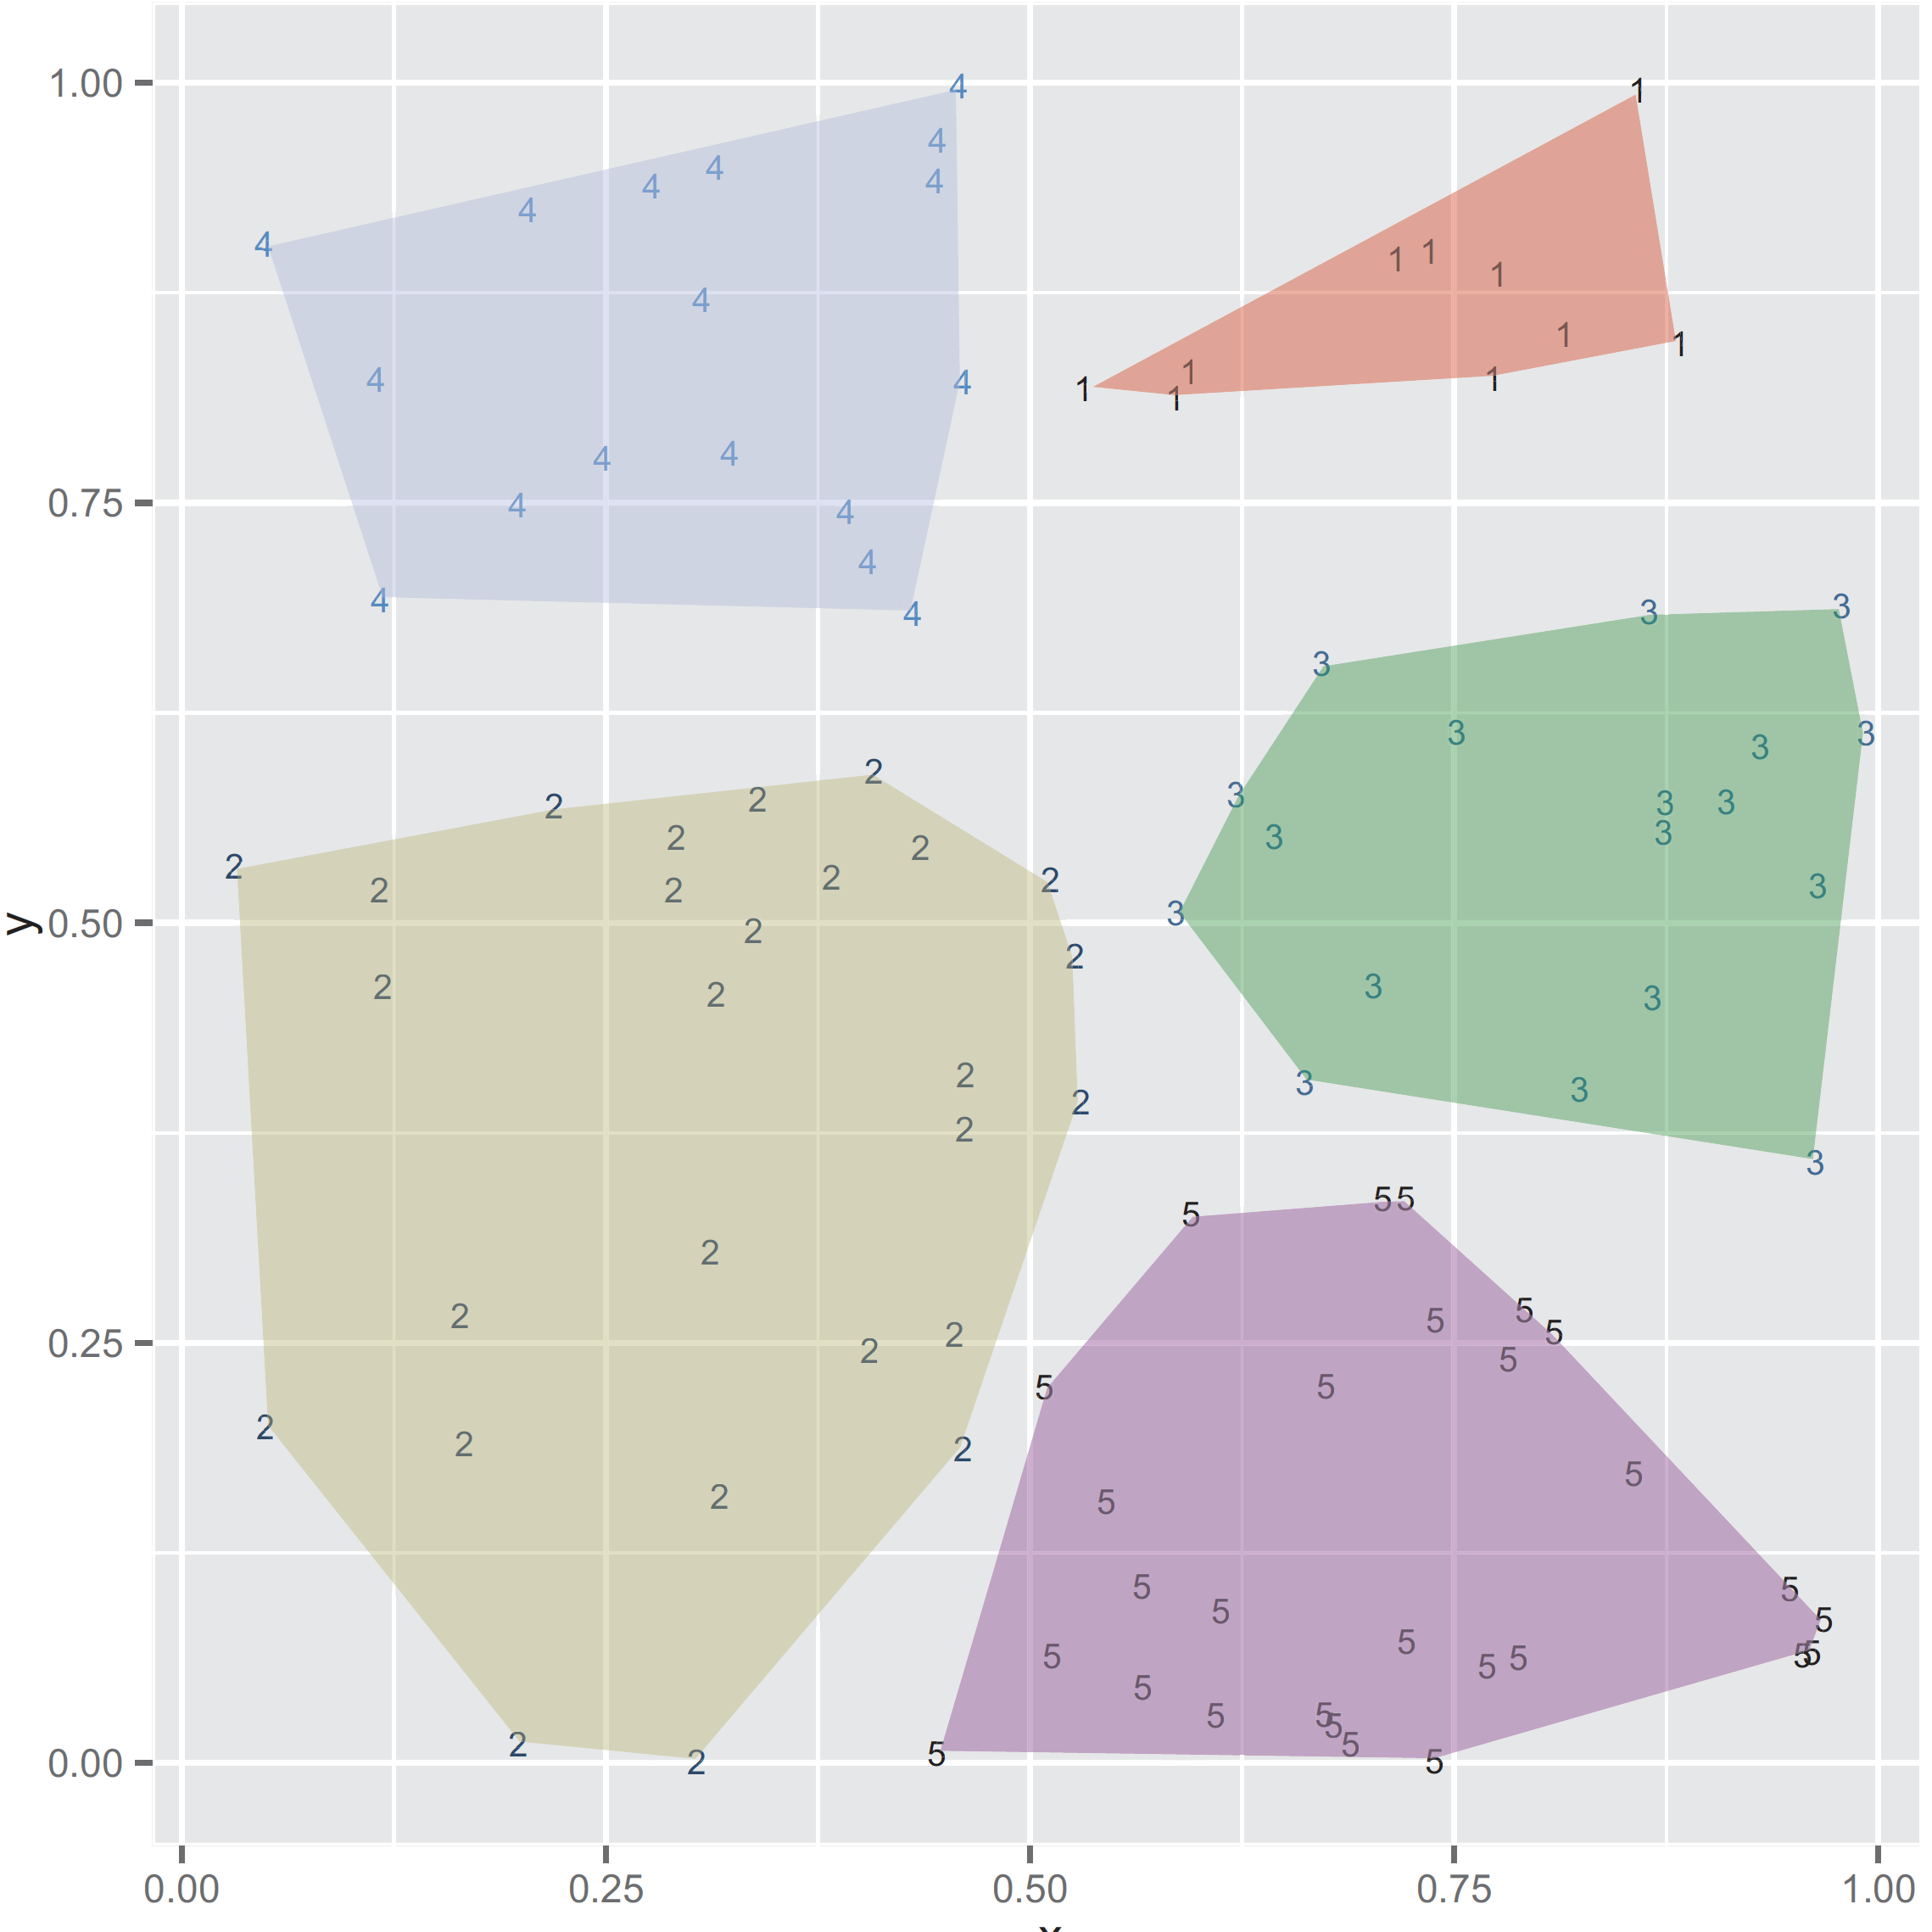
Clustering example
hair clusters : clusters with very few points
waste clusters : clusters with a very large number of points

Slide 42
INTRA-CLUSTER DISTANCES VERSUS CROSS-CLUSTER DISTANCES
Calculating the typical distance between items in every pair of clusters
library('reshape2')
n <- dim(d)[[1]]
pairs <- data.frame(
ca = as.vector(outer(1:n,1:n,function(a,b) d[a,'cluster'])),
cb = as.vector(outer(1:n,1:n,function(a,b) d[b,'cluster'])),
dist = as.vector(outer(1:n,1:n,function(a,b)
sqrt((d[a,'x']-d[b,'x'])^2 + (d[a,'y']-d[b,'y'])^2)))
)
dcast(pairs,ca~cb,value.var='dist',mean)
## ca 1 2 3 4 5
## 1 1 0.1478480 0.6524103 0.3780785 0.4404508 0.7544134
## 2 2 0.6524103 0.2794181 0.5551967 0.4990632 0.5165320
## 3 3 0.3780785 0.5551967 0.2031272 0.6122986 0.4656730
## 4 4 0.4404508 0.4990632 0.6122986 0.2048268 0.8365336
## 5 5 0.7544134 0.5165320 0.4656730 0.8365336 0.2221314
intra-cluster distances (the diagonal elements of the table) < inter-cluster distances (the off-diagonal elements of the table)

Slide 43
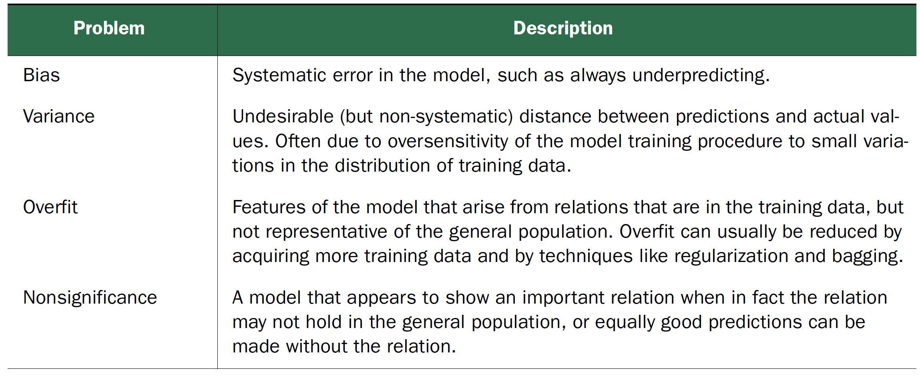
model validation
the testing of a model on new data => will it show similar quality on new data in production?

Slide 44
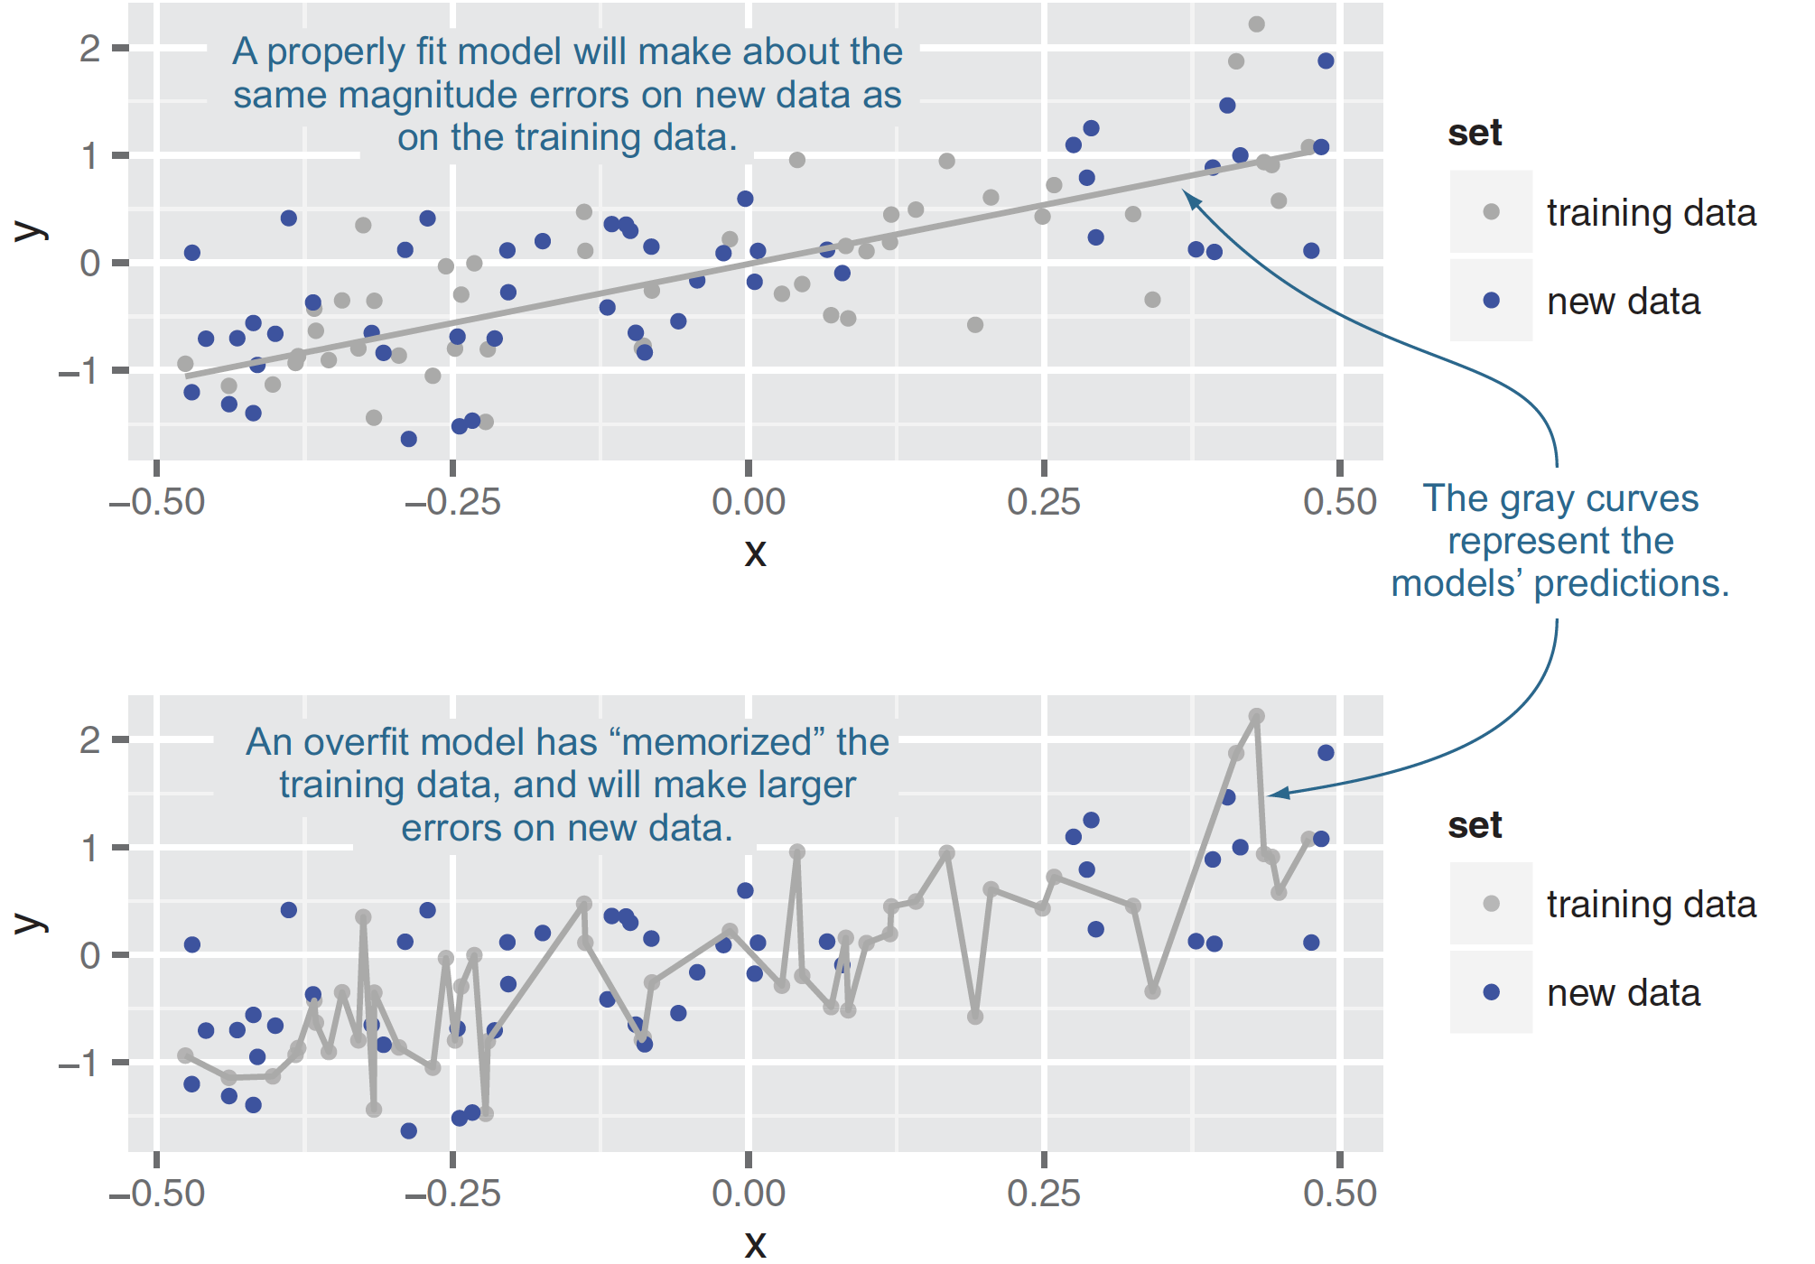
OVERFITTING
training error : a model’s prediction error on the data that it trained
generalization error : a model’s prediction error on new data
overfit : if generalization error is large => prefer simpler models

Slide 45
Ensuring model quality
TESTING ON HELD-OUT DATA
K-FOLD CROSS-VALIDATION
the related ideas of empirical resampling and bootstrapping
Split
a subset of the training data is used to build a model
a complementary subset of the training data is used to score the model
repeated cross-validation, replicated cross-validation

Slide 46
Preparing the KDD data for analysis
https://github.com/WinVector/zmPDSwR/tree/master/KDD2009
Codes
d <- read.table('orange_small_train.data.gz', # Note: 1
header=T,
sep='\t',
na.strings=c('NA','')) # Note: 2
churn <- read.table('orange_small_train_churn.labels.txt',
header=F,sep='\t') # Note: 3
d$churn <- churn$V1 # Note: 4
appetency <- read.table('orange_small_train_appetency.labels.txt',
header=F,sep='\t')
d$appetency <- appetency$V1 # Note: 5
upselling <- read.table('orange_small_train_upselling.labels.txt',
header=F,sep='\t')
d$upselling <- upselling$V1 # Note: 6
set.seed(729375) # Note: 7
d$rgroup <- runif(dim(d)[[1]])
dTrainAll <- subset(d,rgroup<=0.9)

Slide 47
Function to build single-variable models for categorical variables
mkPredC <- function(outCol,varCol,appCol) { # Note: 1
pPos <- sum(outCol==pos)/length(outCol) # Note: 2
naTab <- table(as.factor(outCol[is.na(varCol)]))
pPosWna <- (naTab/sum(naTab))[pos] # Note: 3
vTab <- table(as.factor(outCol),varCol)
pPosWv <- (vTab[pos,]+1.0e-3*pPos)/(colSums(vTab)+1.0e-3) # Note: 4
pred <- pPosWv[appCol] # Note: 5
pred[is.na(appCol)] <- pPosWna # Note: 6
pred[is.na(pred)] <- pPos # Note: 7
pred # Note: 8
}

Slide 48
Running a repeated cross-validation experiment
Codes:
var <- 'Var217'
aucs <- rep(0,100)
for(rep in 1:length(aucs)) { # Note: 1
useForCalRep <- rbinom(n=dim(dTrainAll)[[1]],size=1,prob=0.1)>0 # Note: 2
predRep <- mkPredC(dTrainAll[!useForCalRep,outcome], # Note: 3
dTrainAll[!useForCalRep,var],
dTrainAll[useForCalRep,var])
aucs[rep] <- calcAUC(predRep,dTrainAll[useForCalRep,outcome]) # Note: 4
}
mean(aucs)
## [1] 0.5556656
sd(aucs)
## [1] 0.01569345

Slide 49
Empirically cross-validating performance
fCross <- function() {
useForCalRep <- rbinom(n=dim(dTrainAll)[[1]],size=1,prob=0.1)>0
predRep <- mkPredC(dTrainAll[!useForCalRep,outcome],
dTrainAll[!useForCalRep,var],
dTrainAll[useForCalRep,var])
calcAUC(predRep,dTrainAll[useForCalRep,outcome])
}
aucs <- replicate(100,fCross())

Slide 50
SIGNIFICANCE TESTING
if it’s very unlikely that a naive model could score as well as our model!!!
Example:
you’ve trained a model to predict how much a house will sell for, based on certain variables
null model : the average selling price of a house in the neighborhood
Mispredict given house’s selling price
err.model from you
err.null from null model
null hypothesis D = (err.null - err.model) == 0
p-value is the probability of null hypothesis
p < 0.05 => reject the null hypothesis
Student’s t-test, an f-test, fisher.test() (for the confusion matrix)

Slide 51
Where to find null models?
permutation test
permute the input (or independent) variables among examples
there’s no real relation between the modeling features (which we have permuted among examples) and the quantity to be predicted

Slide 52
Take home message
Always first explore your data, but don’t start modeling before designing some measurable goals.
Divide you model testing into establishing the model’s effect (performance on various metrics) and soundness (likelihood of being a correct model versus arising from overfitting).
Keep a portion of your data out of your modeling work for final testing. You may also want to subdivide your training data into training and calibration and to estimate best values for various modeling parameters.
Keep many different model metrics in mind, and for a given project try to pick the metrics that best model your intended business goal.

Slide 53
Any Question?

