Slide 1
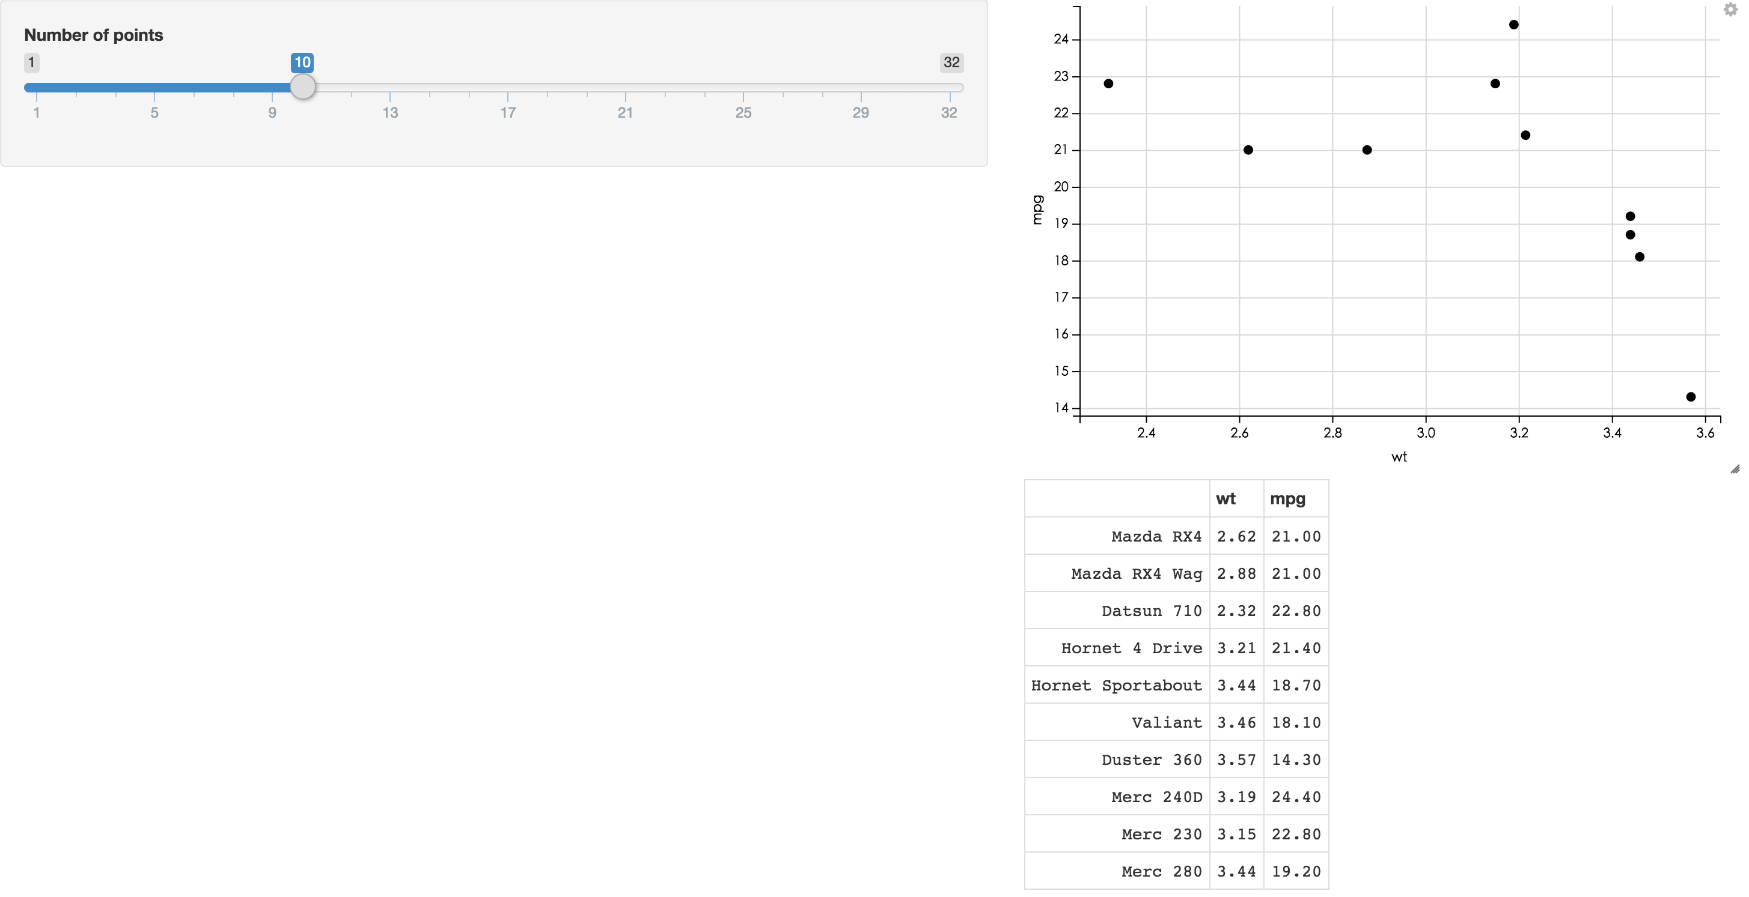
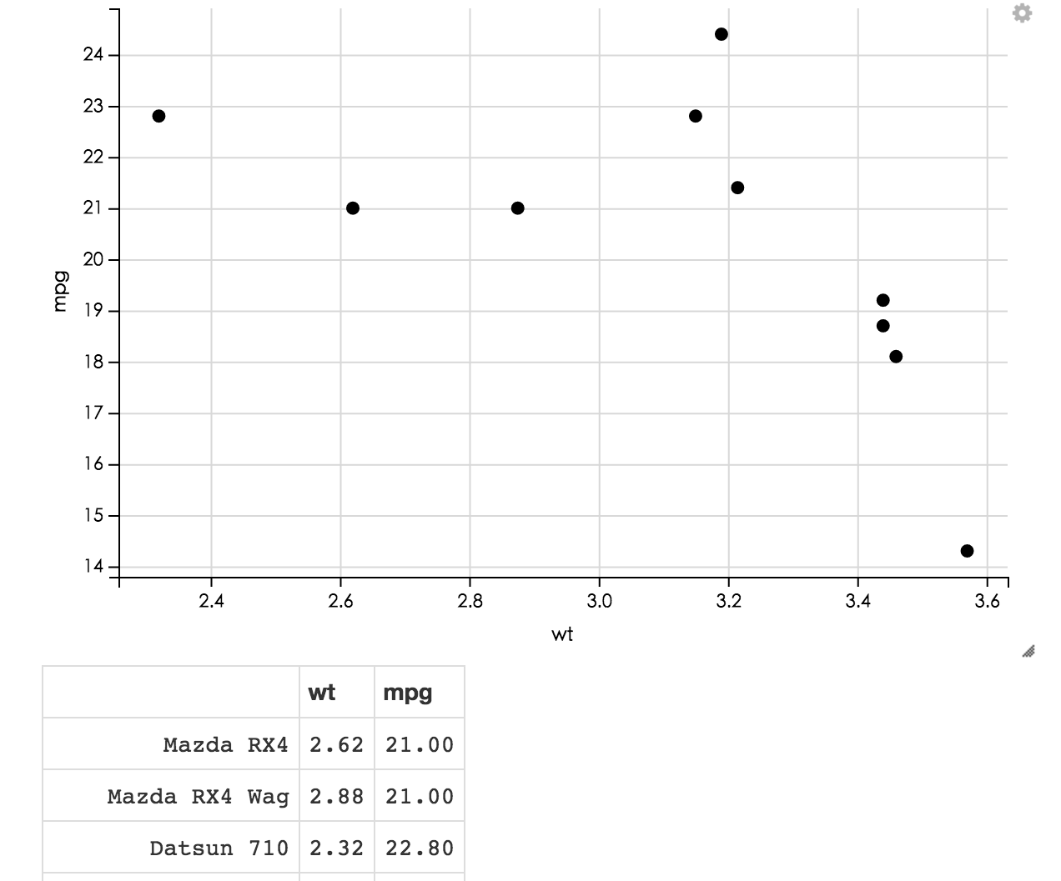
Homework 3 @ 4/25~5/9
https://<yourname>.shinyapps.io/hw3/
https://jmchang.shinyapps.io/ggvisExample/
Select option
Data set
set1
sensitivity
1-specificity
Method F1 AUC sensitivity specificity significant
Method1 0.91 0.96 0.85 0.79 no
Method2 0.99,0.98,0.86,0.70,yes
Highest method2 method2 method2 method1 nan

