Slide 1
🌸 PetalPress
A Multi-Agent Webpage Builder
Sub-agent orchestration · MCP integration · Visible loop pattern
🔗 github.com/ianyian/myAgentTeam
Try it now — copy and paste:
/build-page A short page about BMW car, with variance of BMW car with history in the body and a thank-you footer.
Stack: TypeScript · Claude Agent SDK · Model Context Protocol (MCP) | Claude Code (VS Code / CLI) or npm run start
PetalPress — Multi-Agent Webpage Builder · github.com/ianyian/myAgentTeam

Slide 2
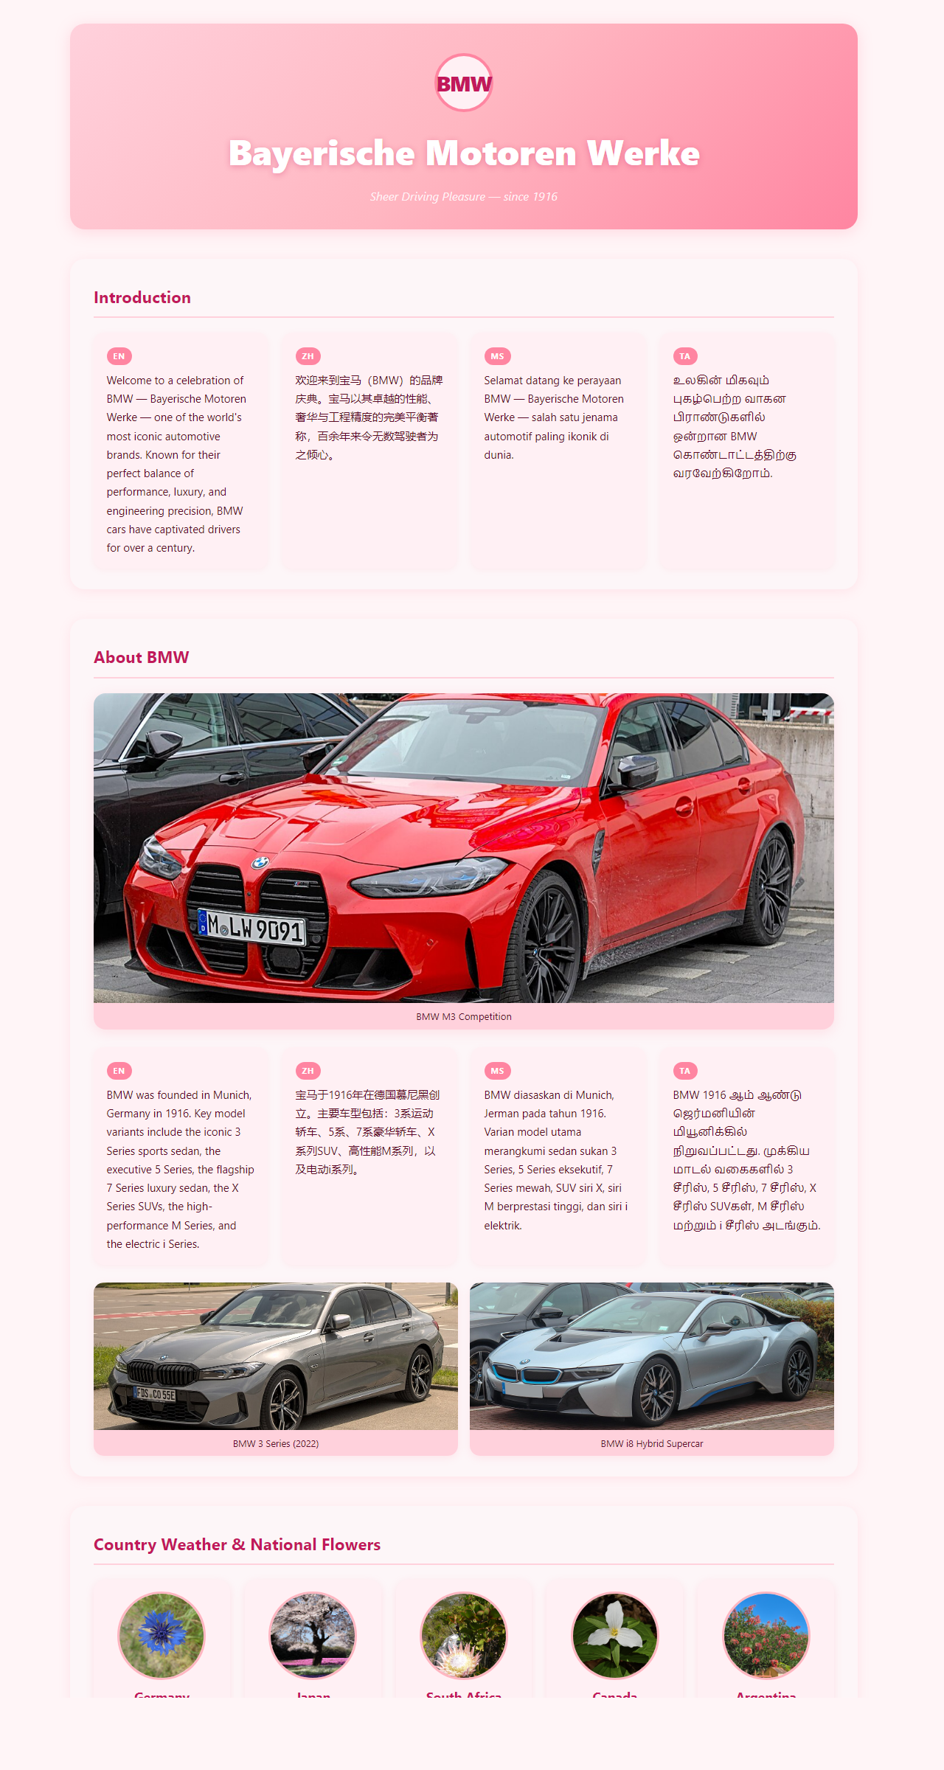
Demo — The Generated Page
Real output produced by running: /build-page A short page about BMW car…
BMW hero image 4-language intro EN / ZH / MS / TA About BMW section 3 car images Country cards (5 countries) Weather data National flowers
PetalPress — Multi-Agent Webpage Builder · github.com/ianyian/myAgentTeam

Slide 3
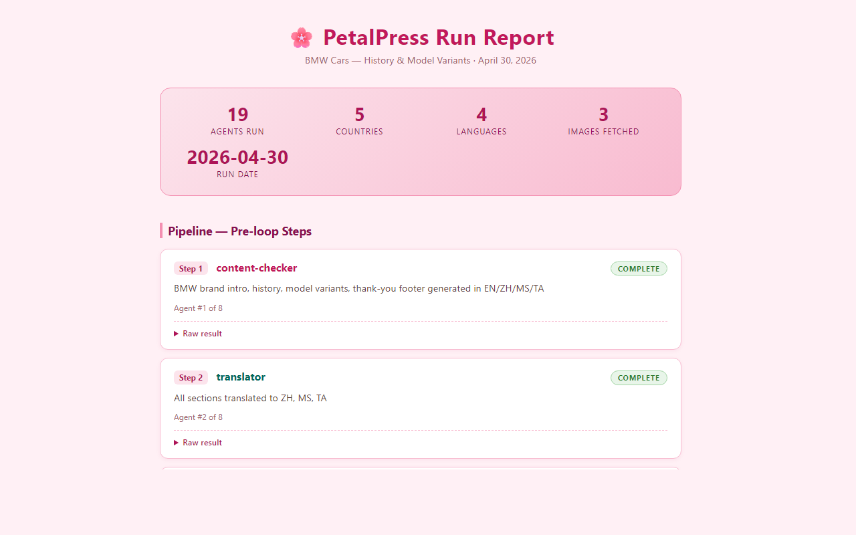
Demo — The Agent Run Report
output/report.html — generated by agent #8 (reporter) from the run log
19 agents run 5 countries 4 languages 3 images fetched Step-by-step timeline Collapsible raw result JSON blocks
PetalPress — Multi-Agent Webpage Builder · github.com/ianyian/myAgentTeam

Slide 4
Key Concepts — Glossary
Definitions of the core terms used throughout this deck
Agent
An AI model instance given a focused system prompt, whitelisted tools, and a strict JSON output contract. Does exactly one job.
Agent Team
A collection of agents orchestrated in sequence. Agents don't talk to each other — the orchestrator passes outputs between them.
Orchestrator
The coordinating program (/build-page or src/orchestrator.ts) that runs agents in order, routes outputs, and manages shared state.
MCP
Model Context Protocol — an open standard that wraps external APIs as structured tool servers. Agents call tools by name; never fetch() directly.
MCP Server
A small Node.js program in mcp-servers/ that registers tools and handles calls. PetalPress has two: weather and images.
System Prompt
The instruction text defining an agent's role, rules, and output format. Stored as the body of each .claude/agents/*.md file.
Tool Whitelist
The list of tools an agent may call (e.g. Read, Edit, mcp__weather__get_weather). Declared in YAML frontmatter. Least-privilege design.
Slash Command
/build-page and /reset — defined in .claude/commands/. Trigger the full pipeline from the Claude Code chat interface.
Loop / Iteration
Agents 5→6→7 run as a sub-pipeline repeated 5 times (once per country). Demonstrates chained-state orchestration.
Run Log
An array of RunLogEntry objects appended after each agent call. Agent #8 (reporter) turns this into output/report.html.
PetalPress — Multi-Agent Webpage Builder · github.com/ianyian/myAgentTeam

Slide 5
The Team — 8 Agents
One agent · one job · focused prompt · strict JSON contract · least-privilege tool whitelist
1
content-checker
Validates intro/body/footer; up to 3 interactive Q&A rounds if sections missing
Agent definition (.md) — weather-fetcher:
---
name: weather-fetcher
tools: ["mcp__weather__get_weather",
"mcp__weather__list_countries"]
---
You are the Weather Fetcher (agent 5).
1. Receive already_used_countries.
2. Pick ONE country not in that list.
3. Call mcp__weather__get_weather({country}).
Return exactly one JSON object:
{
"country": "Japan",
"capital": "Tokyo",
"temperature_c": 18.4,
"weather_description": "Overcast",
"wind_kmh": 12.0
}
2
translator
EN → Chinese (ZH), Malay (MS), Tamil (TA) — structured JSON output
3
image-fetcher
Downloads 2–3 page images → output/images/ via images MCP
4
html-generator
Writes output/index.html — themed layout, 4-language grid, empty country grid
5
weather-fetcher
LOOP: picks a fresh country, calls mcp__weather__get_weather
6
flower-fetcher
LOOP: finds national flower image, saves to output/country-images/
7
page-injector
LOOP: inserts <article class="country-card"> into output/index.html
Agent definition (.md) — page-injector:
8
reporter
Reads run log → writes output/report.html (themed timeline)
---
name: page-injector
tools: ["Read", "Edit"]
---
Insert a card BEFORE the marker:
<!-- country-grid: agents 5–7 inject here -->
<article class="country-card">
<img src="{{flower_path}}" class="country-flower">
<h3>{{country}}</h3>
<p>{{temperature_c}}°C — {{weather_description}}</p>
</article>
PetalPress — Multi-Agent Webpage Builder · github.com/ianyian/myAgentTeam

Slide 6
The Pipeline
Sequential flow: 4 pre-loop steps → LOOP ×5 (agents 5→6→7 per country) → report
1
content-checker
2
translator
3
image-fetcher
4
html-generator
Validate, Q&A
EN→ZH/MS/TA
→ images/
→ index.html
LOOP ×5 — agents 5→6→7 run per iteration (one country each)
5
weather-fetcher
6
flower-fetcher
7
page-injector
live weather
flower image
inject card
8
reporter
→ report.html
PetalPress — Multi-Agent Webpage Builder · github.com/ianyian/myAgentTeam

Slide 7
The Loop — Showcase Feature
Agents 5→6→7 in strict order, 5 times — chained state, no batching
Iter 1
Iter 2
Iter 3
Iter 4
Iter 5
Orchestrator loop (src/orchestrator.ts):
5. weather-fetcher
5. weather-fetcher
5. weather-fetcher
5. weather-fetcher
5. weather-fetcher
const usedCountries = [];
for (let i = 1; i <= 5; i++) {
// Agent 5: receives used list → picks fresh country
const weather = await step(agents.weatherFetcher,
`Loop ${i}/5 — pick a fresh country`,
`already_used_countries = ${JSON.stringify(usedCountries)}`);
// Orchestrator owns uniqueness — not the agent
usedCountries.push(weather.country);
// Agent 6: receives country name from weather output
const flower = await step(agents.flowerFetcher,
`Loop ${i}/5 — flower for ${weather.country}`,
`Country: ${weather.country}`);
// Agent 7: injects card into output/index.html
await step(agents.pageInjector, `Loop ${i}/5 — inject card`,
`Weather: ${JSON.stringify(weather)}
` +
`Flower: ${JSON.stringify(flower)}`);
}
6. flower-fetcher
6. flower-fetcher
6. flower-fetcher
6. flower-fetcher
6. flower-fetcher
7. page-injector
7. page-injector
7. page-injector
7. page-injector
7. page-injector
Orchestrator tracks used countries between iterations
Each iteration's weather output feeds directly into flower & injector
No batching — agents run strictly 5→6→7 per iteration
Loop state lives in orchestrator, not in any agent
PetalPress — Multi-Agent Webpage Builder · github.com/ianyian/myAgentTeam

Slide 8
Two Execution Paths — One Source of Truth
.claude/agents/*.md drives both paths — one edit, zero duplication
.claude/agents/*.md
src/lib/agentLoader.ts — parsing agent .md files:
import matter from "gray-matter";
export async function loadAgent(name) {
const raw = await readFile(
`.claude/agents/${name}.md`, "utf8");
const parsed = matter(raw); // splits frontmatter from body
return {
name: parsed.data.name ?? name,
description: parsed.data.description ?? "",
tools: parsed.data.tools ?? [], // whitelist
systemPrompt: parsed.content.trim(), // = system prompt
};
}
canonical sub-agent definitions
Claude Code
/build-page
Standalone TS
npm run start
Uses the Task tool to delegate
each step. Permissions via
.claude/settings.json
Claude Agent SDK
permissionMode: bypassPermissions
reads same .md files via gray-matter
✓ One edit to any .md file applies everywhere, both paths, immediately — no sync required
Structure of any agent .md file:
Both paths share: gray-matter frontmatter parsing, tool whitelists, system prompt bodies
--- ← YAML frontmatter
name: weather-fetcher
description: "…"
tools:
- mcp__weather__get_weather
- mcp__weather__list_countries
--- ← everything below = system prompt
You are the Weather Fetcher (agent 5).
Pick a country, call the weather tool,
return exactly one JSON object.
Claude Code path uses .claude/settings.json for MCP registration and bash permissions
Standalone path spawns MCP servers as stdio child processes via npx tsx
PetalPress — Multi-Agent Webpage Builder · github.com/ianyian/myAgentTeam

Slide 9
MCP Integration
Model Context Protocol — agents call tools by name, never fetch() directly. Swap a source = edit one file.
Server | Tool(s) | Data Source | Agent(s)
weather | get_weather(country) list_countries() | Open-Meteo (free, no API key) | 5 weather-fetcher
images | search_image(query, save_path) | Wikipedia REST (free, no API key) | 3 image-fetcher 6 flower-fetcher
mcp-servers/weather/src/index.ts — tool declaration + handler:
Server Tool(s) Data Source Agent(s)
// 1. Declare tools this MCP server exposes
server.setRequestHandler(ListToolsRequestSchema, async () => ({
tools: [{
name: "get_weather",
description: "Fetch current weather for a country capital.",
inputSchema: {
type:"object",
properties:{ country:{type:"string"} },
required:["country"]
}
}]
}));
// 2. Handle a tool call from any agent
server.setRequestHandler(CallToolRequestSchema, async (req) => {
const geo = await geocode(
req.params.arguments.country); // Open-Meteo geocoding
const data = await fetchWeather(
geo.latitude, geo.longitude); // Open-Meteo forecast
return {
content: [{ type:"text", text: JSON.stringify(data) }]
};
});
// 3. Serve over stdio — agents connect via npx tsx
await server.connect(new StdioServerTransport());
.claude/settings.json
Claude Code path — MCP config + bash whitelist: mkdir, rm, ls, open, mcp__weather, mcp__images
src/lib/runAgent.ts
Standalone path — spawns each MCP as stdio child process: npx tsx mcp-servers/<name>/src/index.ts
Agents never know which API is behind a tool
Replace Open-Meteo with any weather API — zero agent changes
Tool schema is the contract; implementation is hidden
PetalPress — Multi-Agent Webpage Builder · github.com/ianyian/myAgentTeam

Slide 10
Four-Language Layout
Every section rendered in EN / ZH / MS / TA side-by-side — agent #2 produces all four
en
zh
ms
ta
Translator output contract (.claude/agents/translator.md):
English
Chinese
Malay
Tamil
// Agent #2 returns this JSON — all 4 languages per section
{
"intro": {
"en": "Welcome to our page about BMW…",
"zh": "欢迎来到有关宝马的页面…",
"ms": "Selamat datang ke halaman tentang BMW…",
"ta": "BMW பற்றிய பக்கத்திற்கு வரவேற்கிறோம்…"
},
"body": {
"en": "BMW was founded in Munich…",
"zh": "宝马于慕尼黑创立…",
"ms": "BMW diasaskan di Munich…",
"ta": "BMW மியூனிக்கில் நிறுவப்பட்டது…"
},
"footer": {
"en": "Thank you for visiting…",
"zh": "感谢您的访问…",
"ms": "Terima kasih kerana melawat…",
"ta": "வருகைக்கு நன்றி…"
}
}
// html-generator renders each as:
// <div lang="en">…</div> <div lang="zh">…</div>
// <div lang="ms">…</div> <div lang="ta">…</div>
Latin
简体中文
Latin
தமிழ்
"Welcome to our page…"
"欢迎来到我们的页面…"
"Selamat datang ke…"
"வரவேற்கிறோம்…"
Agent #2 (translator) takes EN content and returns a single JSON object with all 4 languages
Agent #4 (html-generator) renders each section in a 4-column grid with lang= attributes
Country cards (agent #7) inherit the same layout for local weather descriptions
PetalPress — Multi-Agent Webpage Builder · github.com/ianyian/myAgentTeam

Slide 11
The Run Report
Agent #8 writes output/report.html — a themed timeline of every agent step
RunLogEntry (src/lib/types.ts):
Types (src/lib/types.ts) — full interfaces:
{
step: 1,
agent: "content-checker",
started_at: "2026-04-30T08:42:11Z",
finished_at: "2026-04-30T08:42:14Z",
duration_ms: 3120,
description: "Validate intro/body/footer",
result: {
status: "complete",
sections: { intro:"…", body:"…", footer:"…" }
}
}
export interface AgentDefinition {
name: string;
description: string;
tools: string[];
systemPrompt: string;
}
export interface RunLogEntry {
step: number;
agent: string;
started_at: string;
finished_at: string;
duration_ms: number;
description: string;
result: unknown;
}
// step() helper — wraps runAgent + appends to runLog
async function step(
agent: AgentDefinition,
description: string,
userMsg: string
): Promise<unknown> {
const started_at = new Date().toISOString();
const result = await runAgent(agent, userMsg);
runLog.push({
step: ++stepCount, agent: agent.name,
started_at, finished_at: new Date().toISOString(),
duration_ms: Date.now()-t0,
description, result,
});
return result;
}
Reporter invocation (after all 5 loop iterations):
await step(agents.reporter,
"Generate output/report.html from run log",
`run_log = ${JSON.stringify(runLog, null, 2)}`
);
19 agent steps total (4 pre-loop + 5×3 loop + 1 reporter)
Loop iterations grouped under "Iteration N" headings
Raw result JSON in collapsible <details> blocks
Summary card: total agents run, countries, languages, images
Self-contained HTML — no external dependencies
PetalPress — Multi-Agent Webpage Builder · github.com/ianyian/myAgentTeam

Slide 12
File Map
output/ is gitignored — template repo stays clean across runs
myAgentTeam/
├── .claude/
│ ├── agents/ ← 8 sub-agent .md files
│ │ ├── content-checker.md translator.md
│ │ ├── image-fetcher.md html-generator.md
│ │ ├── weather-fetcher.md flower-fetcher.md
│ │ ├── page-injector.md reporter.md
│ ├── commands/ ← /build-page · /reset slash commands
│ └── settings.json ← MCP registration + Claude Code permission whitelist
├── src/
│ ├── orchestrator.ts ← standalone pipeline entry point
│ └── lib/
│ ├── agentLoader.ts ← gray-matter parser → AgentDefinition
│ ├── runAgent.ts ← Claude Agent SDK wrapper (bypassPermissions)
│ ├── prompt.ts ← readline helper for interactive Q&A
│ └── types.ts ← AgentDefinition · RunLogEntry interfaces
├── mcp-servers/
│ ├── weather/src/index.ts ← Open-Meteo MCP (get_weather, list_countries)
│ └── images/src/index.ts ← Wikipedia MCP (search_image)
├── scripts/
│ ├── reset.ts ← wipes output/ only
│ └── gen-ppt-v3.mjs ← this PowerPoint generator
├── package.json ← scripts: start · reset · mcp:weather · mcp:images
├── tsconfig.json
├── output/ ← generated artifacts (gitignored)
│ ├── index.html ← the webpage (4 languages + 5 country cards)
│ ├── report.html ← agent run timeline
│ ├── images/ ← page images (agent 3 downloads)
│ └── country-images/ ← national flower images (agent 6 downloads)
├── CLAUDE.md · myArchitecture.md · README.md
PetalPress — Multi-Agent Webpage Builder · github.com/ianyian/myAgentTeam

Slide 13
Key Takeaways
1
Sub-agents are first-class.
5
One source of truth, two execution paths.
Each agent owns one responsibility, has its own system prompt, and returns strict JSON. No agent has more tool access than its job needs.
The same .claude/agents/*.md files drive Claude Code and the standalone TypeScript orchestrator — no duplication.
2
MCP isolates the external boundary.
6
Agent .md files are self-contained.
Switching data providers never requires editing agent definitions. Change one MCP server file — zero blast radius.
YAML frontmatter = tool whitelist. File body = system prompt. One edit changes behaviour on both paths everywhere.
3
The loop demonstrates chained state.
7
Built for repetition.
Each iteration's output feeds the next agent. Generalises to any "for each X, run sub-pipeline" workflow.
/reset clears output/ in seconds. Source code is never touched. Ready for the next audience immediately.
4
Uniqueness is the orchestrator's job.
already_used_countries is maintained by the orchestrator and passed to weather-fetcher each iteration — not the agent's concern.
PetalPress — Multi-Agent Webpage Builder · github.com/ianyian/myAgentTeam

Slide 14
Q & A
Questions? Comments? Try the demo?
🔗 github.com/ianyian/myAgentTeam
/build-page A short page about <your topic>
PetalPress — Multi-Agent Webpage Builder · github.com/ianyian/myAgentTeam

