Slide 1
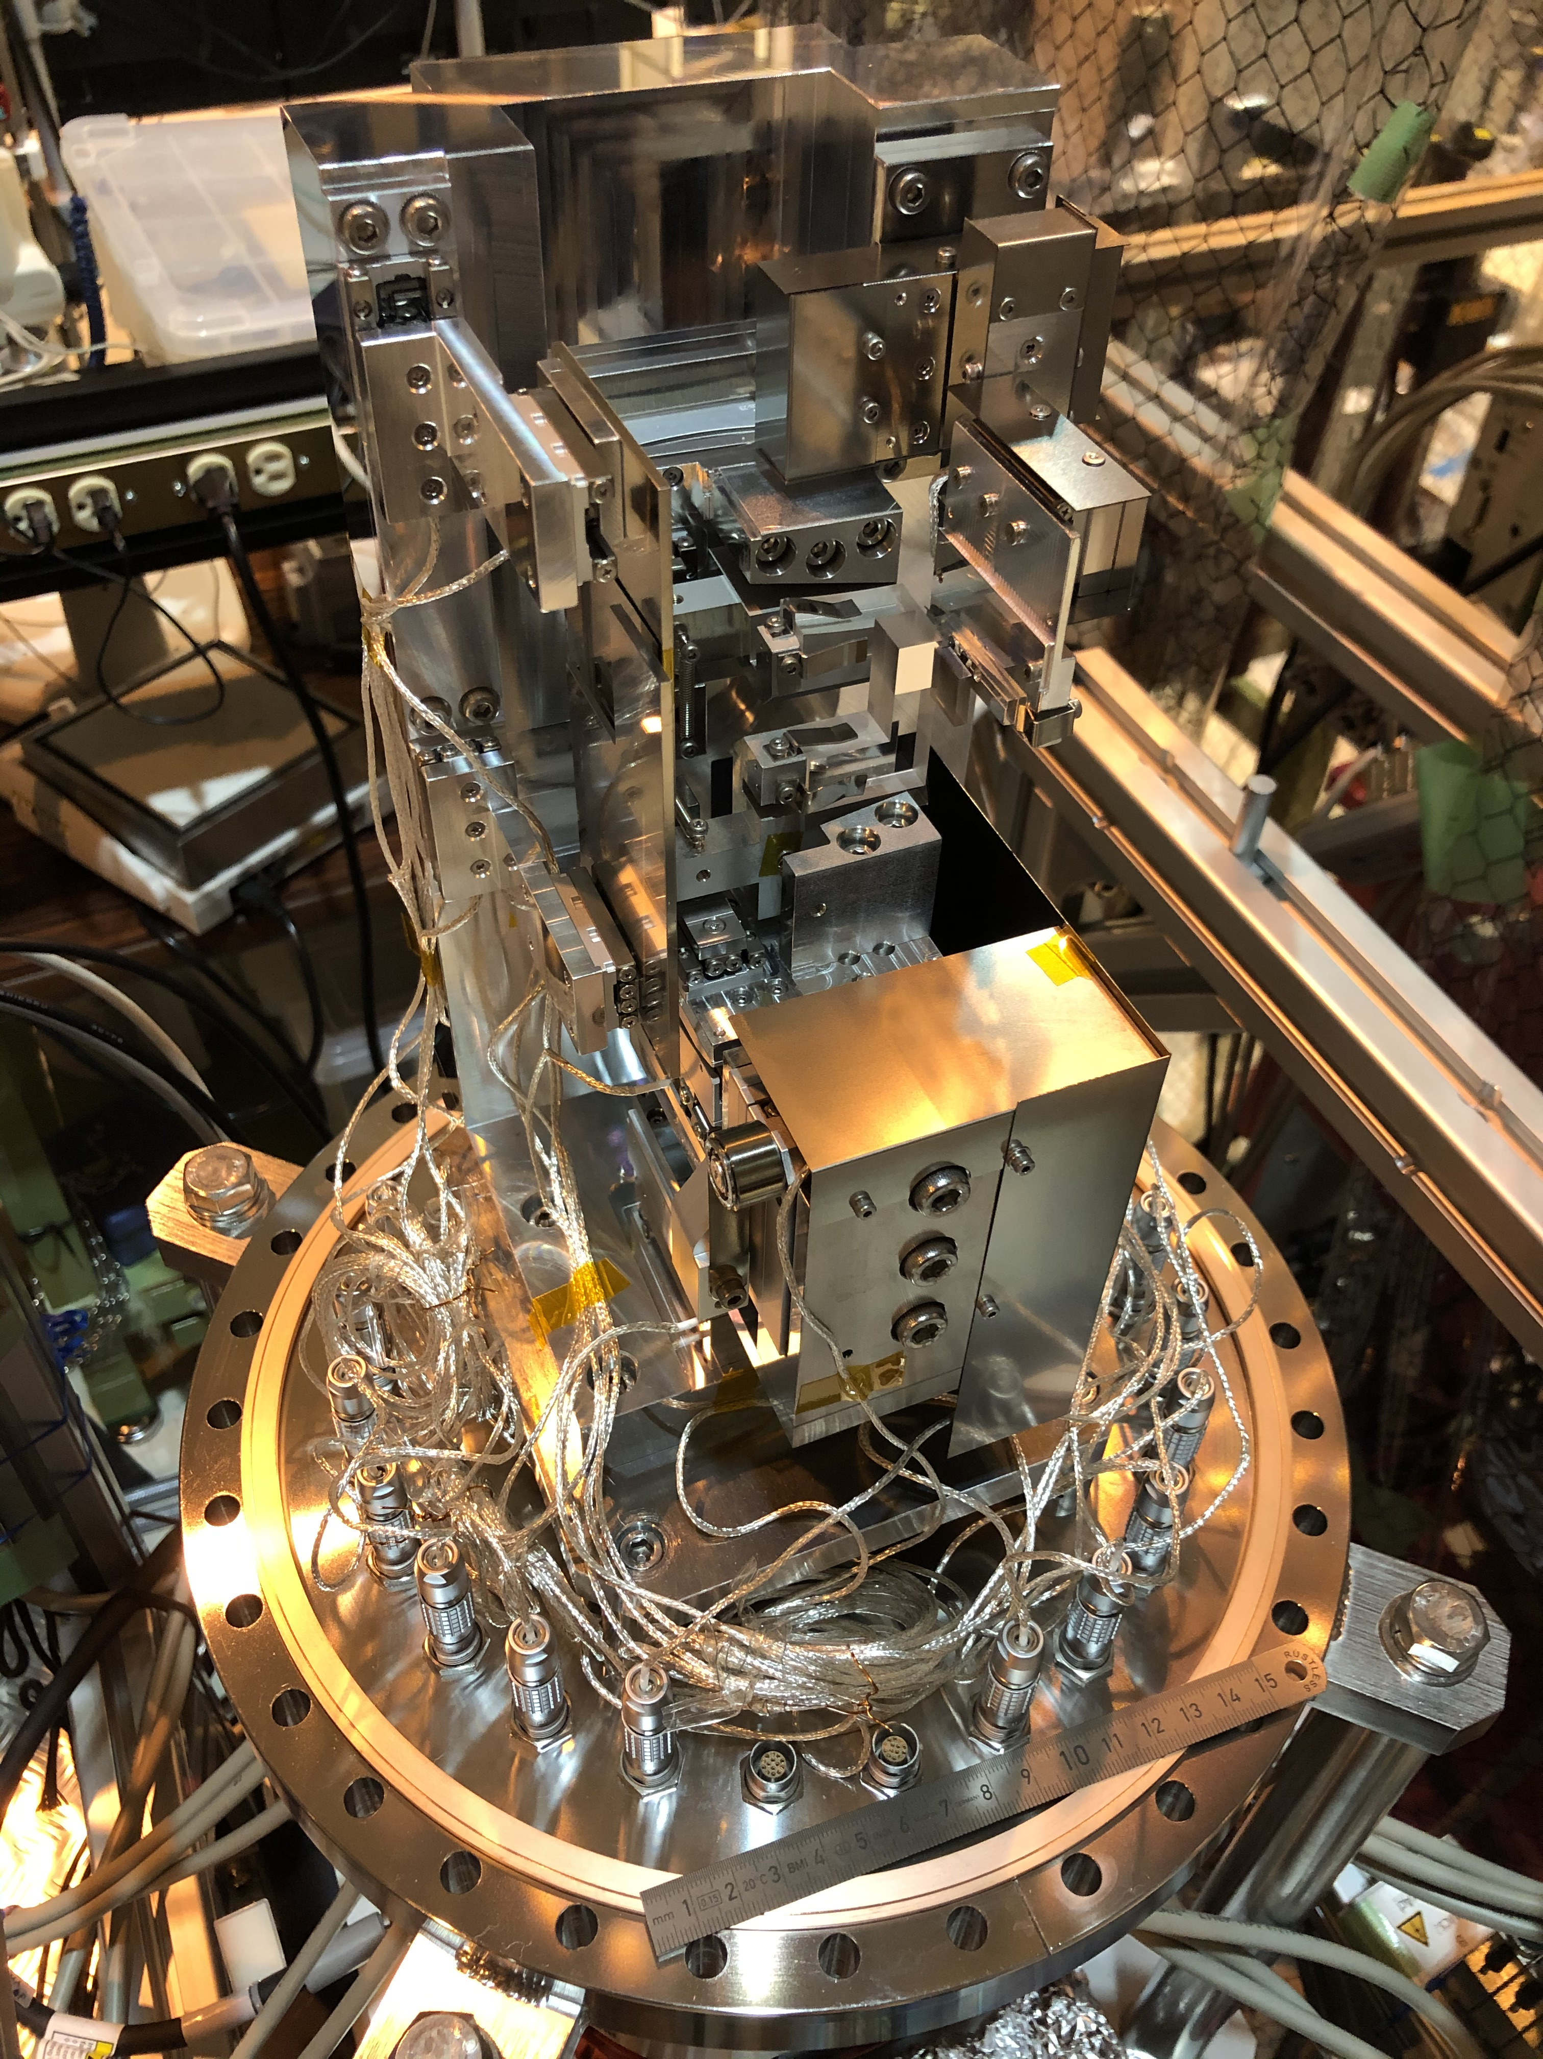

Slide 2
`
X-ray propagation
Weak Overlapped
Focusing
Mirror
Strong Resolved and detailed

