Slide 1
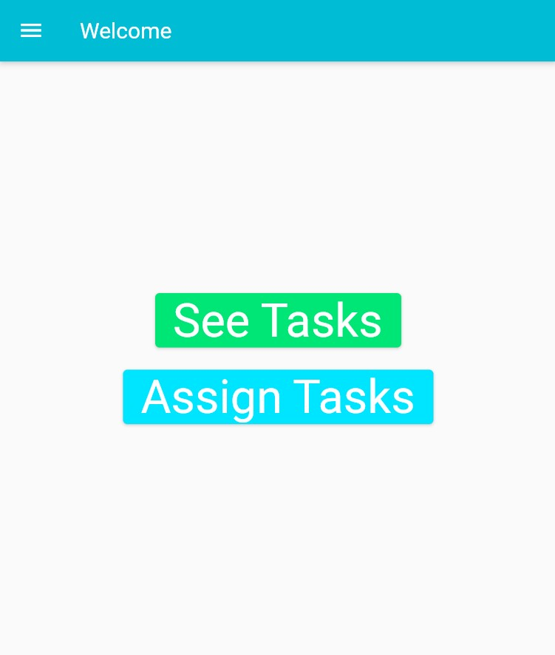

TAskgenix

Slide 2
Introduction
TaskGenix is an app that can reward its users for completing tasks and makes it easy for the users to track the progress of the task completion. We got the idea from our friends who were forgetting to complete their tasks and how hard it is for their parents to convince them to do their work.

Slide 3

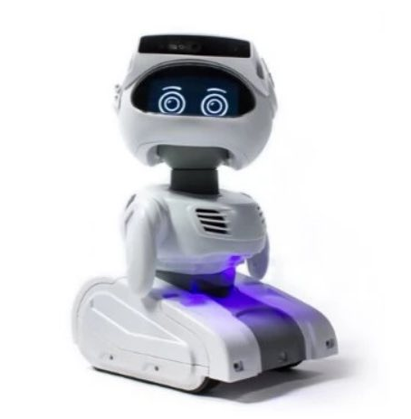
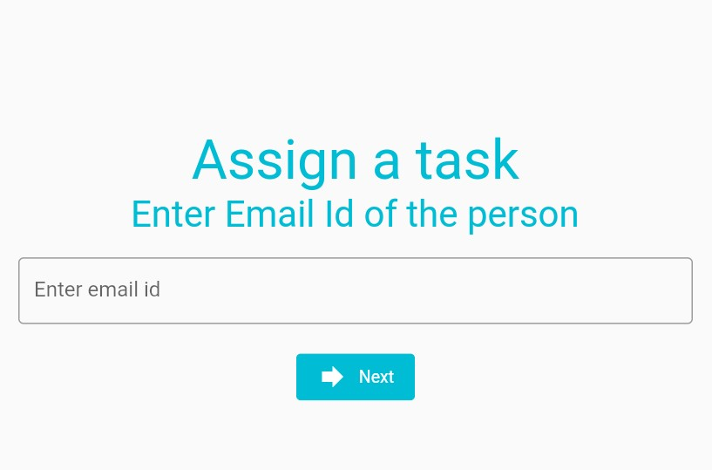
Target Audience and Applications
This app can help organizations track the tasks being done by the employees. It can help us give tasks to people and thus use advanced communication to finish tasks. Parents can set tasks for their children to complete. With more tweaks, the app can also be designed to let machines do the tasks.

Slide 4
How does the app work?
Assigning tasks
Completion and rewards
The user can first enter the email id of the person to whom they want to assign the task.
Next the user can enter the task name and enter the list of things the person must do.
Finally, once the user has assigned the task, they can track the progress of the person they have assigned the task to.
The user can check and complete their tasks.
For every task they complete they can get an in-app reward via a minigame.

Slide 5


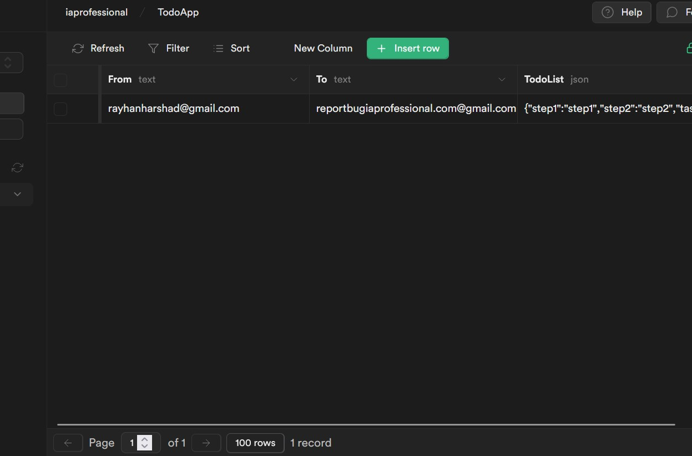
Technical Details
The app was made using Flutter an app development framework made by Google. The backend is powered by Supabase an open-source backend platform that helps in managing authentication and real-time messaging. The app is programmed in Dart another programming language made by Google.

Slide 6



Thank you
We welcome your suggestions for this project

