Slide 1
DEEP KERNEL LEARNING
Andrew Wilson, Zhiting Hu, Ruslan Salathutnikov, Eric Xing
Jakob Lambert-Hartmann, Niklas Bosch
Notes:
We want to introduce the concept/ proposed model of the paper deep kernel learning

Slide 2
Introduction
<number>

Slide 3
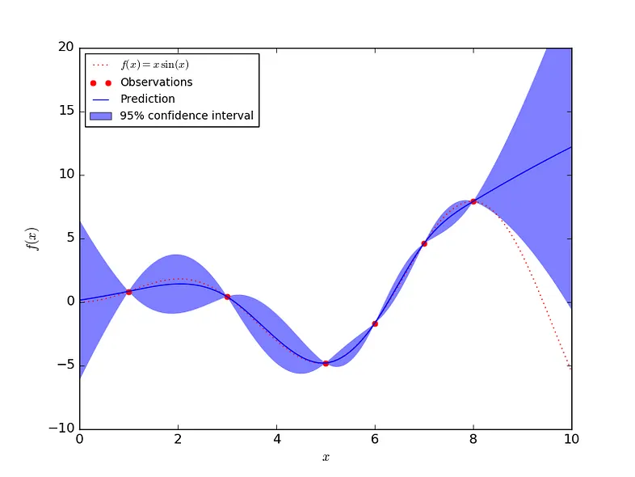
Gaussian Processes
Includes confidence interval into prediction
High confidence near observed data
<number>

Slide 4
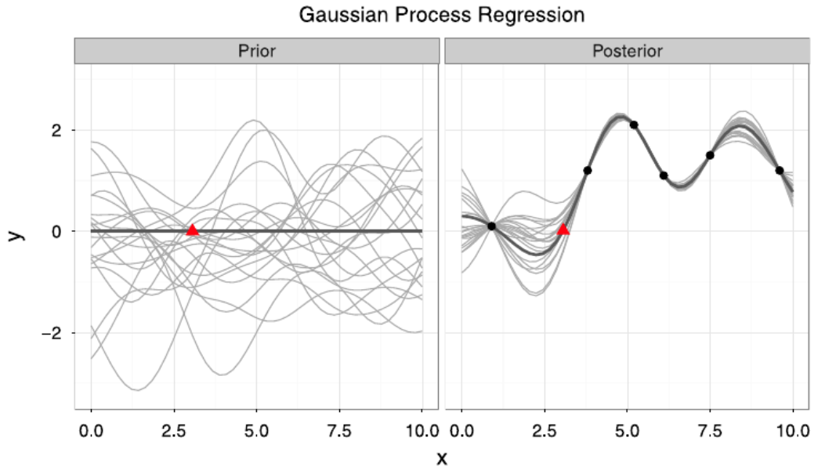
Gaussian Processes
Input:
Distribution of functions (prior)
Observed data
Output:
Infinitly many samples
from prior fitting
observations (posterior)
<number>

Slide 5
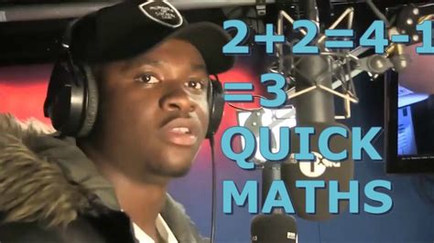
Quick Maths
<number>

Slide 6
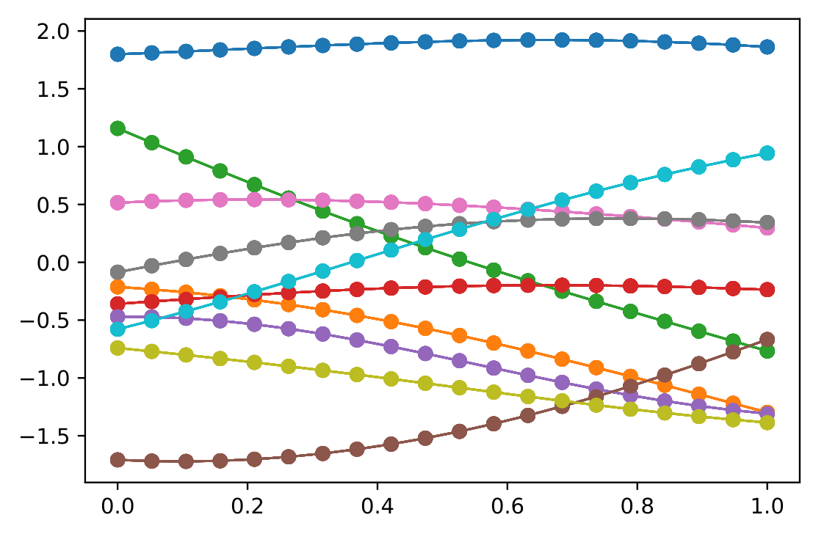
Functions
Sampled points from multivariate
distribution
<number>

Slide 7
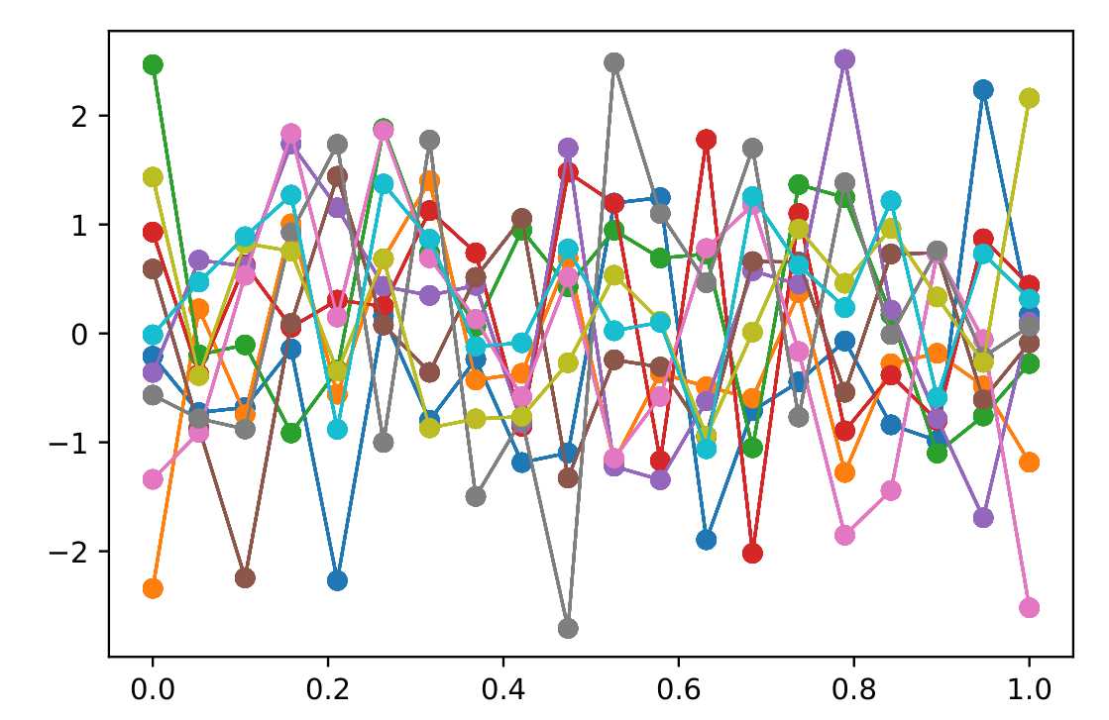
Functions
Not independent because:
similar input → similar output
<number>

Slide 8
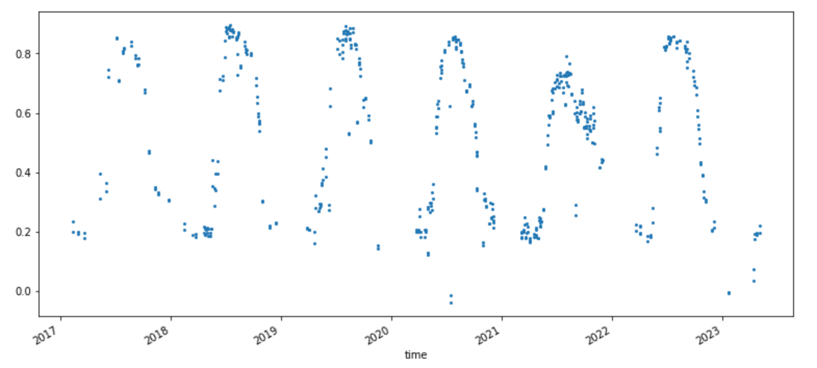
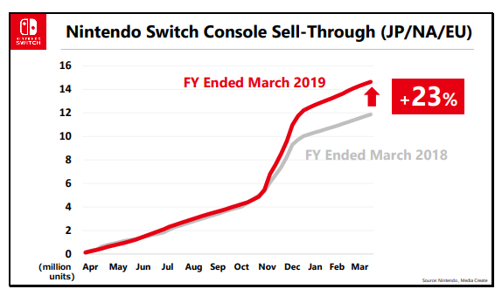
Kernel Functions
Input similarity depends on the context
Plant activity
Cumulative sales data
<number>

Slide 9
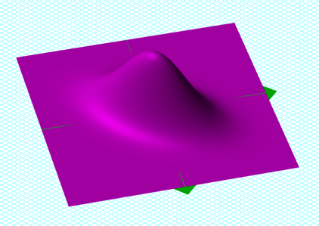

Multivariate distributions
Defined by covariance matrix
<number>

Slide 10
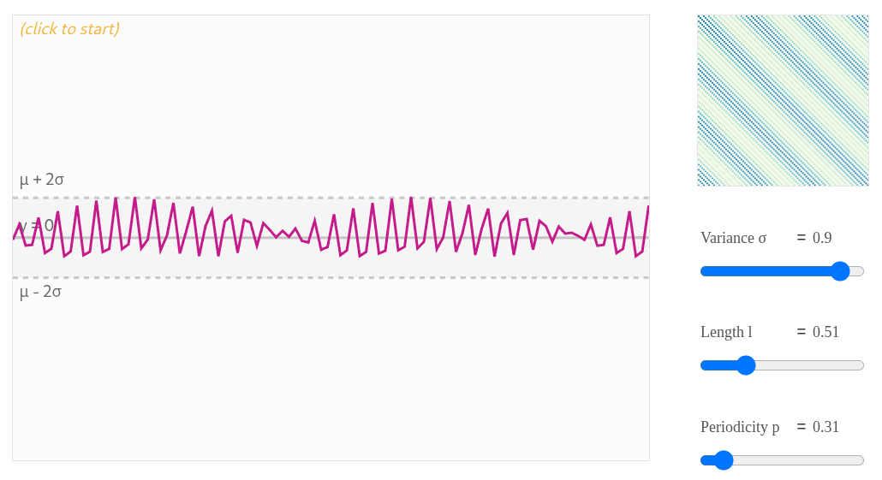
Periodic Kernel
<number>

Slide 11
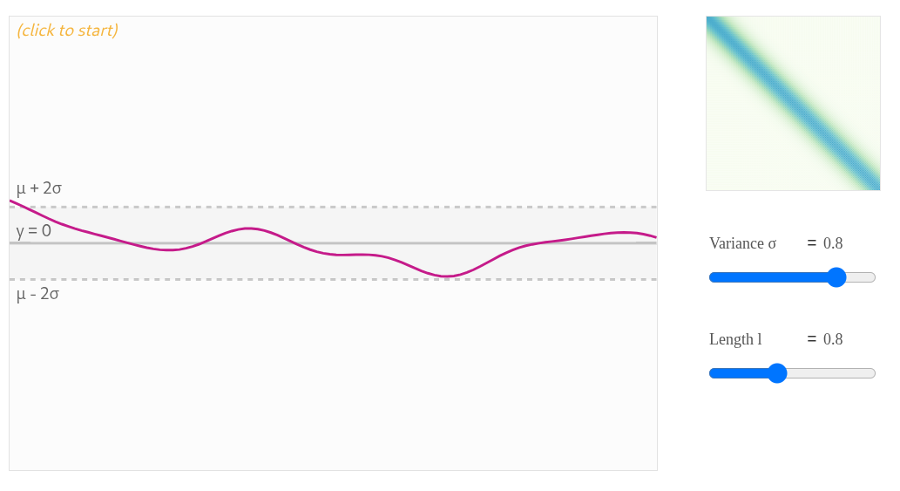
RBF Kernel
<number>

Slide 12
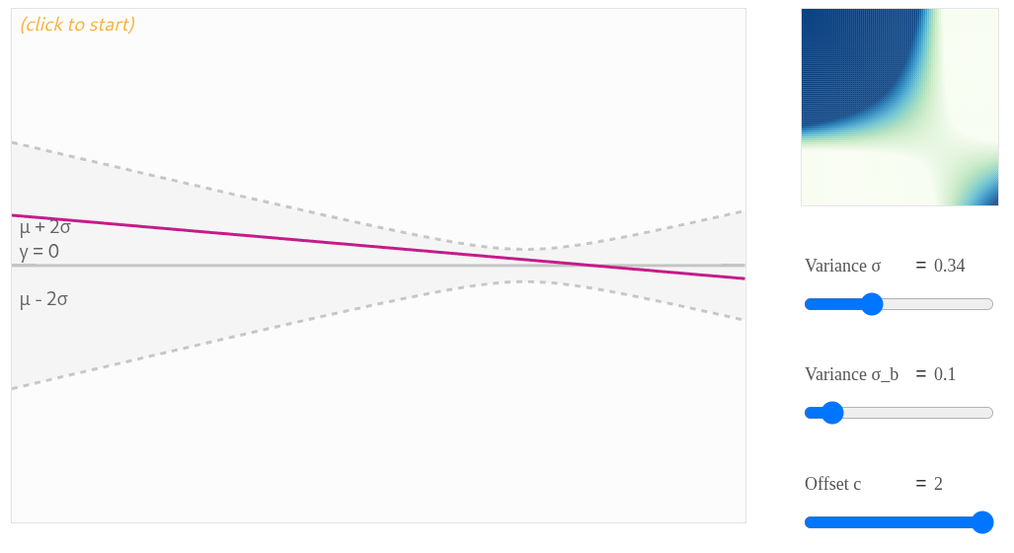
LineaR Kernel
<number>

Slide 13
Why contrarian to neural networks?
Gaussian Process Regressors:
- models uncertainty
- non parametric
- prior knowledge required
- scale poorly with many data points
Neural Networks:
- predict single value
- millions/billions of parameters
- less prior knowledge
- scale well with many data points
<number>

Slide 15
How can we combine these two methods?
Use the DNN as a learned kernel
On which we calculate the GPR model
Notes:
Trivial: Overfitting . Wir trainieren auf Sprache und Fragen nach dem Kontostand
Wie ist es aber in einem komplexeren Problem: Validation loss stops decreasing -> we stop training
Szenario? Wir wollen jetzt ein Bildgenerator zusammenbauen, können es besser als Sora -> wie gehen wir sicher, dass das Modell nicht unsere Trainingsdaten ausspuckt
Canary: Extra Trainingsdaten um zu überprüfen, ob wir genau die Daten durch Anfragen reproduzieren können. Also Antworten die wir schon kennen.
Wird im paper zwischen wirklich sensiblen Daten und trivialen Daten unterschieden?

Slide 16
Backpropagation
Notes:
Ah somewhat uninteresting question, but necessary to understand the concept

Slide 17
Sources
1: https://zlthinker.github.io/gaussian-process-regression
2: https://www.streambatch.io/knowledge/ndvi-from-sentinel-2-imagery-using-stac
3: https://gonintendo.com/stories/334105-nintendo-details-switch-sales-pace-compares-to-wii-ds-era-break
4: https://medium.com/analytics-vidhya/interpreting-posterior-of-gaussian-process-for-regression-1bcfaab8e8aa
5: https://en.wikipedia.org/wiki/Covariance_matrix
6: https://distill.pub/2019/visual-exploration-gaussian-processes/
7: https://medium.com/analytics-vidhya/interpreting-posterior-of-gaussian-process-for-regression-1bcfaab8e8aa
8: WILSON, Andrew Gordon, et al. Deep kernel learning. In: Artificial intelligence and statistics. PMLR, 2016. S. 370-378.
9: Wang, Jie. "An intuitive tutorial to Gaussian process regression." Computing in Science & Engineering 25.4 (2023): 4-11.

Slide 18
Thank you for your attention!

