Slide 1
AI4Math – Group 8
Exploration of Reward Shaping and Imitation Learning in Chess
Jakob Lambert-Hartmann
Jannis Junge
Patric Riedel
2025

Slide 2
AI4Math – Group 8
Exploration of Reward Shaping and Imitation Learning in Chess
A
B
C
D
E
F
G
H
1
1
2
2
3
3
4
4
5
5
6
6
7
7
Jakob Lambert-Hartmann
Jannis
Patric Riedel
8
8
A
B
C
D
E
F
G
H
2025

Slide 3
A
B
C
D
E
F
G
H
1
1
2
2
AI4Math – Group 8
Exploration of Reward Shaping and Imitation Learning in Chess
3
3
4
4
5
5
6
6
Jakob Lambert-Hartmann
Jannis
Patric Riedel
2025
7
7
8
8
A
B
C
D
E
F
G
H

Slide 4
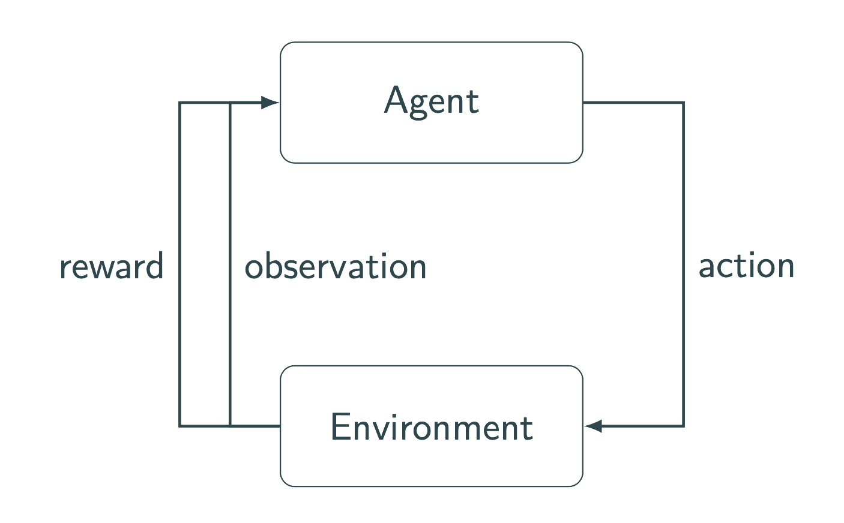
A
B
C
D
E
F
G
H
1
1
2
Reinforcement Learning
2
♜
3
3
4
4
5
5
6
6
7
7
8
8
A
B
C
D
E
F
G
H

Slide 5
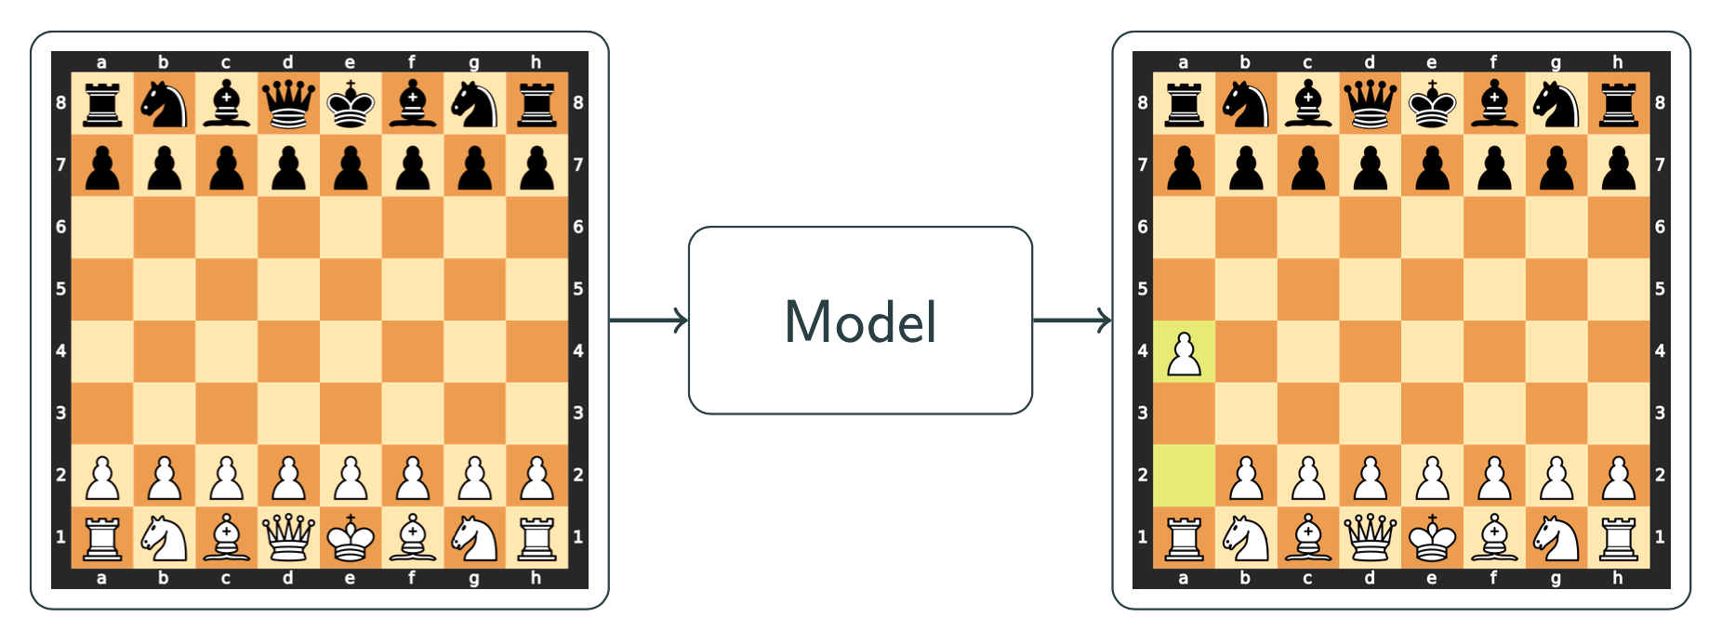
A
B
C
D
E
F
G
H
1
1
2
Reinforcement Learning
2
Reinforcement Learning
♜
3
3
4
4
5
5
6
6
7
7
8
8
A
B
C
D
E
F
G
H

Slide 6
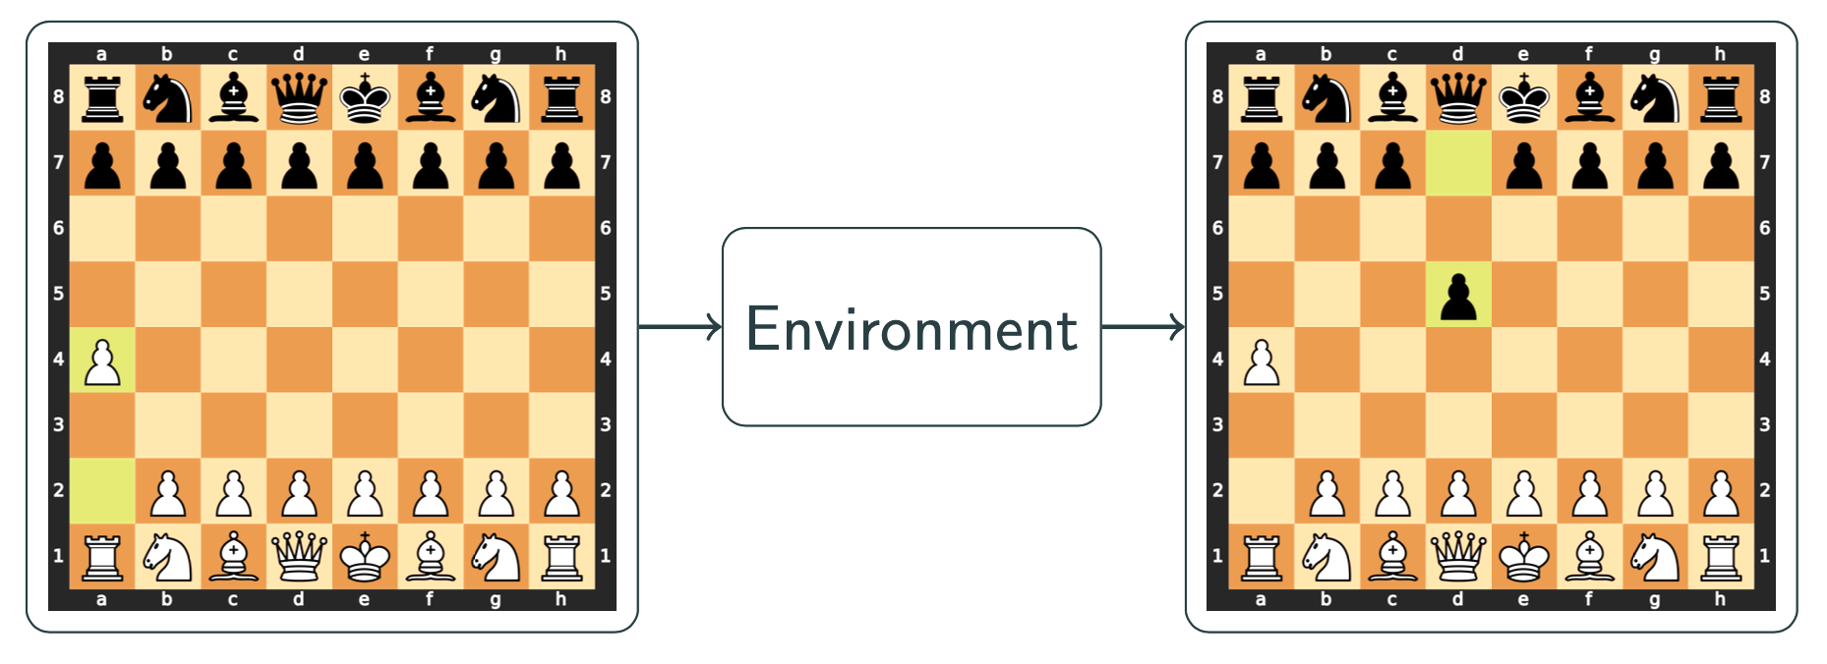
A
B
C
D
E
F
G
H
1
1
2
Reinforcement Learning
2
Reinforcement Learning
♜
3
3
4
4
5
5
6
6
7
7
8
8
A
B
C
D
E
F
G
H

Slide 7
A
B
C
D
E
F
G
H
1
1
2
2
♜
AI4Math
Reinforcement Learning – Chess Model
Jakob [LAST_NAME], Jannis [LAST_NAME], Patric Riedel
3
3
4
4
5
5
6
6
7
7
8
8
A
B
C
D
E
F
G
H

Slide 8
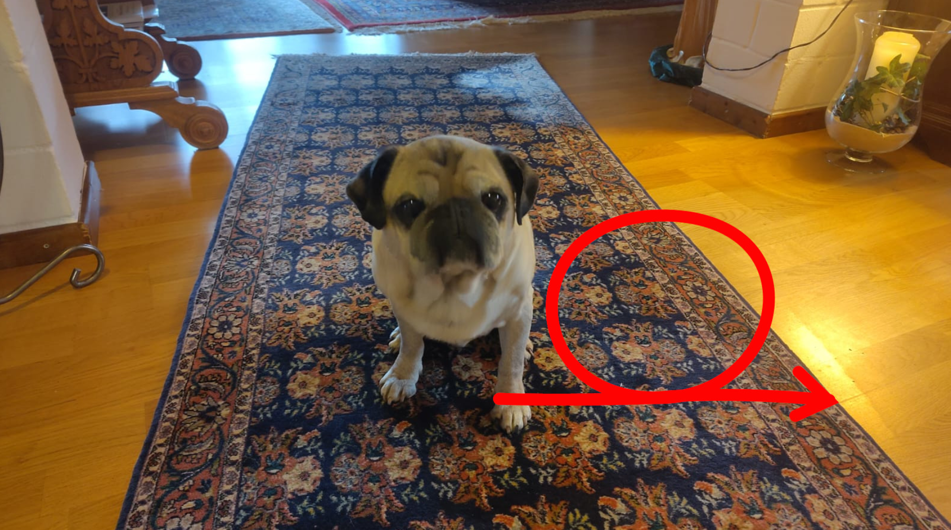
A
B
C
D
E
F
G
H
1
1
2
2
♜
3
3
4
Reward Shaping
4
♚
5
5
6
6
7
7
8
8
A
B
C
D
E
F
G
H

Slide 9
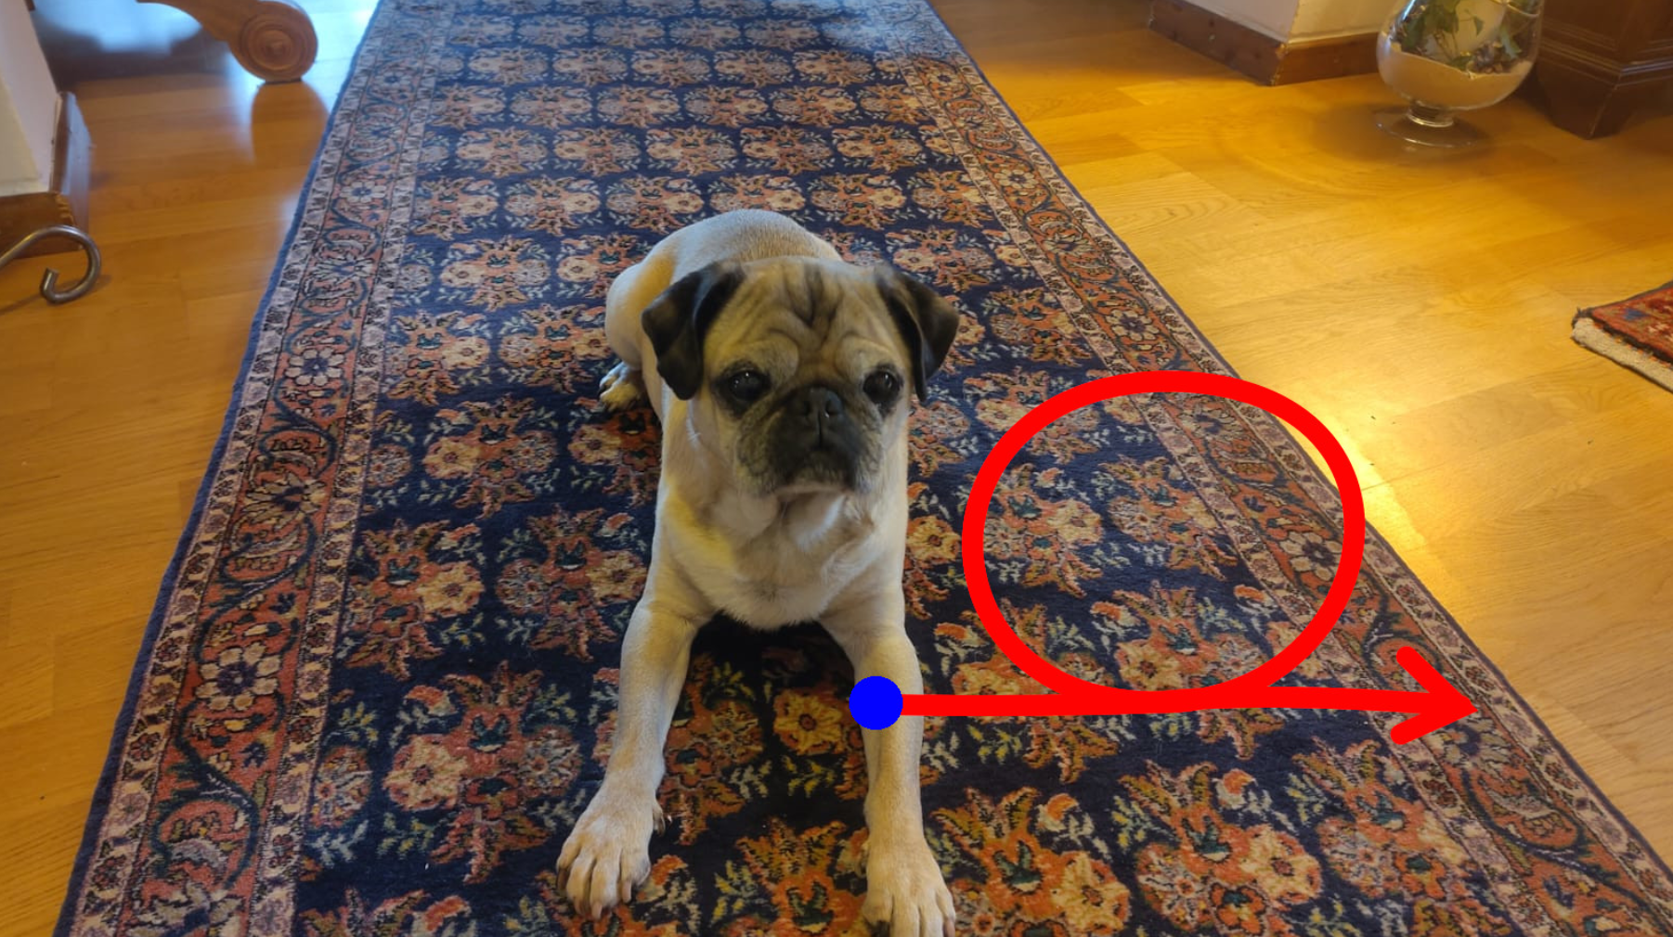
A
B
C
D
E
F
G
H
1
1
2
2
♜
3
3
Reward Shaping
4
Reward Shaping
4
♚
5
5
6
6
7
7
8
8
A
B
C
D
E
F
G
H

Slide 10
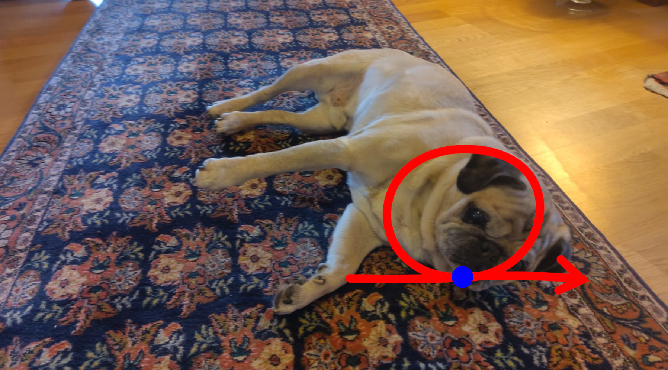
A
B
C
D
E
F
G
H
1
1
2
2
♜
3
3
Reward Shaping
4
Reward Shaping
4
♚
5
5
6
6
7
7
8
8
A
B
C
D
E
F
G
H

Slide 11
A
B
C
D
E
F
G
H
1
1
2
2
♜
3
3
Challenges in Reward Shaping
4
Reward Shaping
4
Common Challenges with rewards[1]:
• Reward Sparsity: Too little rewards for effective
learning
• Reward Hacking: Agent maximizes rewards rather
than learn end goal
• Misaligned Rewards: Rewards do not insentivize
behaviour
• ...
♚
5
5
6
6
7
7
8
8
A
B
C
D
E
F
G
H

Slide 12
A
B
C
D
E
F
G
H
1
1
2
2
♜
AI4Math
Reinforcement Learning – Chess Model
Jakob [LAST_NAME], Jannis [LAST_NAME], Patric Riedel
3
3
4
4
♚
5
5
6
6
7
7
8
8
A
B
C
D
E
F
G
H

Slide 13
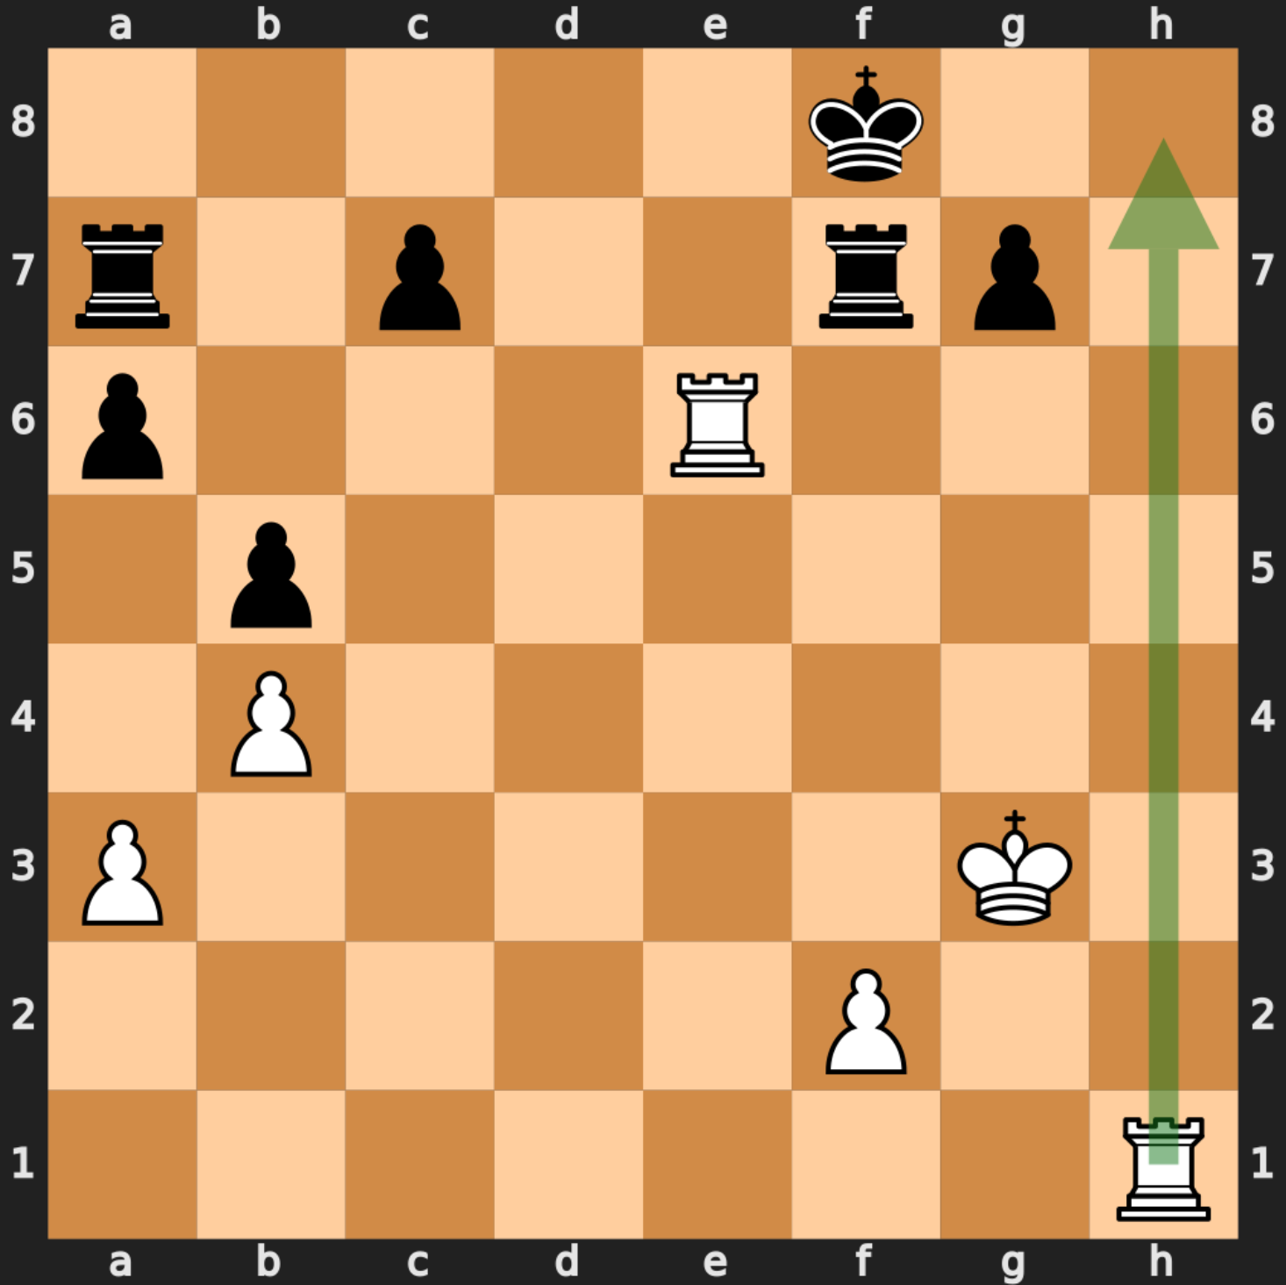
A
B
C
D
E
F
G
H
1
1
2
2
♜
3
3
4
4
♚
Chess Tactics
5
5
♞
Positions with one winning move:
• Lichess publishes puzzles[2]
• Kaggle processed dataset[3]
6
6
7
7
8
8
A
B
C
D
E
F
G
H

Slide 14
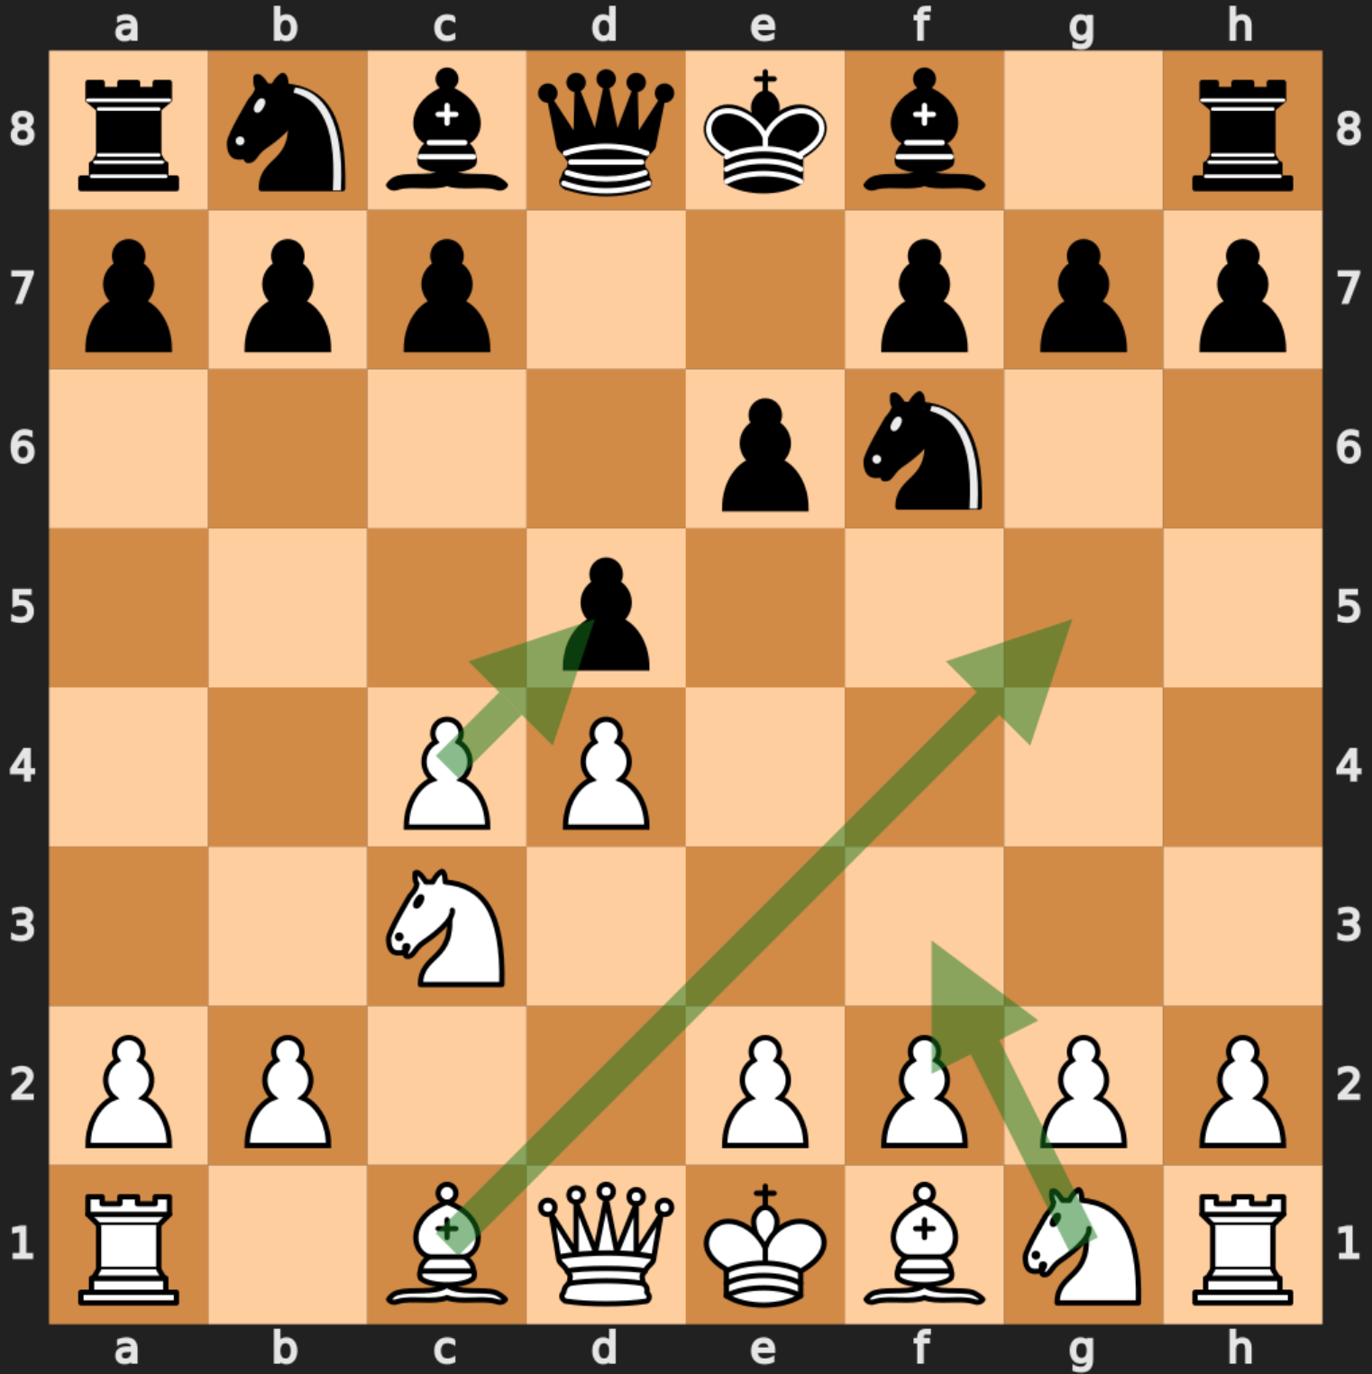
A
B
C
D
E
F
G
H
1
1
2
2
♜
3
3
4
4
♚
Chess Strategy
Chess Tactics
5
5
Chess principles:
• developing pieces
• controlling the middle
• bring the king to safety
• ...
Often multiple viable moves
♞
Positions with one winning move:
• Lichess publishes puzzles[2]
• Kaggle processed dataset[3]
6
6
7
7
8
8
A
B
C
D
E
F
G
H

Slide 15
A
B
C
D
E
F
G
H
1
1
2
2
♜
AI4Math
Reinforcement Learning – Chess Model
Jakob [LAST_NAME], Jannis [LAST_NAME], Patric Riedel
3
3
4
4
♚
5
5
♞
6
6
7
7
8
8
A
B
C
D
E
F
G
H

Slide 16
A
B
C
D
E
F
G
H
1
1
2
2
♜
3
3
4
Idea: Imitation learning
4
For some problems labeled data for some behaviours we want in our agent:
• Chess Tactics: labeled data
• Chess Strategy: no labeled data
Imitation Learning[4]:
1. Pretrain on puzzle data
2. Finetune with reinforcement learning
♚
♚
5
5
♞
6
6
7
7
8
8
A
B
C
D
E
F
G
H

Slide 17
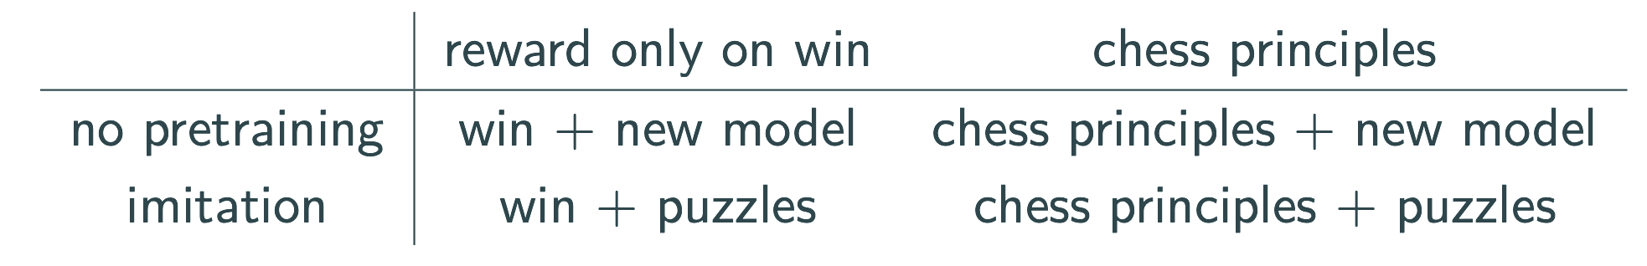
A
B
C
D
E
F
G
H
1
1
2
2
♜
3
3
4
Idea: Imitation learning
4
Goal
Question: Can we be lazy with reward shaping when using imitation learning?
Method: Observe convergence speed/performance for different
configs:
For some problems labeled data for some behaviours we want in our agent:
• Chess Tactics: labeled data
• Chess Strategy: no labeled data
Imitation Learning[4]:
1. Pretrain on puzzle data
2. Finetune with reinforcement learning
♚
♚
5
5
♞
6
6
7
7
8
8
A
B
C
D
E
F
G
H

Slide 18
A
B
C
D
E
F
G
H
1
1
2
2
♜
3
3
x
4
Progress so Far
4
• chess_ml library:
• interface environment <-> neural network
• imitation learning: data preprocessing, etc.
• reinforcement learning: extensible rewards, etc.
• access to SC and trained imitation model
♚
♛
♚
5
5
♞
6
6
7
7
8
8
A
B
C
D
E
F
G
H

Slide 19
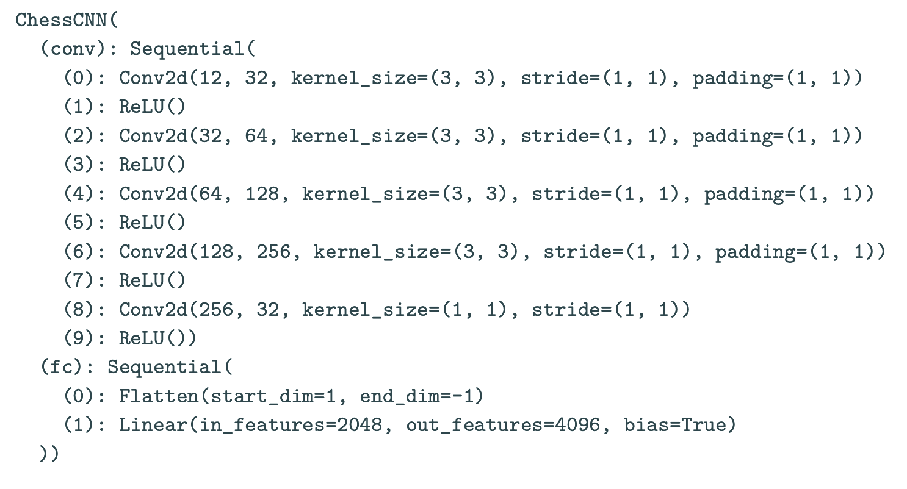
A
B
C
D
E
F
G
H
1
1
2
2
♜
3
3
x
4
Progress so Far
4
Imitation Model
Trained model with ~75% move accuracy in test/validation:
• chess_ml library:
• interface environment <-> neural network
• imitation learning: data preprocessing, etc.
• reinforcement learning: extensible rewards, etc.
• access to SC and trained imitation model
♚
♛
♚
5
5
♞
6
6
7
7
8
8
A
B
C
D
E
F
G
H

Slide 20
A
B
C
D
E
F
G
H
1
1
2
2
♜
3
3
4
Imitation Model
4
Next Steps
Trained model with ~75% move accuracy in test/validation:
• Hyperparameter tuning:
• Layer number/size
• Residual blocks
• Learning rate
• ...
• Design reward functions:
• chess principles
• material imbalance
• ...
♚
♛
♚
5
5
♞
6
6
7
7
8
8
A
B
C
D
E
F
G
H

Slide 21
A
B
C
D
E
F
G
H
1
1
2
2
♜
AI4Math
Reinforcement Learning – Chess Model
Jakob [LAST_NAME], Jannis [LAST_NAME], Patric Riedel
CHECKMATE!
3
3
Sources:
1. Ibrahim, Sinan, et al. “Comprehensive overview of reward
engineering and shaping in advancing reinforcement
learning applications.” IEEE Access (2024).
2. https://database.lichess.org/
3. https://www.kaggle.com/datasets/datasnaek/chess/data
4. Ahmed Hussein, Mohamed Medhat Gaber, Eyad Elyan, and
Chrisina Jayne. 2017. Imitation Learning: A Survey of
Learning Methods. ACM Comput. Surv. 50, 2, Article 21
(March 2018), 35 pages. https://doi.org/10.1145/305491
4
4
♚
♛
♚
5
5
♞
6
6
7
7
8
8
A
B
C
D
E
F
G
H

