Slide 1
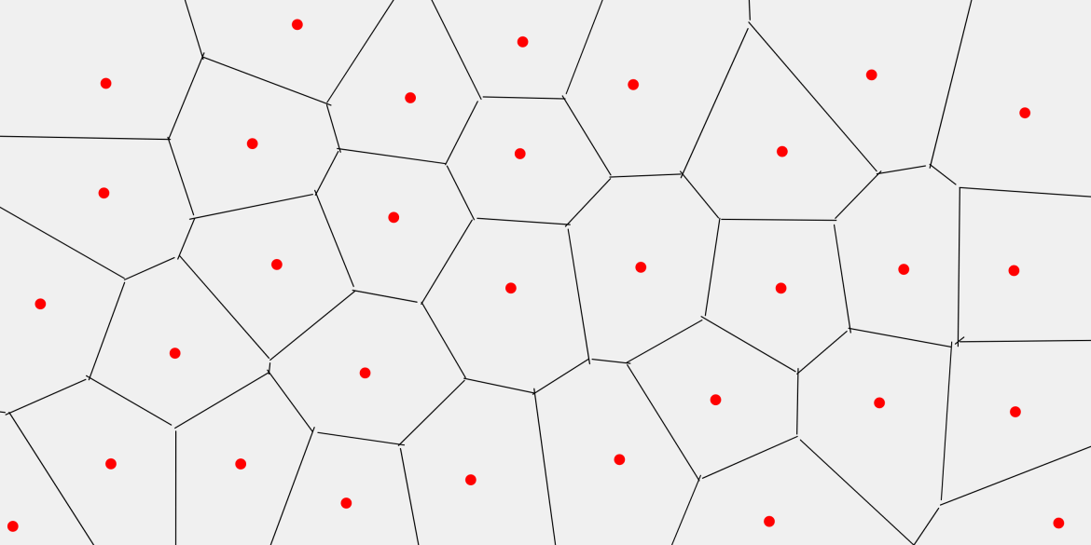
Voronoi Diagram from a set of 2D points
for the lecture “Numerical Software Development 2022“
under Professor Yung-Yu
Notes:
Hi everyone
I‘ll tell you a bit more about my term project:
Computation of a voronoi diagram of a set of 2D points.
Given a plane, a Voronoi diagram is a partition of the plane into regions closest to each of a given set of target points.
Points in red
Regions around the target points, set of all clossest points around that target point

Slide 2
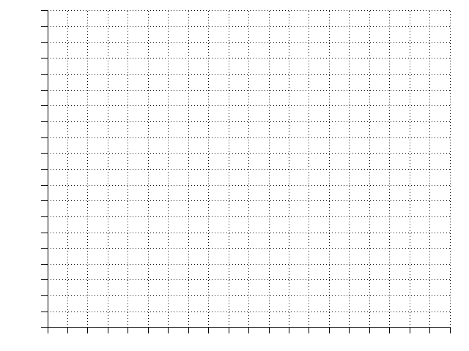
Problem
X
X
X
Notes:
How do we construct those regions:
Set of points
The middle point between to target points has exactly the same point to each of the two target points
Extend this middle point to a perpendicular line, this line describes all points with equal distance to the target points
The lines of every set of three target points meet in the middle of a circle which has the exact same distance to each of the sourrounding target points
This now devides the plane into three regions, each describing the set of points which is closest to it‘s respective target point

Slide 3
Problem
X
X
X
X
Notes:
What if we add a target point
Use can use the same algorithm
find the middle
construct the line
append it the circle center

Slide 4
Problem
X
X
X
X
X
X
Notes:
this can be done with an arbitrary number of points

Slide 5
Problem
X
X
X
X
X
X
Notes:
The resulting set of partitions, Voronoi cells, has many use cases

Slide 6
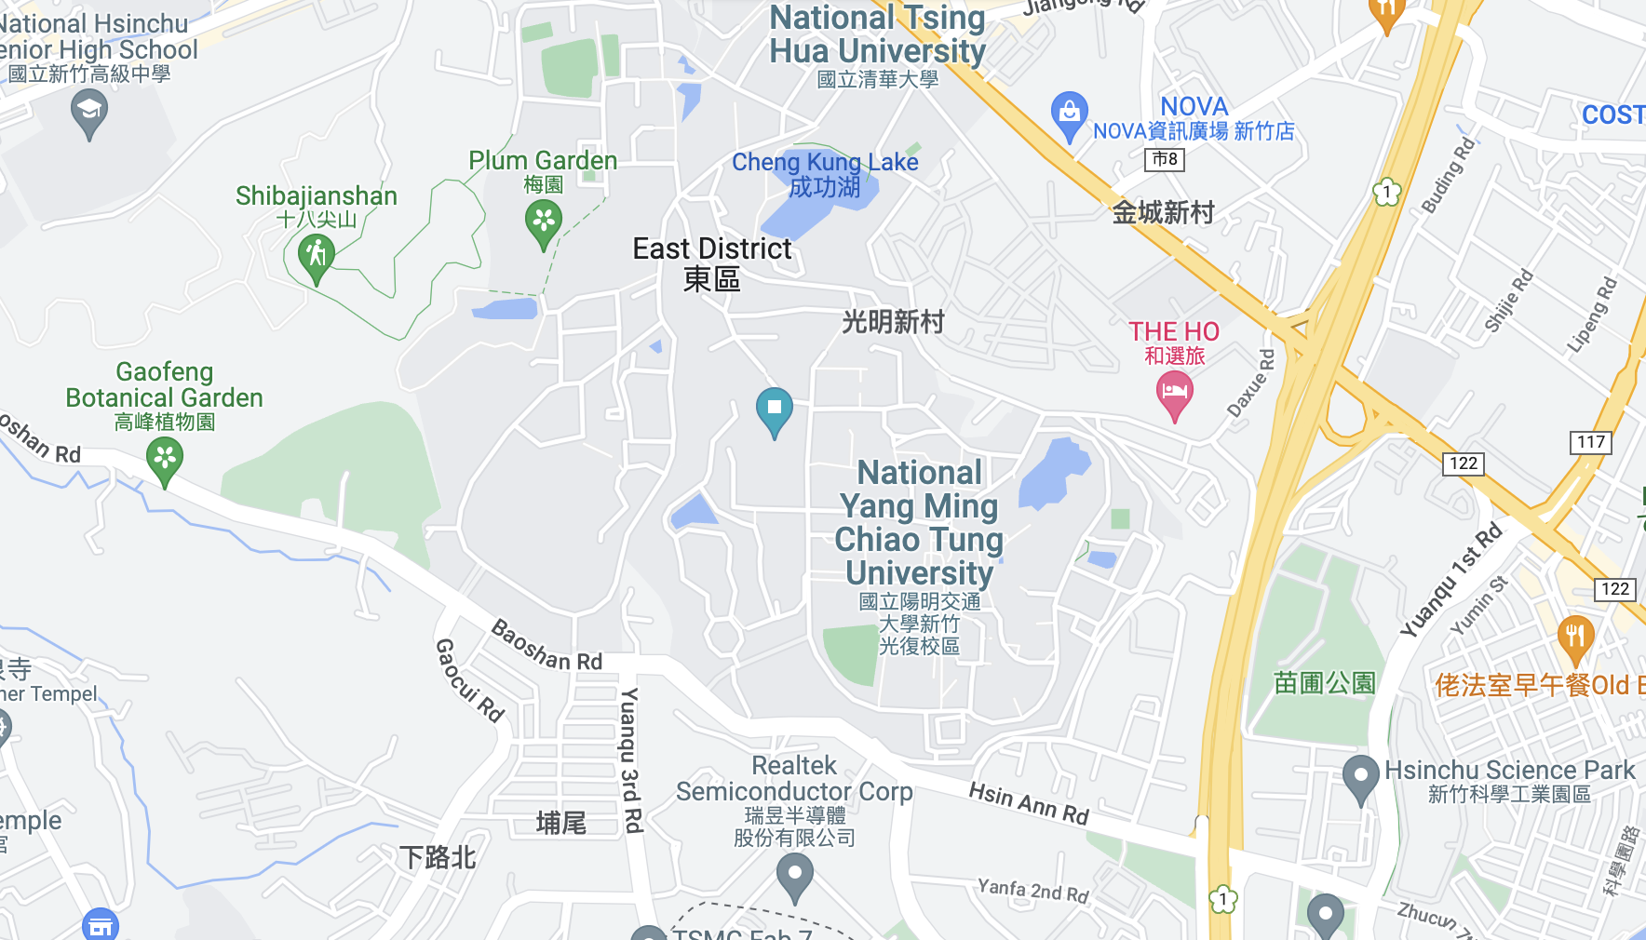
Problem
X
X
X
X
X
X
Notes:
Evacuation
Multiple bodies of water on the campus
On a fire alarm, where should the sutdents go?
- closest body of water

Slide 7
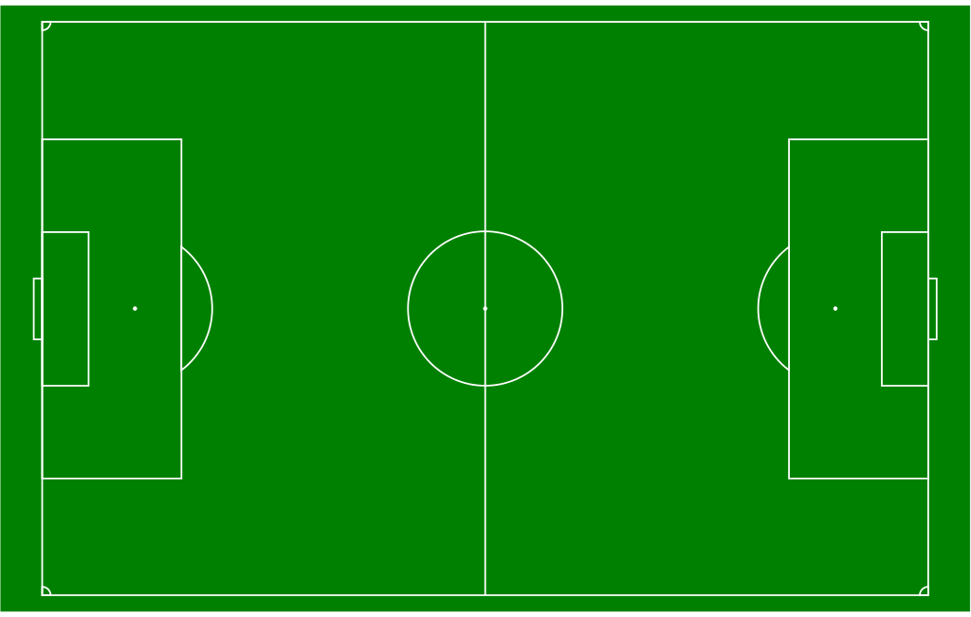
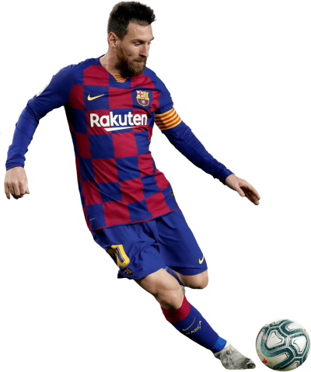
Problem
X
X
X
X
X
X
Notes:
another example in soccer, target points are our players
You can see the defensive lines.
Strategy is zone coverage:
who is responsble for which zone, if messi starts to pass a wide ball?

Slide 8
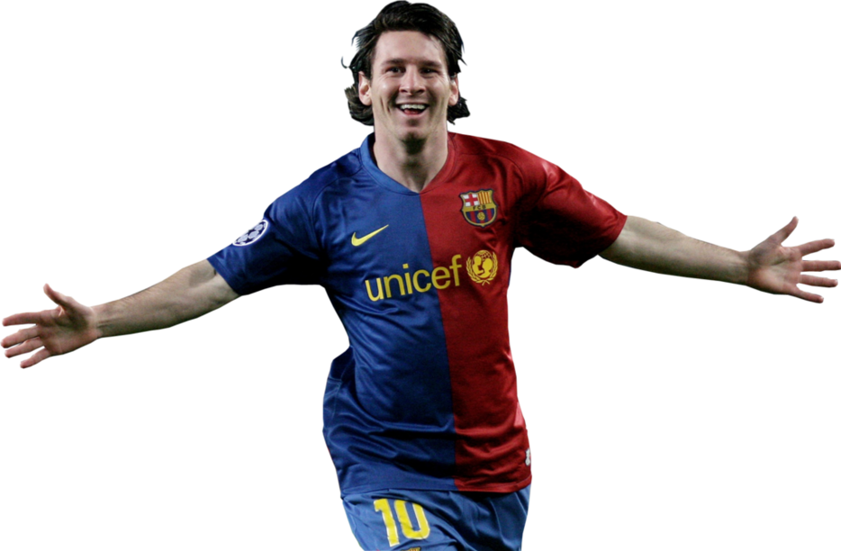
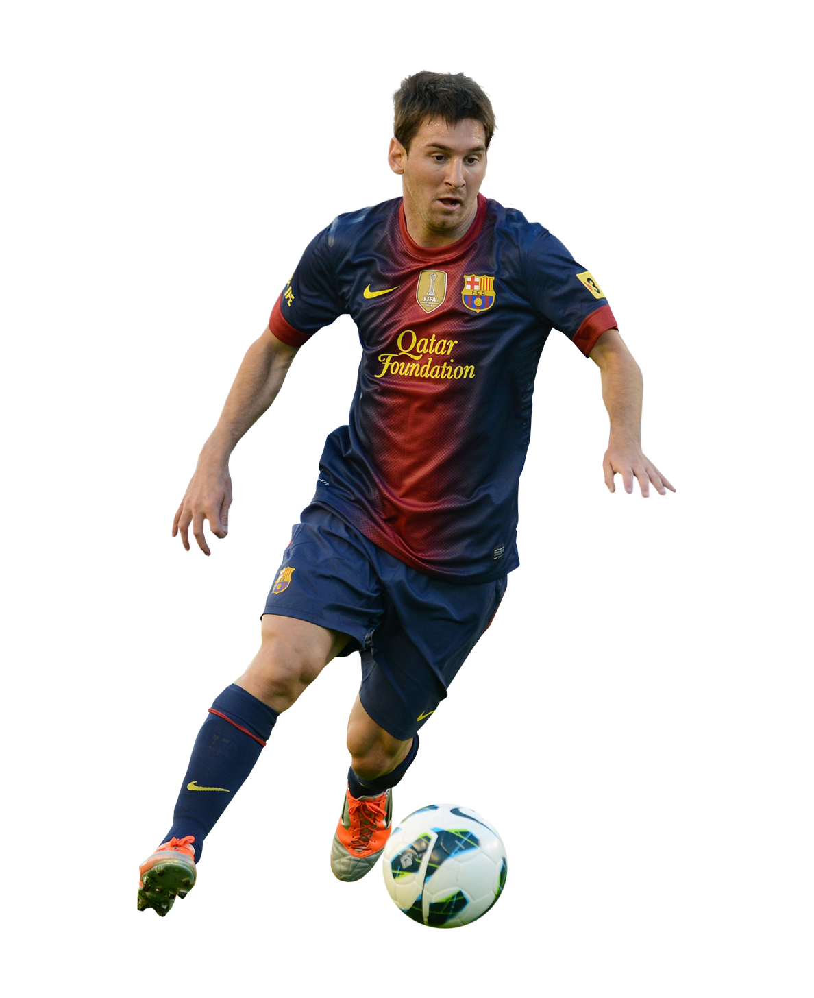
Problem
X
X
X
X
X
X
Notes:
The effectiveness of this is approach is of course a different discussion

Slide 9
Fortune‘s Algorithm
Event Based
Point Event
Circle Event
X
X
X
X
Notes:
Fortunes algorithm to solve the problem
Sweepline and beachline beachline to grow cells around target points
Sweepline in red, creating new cells
Left of the line has been processed, right has not been processd
Beachline piecwise parabolar curve, consisting of arcs that indicate the boarders of cells that are still growing.
All points equidistance from sweepline to nearest point
The length of an arc shrinks to zero, a new vertex in the Voronoi diagram is created.
from there a new voronoi cell boundary starts
two types of events
Point event: New point is introduced, general middle lines are created
Circle events: an arc length shrinks to zero, a new point in the voronoi diagram must be created

Slide 10
Fortune‘s Algorithm
Datastructures
Event Queue
Beachline
X
X
X
X
Notes:
Two most important datastructres were
EventQueue, holds next event that needs to be processed
Beachline holds all arcs of the piecewise parabola.

Slide 11
Architecture
Python
Voronoi
Polygon
Point
Edge
C++
Unit Test
Voronoi
Event Queue
Beachline
Notes:
Those two datastructes were also the first part of the implementation
while implementing those, I implemented everything needed for these datastructures
- Classes for Voronoi diagram
Geometric entities like points and edges and more
The C++ implementaiton was accompanied by unit tests for every class
After finishing a working c++ version, I added the pybind11 connector and python wrapper classes

Slide 12
Wrapping
Point
Edge
Point (x, y):
self.x = x
self.y = y
self.p_cpp = Point_cpp(x, y)
Point (double x, double y):
self.x = x
self.y = y
Point
Edge
Point (x, y):
self.x = x
self.y = y
self.p_cpp = None
Point (double x, double y):
self.x = x
self.y = y
TIME
Notes:
The wrapper classes in python have to handle two cases:
object created in python that are then used in the c++ algorithm
object created in c++ (for exmaple all the edges) that are then used in python
For the first case, the owenership is in python
For all other objects, created in c++, the ownership is at c++. python is copying the data into the wrapping class after getting hte object passed by reference.
I decided to it like this :
I assumed creation of diagram to be a part of a larger process
Copying is a small overhead, c++ can clean up everything after finishing the computation
Like this, the more complicated maniupulations of the objects could be done in python
Plotting
Transformation to polygons

Slide 13
Architecture
Point
Edge
….
….
json
json
-----
-----
-----
-----
Python
native logging
Integration Test
Voronoi
Polygon
Point
Edge
C++
Unit Test
Voronoi
Event Queue
Beachline
spd logger
Notes:
With reading and writing functionality added
integration testing
Created samples by hand (input and output)
Computed voronoi diagram
compared
In the whole process
cpp and python used extensive logging

Slide 14
Build Pipeline

