Slide 1
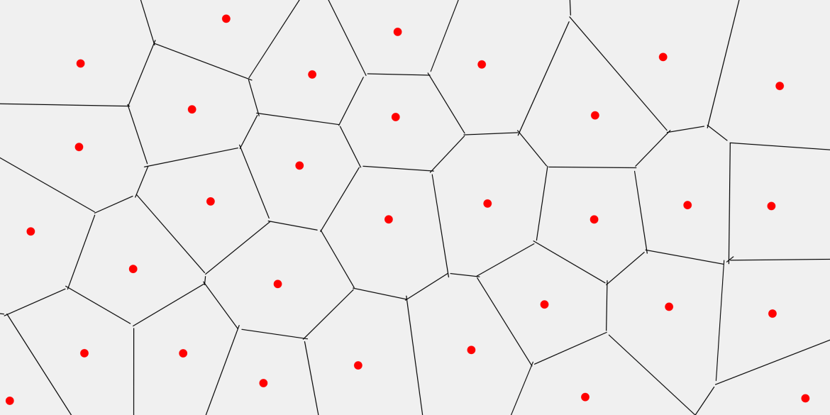
Voronoi Diagram from a set of 2D points
for the lecture “Numerical Software Development 2022“
under Professor Yung-Yu
Notes:
Hi everyone
I‘ll tell you a bit more about my term project:
Computation of a voronoi diagram of a set of 2D points.
Problem of voronoi diagrtam is partitioning a plane into regions closests to each of a given set of target points
Points in red
Regions around the target points, set of all clossest points around that target point

Slide 2
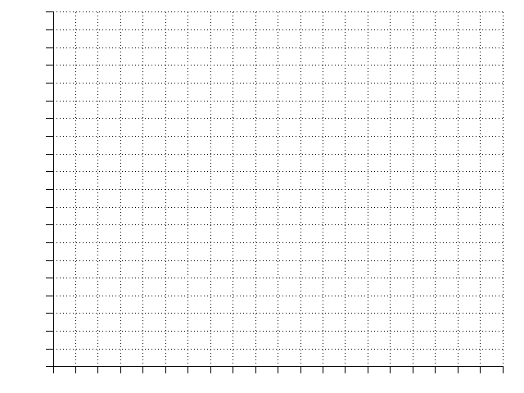
Problem
X
X
X
Notes:
How do we construct those regions:
Set of points
The middle point between to target points has exactly the same point to each of the two target points
Extend this middle point to a perpendicular line, this line describes all points with equal distance to the target points
The lines of every set of three target points meet in the middle of a circle which has the exact same distance to each of the sourrounding target points
This now devides the plane into three regions, each describing the set of points which is closest to it‘s respective target point

Slide 3
Problem
X
X
X
X
Notes:
What if we add a target point
Use can use the same algorithm
find the middle
construct the line
append it the circle center

Slide 4
Problem
X
X
X
X
X
X
Notes:
this can be done with an arbitrary number of points

Slide 5
Problem
X
X
X
X
X
X
Notes:
The resulting set of partitions, Voronoi cells, has many use cases

Slide 6
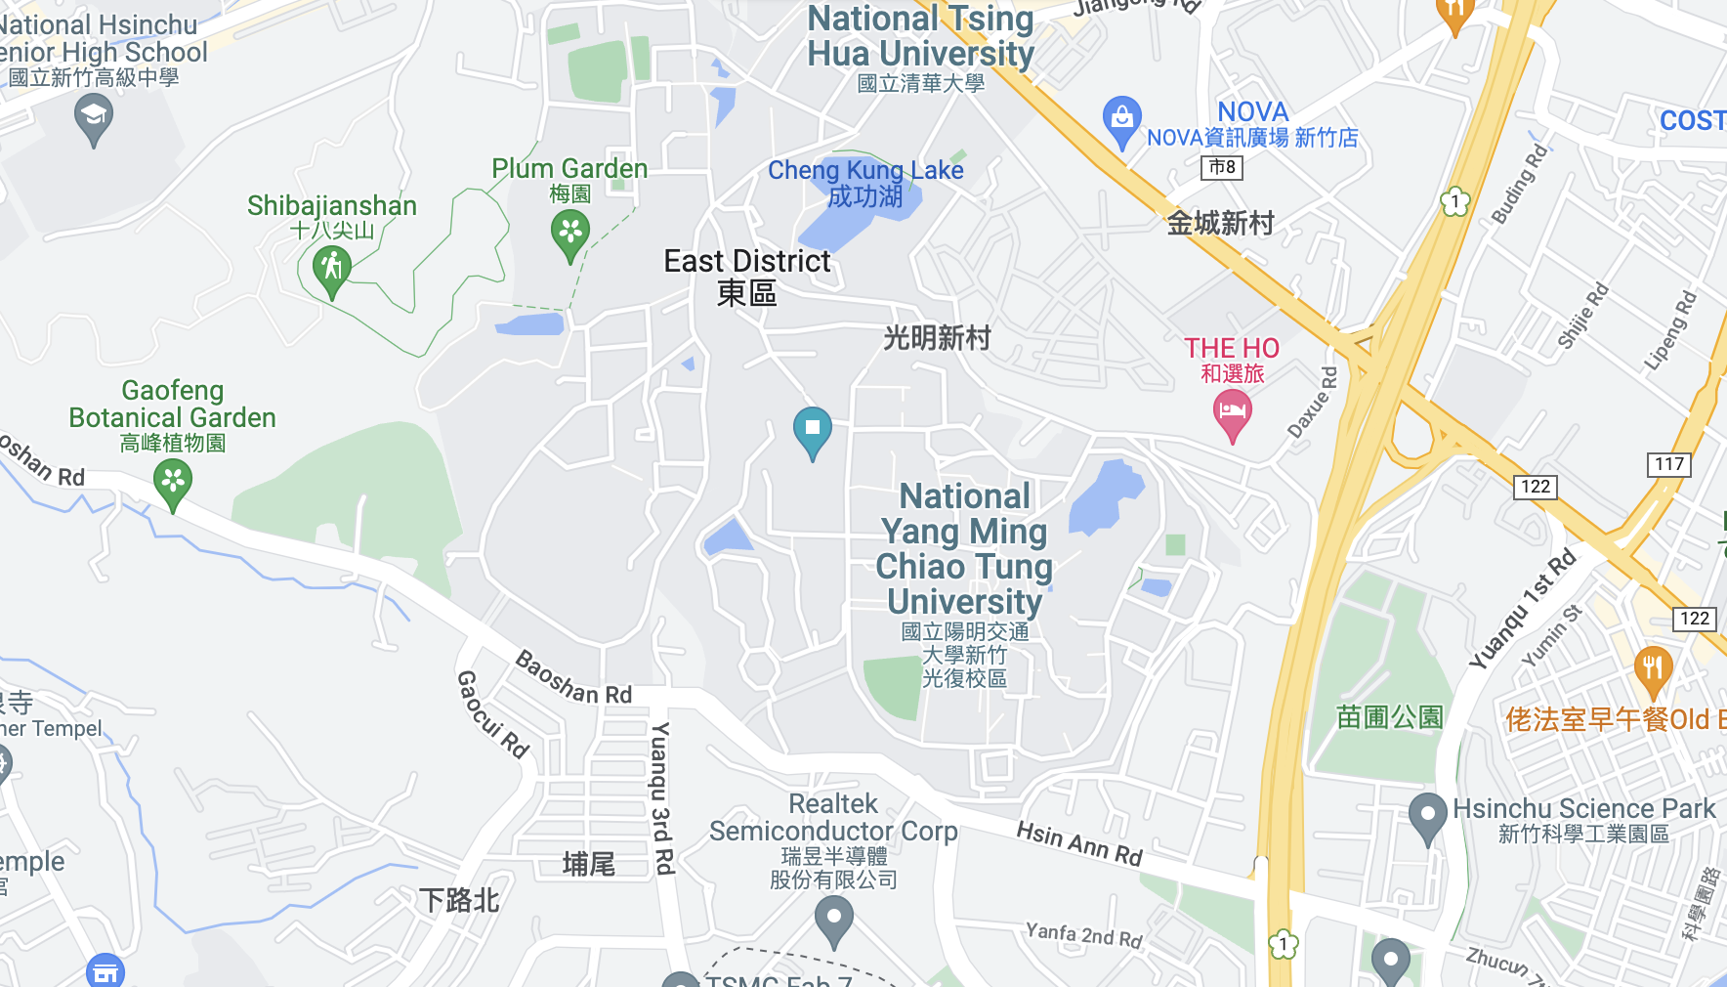
Problem
X
X
X
X
X
X
Notes:
Evacuation
Multiple bodies of water on the campus
On a fire alarm, where should the sutdents go?
- closest body of water

Slide 7
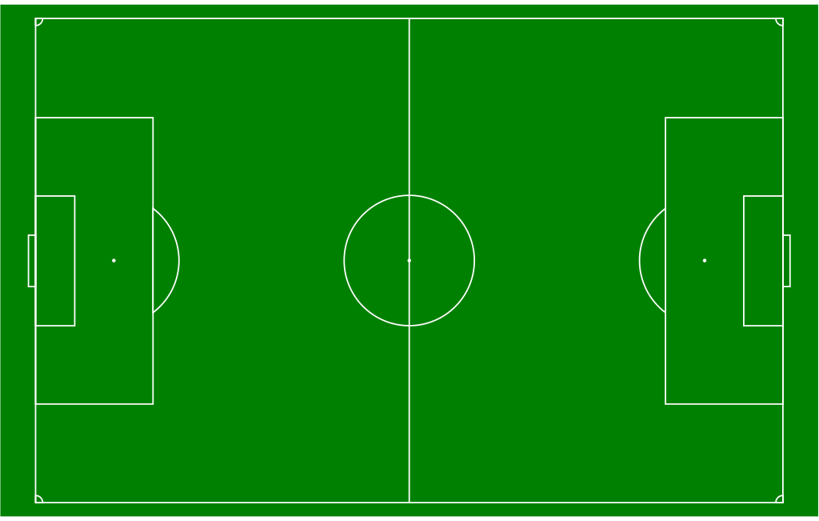
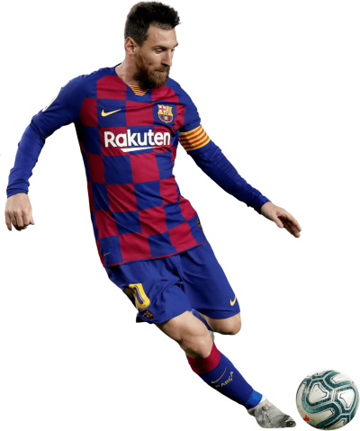
Problem
X
X
X
X
X
X
Notes:
another example in soccer, target points are our players
You can see the defensive lines.
Strategy is zone coverage:
who is responsble for which zone, if messi starts to pass a wide ball?

Slide 8
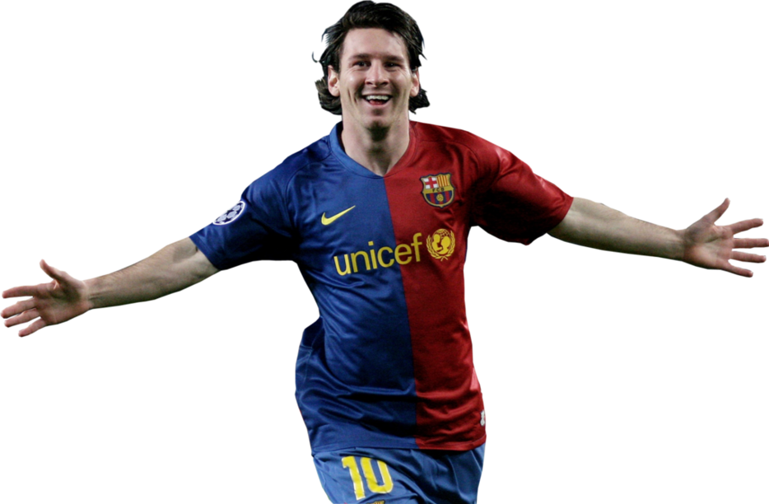
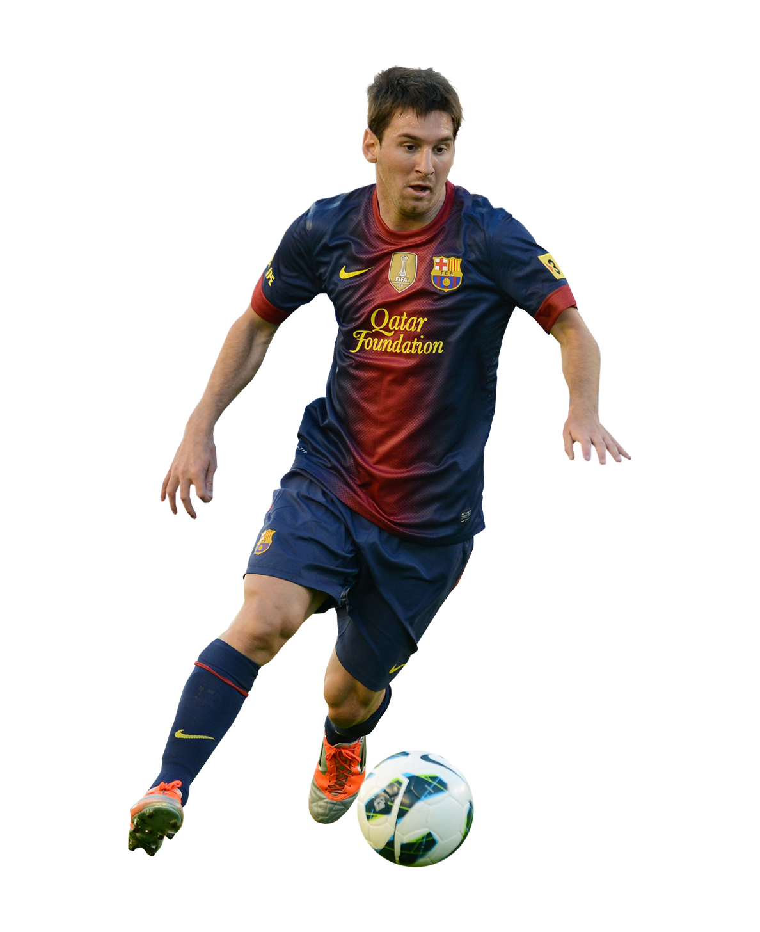
Problem
X
X
X
X
X
X
Notes:
The effectiveness of this is approach is of course a different discussion in reality

Slide 9
Fortune‘s Algorithm
Event Based
Point Event
Circle Event
X
X
X
X
Notes:
Fortunes algorithm to solve the problem
Sweepline and beachline beachline to grow cells around target points
Sweepline in red, creating new cells
Left of the line has been processed, right has not been processd
Beachline piecwise parabolar curve, consisting of arcs that indicate the boarders of cells that are still growing.
All points equidistance from sweepline to nearest point
two types of events
Point event: New point is introduced, general middle lines are created
Circle events: an arc length shrinks to zero, a new point in the voronoi diagram must be created

Slide 10
Fortune‘s Algorithm
Datastructures
Event Queue O(log n)
Beachline O(n)
Performance suboptimal O(n²)
X
X
X
X
Notes:
Two most important datastructres were
EventQueue, holds next event that needs to be processed
Beachline holds all arcs of the piecewise parabola.
Implementation of those dictate the runtime, O(n) many events, each add/lookup or deletes something in the beachline
For the Eventqueue I used a priority queue
Beachline is a linked list
Performance suboptimal, beachline could be a binary search tree which provides the functionalities in O(log n) instead O(n)
Later improvement

Slide 11
Architecture
Python
Voronoi
Polygon
Point
Edge
C++
Unit Test
Voronoi
Event Queue
Beachline
Notes:
Those two datastructes were also the first part of the implementation
while implementing those, I implemented everything needed for these datastructures
- Classes for Voronoi diagram
Geometric entities like points and edges and more
The C++ implementaiton was accompanied by unit tests for every class
After finishing a working c++ version, I added the pybind11 connector and python wrapper classes

Slide 12
Wrapping
Point
Edge
Point (x, y):
self.x = x
self.y = y
self.p_cpp = Point_cpp(x, y)
Point (double x, double y):
self.x = x
self.y = y
Point
Edge
Point (x, y):
self.x = x
self.y = y
self.p_cpp = None
Point (double x, double y):
self.x = x
self.y = y
TIME
Notes:
The wrapper classes in python have to handle two cases:
object created in python that are then used in the c++ algorithm, namely target points
object created in c++ (for exmaple all the edges) that are then used in python, namely everything from the diagram
For the first case, the owenership is in python
For all other objects, created in c++, the ownership is at c++
- python is copying the data into the wrapping class after getting hte object passed by reference from c++
I decided to it like this :
I assumed creation of diagram to be a part of a larger process
Copying is a small overhead
c++ can clean up everything after finishing the computation
Like this, the more complicated maniupulations of the objects could be done in python
Plotting
Transformation to polygons

Slide 13
Architecture
Point
Edge
….
….
json
json
-----
-----
-----
-----
Python
native logging
Integration Test
Voronoi
Polygon
Point
Edge
C++
Unit Test
Voronoi
Event Queue
Beachline
spd logger
Notes:
With reading and writing functionality added
integration testing
Created samples by hand (input and output)
Computed voronoi diagram
compared the polygons
In the whole process
cpp and python used extensive logging which can be opted in or out

Slide 14
Build Pipeline

Slide 15
Bug analysis
X
X
X
X
X
X
X
X
X
Notes:
c++ returns two types of edges
Finished ones
Open ones
Python should „bound“ this edges

Slide 16
Next steps
Fix the bug
Add automated testing -> compare to other implementations
Optimize

