Slide 1
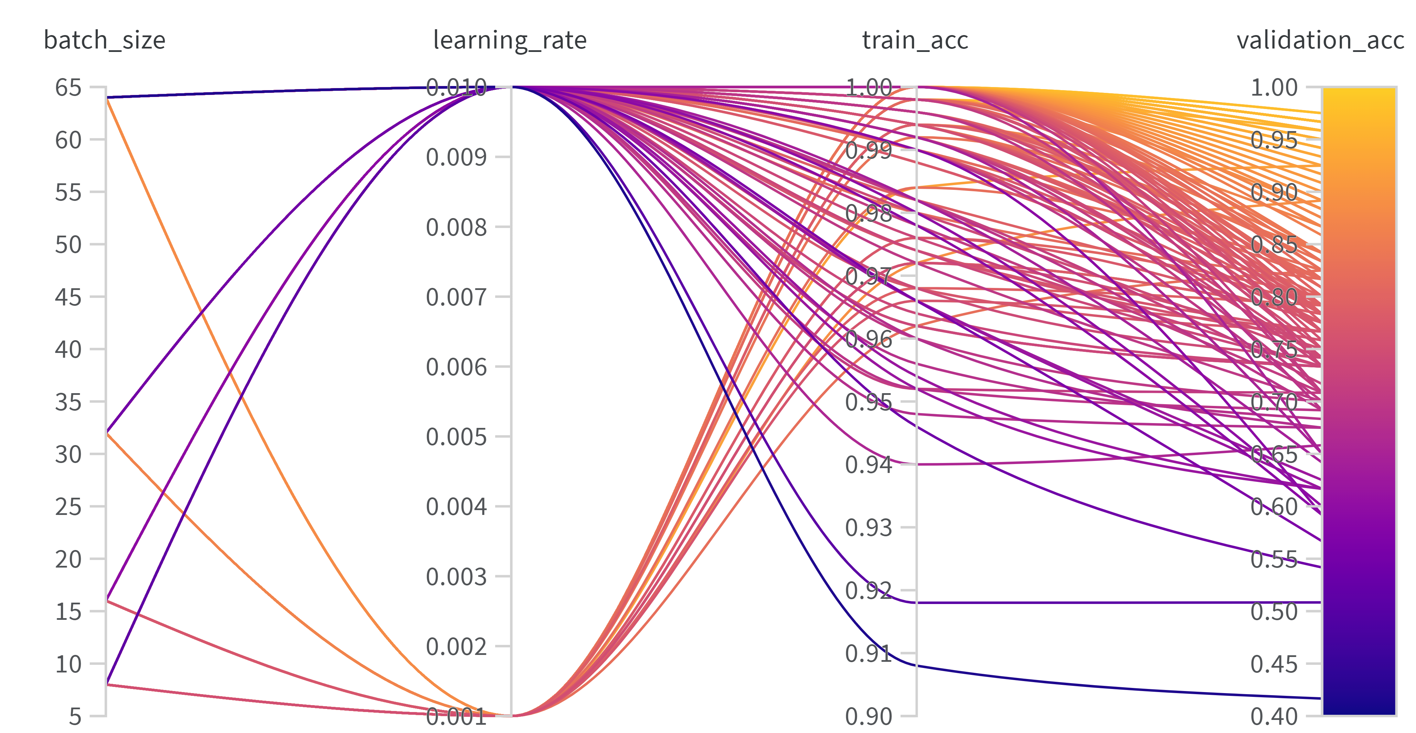
NTK-KAN FEW-SHOT-LEARNING PROJECT
By Alireza, Hugo & Martin
KOLMOGOROV ARNOLD NETWORKS
ARCHITECTURE
DISCUSSION
Flows
Leakage
Subsampling
NEURAL TANGENT KERNELS
RESULTS
FUTURE WORK
REFERENCES
[1] PyTorch, https://pytorch.org/
[2] Weight and Bias, https://wandb.ai/site

